Slide 1
Workshopping Lesson Plans in Computer Science

Slide 2
The Goal
Using what we’ve learned about computer science content, equity-based practices, and Universal Design for Learning, we will create ONE (individually/pairs/groups) developmentally appropriate lesson plan (with corresponding learning resources, learning supports, and assessments)

Slide 3
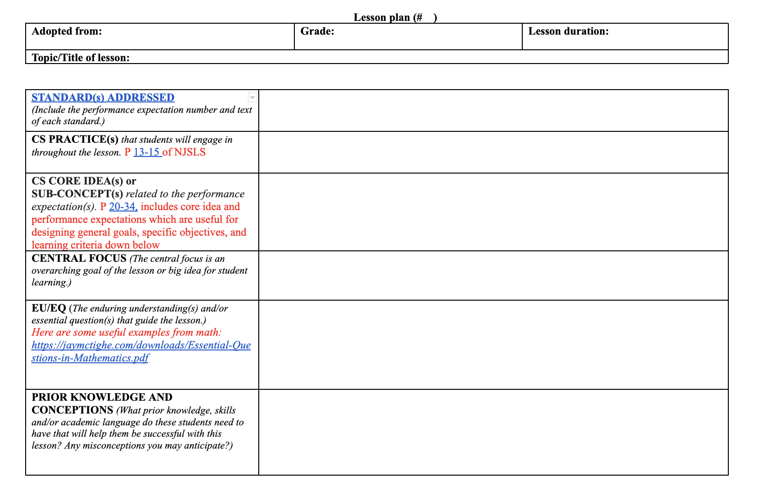
A Lesson Plan Template: With Useful Hints
https://docs.google.com/document/d/1_JQe_2j1XEcexqE6-pz9nnw9AgXSmL9m/edit?usp=sharing&ouid=117593176462355919019&rtpof=true&sd=true

Slide 4
The Steps
You will be divided into groups:
Those who brought a lesson to redesign
Those who’d like to create new a lesson
Everyone will use the same template:
https://docs.google.com/document/d/1eck9A1Az2JfpQelG8CNjM-gBJIB0yc7L/edit

Slide 5
Process: Redesigning a Lesson
Discuss/Consider:
To what extent does the lesson reflect principles of UDL?
Engagement: https://udlguidelines.cast.org/engagement
Representation: https://udlguidelines.cast.org/representation
Action and Expression: https://udlguidelines.cast.org/action-expression
Examine: Learning Activities, Resources, Assessments
Complete the Redesign using the template
Tip
You can always refer back to The Computer Science Primer!

Slide 6
Process: Creating a Lesson
Select a topic (we suggest algorithms or computational thinking
Talk ideas
Plan the lesson using UDL
Engagement: https://udlguidelines.cast.org/engagement
Representation: https://udlguidelines.cast.org/representation
Action and Expression: https://udlguidelines.cast.org/action-expression
Examine: Learning Activities, Resources, Assessments
Complete the Redesign using the template
Tip
You can always refer back to The Computer Science Primer!

