Slide 1
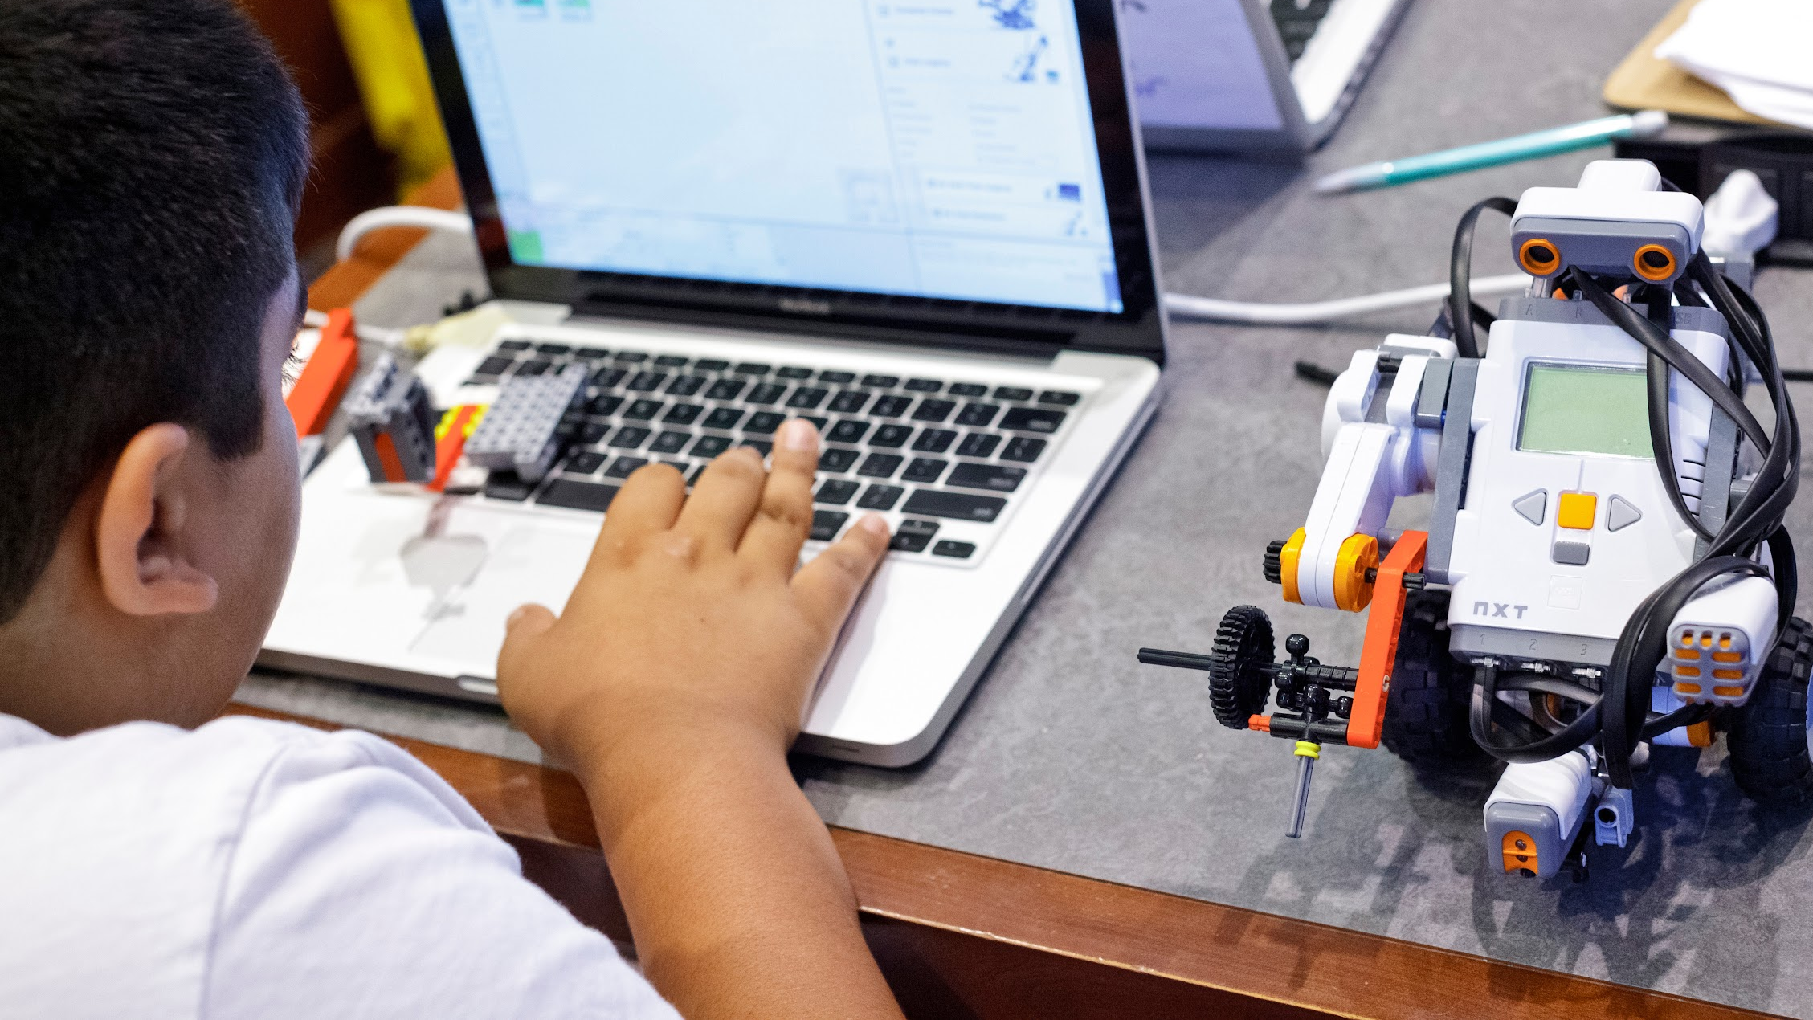
COMPUTER SCIENCE FOR EVERYONE, EVERYWHERE
7/21/22
PD
Orientation
NJDOE Standards 22E00178
NJDOE Hub 22E00173

Slide 2
Welcome!
Today’s Agenda: Understanding Data Communication, Networks and Security
The Hook - You want me to send what to California How?!?!!?!
What is Data Communication?
What is a Network?
A Little History of Networks - or Was the Internet Really Invented on a Napkin?
What are the basic elements of a network?
What is a protocol?
What is the Internet? What is a packet?
What is the difference between the Internet and the World Wide Web?
Activity - the String Network
What is computer security?
What are the basics of security and what is the Dark Web?
Computer Science for Everyone, Everywhere (CSEE)

Slide 3
Activity: Send my friend Niraj in California
Problem - I want to sent the dictionary to my friend Niraj in California. I do not have to include the hard bound cover.
Constraints: You are only allowed to send the physical dictionary that I am showing you in plain, letter envelopes. You have an unlimited number of envelopes to do this, but you must use the letter size envelope.
How do you send the dictionary?
Computer Science for Everyone, Everywhere (CSEE)

Slide 4
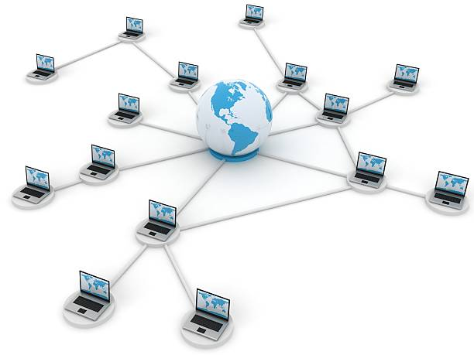
Data Communications
Data Communication is the study of the transport of data between two computing devices.
Essentially, how can we get computers to talk to each other and communicate?
Computer Science for Everyone, Everywhere (CSEE)

Slide 5
Networks
A network is a connection between two or more computers that either share resources or what to communicate with each other.
Networks are described by a few features:
Topology - How is the network physically laid out?
Scope
Personal Area Network (short-range - earbud with your phone and smart watch)
Local Area Network (building/campus)
Metropolitan Area Network (community)
Wide Area Network (greater distances)
How is it connected: wired (bus) or wireless
Computer Science for Everyone, Everywhere (CSEE)

Slide 6
Networks - How are the Computers Connected
Your personal computer/tablet/phone connect to a network in one of two ways - either through a wired connection or a wireless connection.
Wired Connection: A wired connection is just that - a connection with wires! The first connections were like the old style phone lines - copper wire that was wrapped and insulated and then bound together.
Essentially for all media, they have to transports some form of the ones and the zeros. Copper wire could do this but we would lose data in the process - this is called signal degradation.
Fiber Optic cable came along and had better properties for sending a signal. Instead of using electricity, we use light pulses that follow a very thin glass wire that has some flexibility in it. We are now truly moving closer to the speed of light.
Wireless uses the properties of radio waves to send a signal. However, your need to be in “line of sight” of a router, tower, satellite. Signal has a lot of problems going through cinderblock, the hills of NJ, and is susceptible to outages when there is solar flare activity.
Computer Science for Everyone, Everywhere (CSEE)

Slide 7
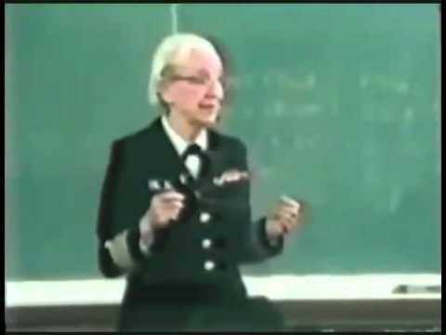
Networks - Speeds
Network speeds are managed in bits per second - we measure how many ones and zeros we can send in a second
When we talked about data last week, we talked about how we record data in Bytes.
Network speeds are measured in how many 1s and 0s I can send, not how many Bytes i send.
Most US homes have about 50 Megabits per second, or Mbps.
The average zoom/Google Hangout call is about 4 Mbps
Grace Hopper and the Nanosecond:
Computer Science for Everyone, Everywhere (CSEE)

Slide 8
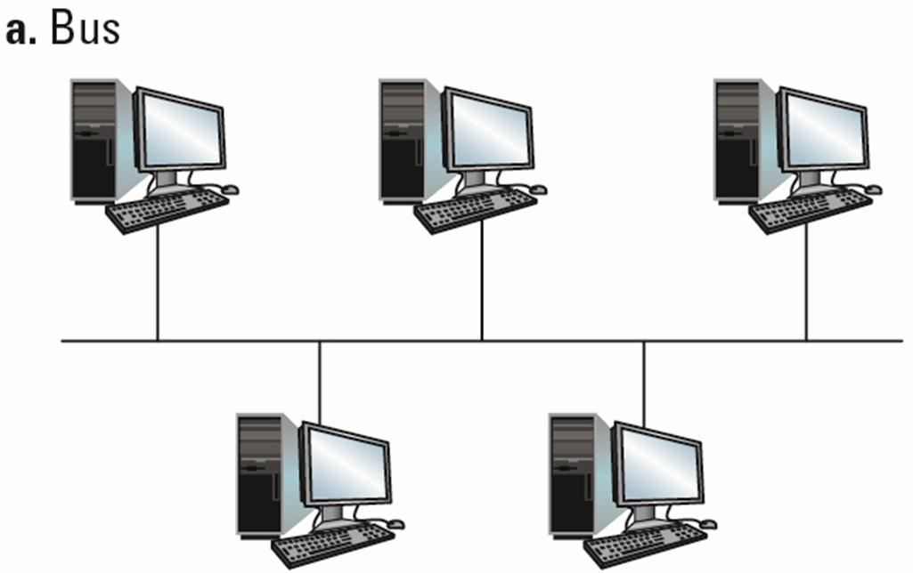
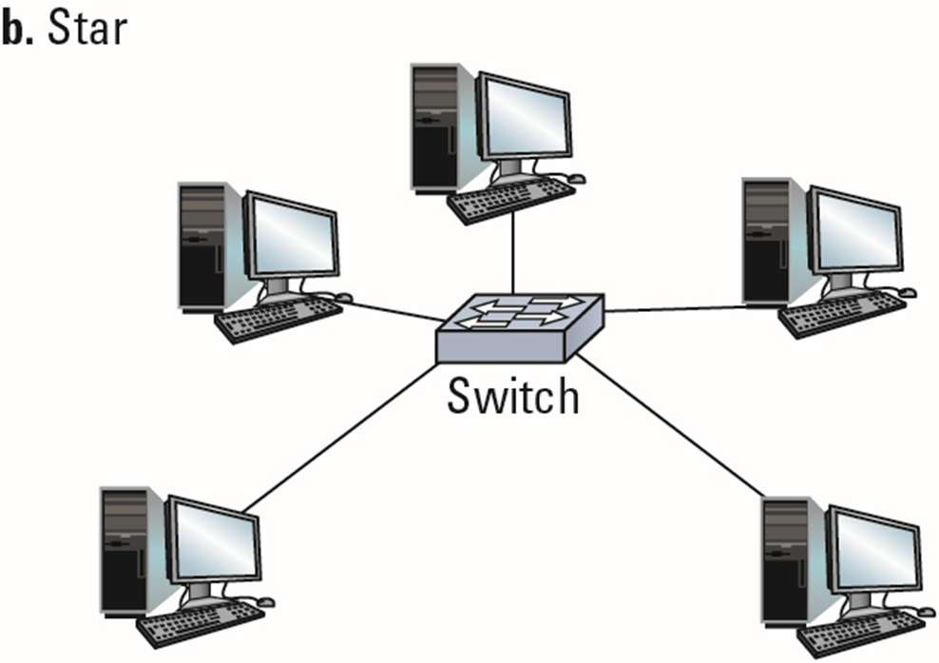
Examples of Networks
Computer Science for Everyone, Everywhere (CSEE)

Slide 9
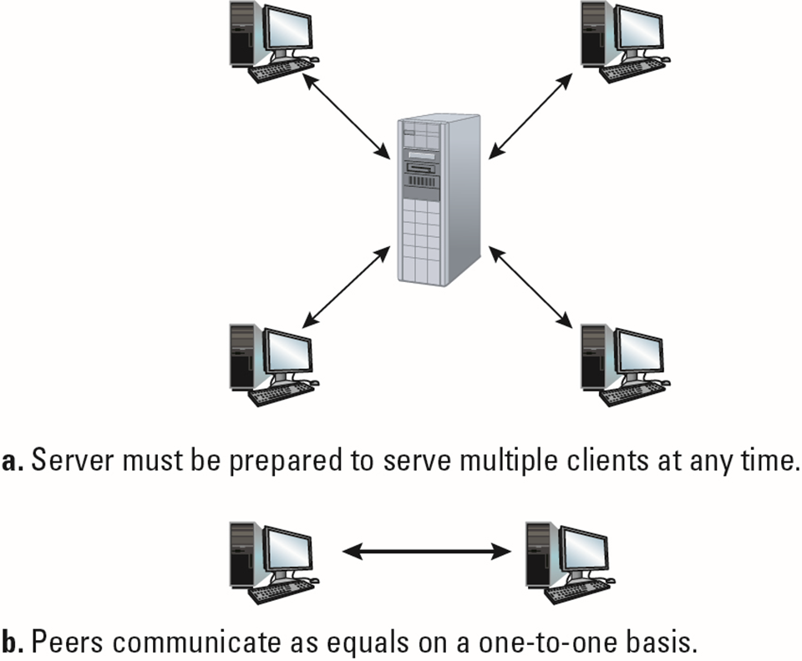
Methods of Communicating on Networks
Client-server
Many clients, one server (executing continuously)
Clients make requests of other processes
Server satisfies requests made by clients
Peer-to-peer (P2P)
Two processes communicating as equals
Processes execute on a temporary basis
Computer Science for Everyone, Everywhere (CSEE)

Slide 10
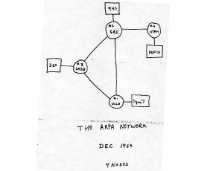
History of Networks
The history of computer networks starts with the … telephone.
The modern age of computing comes about during World War 2 and post WW2 society. This is also an age where getting a phone line into one’s house or apartment becomes possible.
With the detonation of nuclear weapons, the Department of Defense recognizes that the phone network - which has become very important for military, political and business functions - is vulnerable. Therefore, they are looking for an alternative to the Plain Old Telephone System (POTS) network.
A Team from University of Utah, UCLA, UC Santa Barbara and Stanford proposed another type of communications system, that didn’t use switches and operators but a computing based technique.
Computer Science for Everyone, Everywhere (CSEE)

Slide 11
Networks - Protocols
A Network is built on the concept of the Protocol.
A Protocol is the set of rules by which two or more computers communicate.
You use Protocols everyday
Voice over IP (VoIP) - basis for the modern telephone network, especially the cell phone network.
TCP/IP - the protocol that is overwhelmingly used now and creates the Internet.
FTP - File transfer protocol - how you upload and download files
SMTP/POP3 - how you get your email
HTTP - the protocol that defines the World Wide Web
Computer Science for Everyone, Everywhere (CSEE)

Slide 12
Networks - How does the Internet Work?
The Internet is the largest computing network in the world
It is made up of thousands of smaller networks that connect to each other.
The basis of the network is the Transfer Control Protocol/ Internet Protocol (TCP/IP)
TCP/IP has two basic concepts
Every computer has an address on the network
Every “message” or communication is sent through packets
Messages - like emails, website requests, file requests - are broken into small little parts to transition the network. The packet contains the source information, the destination information, a tiny bit of data that is part of the message, this data’s position in the larger message, a security check code
The message is they sent through the network, packet by packet at the same time, and it follows the best path to the destination. The packets are rebuilt into the message at the destination.
Computer Science for Everyone, Everywhere (CSEE)

Slide 13
Networks - How does the Internet Work?
Computer Science for Everyone, Everywhere (CSEE)

Slide 14
Networks - Works in Layers
Computer Science for Everyone, Everywhere (CSEE)

Slide 15
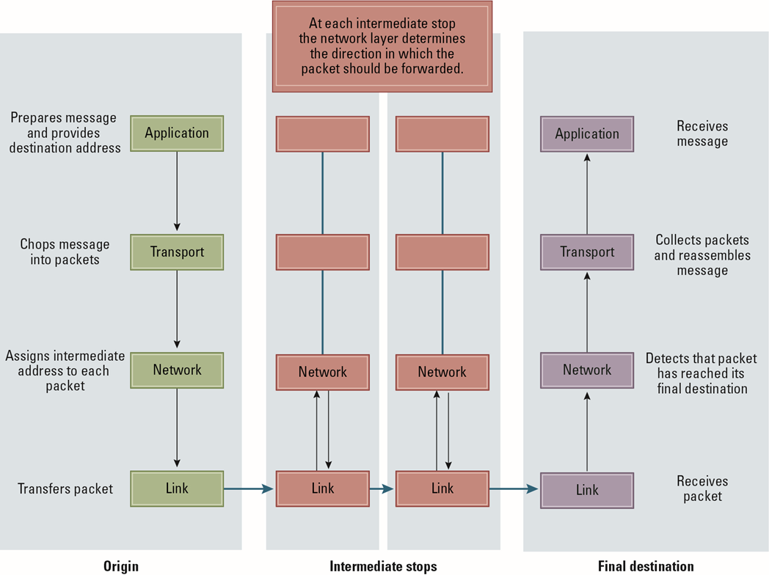
Networks
Computer Science for Everyone, Everywhere (CSEE)

Slide 16
What is the World Wide Web?
The World Wide Web is an information space that is supported by the Internet
The Internet is the largest physical connected network in the world.
The World Wide Web uses the Internet, but it is not the Internet.
However, the two terms are often used to mean the same thing.
World Wide Web uses HTML to create documents and scripting languages to create dynamic content.
Computer Science for Everyone, Everywhere (CSEE)

Slide 17
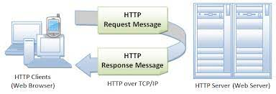
What is the World Wide Web? - Anatomy of an HTTP Request
Computer Science for Everyone, Everywhere (CSEE)

Slide 18
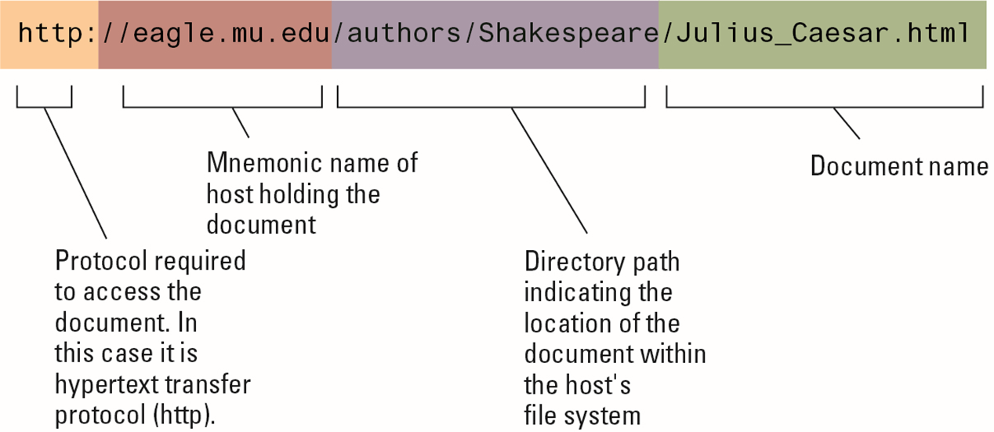
What is the World Wide Web? - How a Hyperlink Works
Computer Science for Everyone, Everywhere (CSEE)

Slide 19
Activity - The String Network
Get into your groups – two tables per group.
Assign roles:
· Two “Routers”: Routers will help the message move around the network.
· Everyone else is a “Node”. A node is a computer on the network. A Node should be assigned a number in your group starting at 0 and going to n-1, where n is the number of people in your group.
· One “Source” Node: The source is where the message originates.
· One “Destination” Node: The destination. The source and destination should be as far apart as possible.
Computer Science for Everyone, Everywhere (CSEE)

Slide 20
Activity - The String Network
Directions:
1. The two routers (A add B) should develop a 1 sentence – with at least 5 words – message. This is the “Application layer” of your network – it is the data you are sending.
a. For each message, Routers do the following:
i. Write the Source’s Name on the message
ii. Write the Destination’s Name on the message
iii. Take an index card. Write one word from the sentence on the card – this is the data for your “packet”. Write what place this word is in your sentence. For example, if you sentence is “Hello There Chewbacca!”
1. Hello is word 1 of 3
2. There is word 2 of 3
3. Chewbacca is word 3 of 3
The index cards represents the “transport layer of your network” – and each index card represents a “packet”.
b. Next – unbend a paperclip so that you can push one hooked end through the index card and one hooked end onto the string.
Computer Science for Everyone, Everywhere (CSEE)

Slide 21
Activity - The String Network - Home Network Edition
2. In the meantime: All the nodes need to create the String Network
a. Everyone who is a node needs to cut a piece of string and hold it. Each node should hold a minimum of two strings. A neighboring person needs to be able to pick up the string. Kudos are given to any node who can hold more than 2 strings!
b. The more connections in between nodes the better.
Computer Science for Everyone, Everywhere (CSEE)

Slide 22
Activity - The String Network
Once the message is ready
a. The Routers A and B will line up the messages at the source.
b. Router A will then take one packet and slide it through our string network to the source. You take it along the network by picking any string path in front of you.
c. Router B will go immediately after the first router and pick a path to get that packet to the source. NOTE – the second router does not have to follow the same string lines as the first packet. – The practice of the router picking the route is the Network Layer
Computer Science for Everyone, Everywhere (CSEE)

Slide 23
Activity - The String Network
Once the message is ready
a. The Routers A and B will line up the messages at the source.
b. Router A will then take one packet and slide it through our string network to the source. You take it along the network by picking any string path in front of you.
c. Router B will go immediately after the first router and pick a path to get that packet to the source. NOTE – the second router does not have to follow the same string lines as the first packet. – The practice of the router picking the route is the Network Layer
4. Repeat until all the messages are at the destination. The String network forms the “Link Level”.
5. Also note – if two packets collide – that is are on the same string at the same time – you have to go back to your last node and wait the number of seconds that the number that node is. If you are at node 3 – wait three full seconds and pick a path to the next node.
Computer Science for Everyone, Everywhere (CSEE)

Slide 24
Networks Debrief
This string network is mimicking your home network
Some questions?
How was the message broken up?
Did you have any collisions?
Was every node reachable - that is was every node connected?
Did the router take the same path of string every time?
Computer Science for Everyone, Everywhere (CSEE)

Slide 25
Activity - The String Network - Internet Edition
How the Internet Works: Level Up
1. Pick the two nodes with the highest numbers from your group and change their roles. One will
be a “bridge”, the other will be a Router that stays with the bridge. Bridge – The bridge keeps its
connections to its network but now gets another string to hold – a line between its group and
another group.
2. Every group will be assigned a color. The Nodes names now become a color + number.
3. The New router will act like a go between a bridge and router A or B when there is a message on
that like. The original routers will always stay with their group but the new router will move
packets between bridges and hand off their packet to one of the original routers once it reaches
their network. When it reaches that other router – it can chat for a moment to help that router
choose the net pack to take that external packet on.
Computer Science for Everyone, Everywhere (CSEE)

Slide 26
Activity - The String Network - Internet Edition
We are going to create a new message.
The two original routers will pick a color (not their group’s color) and number to send it to.
Repeat the message process above.
Then send the message but now all paths have to lead to the bridge so you can get the message to the other group.
Try to get the message to a group at least 2 groups away from you.
Computer Science for Everyone, Everywhere (CSEE)

Slide 27
Networks - Computer Security
While networks can be a wonderful tool to help us with everything (literally my life hinged on it during the pandemic), they can also be dangerous.
Any computer that has software can be hacked.
Any computer on the network can be hacked remotely.
Computer Science for Everyone, Everywhere (CSEE)

Slide 28
Networks - Computer Security
Malicious Software or Malware - this is a program that does an unwanted and potentially dangerous activity on your computer.
Computer virus - a program that attaches itself to other programs and then replicates itself and tries to spread to other programs. It needs it’s host computer to do an action.
Computer worm - is like a worm but does not need the host computer to do an action.
Trojan - a program that looks like a good program but does unwanted things “behind the scenes”
Phishing - a social engineering technique where it is a fraudulent practice of sending emails purporting to be from reputable companies in order to induce individuals to reveal personal information.
Spyware is a form of malware that hides on your device, monitors your activity, and steals sensitive information like bank details and passwords.
Computer Science for Everyone, Everywhere (CSEE)

Slide 29
Networks - Computer Security
How to protect yourself?
DON’T TRUST ANY MESSAGE UNTIL YOU VERIFY IT!!!!!
If a company is threatening you, get their phone number from the Web and call them.
Don’t open an attachment.
Look at the senders email, not the name associated with the email.
“Roll over a hyperlink”, where you bring your mouse over the link to reveal the real location it is taking you.
Computer Science for Everyone, Everywhere (CSEE)

Slide 30
Networks - Computer Security
Children are particularly vulnerable - even older children.
If something happens with a child, tell them to start record it and get an adult. If they feel threatened or unsafe, get off the computer.
Excellent resources to teach about safety:
Be Internet Awesome by Google: https://beinternetawesome.withgoogle.com/en_us/
NJ Cyber Crimes: https://nj.gov/njsp/division/investigations/cyber-crimes.shtml?fbclid=IwAR3xfMrrafMNpVQYbIKjBlsY14Ci4ENqOOpe03iF19-pjjbxXgnhSeRENTU
FBI Cyber Crimes: https://www.fbi.gov/investigate/cyber?fbclid=IwAR2Ej7adbR1oxa4JWeTbY0sUpKi0f-kWvngJJsGVEky89WpOKb9wQPKT7BE#Respond-and%20Report
Computer Science for Everyone, Everywhere (CSEE)

Slide 31
Networks - Dark Web
The WWW is navigable due to search engine tools.
Search engine tools “crawl” the networking, using algorithms to analyze the content of the page and put it into its database - this is called indexing.
The Dark Web is technically any website that is not indexed by a search engine.
This is often peer-to-peer content that is raised and torn down quickly
The Dark Web is part of the Deep Web - that is everything on the WWW.
Computer Science for Everyone, Everywhere (CSEE)

Slide 32
Networks - FBI Report on Computer Security
Hacking - trying to use either computational or social techniques to gain access to a computing system
Overwhelmingly, major hacks are still using techniques that were used in the late 1990’s
Doing simple things to protect yourself goes a long way.
Computer Science for Everyone, Everywhere (CSEE)

