Slide 1

Networks
and the
Internet
Prepared By: Angela Nash, East Orange School District
Prepared For: Montclair State University (MSU)
CS Teacher Education HUB
August 2023

Slide 2


New Jersey Student Learning Standards
Computer Science & Design Thinking
8.1.2 K-2
Networks and The Internet
Prepared By: Angela Nash, MS CID Montclair State University August 2023
East Orange SD, East Orange, NJ Computer Science HUB Page

Slide 3
NJSLS
Computer Science & Design Thinking
8.1.2 Networks and The Internet
Computing devices typically do not operate in isolation. Networks connect computing devices to share information and resources and are an increasingly integral part of computing. Networks and communication systems provide greater connectivity in the computing world.
Core Concept
Standards
• 8.1.2.NI.1: Model and describe how individuals use computers to connect to other individuals, places, information, and ideas through a network.
• 8.1.2.NI.2: Describe how the Internet enables individuals to connect with others worldwide.
• 8.1.2.NI.3: Create a password that secures access to a device. Explain why it is important to create unique passwords that are not shared with others.
• 8.1.2.NI.4: Explain why access to devices need to be secured.
Prepared By: Angela Nash, MS CID Montclair State University August 2023
East Orange SD, East Orange, NJ Computer Science HUB Page

Slide 4
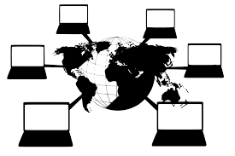
Vocabulary Review
Before discussing networks, we will define the following key vocabulary words:
Data
Hardware
Software
CPU
RAM
Protocols
Prepared By: Angela Nash, MS CID Montclair State University August 2023
East Orange SD, East Orange, NJ Computer Science HUB Page

Slide 5


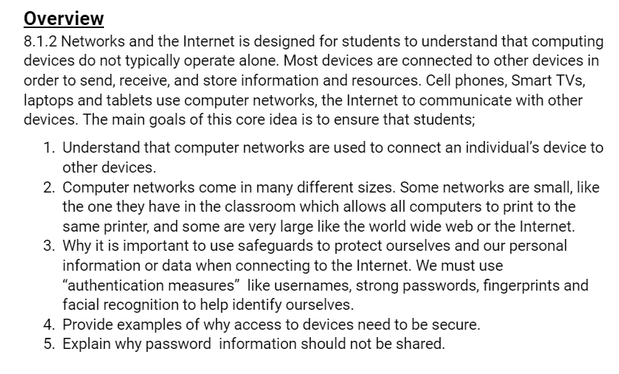
Data is the information you send and receive. Data includes …
Data
pictures or images
sounds
(words, noise and music)
text
Prepared By: Angela Nash, MS CID Montclair State University August 2023
East Orange SD, East Orange, NJ Computer Science HUB Page

Slide 6
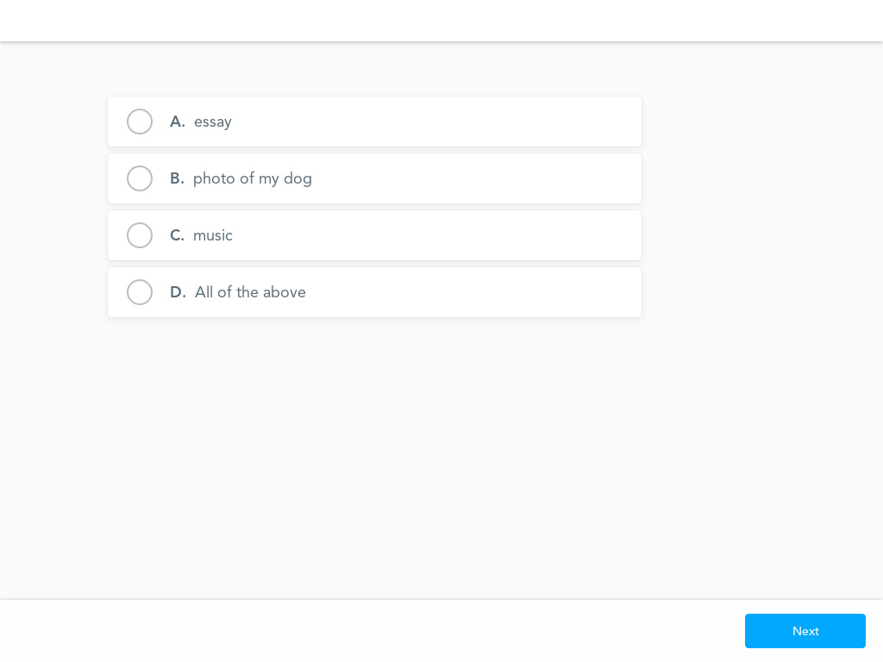
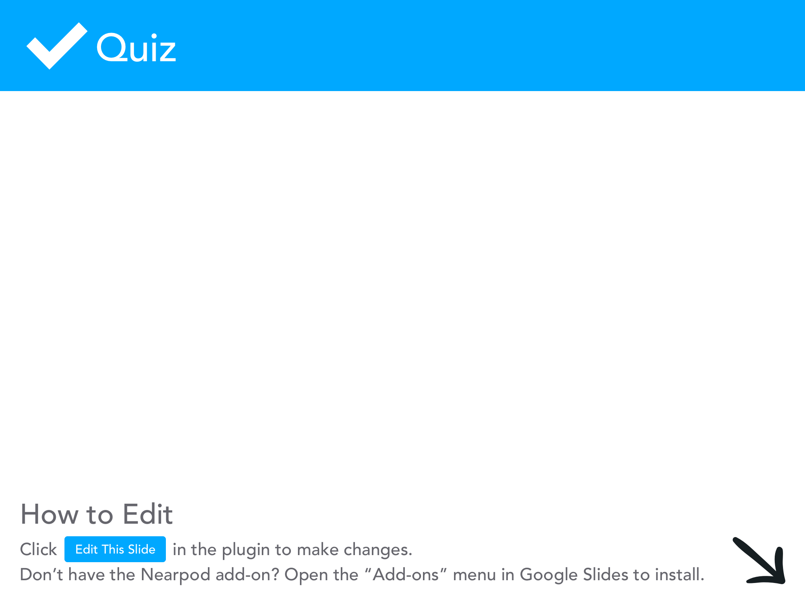

Slide 7

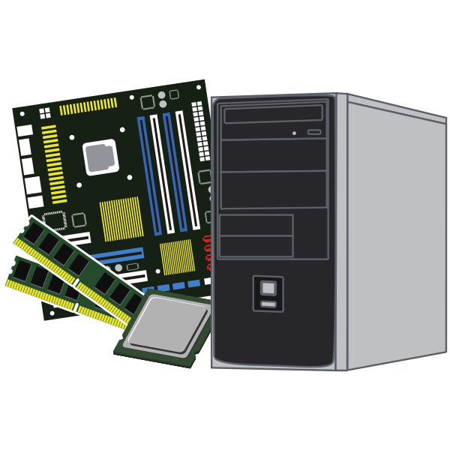
Hardware
Hardware - all of the physical equipment (inside and outside) that makes up a computer system. If you can touch it, its hardware!

Slide 8


Slide 9

Software
Software - all of the programs that make the computer run. This includes programs that manage the computer and complete tasks for users like you.

Slide 10
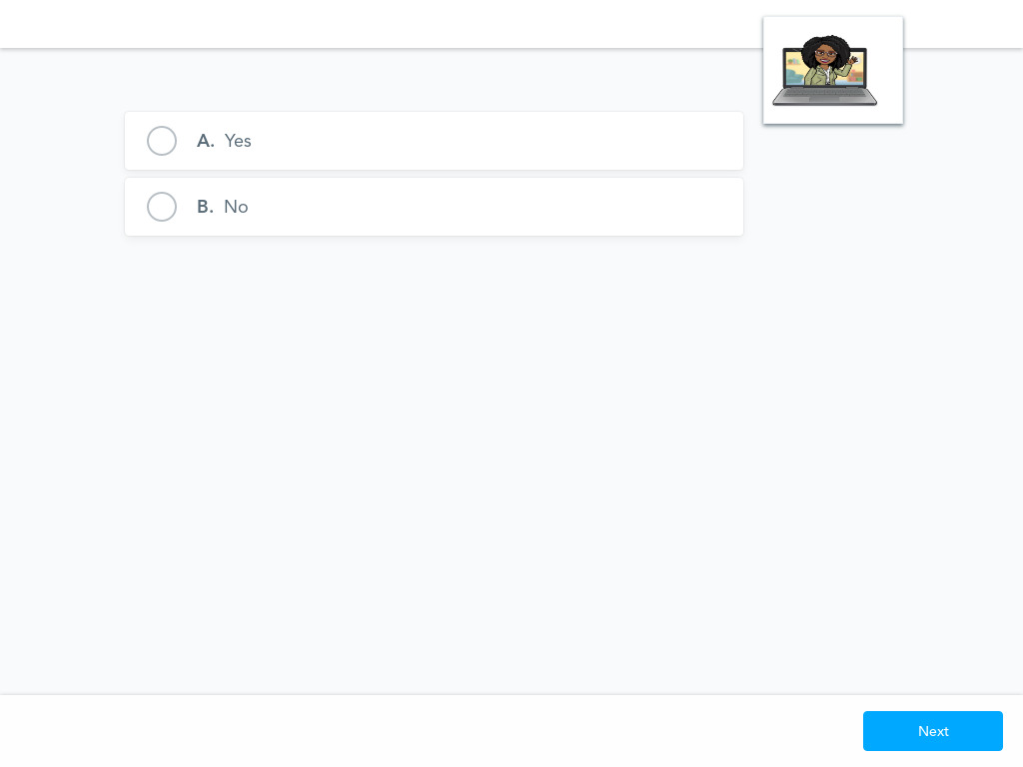

Slide 11
You need both hardware and software in order to have a operable computer system!

Slide 12


Slide 13
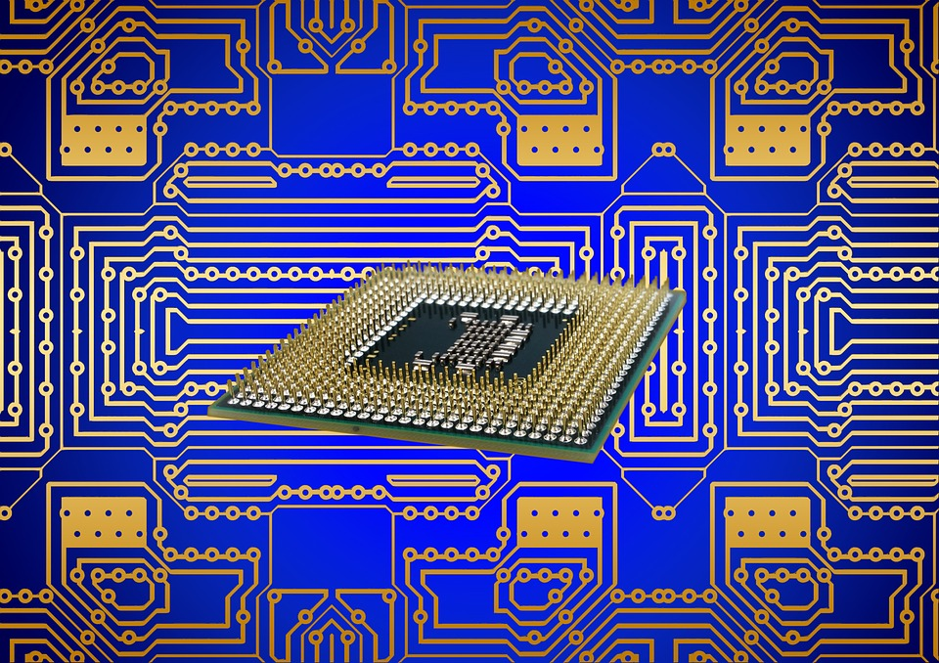
Central Process Unit (CPU)
CPU stands for "Central Processing Unit” is the primary component of a computer that processes instructions. It;
runs the operating system,
runs all applications,
constantly receiving input from the user or active software programs,
processes the data,
and produces output, which may stored by an application or displayed on the screen.

Slide 14
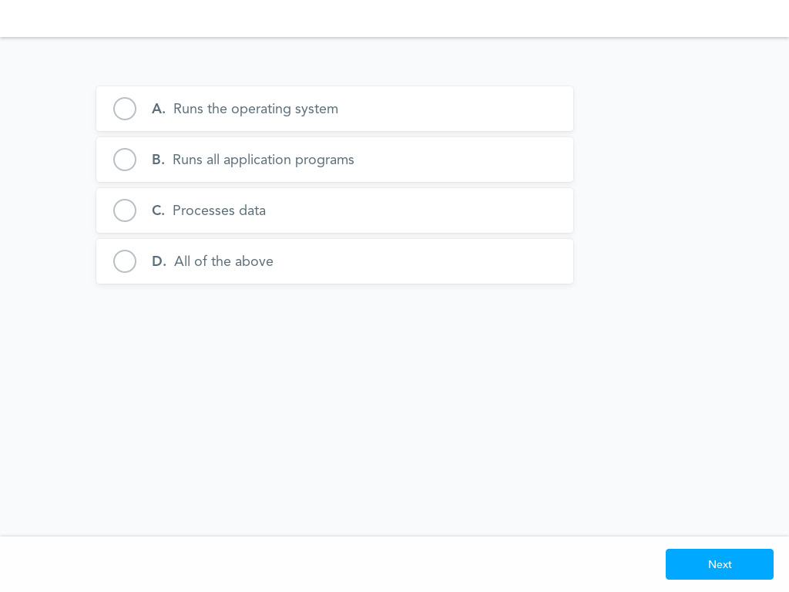

Slide 15
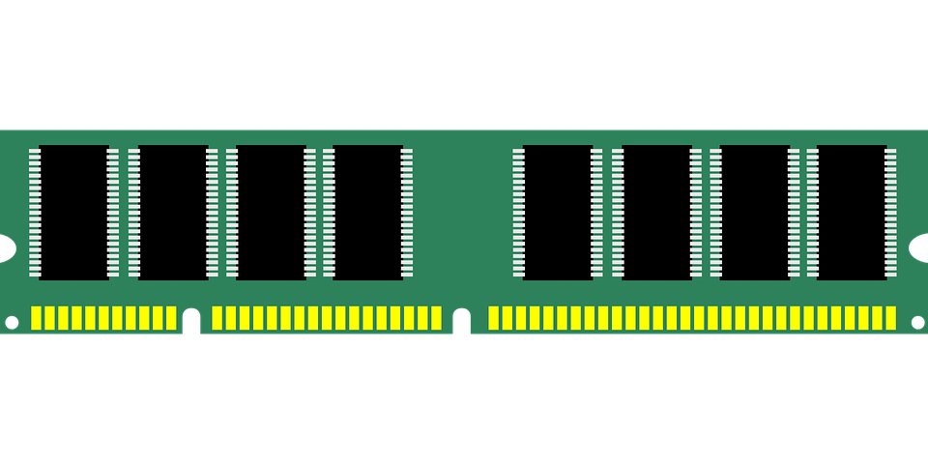
Random Access Memory (RAM)
RAM is system memory. It is considered "volatile" memory since it only stores data while a device is turned on. When the device is powered down, data stored in the RAM is erased.
The amount of RAM in a device determines how much memory the operating system and open applications can use.
When a device has sufficient RAM, several programs can run at the same time.
When a device uses close to 100% of the available RAM, memory must be swapped between applications, which may cause a noticeable slowdown.
Adding more RAM is one of the best ways to improve the performance of your device.

Slide 16
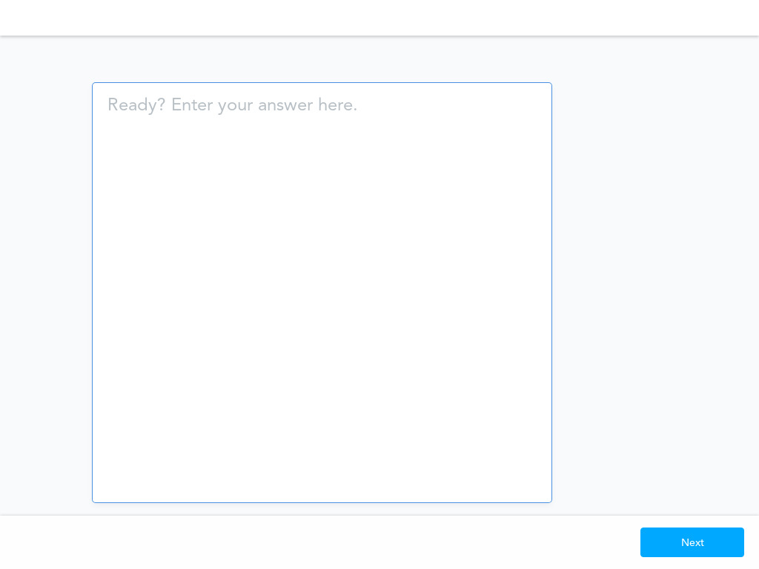
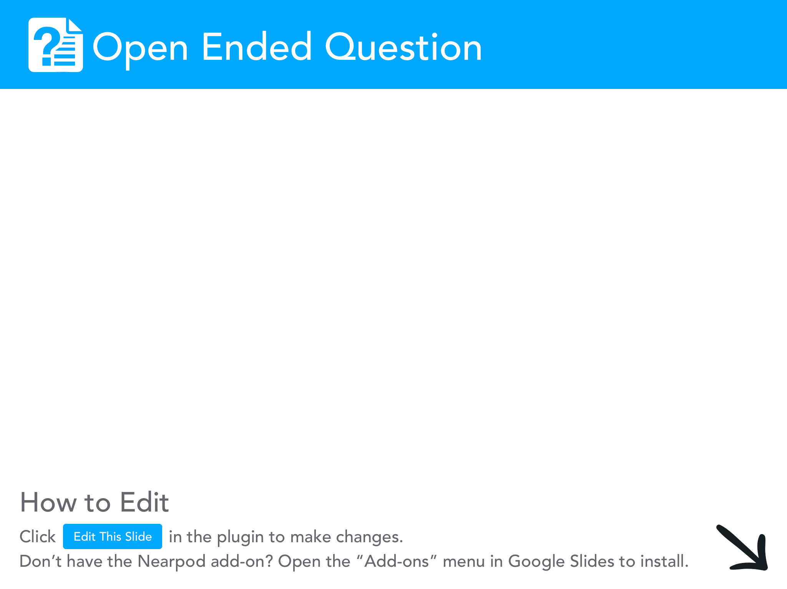

Slide 17

Protocols
Protocols - a standard set of rules that allow electronic devices to communicate with each other.

Slide 18


Slide 19
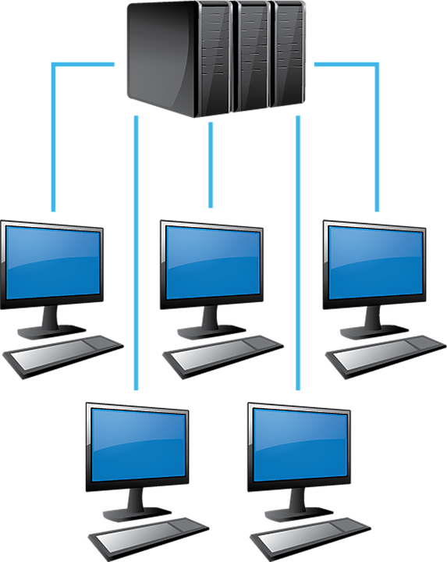
Computer Networks

Slide 21
Network Latency
Network Latency is the delay (amount of time) between when an action is performed and when it is completed. A low latency means your computer system is functioning well. Below are some issues that prevent network latency from remaining low:
  distance between the source and destination
  Amount of data sent or received
  Problems with the router
  Using a wireless internet connection rather than a wired connection

Slide 22
Network Protocols
Network Protocols - defines the rules for communication between computers and/or servers in a network.
Peer-to-peer networks share data and resources between two or more computers without going through a server.
Client-server network shares resources between local computers and a server.

Slide 24
Types of Network Protocols
Internet Protocol (IP) is based on internet addresses and is used for sending and receiving messages on the Internet.
Transmission Control Protocol (TCP) is a connection protocol that makes sure data reaches its destination error free.
Simple Mail Transfer Protocol (SMTP) is used for sending emails within the same network and between different networks.
Hypertext Transfer Protocol (HTTP) is used to browse the Internet and download material.
File Transfer Protocol (FTP) is used to allow users to work from a remote server.

Slide 25
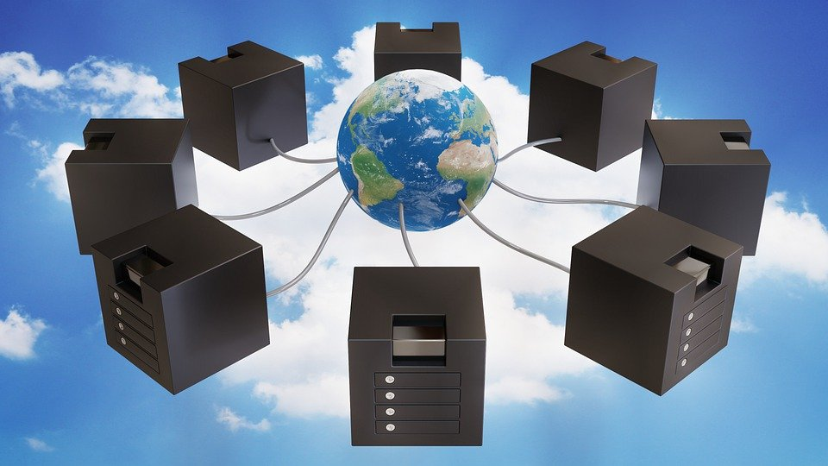

Slide 26
Some Types of Network
PAN (Personal Area Network) - it is a small network that is used to transfer small files. It connects devices such as smartphones, tablets and laptops. They connect to each other wirelessly or with a USB.

Slide 27
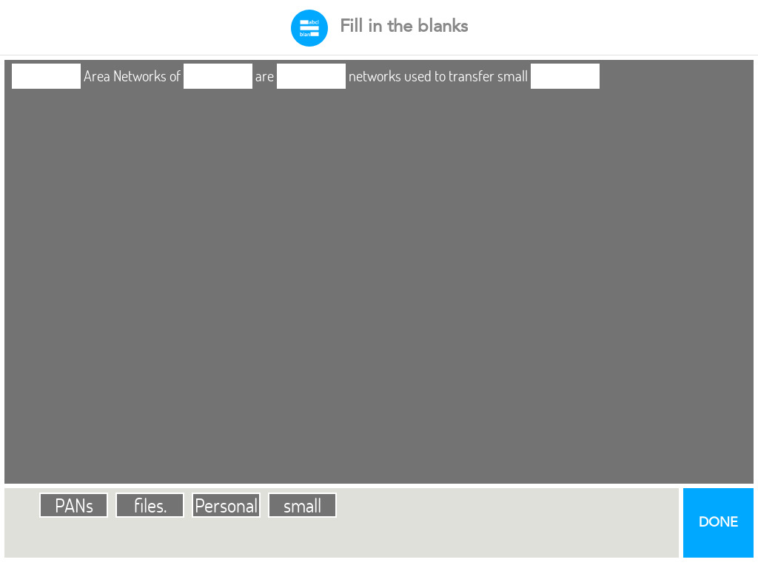


Slide 28
Some Types of Network
LAN (Local Area Network)- a group of devices (computers, servers, switches and printers) that are located close to each other, for example the same building, office or home.

Slide 29
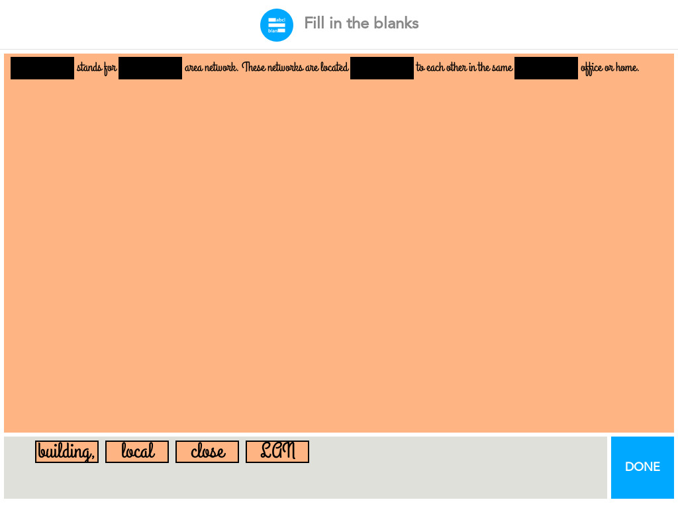

Slide 30
Some Types of Network
WLAN (Wireless Local Area Network) -is a network that uses wireless communication instead of wired communication.

Slide 31


Slide 32
Some Types of Network
CAN (Campus Area Network) - a network that joins 2 or more LANS together within a limited area.

Slide 33
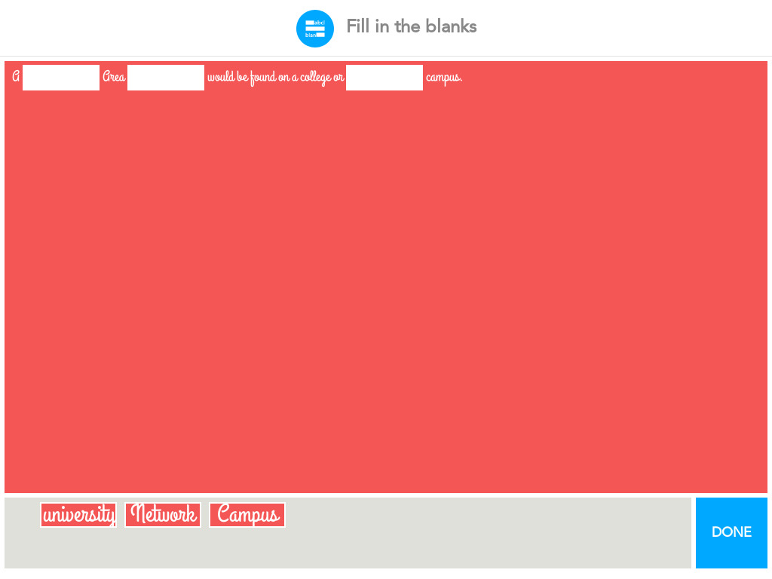

Slide 34
Some Types of Network
MAN (Metropolitan Area Network) -A MAN is larger than a CAN. It covers several buildings in a city or town typically using a high speed, fiber optic cables.

Slide 35
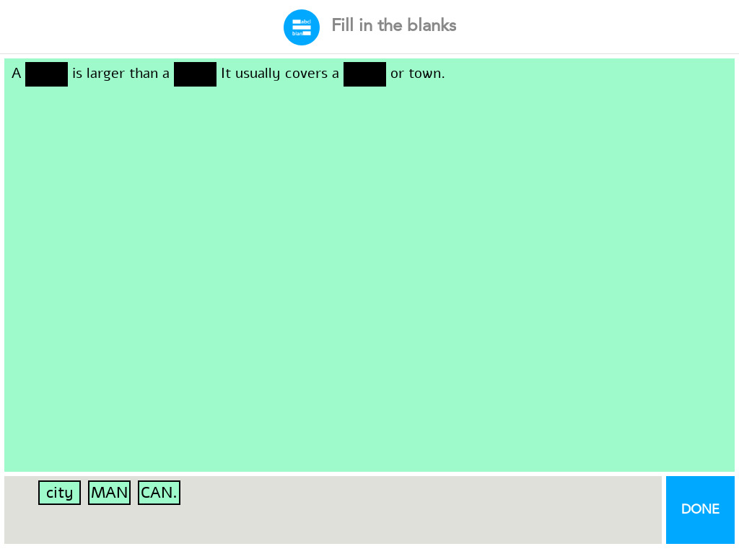

Slide 36
Some Types of Network
SAN (Storage Area Network) - a network dedicated that stores and provides access to large amounts of data.

Slide 37
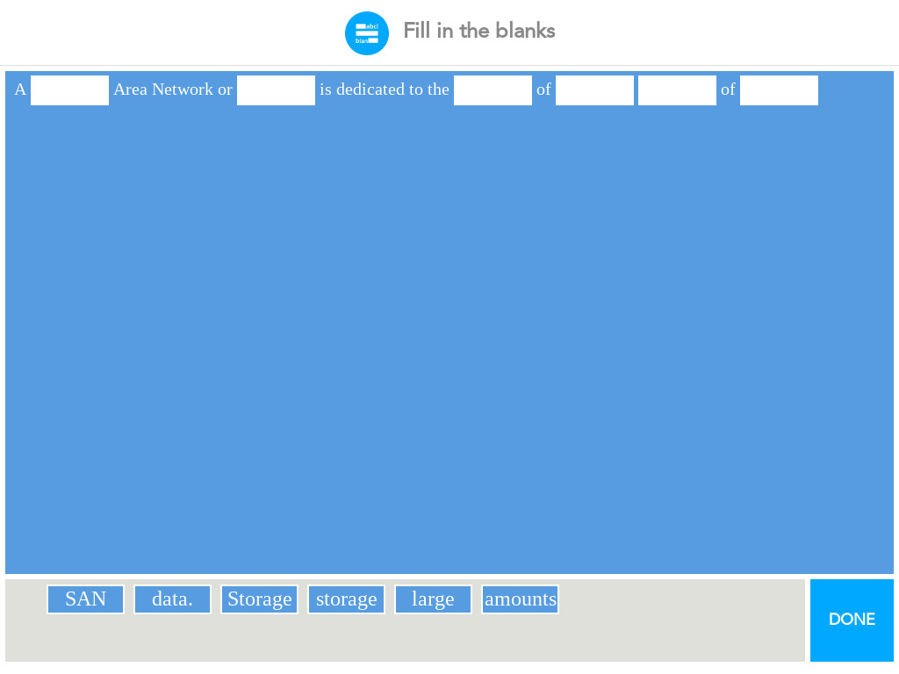

Slide 38
Some Types of Network
WAN (Wide Area Network) - is a network that covers a large geographical area like a country or continent. The Internet is the largest WAN in our world!

Slide 39
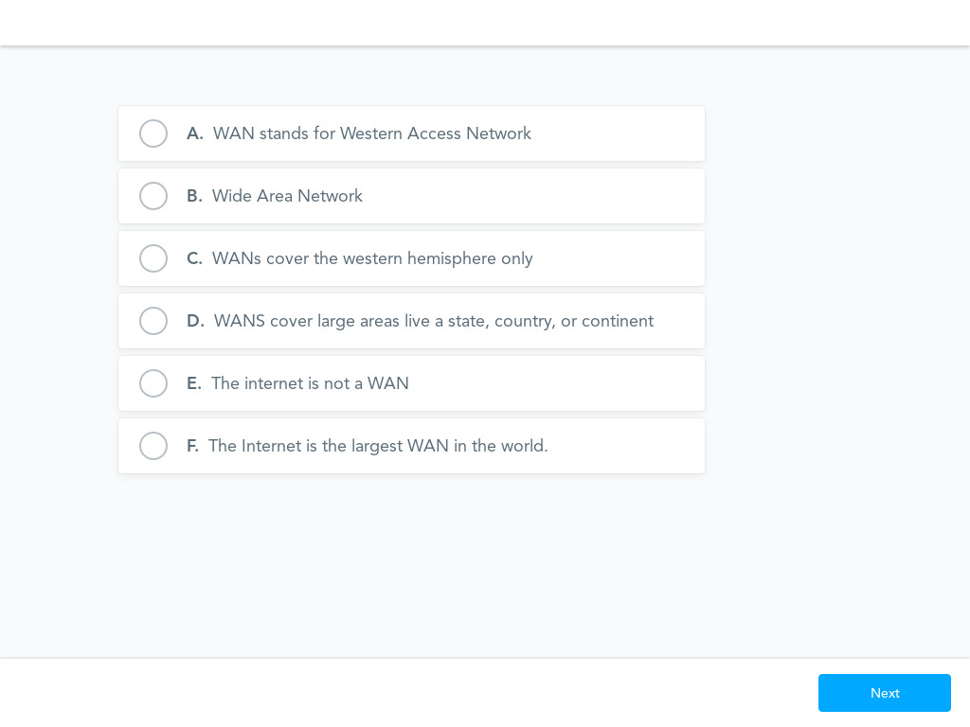

Slide 40

Bandwidth
Bandwidth - determines the rate (amount/speed) of data transfer across a path. The higher the bandwidth the more users that can be serviced at the same time without slowing down the speed. Below are some issues that cause bandwidth problems:
Watching a video on the Internet
Transferring large files
Constantly streaming data
Downloading files from the Internet

Slide 42

Firewalls
Firewalls - protect your computer from malware (malicious software) and viruses. Firewalls have rules that it uses to decide what to do with data and data requests.
Organizations use firewalls to protect their computer systems from threats.
Firewalls can affect network latency by slowing down the data transmission rate.

Slide 44
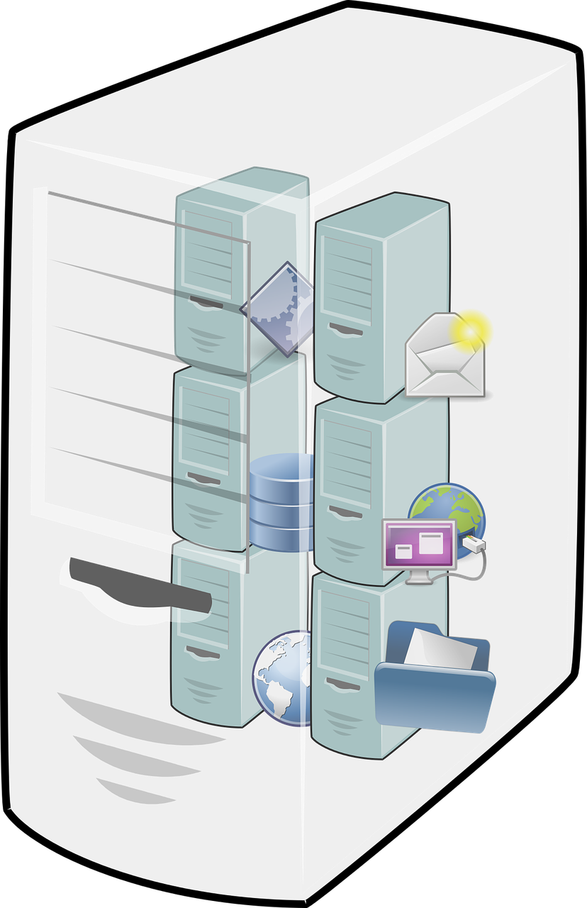
Server Capability
Server Capability- All data is stored on a server somewhere. Servers can only process a certain amount of data in a given amount of time. A network can only send data at the processing capacity of the server. The following components (parts of a computer) can affect a server's capacity.
Server capacity
Central processing unit (CPU)
Random access memory (RAM)

