Slide 1
COMPUTATIONAL THINKING (CT) and INQUIRY:
Playful participatory research
Sumi Hagiwara, hagiwaras@montclair.edu

Slide 2
When students or adults engage in a process of inquiry that is self-chosen, is personally motivating, and has meaningful implications, they can lose themselves in the inquiry process.
Inquiry becomes play.
Baker, M., Daliva,G.S. (2018, November). Inquiry is play: Playful participatory research.
Retrieved from https://www.naeyc.org/resources/pubs/yc/nov2018/inquiry-is-play-playful-participatory-research

Slide 3
LEARNING STEM/INQUIRY THROUGH PLAY
Recall the Article: “Inquiry Is Play: Playful Participatory Research (Voices)”
WHEN TEACHERS ENGAGE IN PLAY…..
The article starts with PD in the form of a scavenger hunt for teachers.
One teacher, Gayle, described how she felt being engaged in a playful participatory research,“I feel like I’m on a team—it’s part of your day, part of your way. . . . I feel more active—an active learner.”
Another participant, Helena, described the playful participatory research process as playful: “We see each others’ questions and the playfulness in each others’ questions . . . [and] help each other get new ideas.”

Slide 4
WHEN ADULTS ENGAGE IN PLAY….
Being in a relaxed and playful state of mind, we were eager to share ideas and feedback with each other; we experienced playful learning when the documentation we shared offered windows into each other’s classrooms, providing a common reference point for generative and supportive dialogue.
Baker, M. & Daliva,G.S. (2018)

Slide 5
PLAYFUL, PARTICIPATORY RESEARCH (PPR): Having choice, invitations to wonder, and discover delight in play and inquiry, teachers and researchers can imagine possibilities, experiment with materials and ideas, and be inspired by their work.
REAL, ENGAGING ISSUES IN TEACHERS’ PRACTICES AND BELIEFS ABOUT TEACHING COMPUTER SCIENCE
ENGAGING PLAYFULLY IN THIS RESEARCH WITH COLLEAGUES AND CHILDREN
PPR

Slide 6
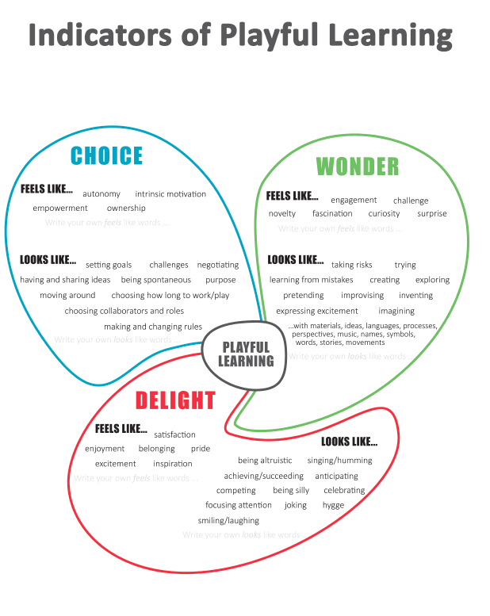
WHAT PLAYFUL LEARNING LOOKS LIKE and FEELS LIKE:
Choice, Wonder, Delight

Slide 7
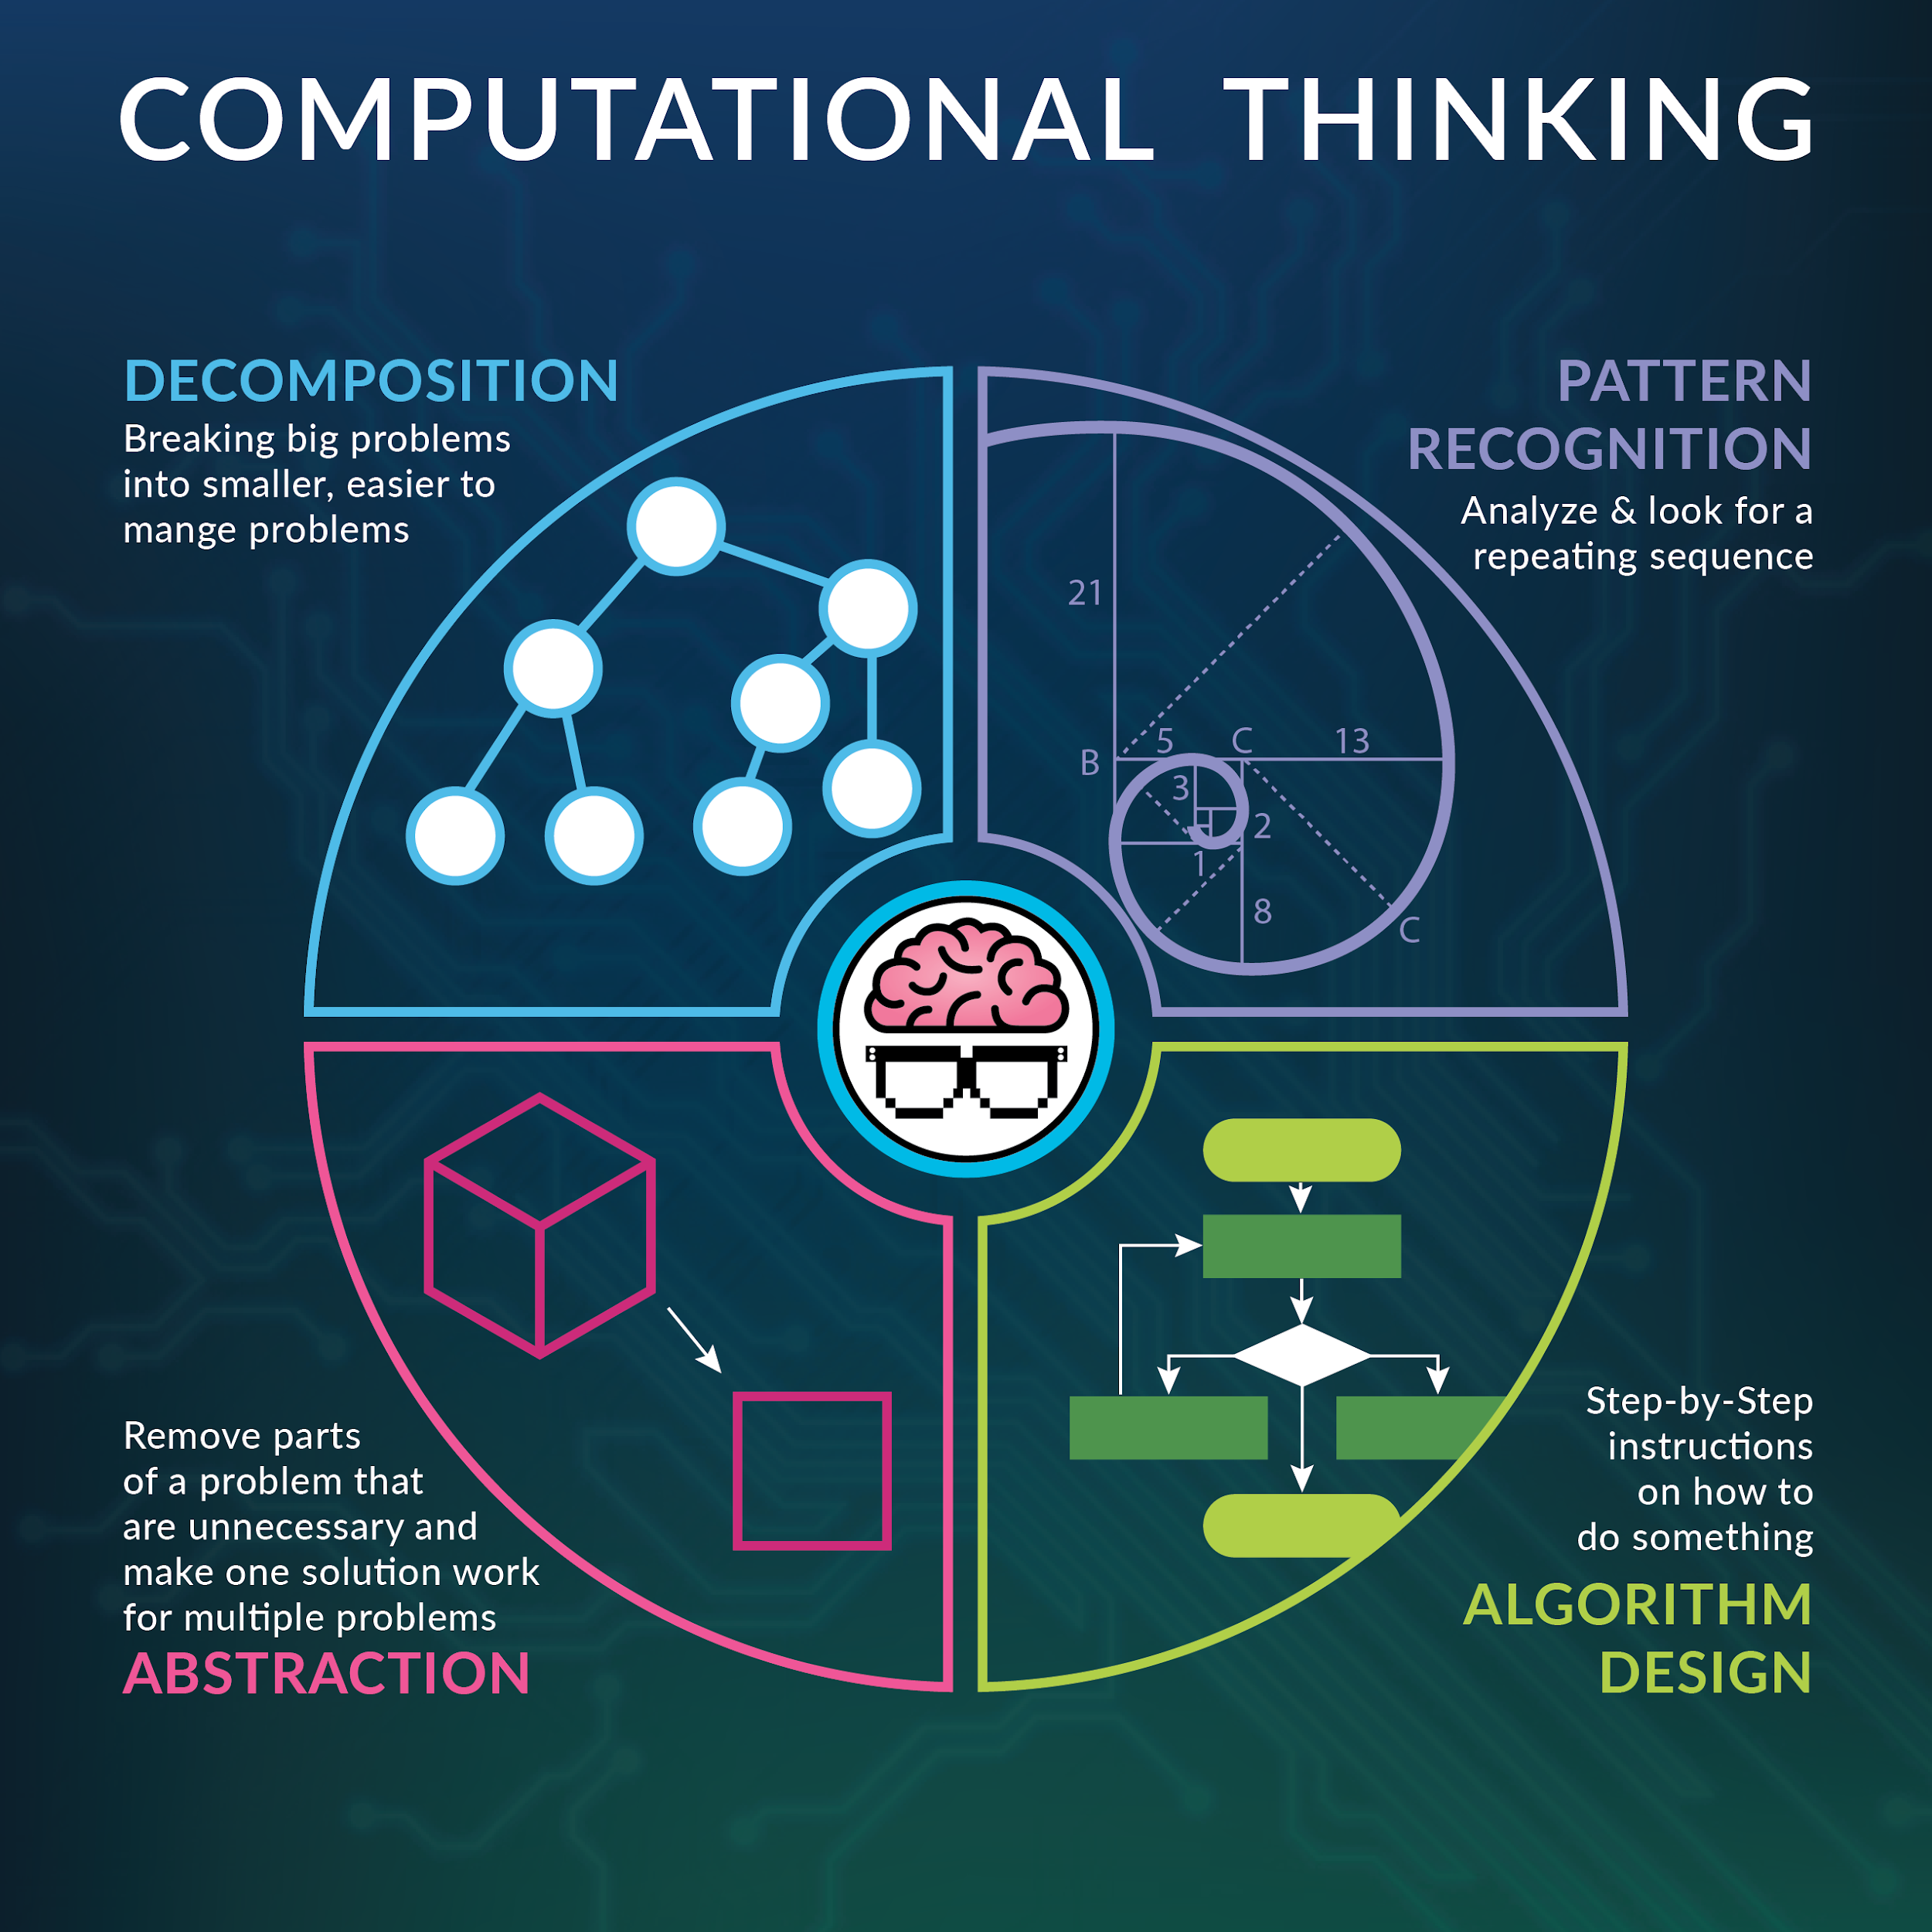
INTEGRATING PLAYFUL LEARNING WITH COMPUTATIONAL THINKING

Slide 8
THE HOOK or ANTICIPATORY SET
ENGAGE a learner (WONDER):
  Have you seen a robot? How does a robot know how to move?
  This can lead to a conversation about programming?
Definitions:
  Algorithm - A precise sequence of instructions that can be executed by a computer
  Bug - Part of a program that does not work correctly.
  Debugging - Finding and fixing problems in an algorithm or program.
  Program - An algorithm that has been coded into something that can be run by a machine.
https://www.youtube.com/watch?v=QdQL11uWWcI&t=47s

Slide 9

PLAY: CUP STACKING GAME (CHOICE and DELIGHT)
(or MY ROBOTIC FRIEND from Code.org)
https://studio.code.org/s/pre-express-2018/stage/6/puzzle/1
How can children create this image of cups:
Start with a stack of three cups.
Code:
↑: pick up cup (approx. 1 foot/12 inches)
↓: put down cup
→: forward (right, 1/2 cup width)
←: backward (left, 1/2 cup width)

Slide 10
Handy Rules: Students = Programmers
Up means that the cup automatically goes up 12 inches
Down means that it automatically goes down until it lands on something
  The hand automatically returns to cup stack after setting down a cup
Forward means the robot moves one step (1/2 cup width) forward
Backward means the robot moves one step (1/2 cup width) Backward
  Note: Students may not use backward at this age unless they want to build the cup stacks in reverse (which is also okay)
Programmers are not allowed to talk when the robot is working. This includes blurting out answers or pointing out when the robot has done something wrong
Programmers should raise their hand if they see a bug

Slide 11
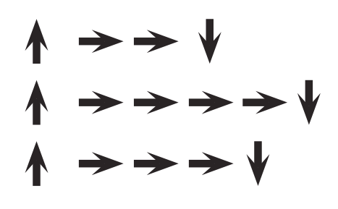
HOW TO MAKE A ROBOT MOVE?
PROGRAM IT- Answer key

Slide 12
Discussion questions
What was the most difficult part of coming up with the instructions?
Did anyone find a bug (mistake) in your instructions once your robot started following them?
    What was the bug?
    Why do you think you didn't notice it when writing the program?
When you were the robot, what was the hardest part of following the instructions you were given?

Slide 13
ASSESSMENT
Journal Prompts:
Draw your own stack of cups that you would like to see a robot build.
Can you create a program for that cup stack?
OTHERS:
1. Create a program for your partner (robot). Try to create each other’s design.
2. Write the program in reverse (unstack the cups).

Slide 14
REFLECTION QUESTIONS FOR TEACHERS:
In what ways do you see the role of computer science in your classroom?
What professional development do you need to develop CT practice?
What questions and concerns do you have with CT integration into your lessons?

