Slide 1


NI
The New Jersey Student Learning Standards
Computer Science & Design Thinking
8.1.5 Networks
& The Internet
8.1.5

Slide 2

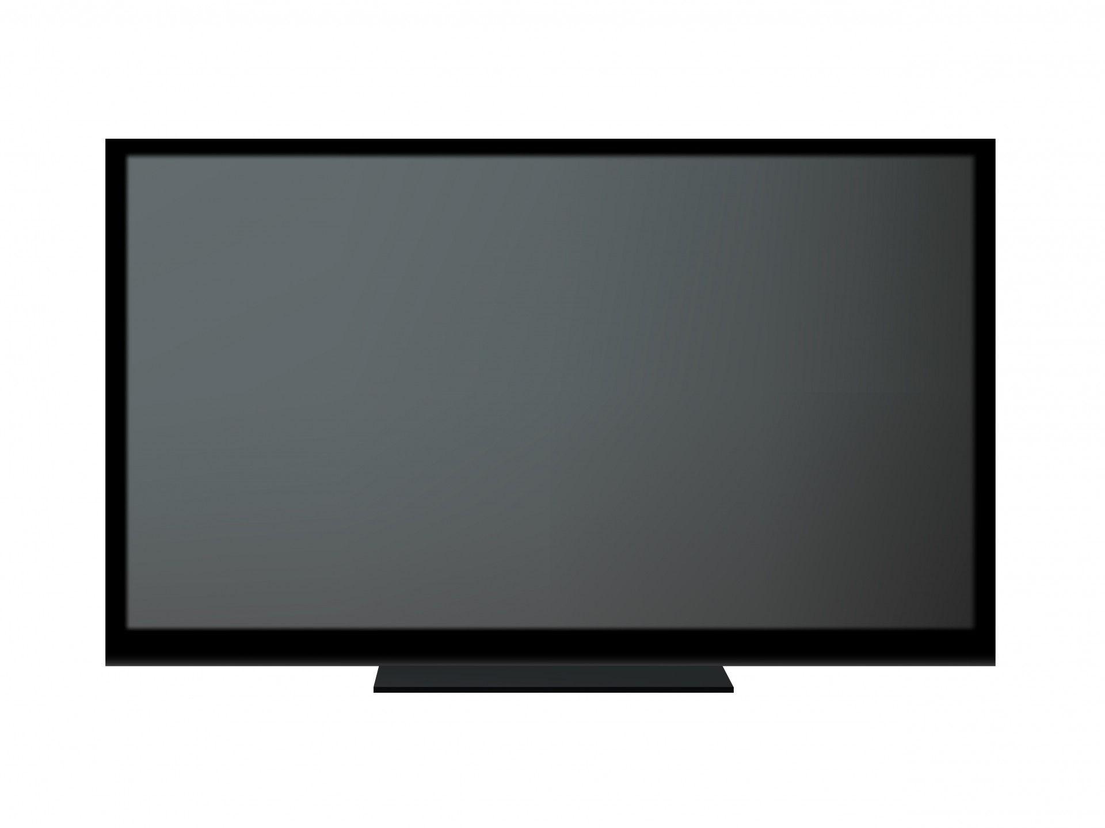
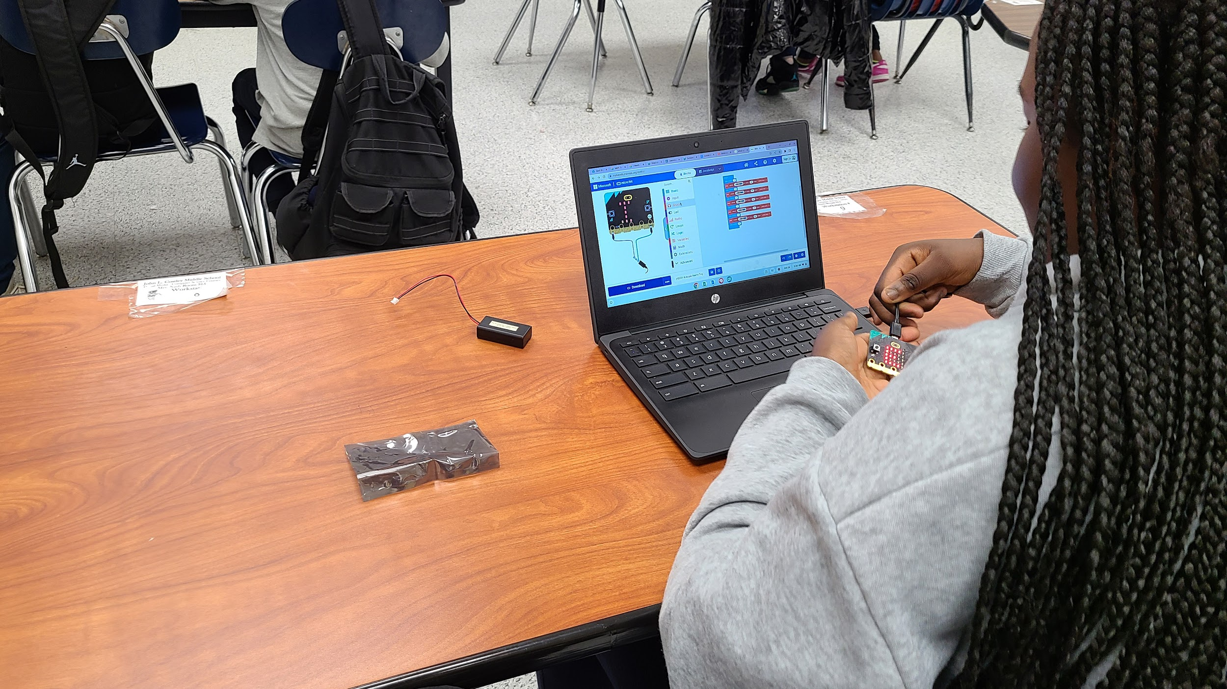




New Jersey Student Learning Standards
NI
Technology:
8.1.5.NI.1: Develop models that successfully transmit and receive information using both wired and wireless methods.
8.1.5.NI.2: Describe physical and digital security measures for protecting sensitive personal information.
8.1.5

Slide 3
I
NI
Core Concept 8.1.5 Networks & The Internet
Computing devices typically do not operate in isolation. Networks connect computing devices to share information and resources and are an increasingly integral part of computing. Networks and communication systems provide greater connectivity in the computing world.
8.1.5

Slide 4
NI
Topics Covered
Background Vocabulary
Computer Network
The Internet
Network Protocols
The Login Process
8.1.5

Slide 5
NI
Background Vocabulary
8.1.5

Slide 6
Background Vocabulary
NI
Before discussing networks, we will define the following key vocabulary words:
Data
Hardware
  CPU
  Memory
    ROM
    RAM
Software
8.1.5

Slide 7
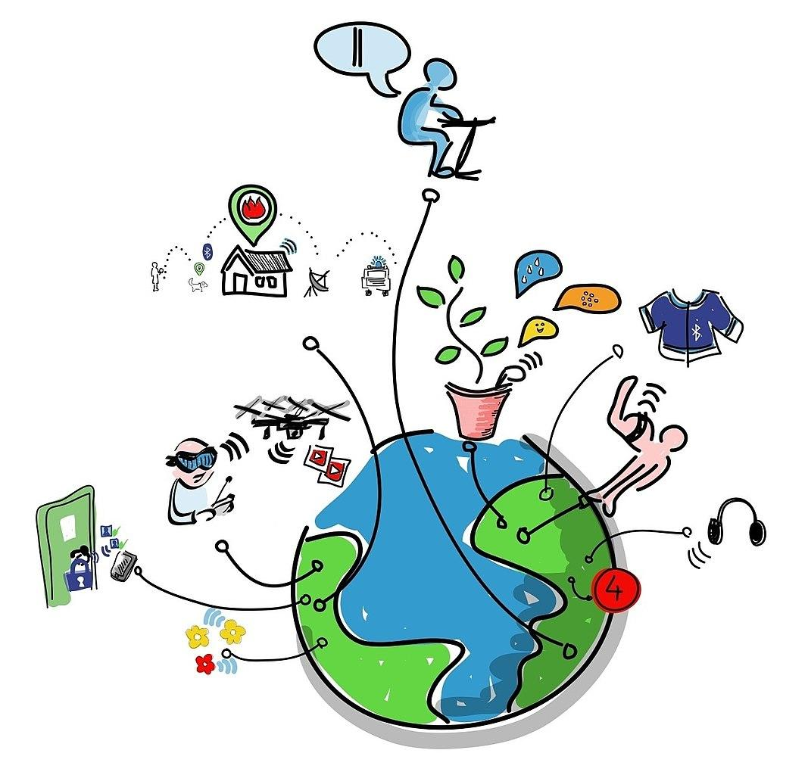
Background Vocabulary -> Data
NI
Data is the information you send and receive over the Internet.
8.1.5

Slide 8
Background Vocabulary -> Data
NI
Question:
What types of data do you send or receive over the internet?
8.1.5

Slide 9
Background Vocabulary -> Data
NI
Answer:
Data includes pictures, drawings, images, sounds, and text like notes, letters, essays and book reports.
8.1.5

Slide 10
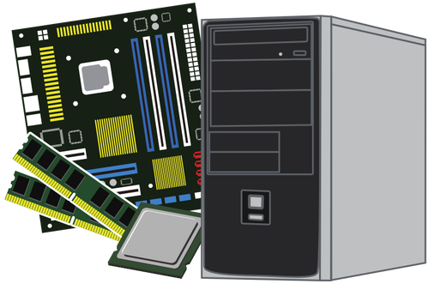
Background Vocabulary -> Hardware
NI
Hardware is all of the physical equipment (inside and outside) that makes up a computer system. If you can touch it, its hardware!
8.1.5

Slide 11
Background Vocabulary -> Hardware
NI
The Central Processing Unit (CPU) is often referred to as the brains of a computer. It performs arithmetic and logic operations and coordinates the activities of the other hardware components.
8.1.5

Slide 12
Background Vocabulary -> Hardware
NI
The Central Processing Unit (CPU) is often referred to as the brains of a computer. It performs arithmetic and logic operations and coordinates the activities of the other hardware components.
8.1.5

Slide 13
Background Vocabulary -> Hardware
NI
Computer memory are the physical devices or components used to store and retrieve data.The two main types of memory are:
ROM-Read Only Memory
RAM-Random Access Memory
8.1.5

Slide 14
Background Vocabulary -> Hardware
NI
ROM stands for "Read-Only Memory." ROM is used primarily in the storage of firmware and system software in electronic devices.
8.1.5

Slide 15
Background Vocabulary -> Hardware
NI
RAM or system memory is considered "volatile" memory. It only stores data while a device is turned on. When the device is powered down, data stored in the RAM is erased.
8.1.5

Slide 16
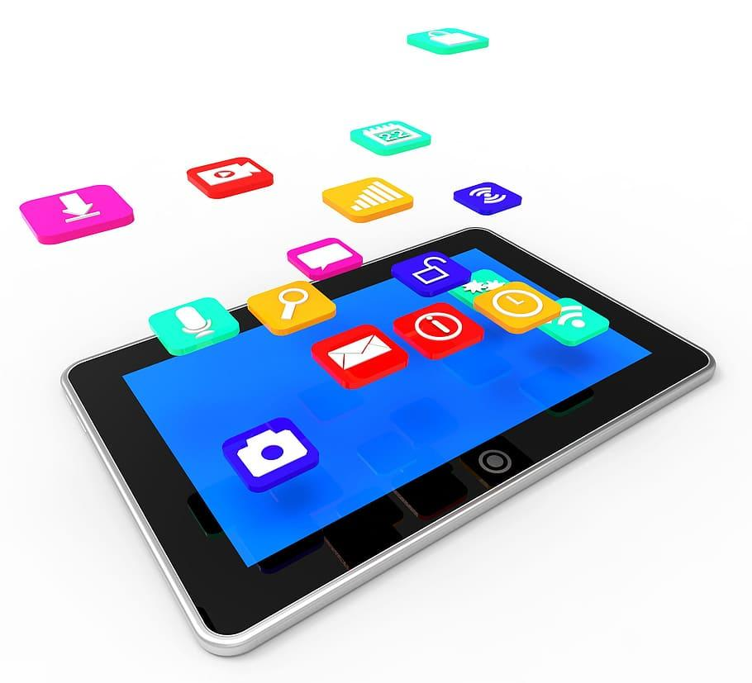
Background Vocabulary -> Software
NI
Software are the programs that manage the computer and complete tasks for users like you.
8.1.5

Slide 17
Background Vocabulary
NI
You need both hardware and software in order to have a operable computer system!
8.1.5

Slide 18
NI
Computer Network
8.1.5

Slide 19
NI
What is a Computer Network
Imagine you have a bunch of friends. You all like to talk to each other and share your games. Your friends live in different houses and in different towns. Think of the houses that your friends live in as computers. Think about the roads you travel to get to their houses as connections.
8.1.5

Slide 20
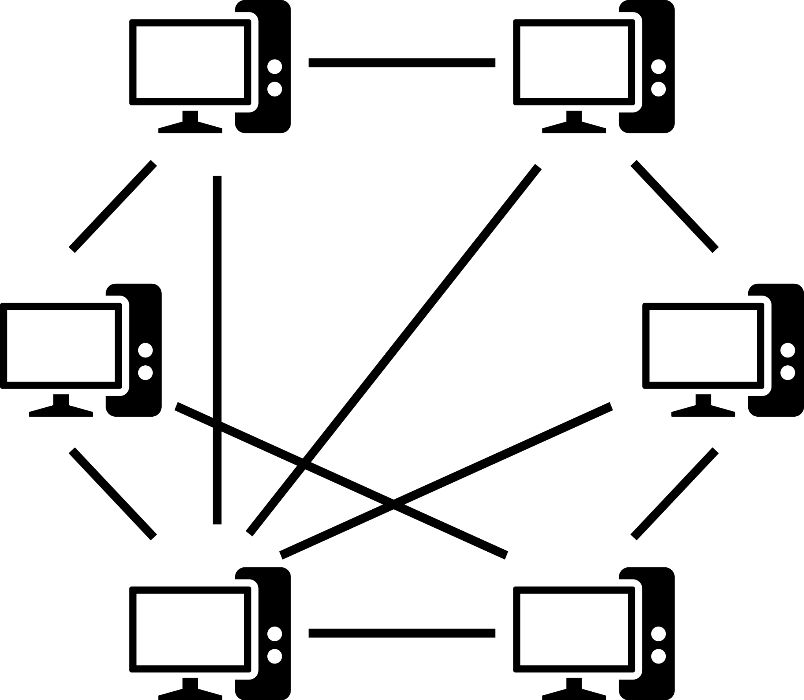
NI
What is a Computer Network
A computer network is like a big map that shows all the roads (connections) between the houses (computers).
8.1.5

Slide 21
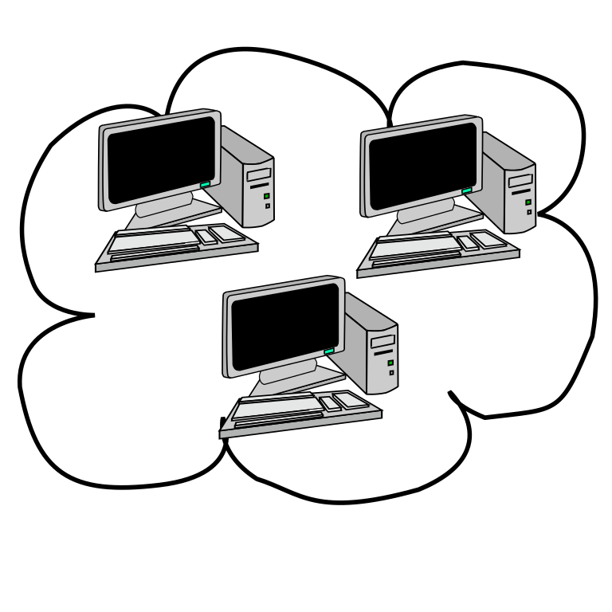
NI
What is a Computer Network
When your friends want to hangout or play a game, they use these roads (connections) to send messages back and forth between the houses (computers). Computers pass information to each other through network connections.
8.1.5

Slide 22
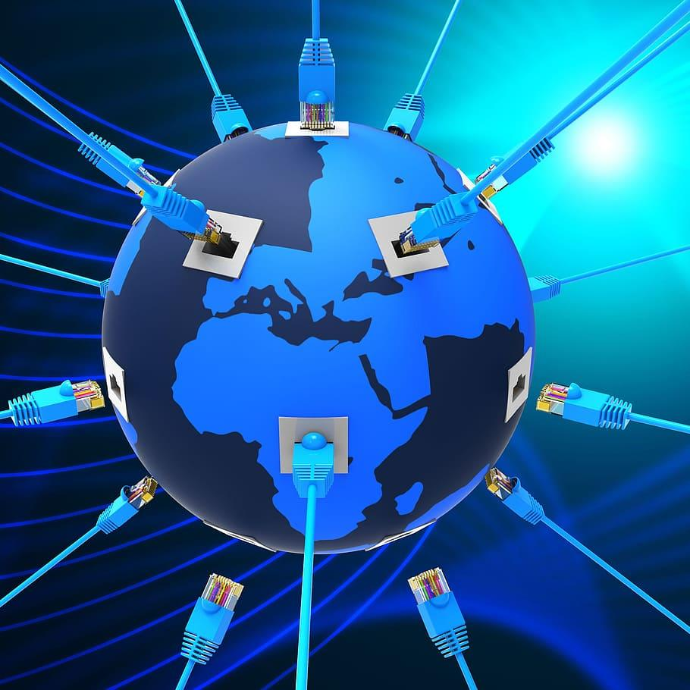
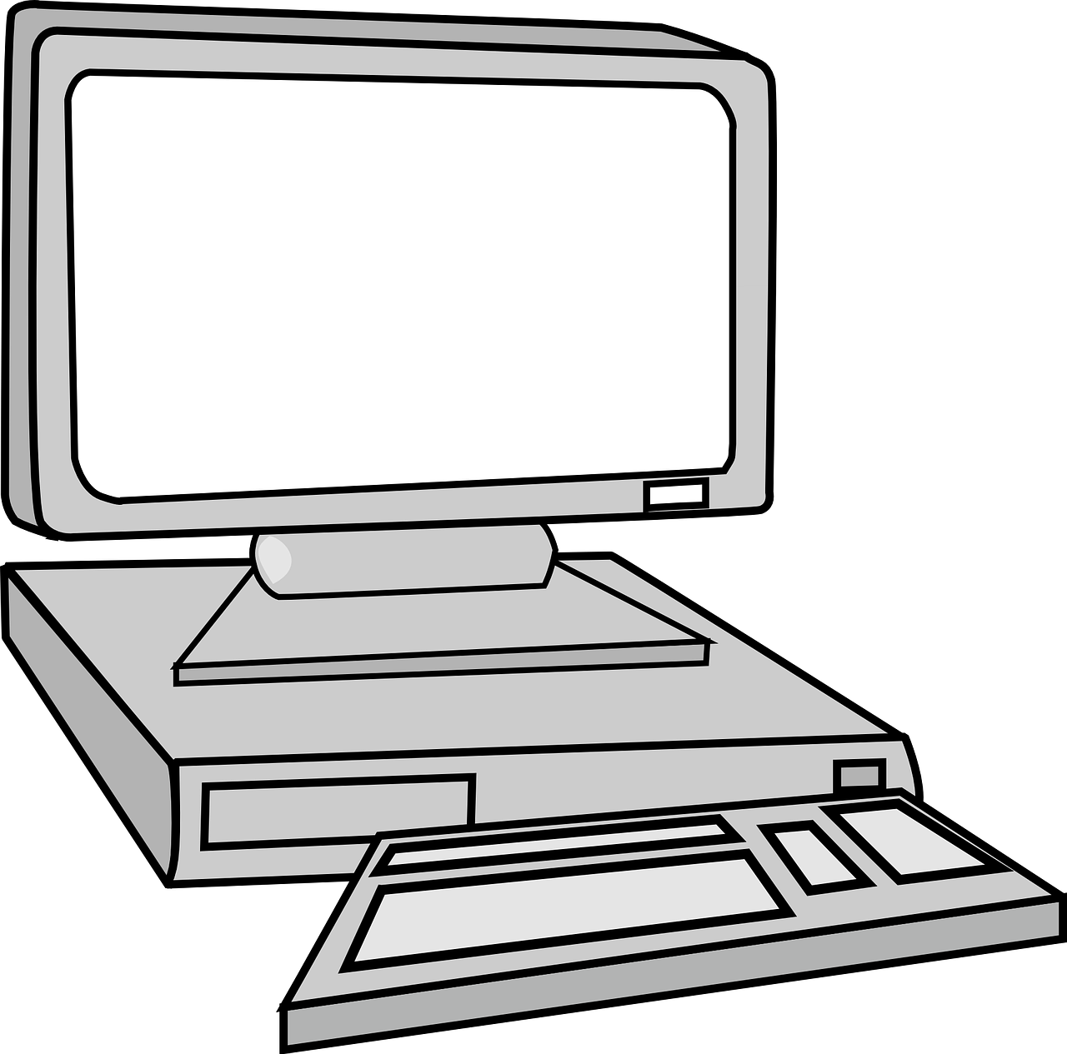
NI
What is a Computer Network
The more roads (connections) there are and the faster they are, the quicker your friends can share and play together! That's what computer networks do—they help computers talk and share stuff with each other, no matter where they are!
8.1.5

Slide 23
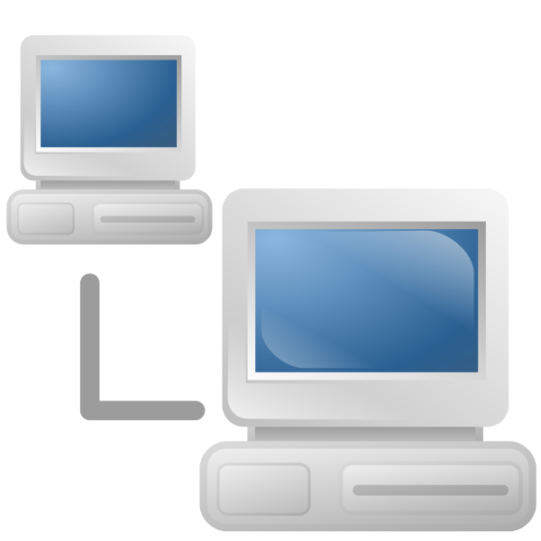
NI
What is a Computer Network
A computer network has lots of devices that are connected via wires or wireless to communicate with one another to share information and resources.
8.1.5

Slide 24
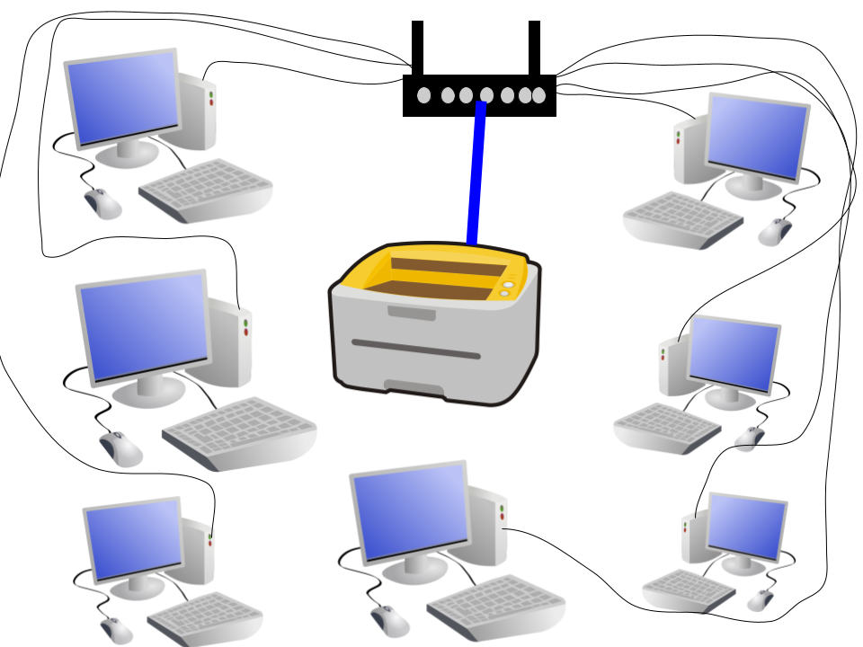
NI
What is a Computer Network
Traditional computer networks have desktop computers connect to printers.
8.1.5

Slide 25

NI
What is a Computer Network
Modern computer networks include a lot of different devices like laptops, tablets, smart phones, smart TVs and other electronics.
8.1.5

Slide 26
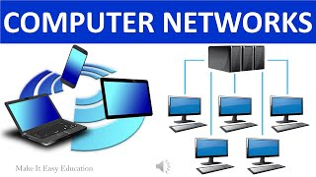
NI
What is a Computer Network
8.1.5

Slide 27
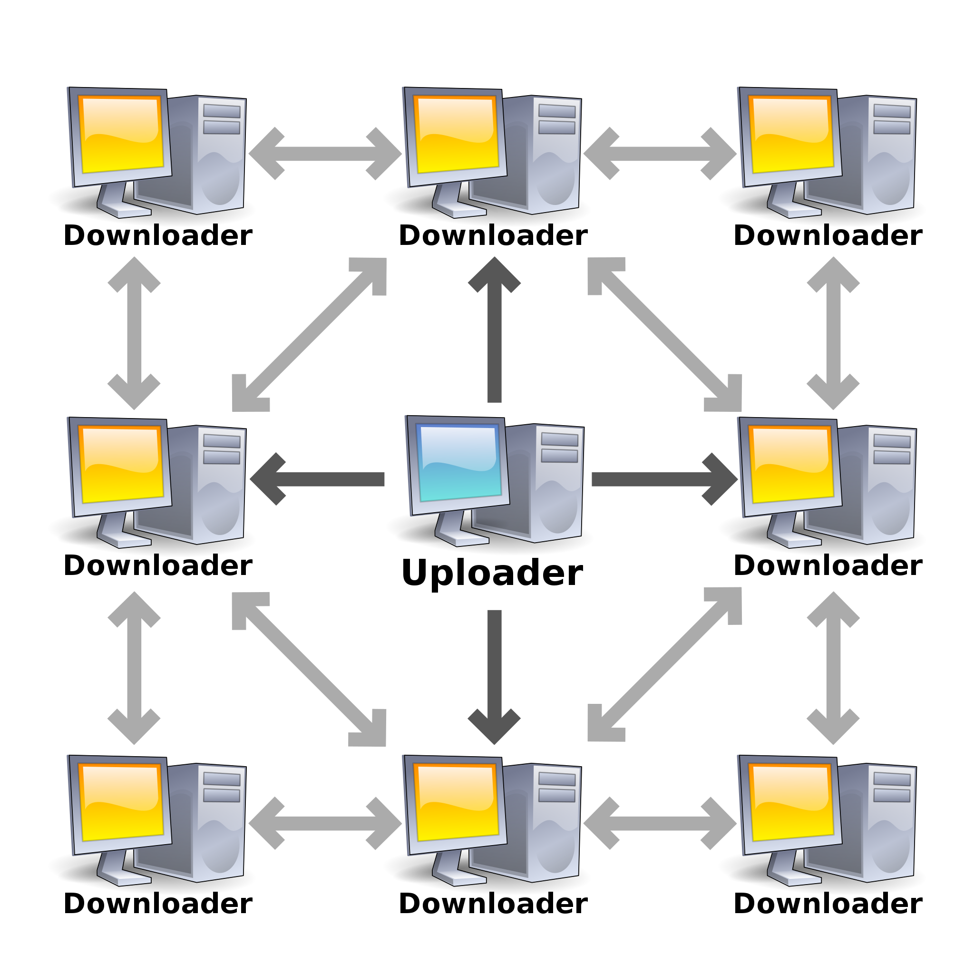
NI
What is a Computer Network
Computer networks come in different sizes. Some are very small like the one in a classroom that connects all computers to one printer. And some are very large. The Internet is the largest computer network in the world!
8.1.5

Slide 28
NI
What is a Computer Network
Remember, computer networks are used to connect individuals to other individuals, places, information, and ideas. And the Internet is the largest computer network in the world!
8.1.5

Slide 29
NI
The Internet
8.1.5

Slide 30
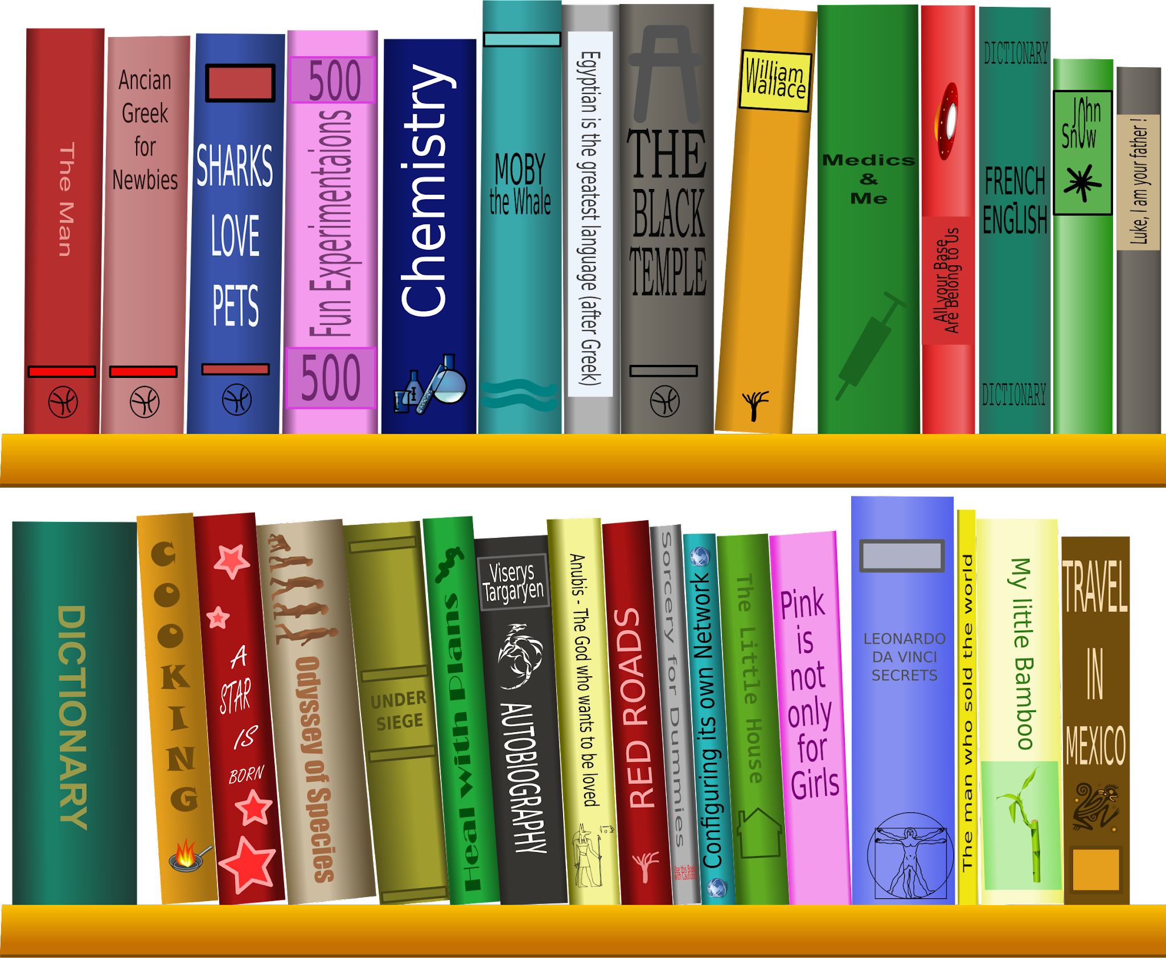
What is the Internet?
NI
The Internet is also called the world wide web. Imagine the Internet as a super, duper, humongous library that has every book, movie, video game, picture and other stuff in it ever made.
8.1.5

Slide 31
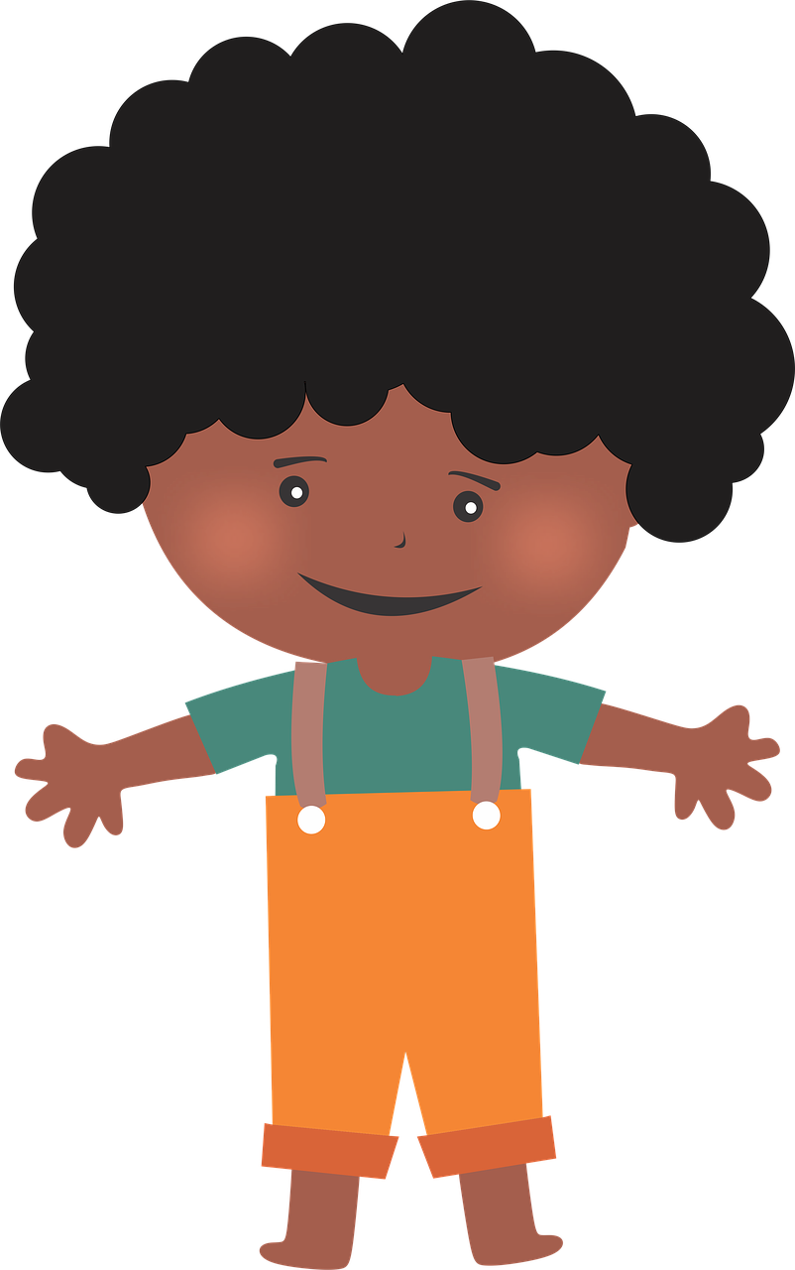

What is the Internet?
NI
Picture yourself with a magical map that can take you to any book in the library just by touching it.
8.1.5

Slide 32
What is the Internet?
NI
The Internet is like a magical map that helps you find and visit all the cool stuff.
8.1.5

Slide 33
NI
Network Protocols
8.1.5

Slide 34

NI
What is a Network Protocol?
A protocol is a standard set of rules that allow electronic devices to communicate with each other.
8.1.5

Slide 35
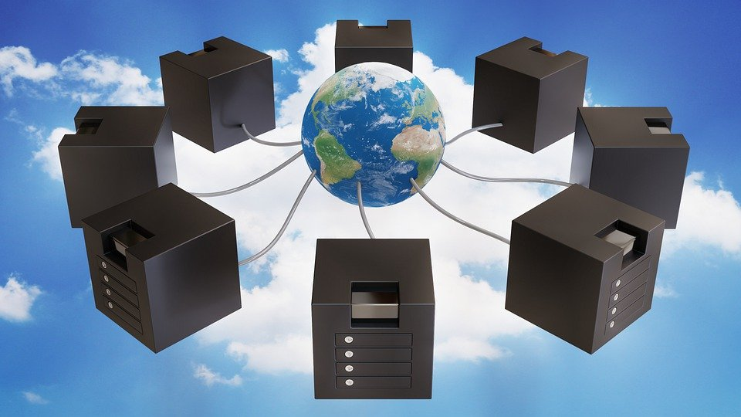
NI
What is a Network Protocol?
There are different types of protocols for the different types of jobs or tasks needed to make the Internet work.
8.1.5

Slide 36
Network Protocol
NI
Protocols - a standard set of rules that allow electronic devices to communicate with each other.
8.1.5

Slide 37
Network Protocol
NI
Network Protocols define the rules for communication between computers and/or servers in a network.
8.1.5

Slide 38
Network Protocol
NI
The two types of networks are:
Peer to Peer Networks
Client-Server Networks
8.1.5

Slide 39
Network Protocol
NI
Peer-to-peer networks share data and resources between two or more computers without going through a server.
8.1.5

Slide 40
Network Protocol
NI
Client-server network shares resources between local computers and a server.
8.1.5

Slide 41
Computer Server
NI
A computer server is a specialized computer system designed to provide various services, resources, or data to other computers or clients over a network.
8.1.5

Slide 42
NI
Computer Server
A packet is a unit of data that is transmitted over a network.
Packets are the basic units of data transmission in computer networks, enabling efficient and reliable communication between devices across local and wide-area networks.
8.1.5

Slide 43
NI
A Packets Tale
Click the link above to view the video.
8.1.5

Slide 44
NI
The Login Process
8.1.5

Slide 45
NI
The Login Process
The computer logon process is like having a secret code. Imagine you have a magical treehouse that only you and your friends can enter. But to get inside, you need a secret code. That secret code is like your password. So, when you get to the treehouse you state your name (username) and then you give your secret code (password).
8.1.5

Slide 46
NI
The Login Process
The treehouse keeper checks to make sure the your information is on the members only list. If it is, the keeper lets you in. But if it's the wrong the door will be shut tight and you will not be allowed to go in.
8.1.5

Slide 47
NI
The Login Process
Before you can use your desktop, laptop, tablet or similar devices, you must first give your name (username) and secret code (password). This is called the login process. Remember, your device just want to make sure you are really you!
8.1.5

Slide 48
NI
The Login Process
The username and password is also known as your account information. The username usually stays the same. Your password should be changed sometimes. Just remember to keep your password in a safe place and keep it private. Never share personal information.
8.1.5

Slide 49
Protecting Your Password
NI
In order to keep your password secure you need to do two things:
Change it every few months.
Create a strong password.
8.1.5

Slide 50
Protecting Your Password
NI
Weak passwords are simple and easy to guess, often consisting of common words, phrases, or patterns.
8.1.5

Slide 51
Protecting Your Password
NI
Strong passwords make it difficult for others to guess and gain access to your device and your personal, private information. Strong passwords typically contain:
6 or more characters:
contain upper and lower case letters,
numbers, and
special characters.
8.1.5

Slide 52
Protecting Your Password
NI
Let’s look at some passwords and discuss whether they are strong or weak.
abcdefg | 123456
password | abc123
mytoys | hello
Rvt54vBz | cat$D0g$z
hst8$3wl | la75k$RT
8.1.5

Slide 53
Protecting Your Password
NI
Now, I want you to practice creating a password. Put an example in one of the boxes below.
8.1.5

Slide 54

NI
Protecting Your Password
Here are some reasons why you need a strong password:
1. Stop Unauthorized Access.
2. Protect Sensitive Information.
3. Mitigation of Security Risks.
4. Compliance Requirements.
5. Maintaining Trust and Reputation.
6. Preventing Account Takeover.
8.1.5

Slide 55
Protecting Your Password
NI
Remember, strong passwords are needed to maintain the security and integrity of your devices, accounts, and personal information.
8.1.5

Slide 56
NI
Works Cited
OpenAI. (2023-2024). ChatGPT (3.5)
TechTerms.com
Algorithms
Introduction to Computer Networks
RBC Cyber Security - Powerful Passwords
A Packet’s Tale
8.1.5

