Slide 1
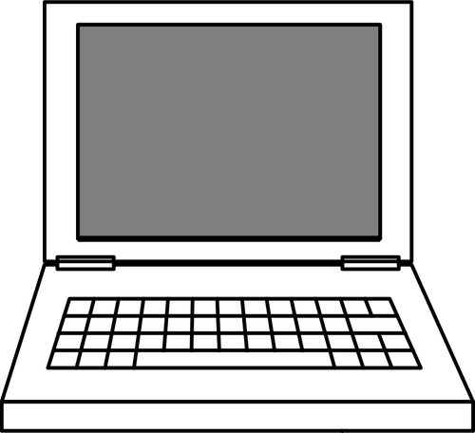
C
S
The New Jersey Student Learning Standards
Computer Science & Design Thinking
8.1.5 Computing Systems
8.1.5

Slide 2
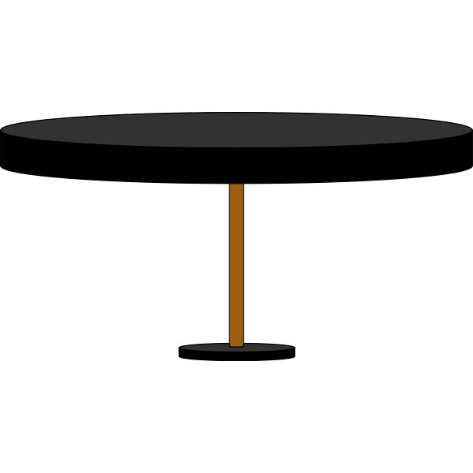
C
S
New Jersey Student Learning Standards
Technology
8.1.5.CS.1: Model how computing devices connect to other components to form a system.
8.1.5.CS.2: Model how computer software and hardware work together as a system to accomplish tasks.
8.1.5.CS.3: Identify potential solutions for simple hardware and software problems using common troubleshooting strategies.
8.1.5

Slide 3
C
S
Core Concept 8.1.5 Computing Devices
People interact with a wide variety of computing devices everyday. These devices collect, store, analyze and act upon information in ways that can positively or negatively affect people.
Computing devices need hardware (physical components) and software (instructions) in order to process information in digital form.
8.1.5

Slide 4
C
S
Topics Covered
What is a Computer
What is Computer Science
Computing Systems
Computer Hardware
Internal Hardware
External Hardware - I/O Devices
Computer Software
System Software
Operating Software
Applications Software Programs
Troubleshooting
Basic Problems
8.1.5

Slide 5
C
S
What is a Computer?
8.1.5

Slide 6
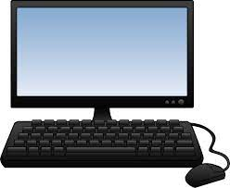
C
S
What is a Computer?
A computer is an electronic device that
collects,
analyzes (or study), and
acts upon
information we give it.
8.1.5
Page 6

Slide 7
C
S
What is Computer Science?
8.1.5

Slide 8
C
S
8.1.5

Slide 9
C
S
Computing Systems
8.1.5

Slide 10
C
S
Computing Systems
What is a Computing System?
The Internet of Things (IoT)
Categories of Computing Systems
Types of Computing Devices
8.1.5

Slide 11
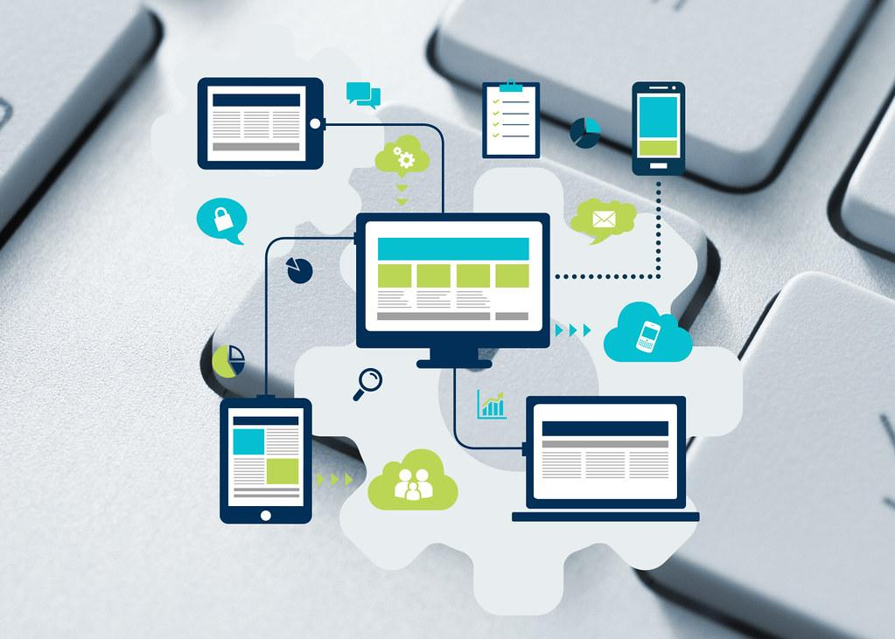
What is a Computing System?
C
S
A computing system is the layout of hardware and software programs that work together to perform various tasks.
8.1.5

Slide 12
C
S
Question:
Can you name
a computing device that is used in school or at home everyday?
?
?
?
?
8.1.5

Slide 13
Answer: Here are some computing devices you might use in school or at home everyday!
C
S
Desktop
Laptop
Tablet
Smart phone
Smart TVs
Smartwatch
Fitness Trackers
E-readers
8.1.5

Slide 14
C
S
Let’s talk about each of these computing systems in a little more detail!
8.1.5

Slide 15
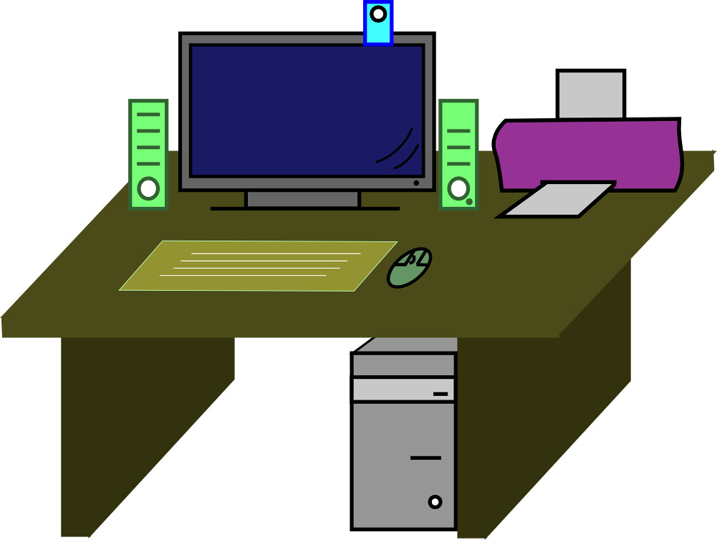
Desktop: Traditional computers with a stand alone monitor, keyboard, mouse, and system unit that are connected together.
C
S
8.1.5

Slide 16
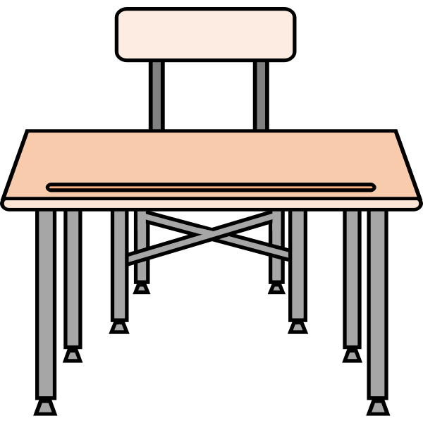
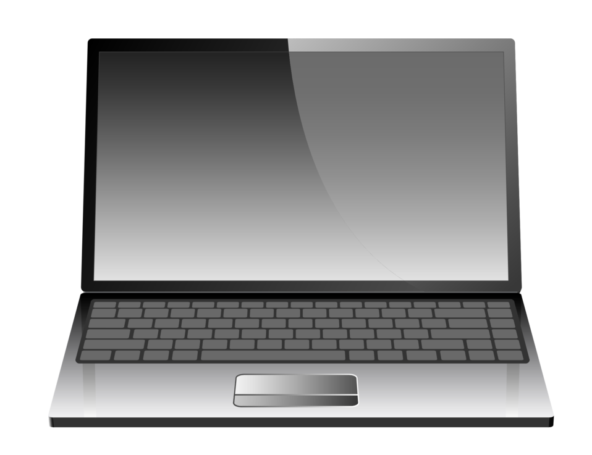
Laptop or notebooks: Portable computers with an integrated screen (display), keyboard, and trackpad or pointing device.
C
S
8.1.5

Slide 17
Tablets an integrated large screen (display) device, with an onscreen keyboard, touchpad with similar features to a Smartphone.
C
S
8.1.5

Slide 18
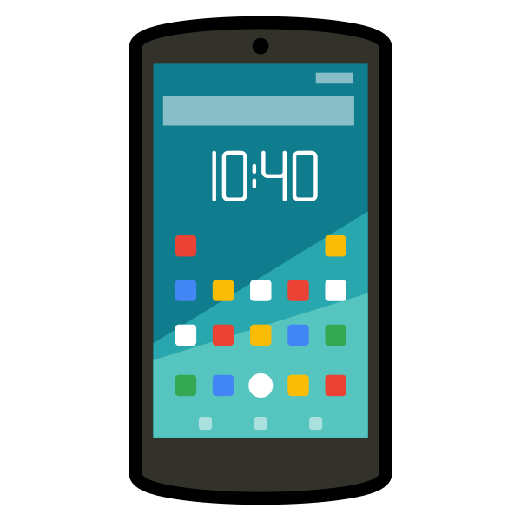
Smartphones Portable, handheld device with computing capabilities including communications and internet access and apps.
C
S
8.1.5

Slide 19
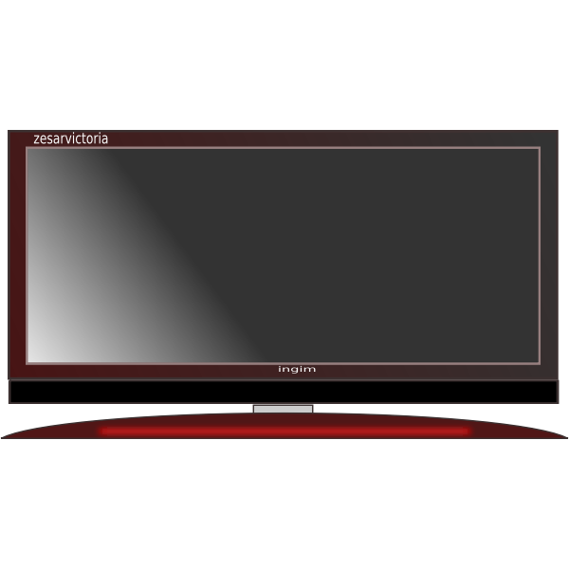
Smart TV: Television set with computing capabilities. These TVs have built-in internet connectivity and the ability to run apps.!
C
S
8.1.5

Slide 20
Smartwatch: Device worn on the wrist that has apps that monitor and track health and fitness.
C
S
8.1.5

Slide 21
Fitness Tracker: Device worn on the wrist that helps monitor physical activity, sleep, and health metrics.
C
S
8.1.5

Slide 22
E-readers: Electronic Book Readers. These devices are used to read digital books and documents.
C
S
8.1.5

Slide 23
C
S
There are additional computing devices that work behind the scenes at home, school and businesses. For now, we want to add one more computing device called IoT Devices.
8.1.5

Slide 24
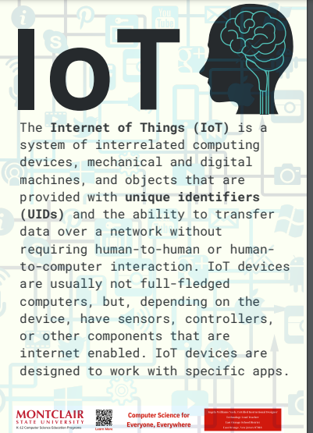
C
S
Internet of Things
interrelated
unique identifiers
Transfer data over network without human-to-human or human-to-computer interaction.
8.1.5
Sensors, controllers, and other internet enabled components.

Slide 25
C
S
Categories of Computing Devices
The three main categories of computing systems or devices are:
stationary devices
mobile devices
wearable devices
8.1.5

Slide 26
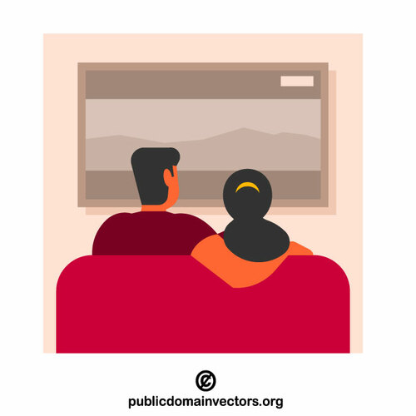
Categories of Computing Devices
C
S
Stationary devices stay in one place, like a desktop computer. You go to the device when you need to use it.
8.1.5

Slide 27
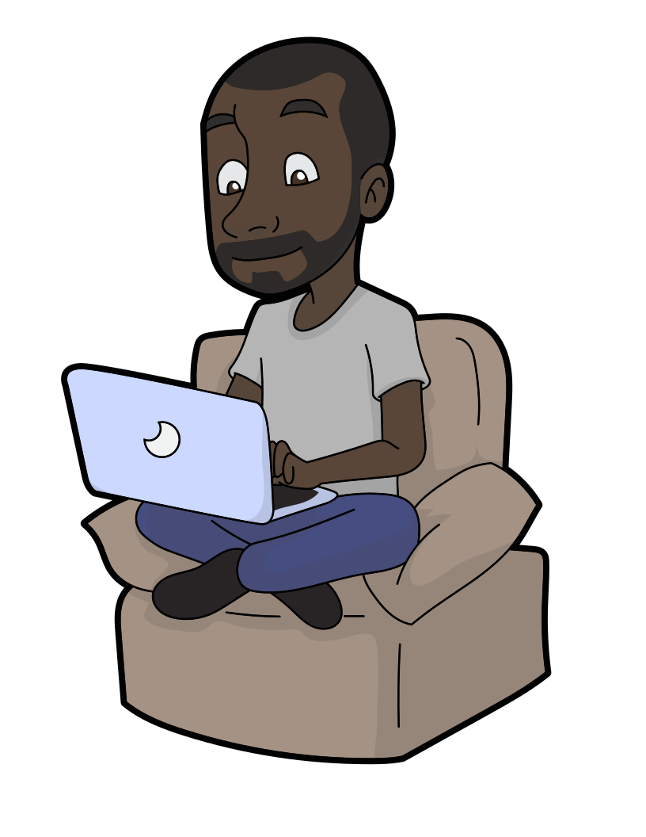
Categories of Computing Devices
C
S
2. Mobile devices go with you from place to place like a laptop, tablet and smartphone in your bookbag.
8.1.5

Slide 28
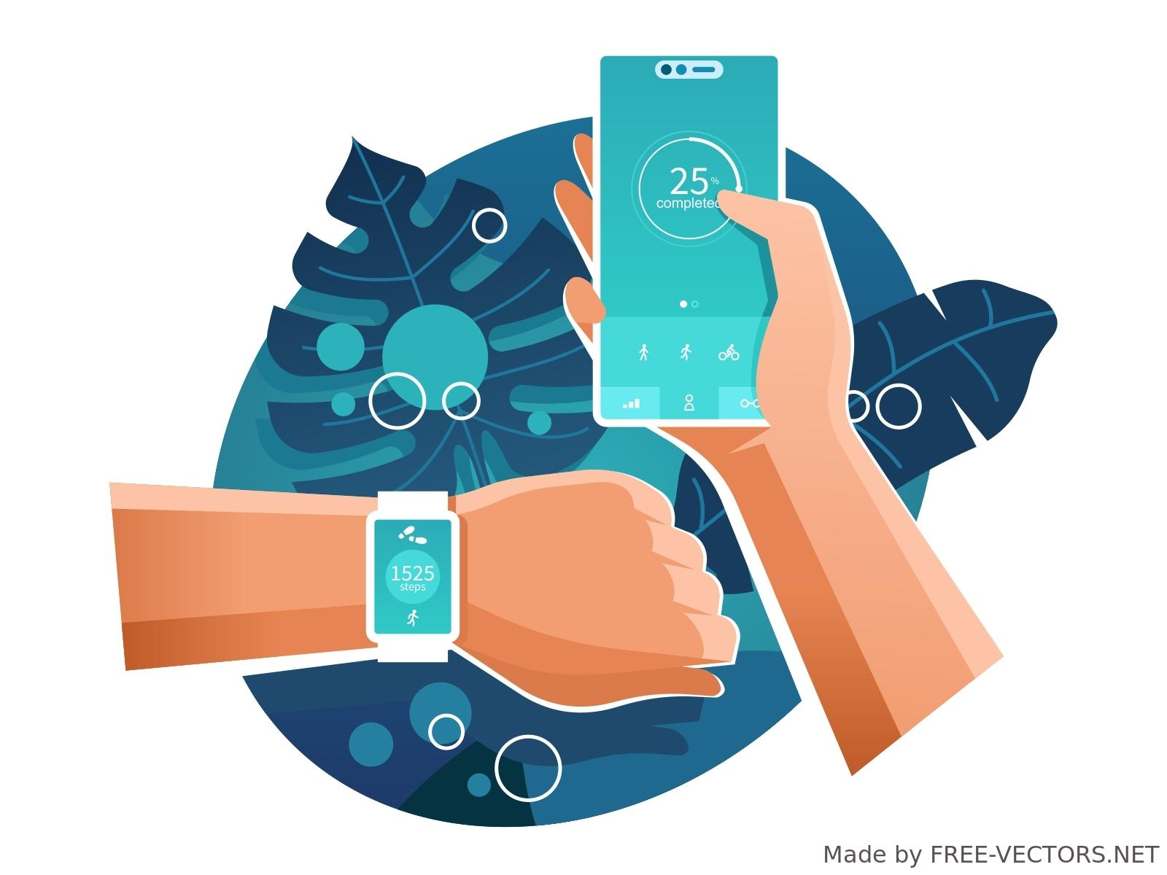
Categories of Computing Devices
C
S
3. Wearable devices are worn on the human body, like a watch connected to a smartphone or fitness tracker.
8.1.5

Slide 29
Question: Can you put each device in its proper place!
C
S
Stationary devices | Mobile Devices | Wearable Devices
8.1.5
Fitness Trackers
Smart TVs
E-readers
Laptop
Smart phone
Smartwatch
Tablet
Desktop

Slide 30
C
S
Computer Hardware
8.1.5

Slide 31
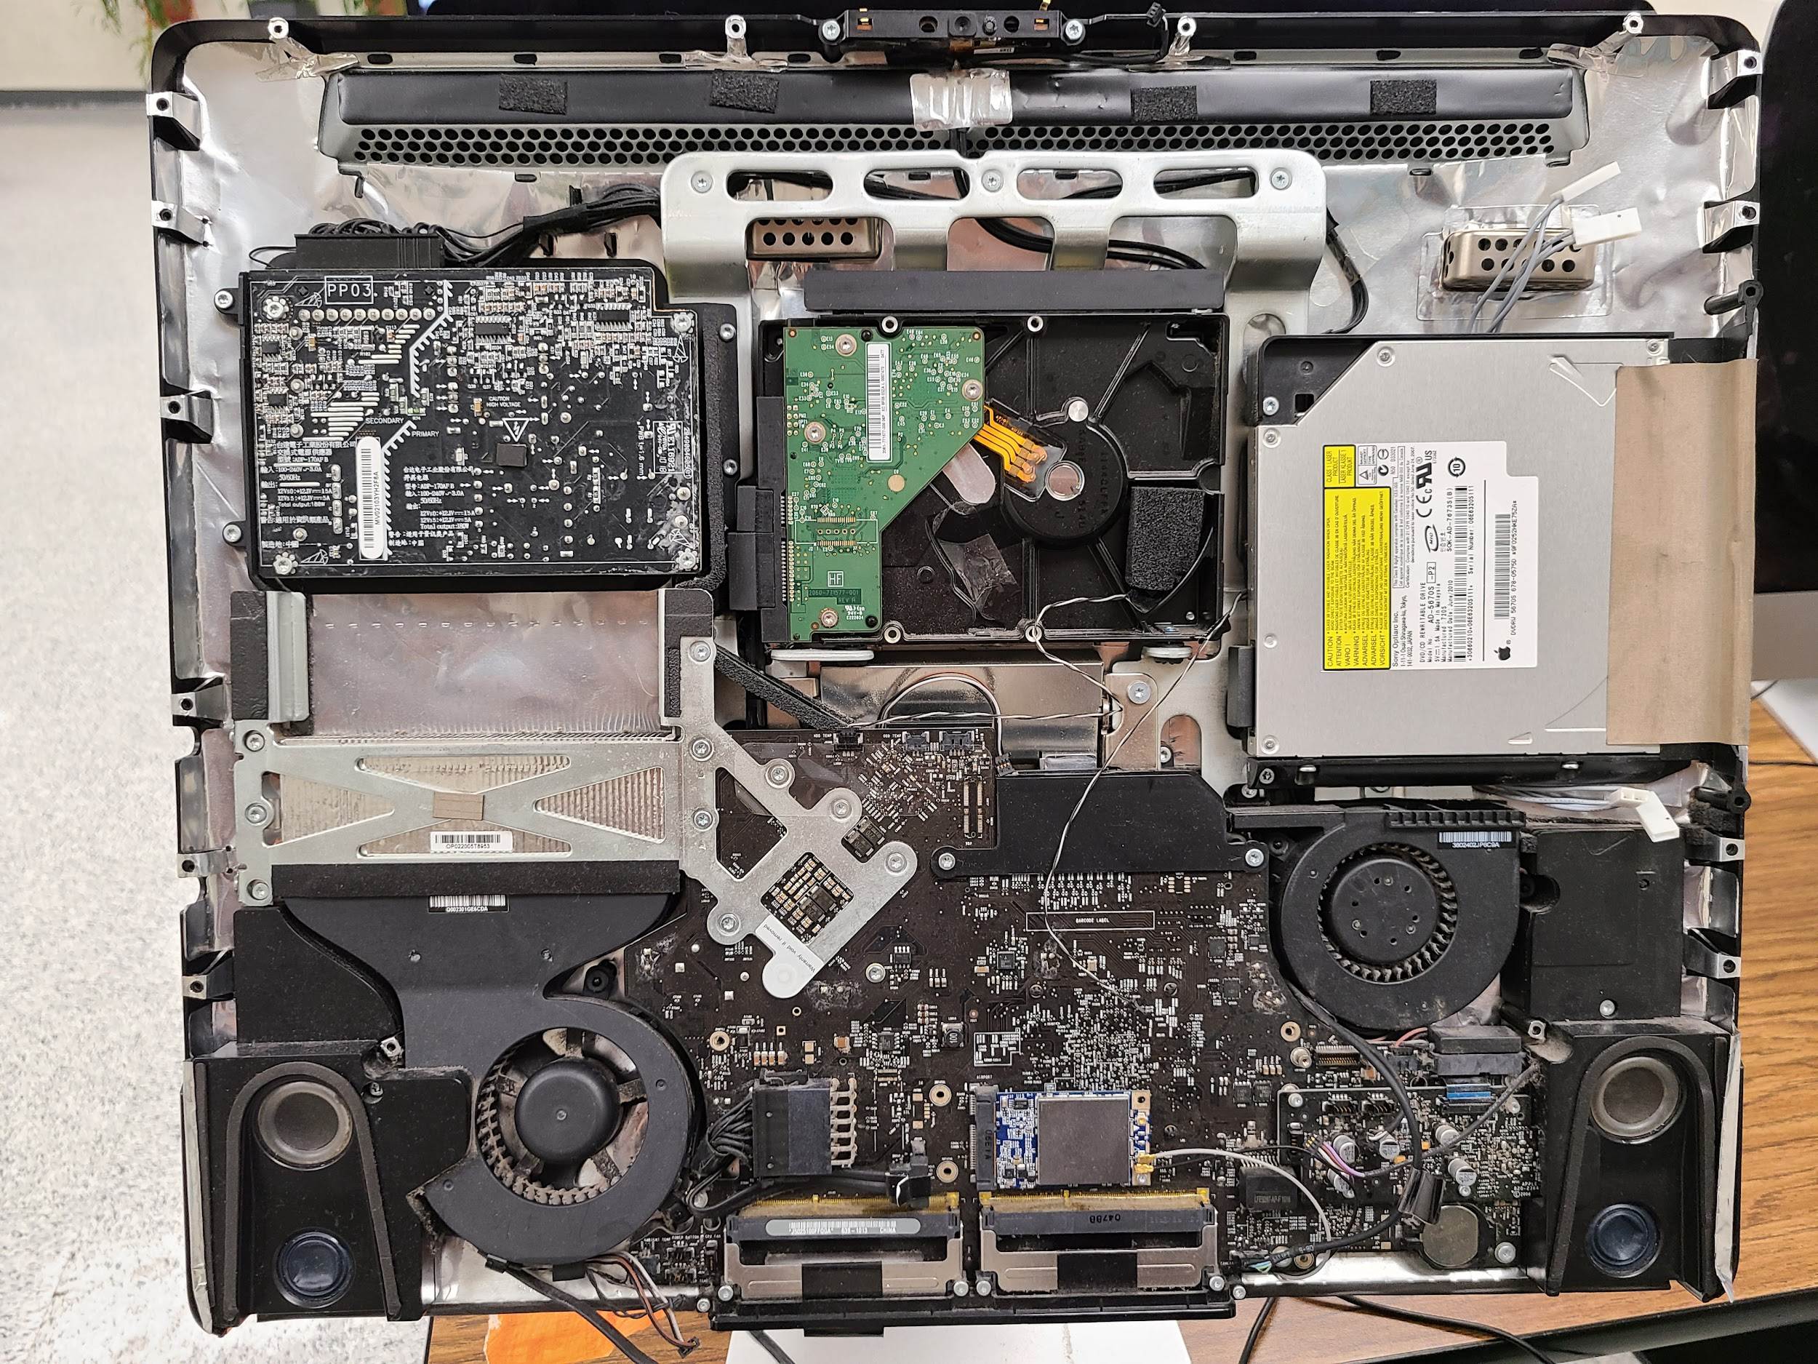
Computer Hardware
C
S
Computer hardware refers to the physical (touchable) parts and related devices that make up a computer systems.
8.1.5

Slide 32
Computer Hardware
C
S
Computers have
Internal (inside) and external (outside) components (parts).
8.1.5

Slide 33
Computer Hardware
C
S
The internal hardware parts of a computer are often referred to as components, while external hardware devices are usually called peripheral devices or peripherals.
8.1.5

Slide 34
C
S
Internal Computer Hardware
Central Processing Unit (CPU)
Motherboard
Storage Devices
Memory (ROM and RAM)
Power Supply Unit (PSU)
Cooling Fans
8.1.5

Slide 35
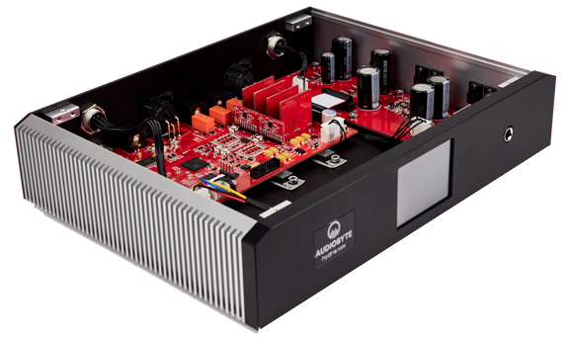
Internal Computer Hardware
C
S
Internal hardware refers to devices that are inside
the computer. Some
main devices are highlighted below.
8.1.5

Slide 36
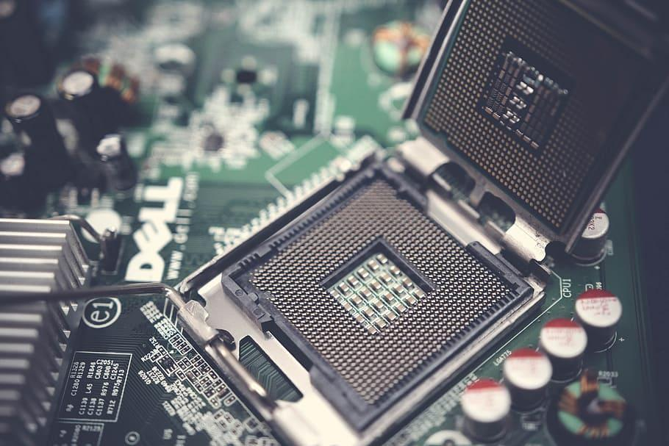
Internal Computer Hardware
C
S
The Central Processing Unit (CPU) is often referred to as the brains of a computer. It performs arithmetic and logic operations and coordinates the activities of the other hardware components.
8.1.5

Slide 37
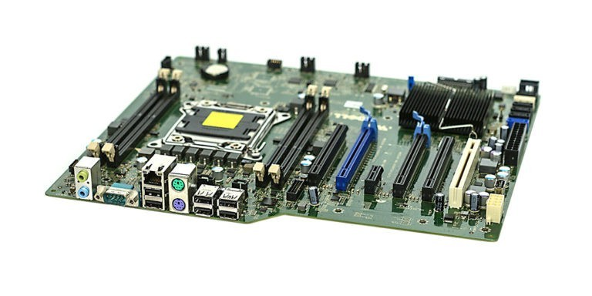
Internal Computer Hardware
C
S
The motherboard is the main circuit board. It houses the CPU, memory, and other essential components. It provides the electrical connections between the various hardware components.
8.1.5

Slide 38
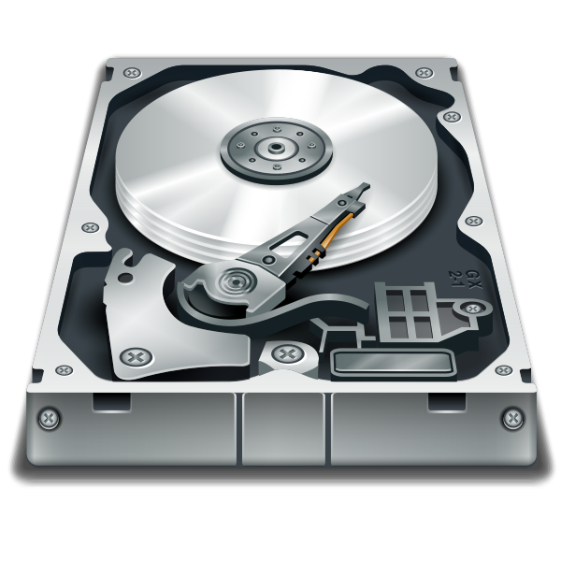
Internal Computer Hardware
C
S
Storage devices like hard disk drives (HDD), solid-state drives (SSD) or other storage media stores data and programs even when your device is off.
8.1.5

Slide 39
Internal Computer Hardware
C
S
ROM stands for "Read-Only Memory." It is memory containing hardwired instructions that the computer uses when it boots up, before the system software loads.
8.1.5

Slide 40
Internal Computer Hardware
C
S
RAM stands for "Random Access Memory”. It only stores data while your device is turned on. When you turn your device off, the data stored in the RAM is erased.
8.1.5

Slide 41
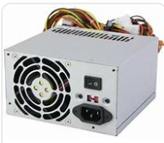
Internal Computer Hardware
C
S
The power supply unit (PSU) provides electricity to components in the device.
8.1.5

Slide 42
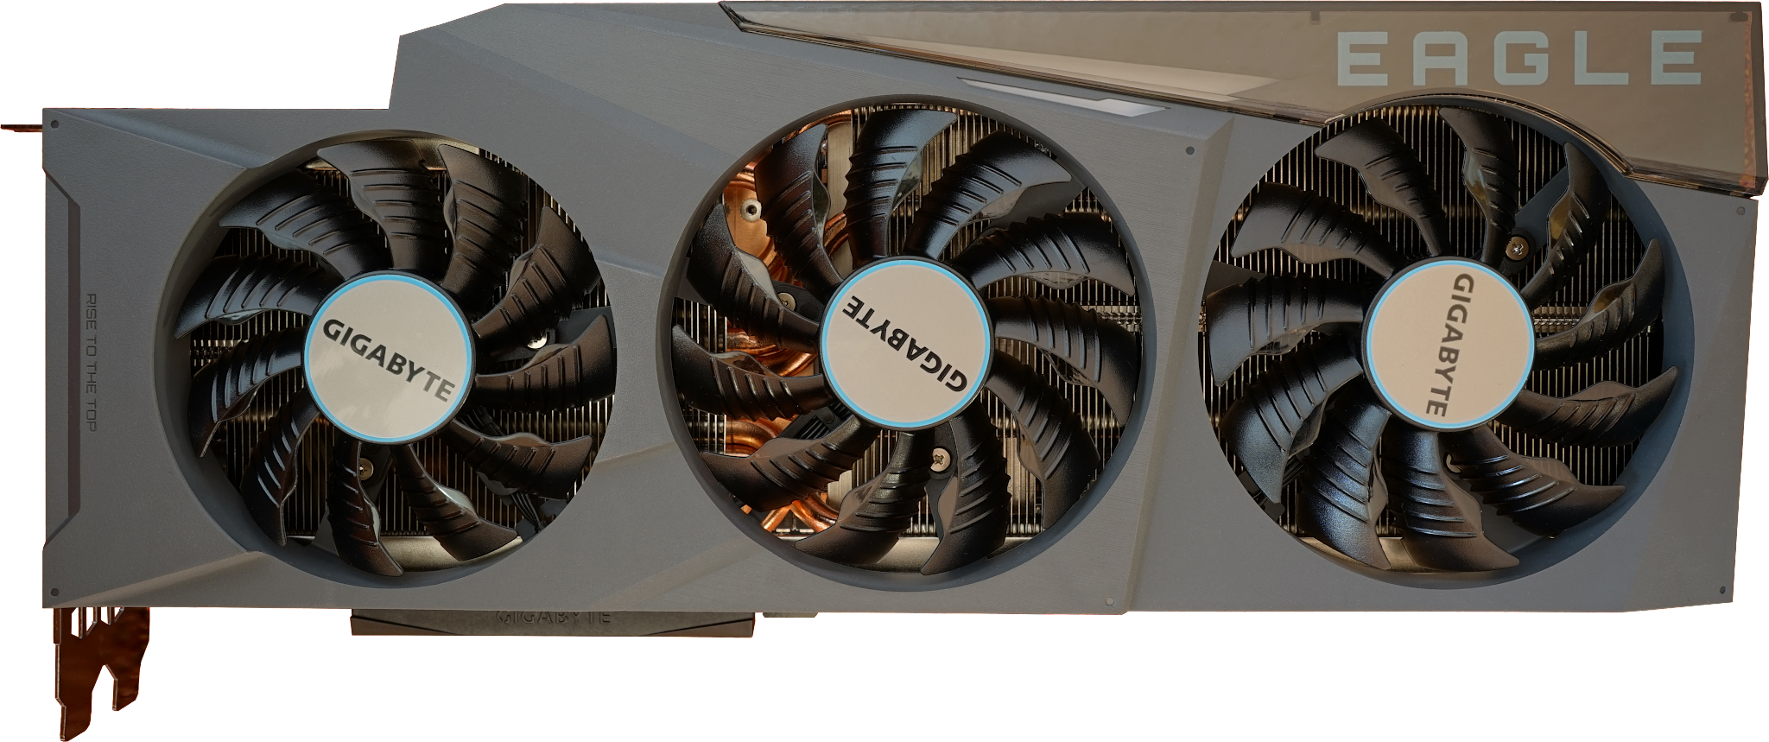
Internal Computer Hardware
C
S
A computer fan is used to cool down the insides.
8.1.5

Slide 43
C
S
External Computer Hardware
Wired and Wireless Devices
I/O Devices
Input Devices
Output Devices
8.1.5

Slide 44
External Computer Hardware
C
S
External hardware refers to devices that are attached to a computer system.
8.1.5

Slide 45
External Computer Hardware
C
S
Some devices are wired, they connect to a computer with a cord.
Some devices are wireless, they connect to a computer by transmitting a signal.
8.1.5

Slide 46
External Computer Hardware
C
S
Some external devices are also called peripheral or I/O (Input/Output) Devices.
8.1.5

Slide 47
External Computer Hardware
C
S
I/O (Input/Output) Devices
Input devices get data into the computer.
Output devices allow you to retrieve, see or hear results.
8.1.5

Slide 48
External Computer Hardware
C
S
Input Devices
mouse
keyboard
joystick
microphone
digital camera
webcams
8.1.5

Slide 49
External Computer Hardware
C
S
An input device is any device that lets you get data into to a computer.
8.1.5

Slide 50
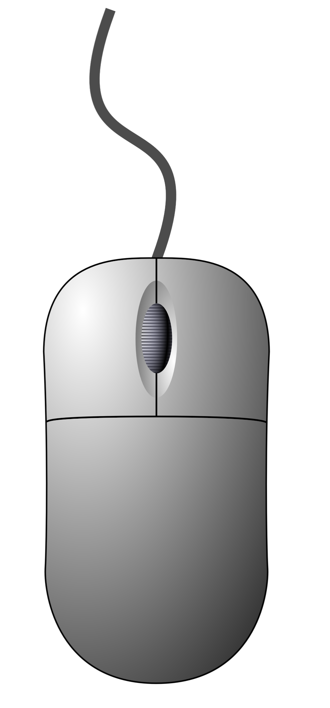
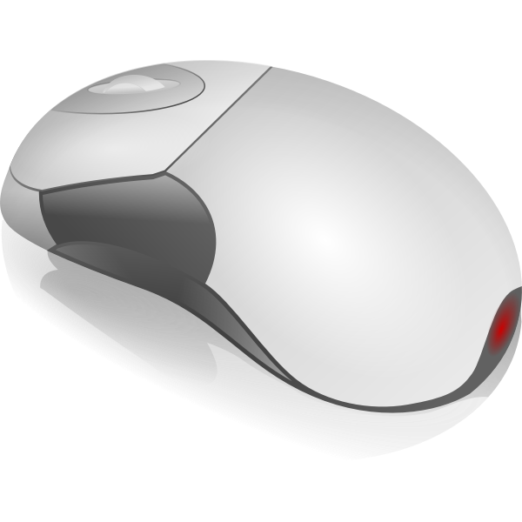
External Computer Hardware
C
S
A mouse is an input device that let’s navigate (or move) around the screen and provide instructions. Some mouse are wired and some are wireless.
Wired mouse
8.1.5
Wireless mouse

Slide 51
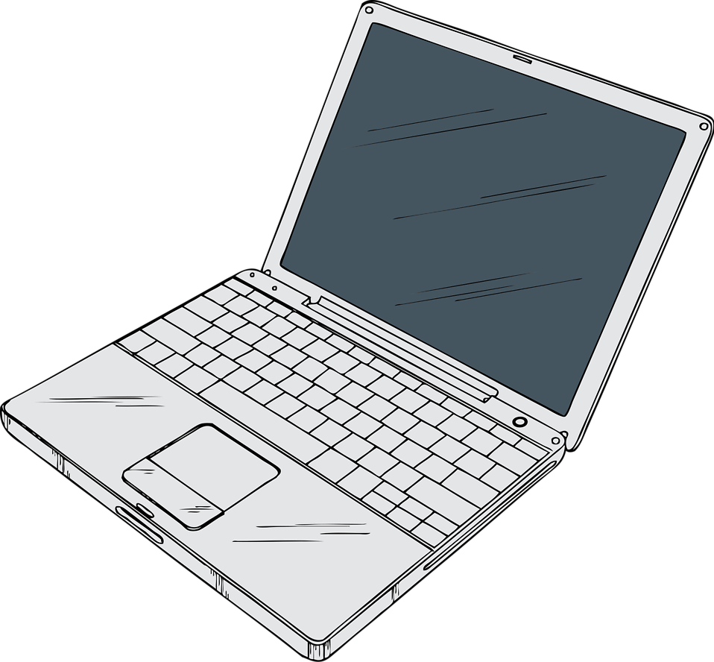
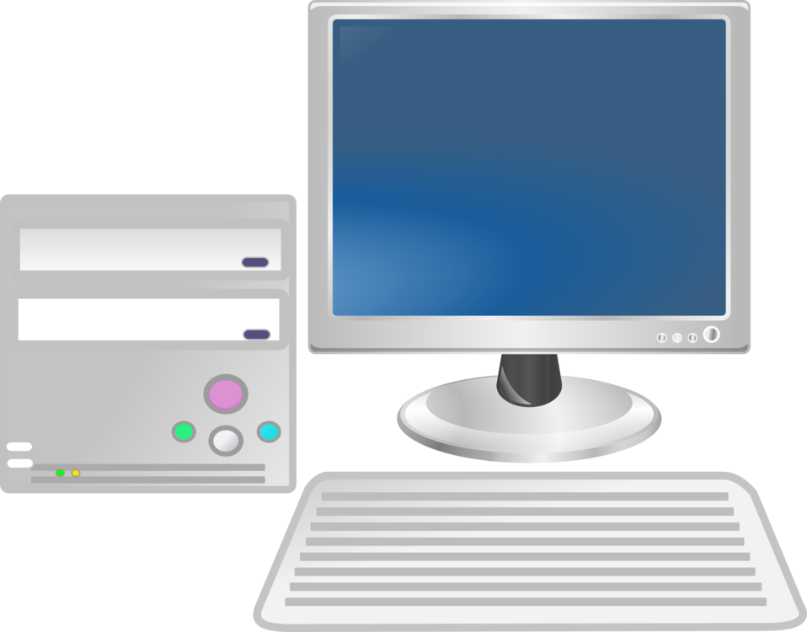
External Computer Hardware
C
S
A keyboard is an input device that lets you insert text, numbers, symbols, and commands. Some keyboards are built into your device and some keyboards are wired or wireless.
keyboard
8.1.5

Slide 52
External Computer Hardware
C
S
A joystick is an input device that lets you navigate (move around) a screen while playing online games.
8.1.5

Slide 53
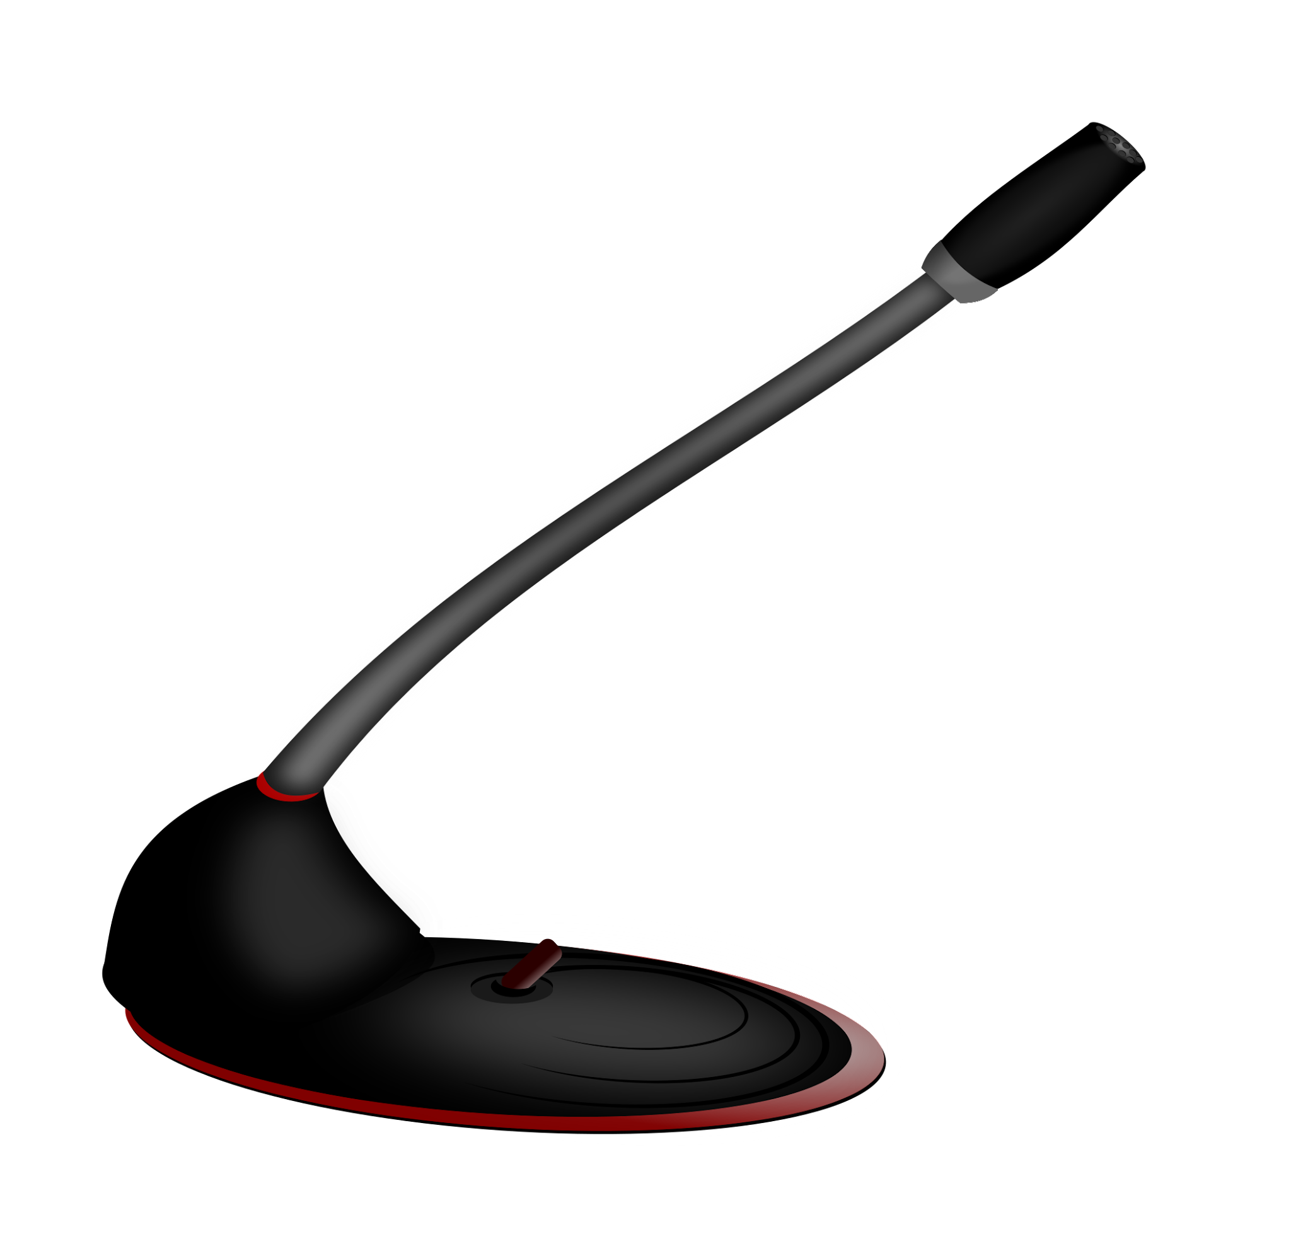
External Computer Hardware
C
S
A microphone is an input device that lets you record sounds like your voice. Some microphones are built into the device, some are wired and some are wireless.
8.1.5

Slide 54
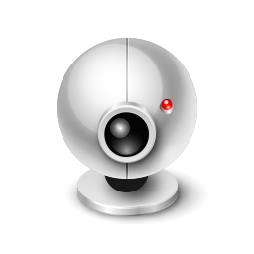
External Computer Hardware
C
S
A digital camera and webcam are input devices that lets you take pictures that can be stored on your computer.
Some cameras are built into the computing device and some are attached.
8.1.5

Slide 55
External Computer Hardware
C
S
Output Devices
monitors
speakers
headphones
printers
projectors
8.1.5

Slide 56
External Computer Hardware
C
S
An output device allow you to retrieve (or get) information from the computer. Some output devices are wired and some are wireless (without wires).
8.1.5

Slide 57
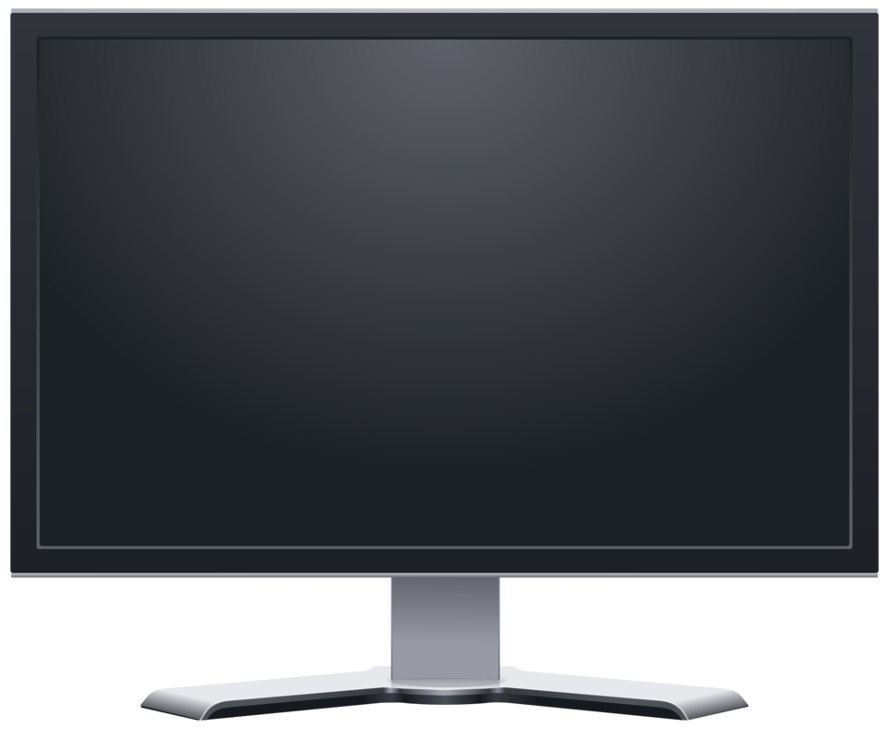
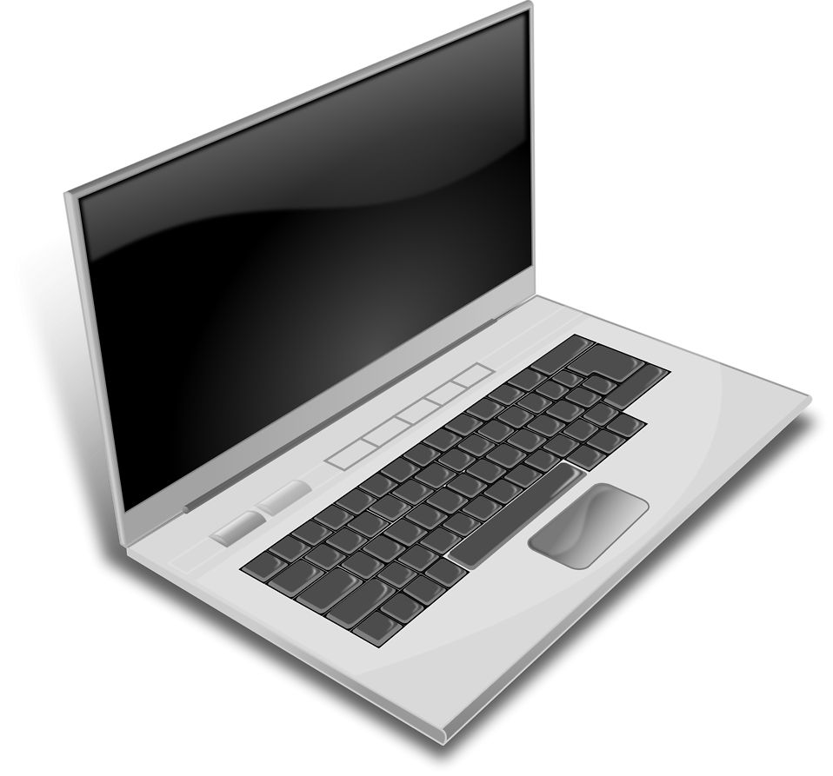
External Computer Hardware
C
S
A monitor (screen) is an output device like allows you to see information. Some screens are built-in and some are connected, wired or wireless.
8.1.5
screen or monitor

Slide 58
External Computer Hardware
C
S
A speaker is an output device that allows you to hear sound. Some speakers are built into the device and some are attached, wired or wirelessly.
8.1.5

Slide 59
External Computer Hardware
C
S
Headphones are an output device that is placed over your ears to hear sound. Some headphones are wired and some are wireless.
8.1.5

Slide 60
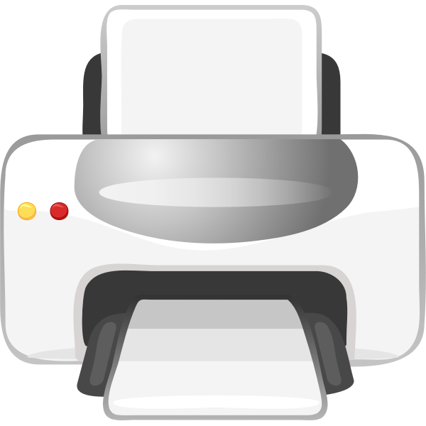
External Computer Hardware
C
S
A printer is an output device that allows you to get a hard copy or printout of your information. Some printers are wired some are wireless.
Guide dogs serves humans in many ways. In addition to being a companion animal, they can alert people to the presence of danger.
8.1.5

Slide 61
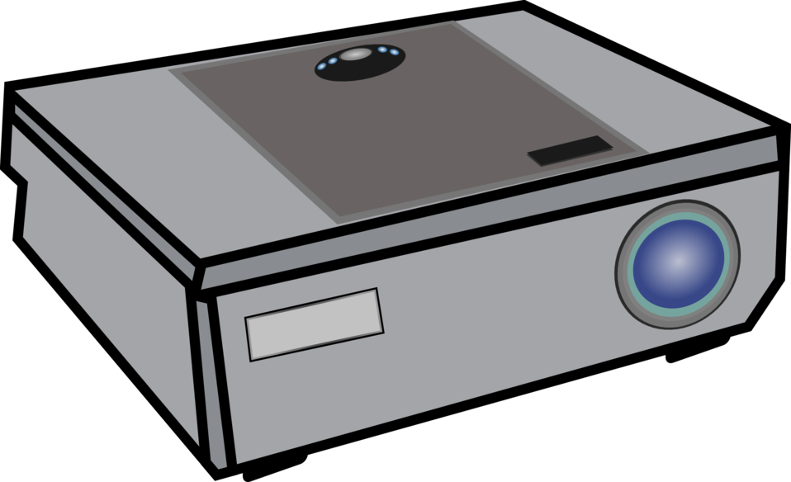
External Computer Hardware
C
S
A projector is an output device that allows you to display images or video on a much larger screen.
8.1.5

Slide 62
C
S
Computer Software
8.1.5

Slide 63
Other names are software programs?
Computer Software Programs
C
S
software;
software application; or
apps
8.1.5

Slide 64
Computer Software Programs
C
S
Software program or app, is a set of instructions that allow the computer to perform an operation or task.
8.1.5

Slide 65
Computer Software Programs
C
S
Software program are categorized or grouped according to the type of tasks they perform. The three main ones we use are:
System Software
Operating Software
Drivers
Applications Software
8.1.5

Slide 66
C
S
System Software
Control and coordinate the procedures and functions of computer hardware.
8.1.5

Slide 67
C
S
Operating Software
Converts user instructions into code that the computer can understand and vice versa.
8.1.5

Slide 68
C
S
Operating Software
A driver, or device driver, is a set of files that tells a piece of hardware how to function by communicating with a computer's operating system. All pieces of hardware require a driver.
8.1.5

Slide 69
C
S
Applications Software
Programs created to complete specific tasks.
8.1.5

Slide 70
C
S
We will focus on learning about application software programs.
8.1.5

Slide 71
Computer Software
C
S
Applications Software Programs
Web Browser
Document Production
Spreadsheets
Presentation
Educational
8.1.5

Slide 72
Applications Software Programs
C
S
There are many categories of applications programs. We will focus on the four main types you use in school.
8.1.5

Slide 73
C
S
Applications Software often used in school.
Web browsers
Chrome
Safari
Apps that facilitate easy access and surfing on the internet.
8.1.5
Internet Explorer

Slide 74
C
S
Applications Software often used in school.
Document Production
Apps like MS Word and Google Docs that enable document production like book reports and essays.
8.1.5

Slide 75
C
S
Applications Software often used in school.
Spreadsheet Programs
Apps like MS Excel and Google Sheets are used to organize, analyze, and store data (numeric and text) in a tables. The tables can be changed into charts and graphs.
8.1.5

Slide 76
C
S
Applications Software often used in school.
Presentation
Apps like MS Powerpoint and Google Slides allow the visual presentation of information in the form of slides that can contain text, charts, tables, audio, video, and animation.
8.1.5

Slide 77
Applications Software often used in school.
C
S
Education Software
flocabulary.com
Educational software apps are designed for learning and practice!
ixl.com
8.1.5
typing.com

Slide 78
C
S
Web
Browsers
Apps that facilitate easy surfing of the internet like Internet Explorer and Chrome.
Apps like MS Word and Google Docs that enable document production like letters, essays, book reports, and research papers.
Document Production
Applications Software
often used in school.
Apps Like MS Powerpoint and Google Slides that allow visual presentations of information in the form of slides that incorporate text, charts, tables, audio, video, and animation.
Spreadsheet
Apps Like MS Powerpoint and Google Slides that allow visual presentations of information in the form of slides that incorporate text, charts, tables, audio, video, and animation.
Presentation
8.1.5
Apps like Typing.com and Flocabulary that are designed for learning and tutorials.
Education Software

Slide 79
C
S
Forming A Computer System
8.1.5

Slide 80
The Fetch-Execute Cycle
C
S
The fetch-execution cycle is also known
as the instruction cycle. It is the basic operational method of a device that includes:
Information (data) is received by the computer.
A determination is made on what to do with the data.
The Central Process Unit (CPU) continuously cycles through the the fetch-execute cycle.
8.1.5

Slide 81
The Fetch-Execute Cycle
C
S
The Central Process Unit (CPU) cycles through the following steps:
Fetch. The CPU collects an instruction and prepares it for decoding.
Decode. The decoder in the control unit works out (decodes) what to do with the instruction.
Execute. The Arithmetic Logic Unit (ALU) then executes decoded instructions.
Store. Send and write the results back into main memory.
8.1.5

Slide 82
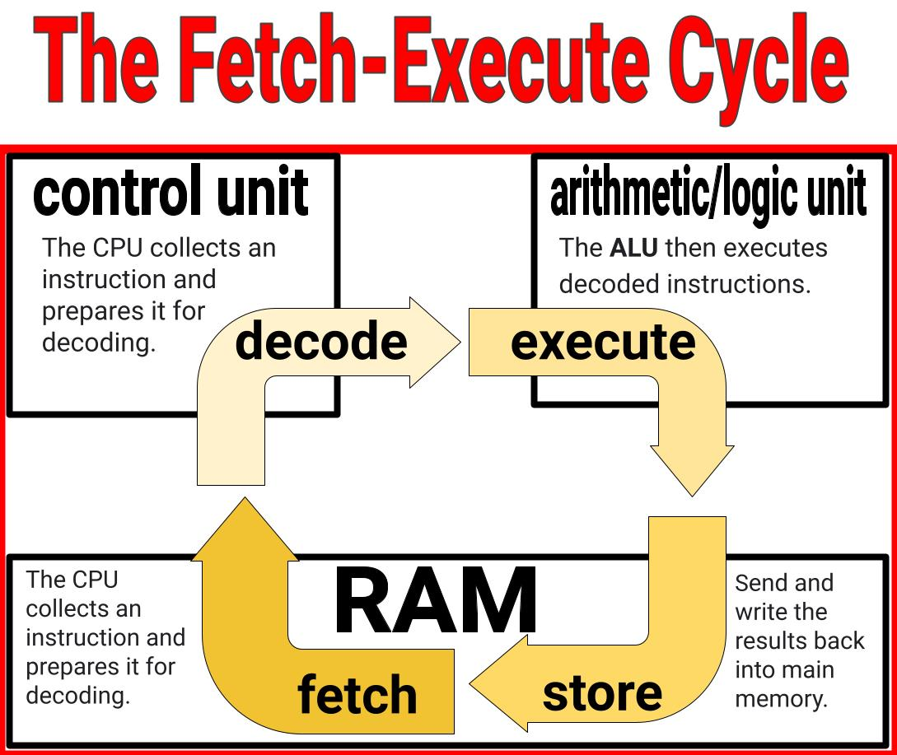
C
S
8.1.5

Slide 83
C
S
Troubleshooting
8.1.5

Slide 84
C
S
Troubleshooting
Sometimes things go wrong with a computing device. The key is not to worry! Find a trusted adult to help you! Here are some things you and a trusted adult can do.
8.1.5

Slide 85
C
S
Troubleshooting
Troubleshooting is the process of diagnosing the sources of a problem (hardware or software) then working toward solving or fixing the problem. Start with the most general possible problem and then narrow it down to a specific issue.
8.1.5

Slide 86
Troubleshooting Strategies For Grades 3-5
C
S
DON’T
PANIC!!
8.1.5

Slide 87
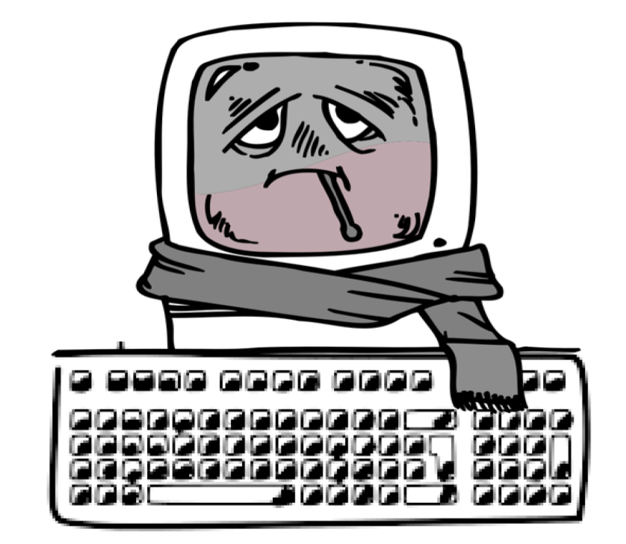
Troubleshooting Strategies For Grades 3-5
C
S
Isolation
Check for Updates
Backup Data
Built-in Diagnostic Tools
System Restore
8.1.5
Seek Professional Help

Slide 88
Resources
C
S
The Journey Inside Microprocessors
Fetch-Execute Cycle
Computer Hardware
Types of Software Programs
Different Types of Applications Software
I/O Devices
OpenAI. (2023-2024). ChatGPT (3.5)
TechTerms.com
HP What Are Computer Drivers
8.1.5

