Slide 1
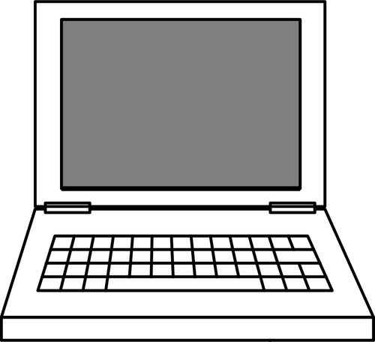
C
S
The New Jersey Student Learning Standards
Computer Science & Design Thinking
8.1.2 Computing Systems
8.1.2

Slide 2
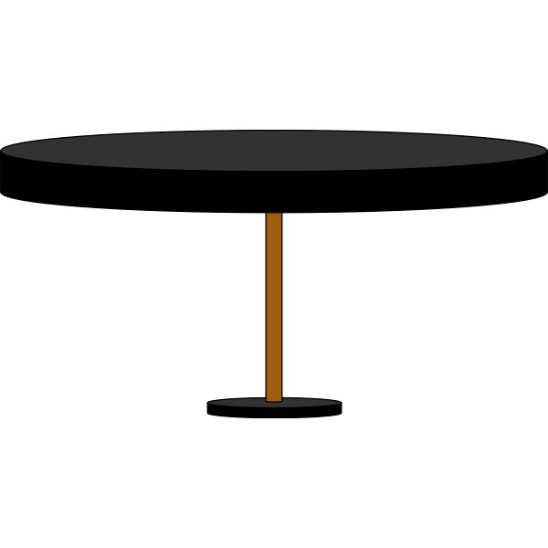
C
S
New Jersey Student Learning Standards
Technology
8.1.2.CS.1: Select and operate computing devices that perform a variety of tasks accurately and quickly based on user needs and preferences.
8.1.2.CS.2: Explain the functions of common software and hardware components of computing systems.
8.1.2.CS.3: Describe basic hardware and software problems using accurate terminology.
8.1.2

Slide 3
C
S
Core Concept 8.1.2 Computing Devices
Computing devices have physical components (hardware) and instructions (software) that allow them to communicate and process information in digital form.
People interact with a wide variety of computing devices. Some interaction are good and some are not so good.
8.1.2

Slide 4
C
S
Topics Covered
What is a Computer
What is Computer Science
What is a Computing System
Computer Hardware
Internal Hardware
External Hardware - I/O Devices
Computer Software
System Software
Operating Software
Applications Software Programs
Troubleshooting
Basic Problems
8.1.2

Slide 5
C
S
What is a Computer?
8.1.2

Slide 6
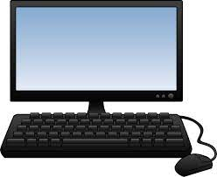
C
S
What is a Computer?
A computer is an electronic device that
collects,
analyzes (or study), and
acts upon
information we give it.
8.1.2
Page 6

Slide 7
C
S
What is Computer Science?
8.1.2

Slide 8
C
S
8.1.2

Slide 9
C
S
What is a Computing System?
8.1.2

Slide 10
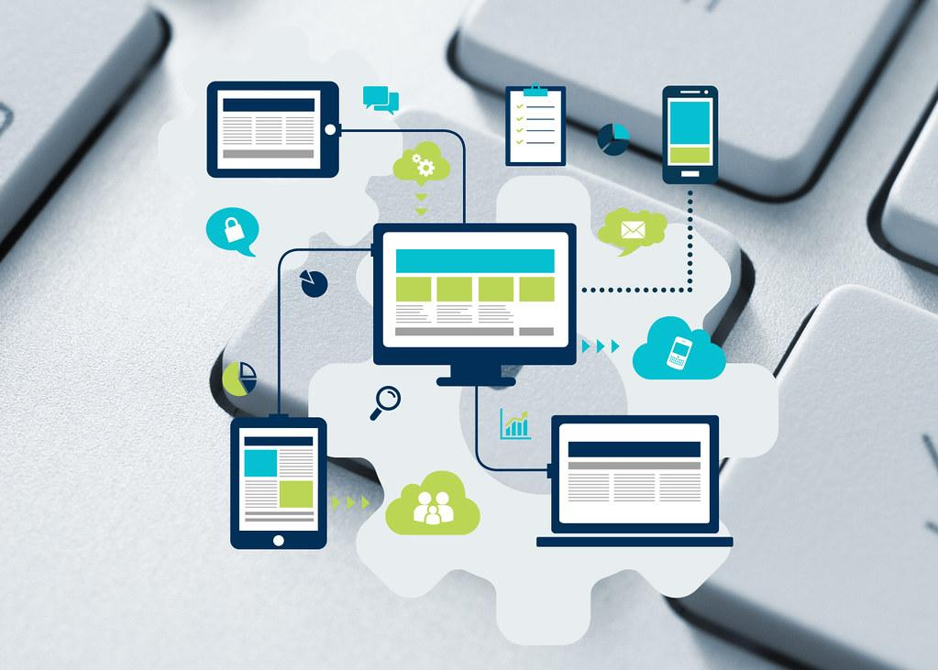
What is a Computing System?
C
S
A computing system is an arrangement (or layout) of hardware and software to
perform a computing task.
8.1.2

Slide 11
C
S
Question:
Can you name
a computing device that use in school or at home everyday?
?
?
?
?
8.1.2

Slide 12
Answer: Below is a list of some computing devices that you use at school and home.
C
S
Smart TVs
Smartwatch
Fitness Trackers
E-readers
Desktop
Laptop
Tablet
Smart phone
8.1.2

Slide 13
Types of Computing Devices
C
S
We use three different types of computing systems or devices:
stationary devices
mobile devices
wearable devices
8.1.2

Slide 14
Types of Computing Devices
C
S
Stationary devices stay in one place, like a desktop computer. You go to the device when you need to use it.
8.1.2

Slide 15
Types of Computing Devices
C
S
2. Mobile devices go with you from place to place like a laptop, tablet and smartphone in your bookbag.
8.1.2

Slide 16
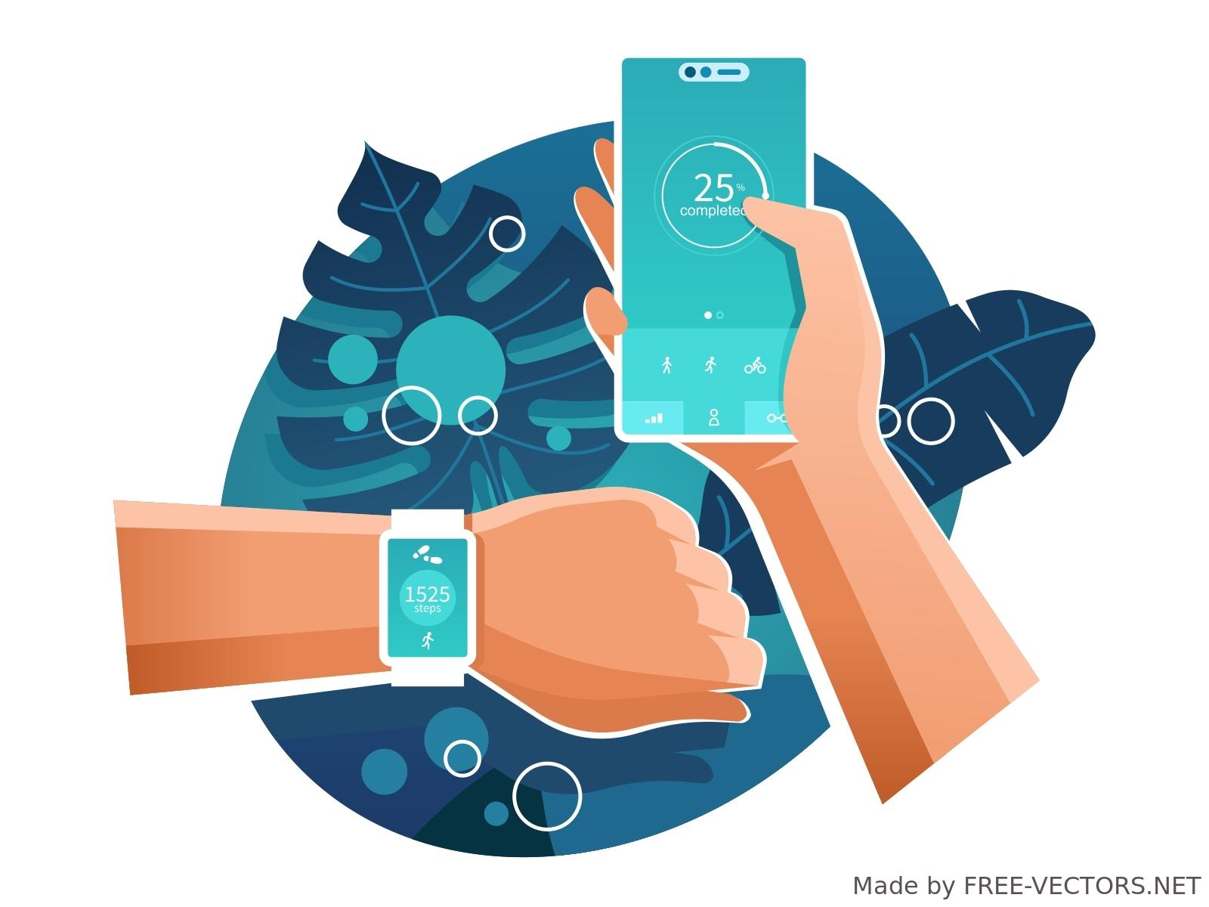
Types of Computing Devices
C
S
3. Wearable devices are worn on the human body, like a watch connected to a smartphone or fitness tracker.
8.1.2

Slide 17
Computing Devices
C
S
Some of the information we give or get from computing devices is good and helpful. Some information is not good and is not helpful.
8.1.2

Slide 18
C
S
Computer Hardware
8.1.2

Slide 19
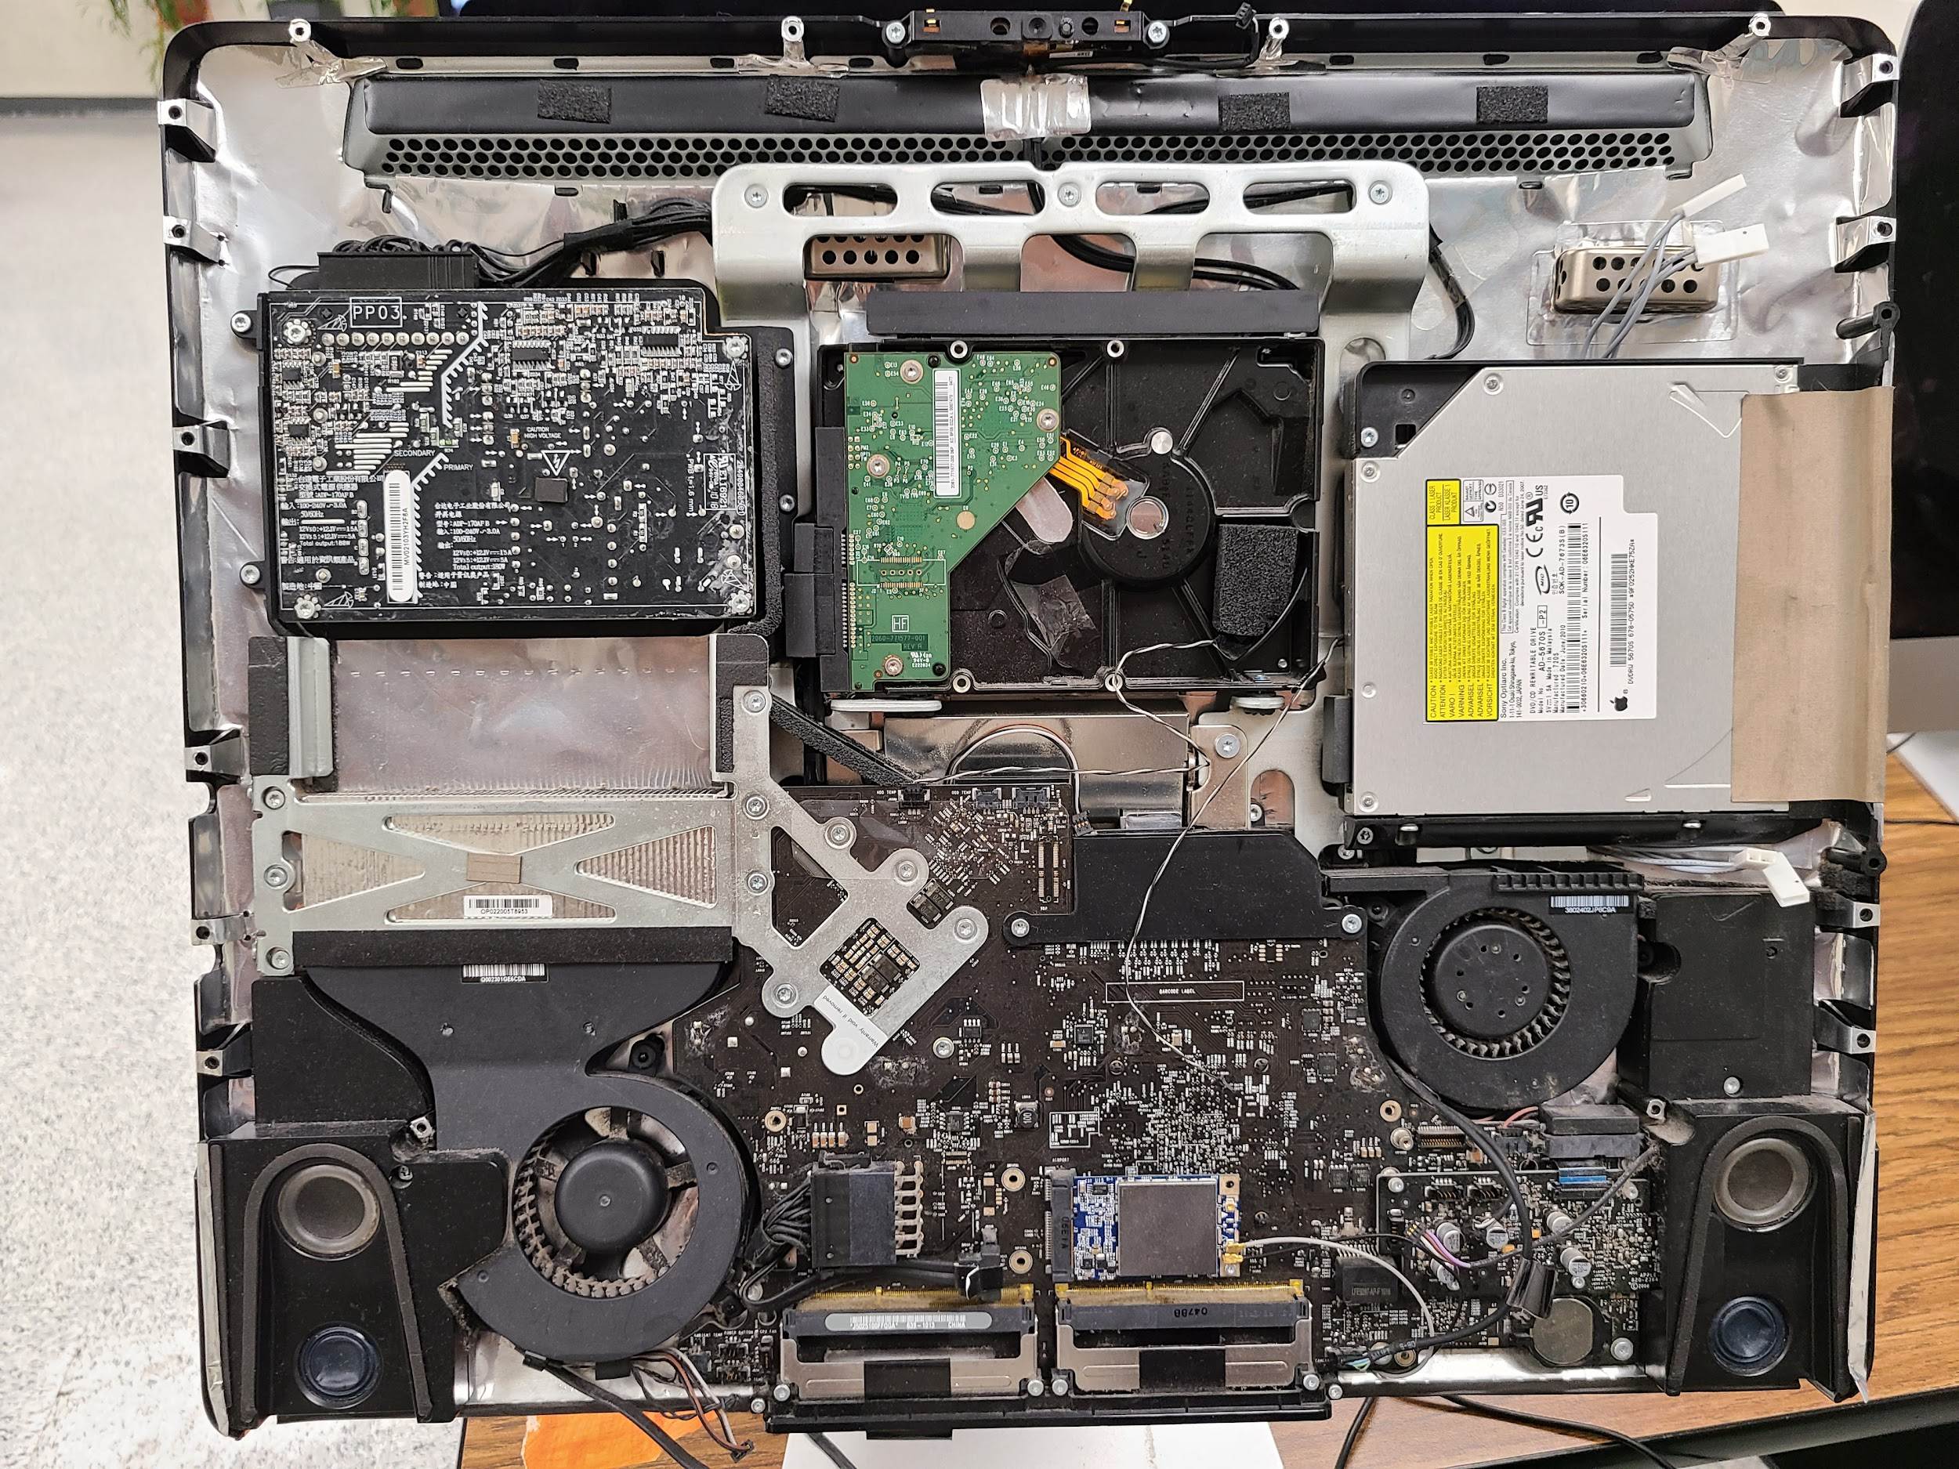
Computer Hardware
C
S
Computer hardware refers to the physical (touchable) parts and related devices that make up a computer systems.
8.1.2

Slide 20
Computer Hardware
C
S
Computers have
Internal (inside) and external (outside) components (parts).
8.1.2

Slide 21
Computer Hardware
C
S
The internal hardware parts of a computer are often referred to as components, while external hardware devices are usually called peripherals.
8.1.2

Slide 22
C
S
Internal Computer Hardware
8.1.2

Slide 23
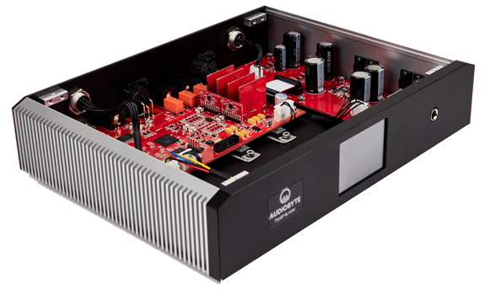
Internal Computer Hardware
C
S
Internal hardware refers to devices that are inside
the computer.
8.1.2

Slide 24
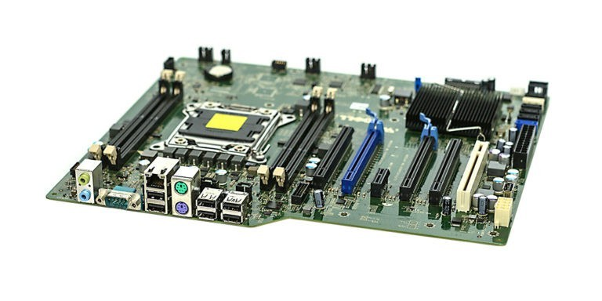
Internal Computer Hardware
C
S
The motherboard is a computer's brain.
8.1.2

Slide 25
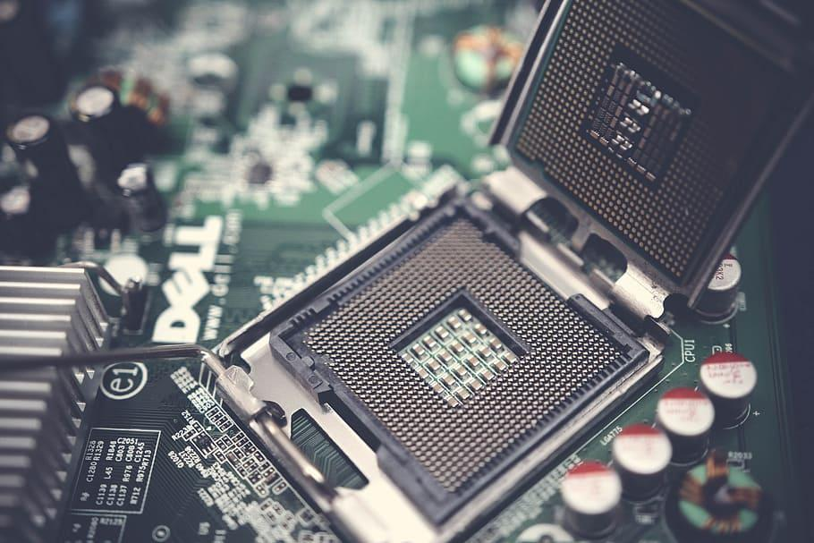
Internal Computer Hardware
C
S
The Central Processing Unit (CPU) acts like “control center”, it runs the machine's operating system and apps.
8.1.2

Slide 26
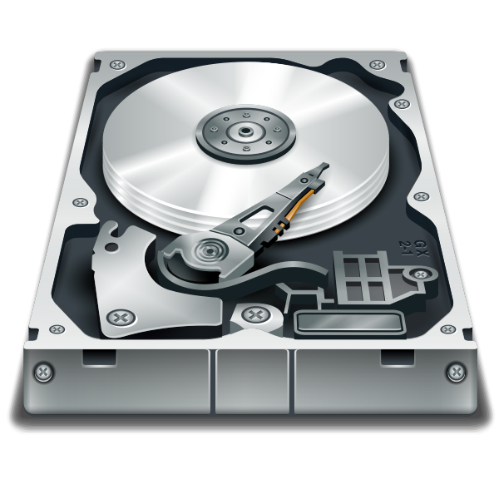
Internal Computer Hardware
C
S
A hard drive or hard disk drive (HDD) is a type of data storage device that stores data even when your device is off.
8.1.2

Slide 27
Internal Computer Hardware
C
S
Memory is the electronic holding place for the instructions and data or information the computer needs to reach quickly.
8.1.2

Slide 28
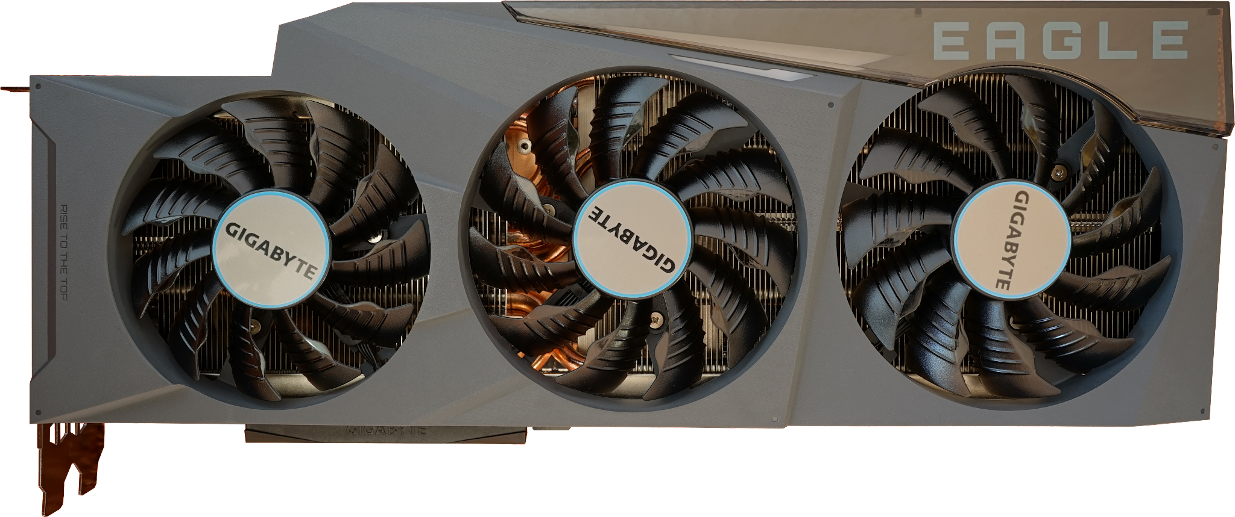
Internal Computer Hardware
C
S
A computer fan is used to cool the insides down.
8.1.2

Slide 29
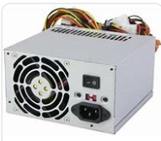
Internal Computer Hardware
C
S
A power supply unit (PSU) provides electricity.
8.1.2

Slide 30
C
S
External Computer Hardware
8.1.2

Slide 31
External Computer Hardware
C
S
External hardware refers to devices that are attached to a computer.
8.1.2

Slide 32
External Computer Hardware
C
S
Some external devices are also called peripheral or I/O (input/output) devices.
8.1.2

Slide 33
External Computer Hardware
C
S
I/O (Input/Output) Devices
Input devices get data into the computer.
Output devices allow you to retrieve, see or hear results.
8.1.2

Slide 34
C
S
External Computer Hardware
Input Devices
8.1.2

Slide 35
External Computer Hardware
C
S
An input device is any device that lets you get data into to a computer.
8.1.2

Slide 36
External Computer Hardware
C
S
Some input devices are wired. They connect to a device with a cord.
Some input devices are wireless. They connect to a device by transmitting a signal.
8.1.2

Slide 37
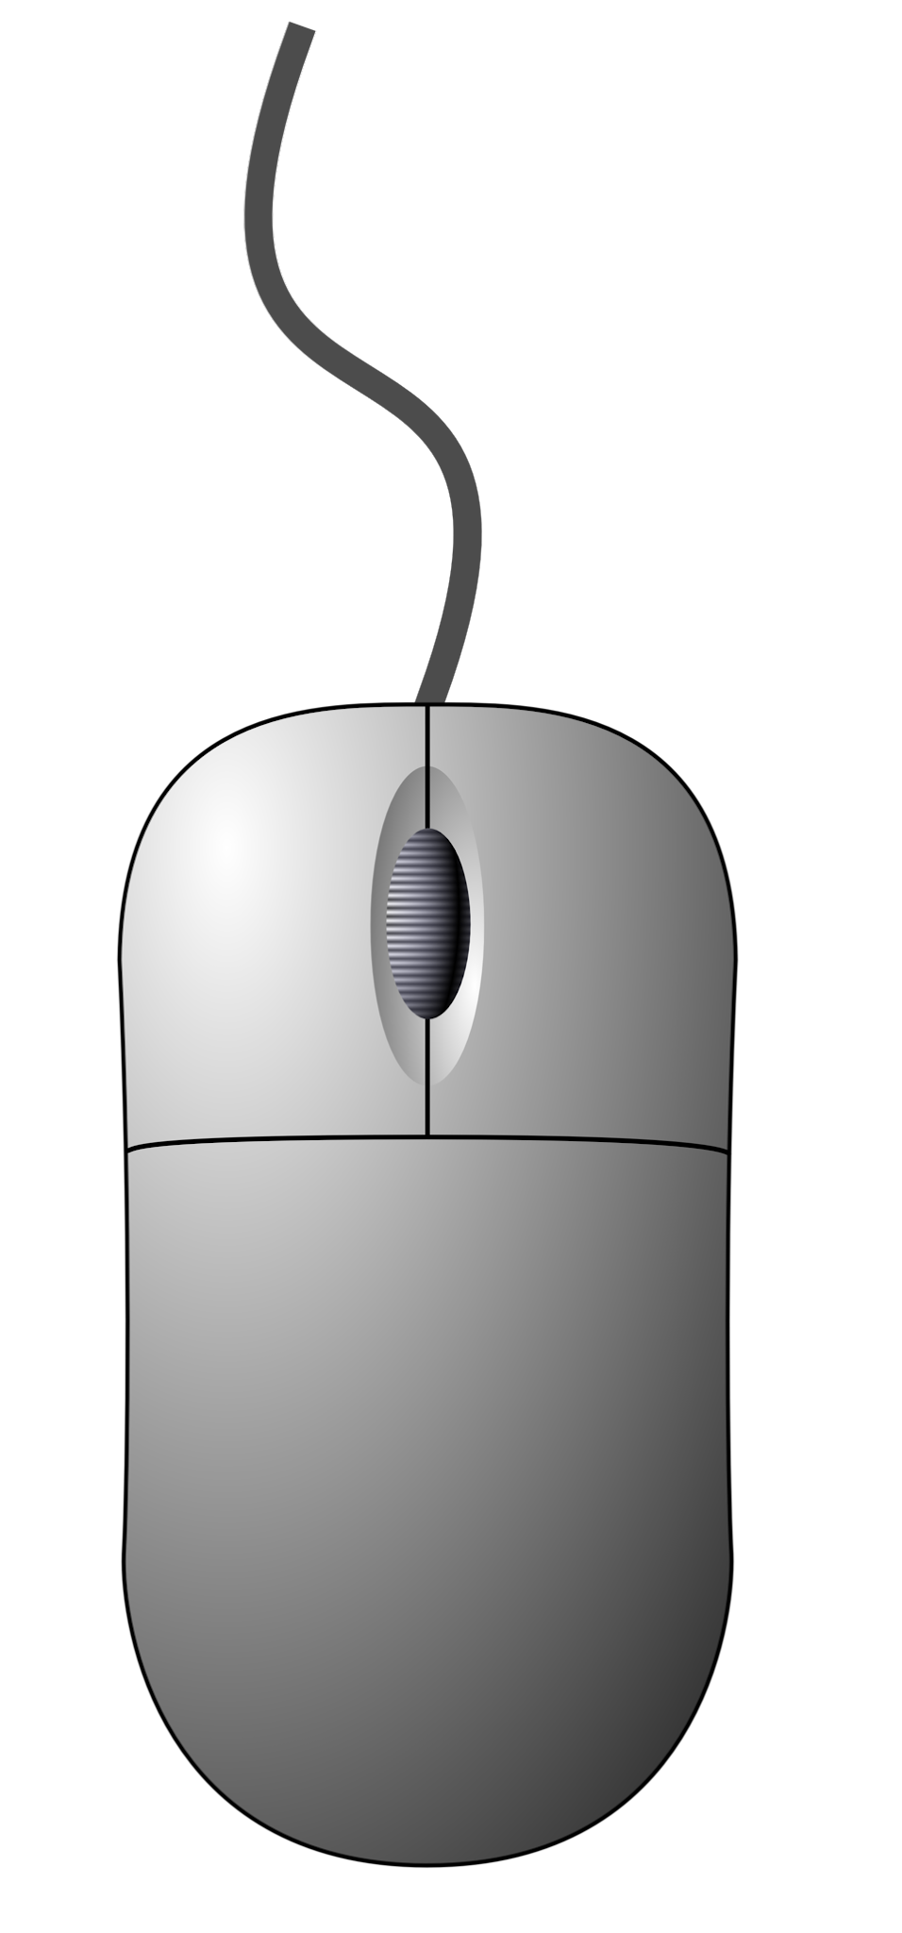
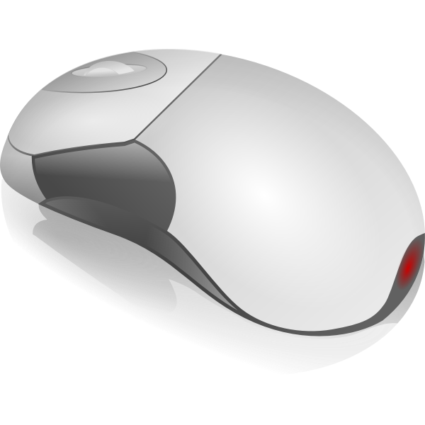
External Computer Hardware
C
S
A mouse is an input device that let’s navigate (or move) around the screen and provide instructions. Some mouse are connected with a wire to your computer and some are wireless.
Wired mouse
8.1.2
Wireless mouse

Slide 38
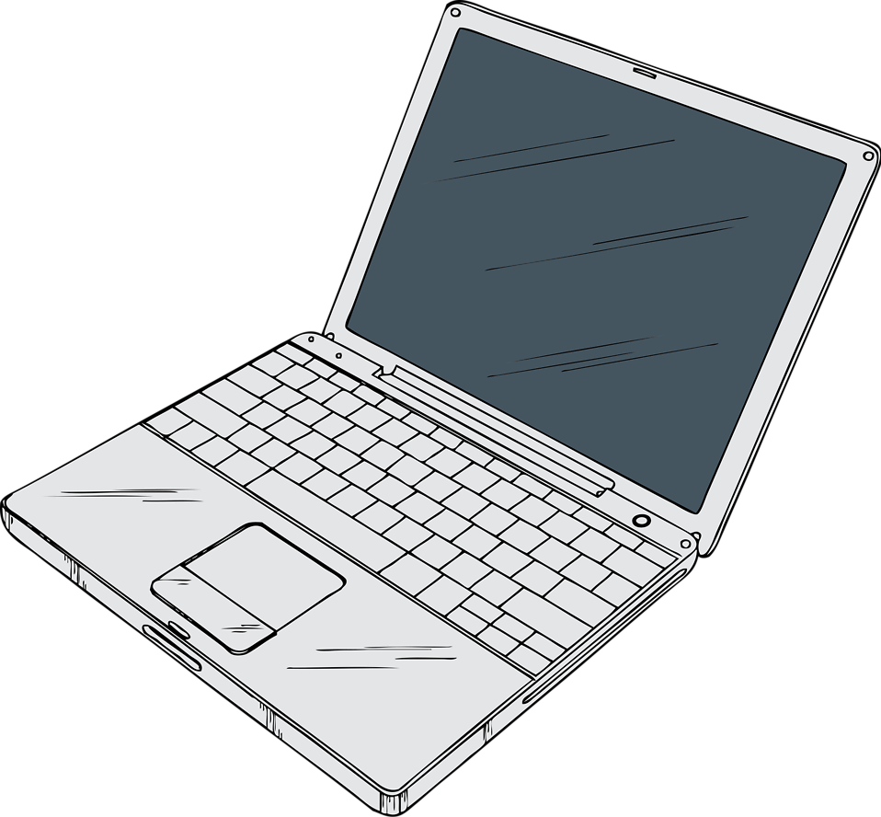
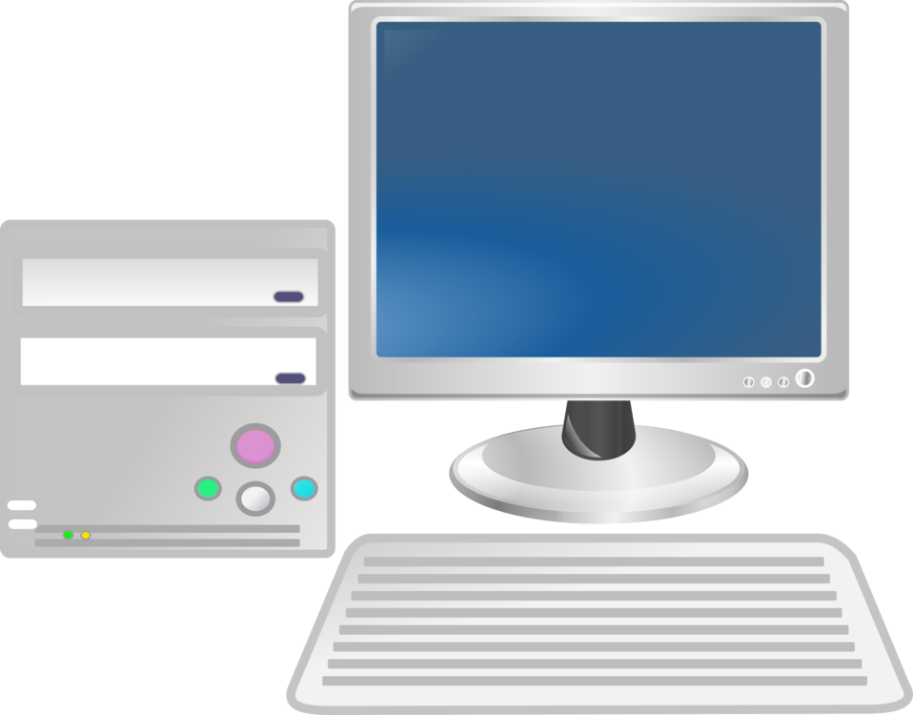
External Computer Hardware
C
S
A keyboard is an input device that lets you insert text, numbers, symbols, and commands. Some keyboards are built into your device and some keyboards are connected with a wire or without a wire, wireless.
keyboard
8.1.2

Slide 39
External Computer Hardware
C
S
A joystick is an input device that lets you navigate (move around) a screen while playing online games.
8.1.2

Slide 40
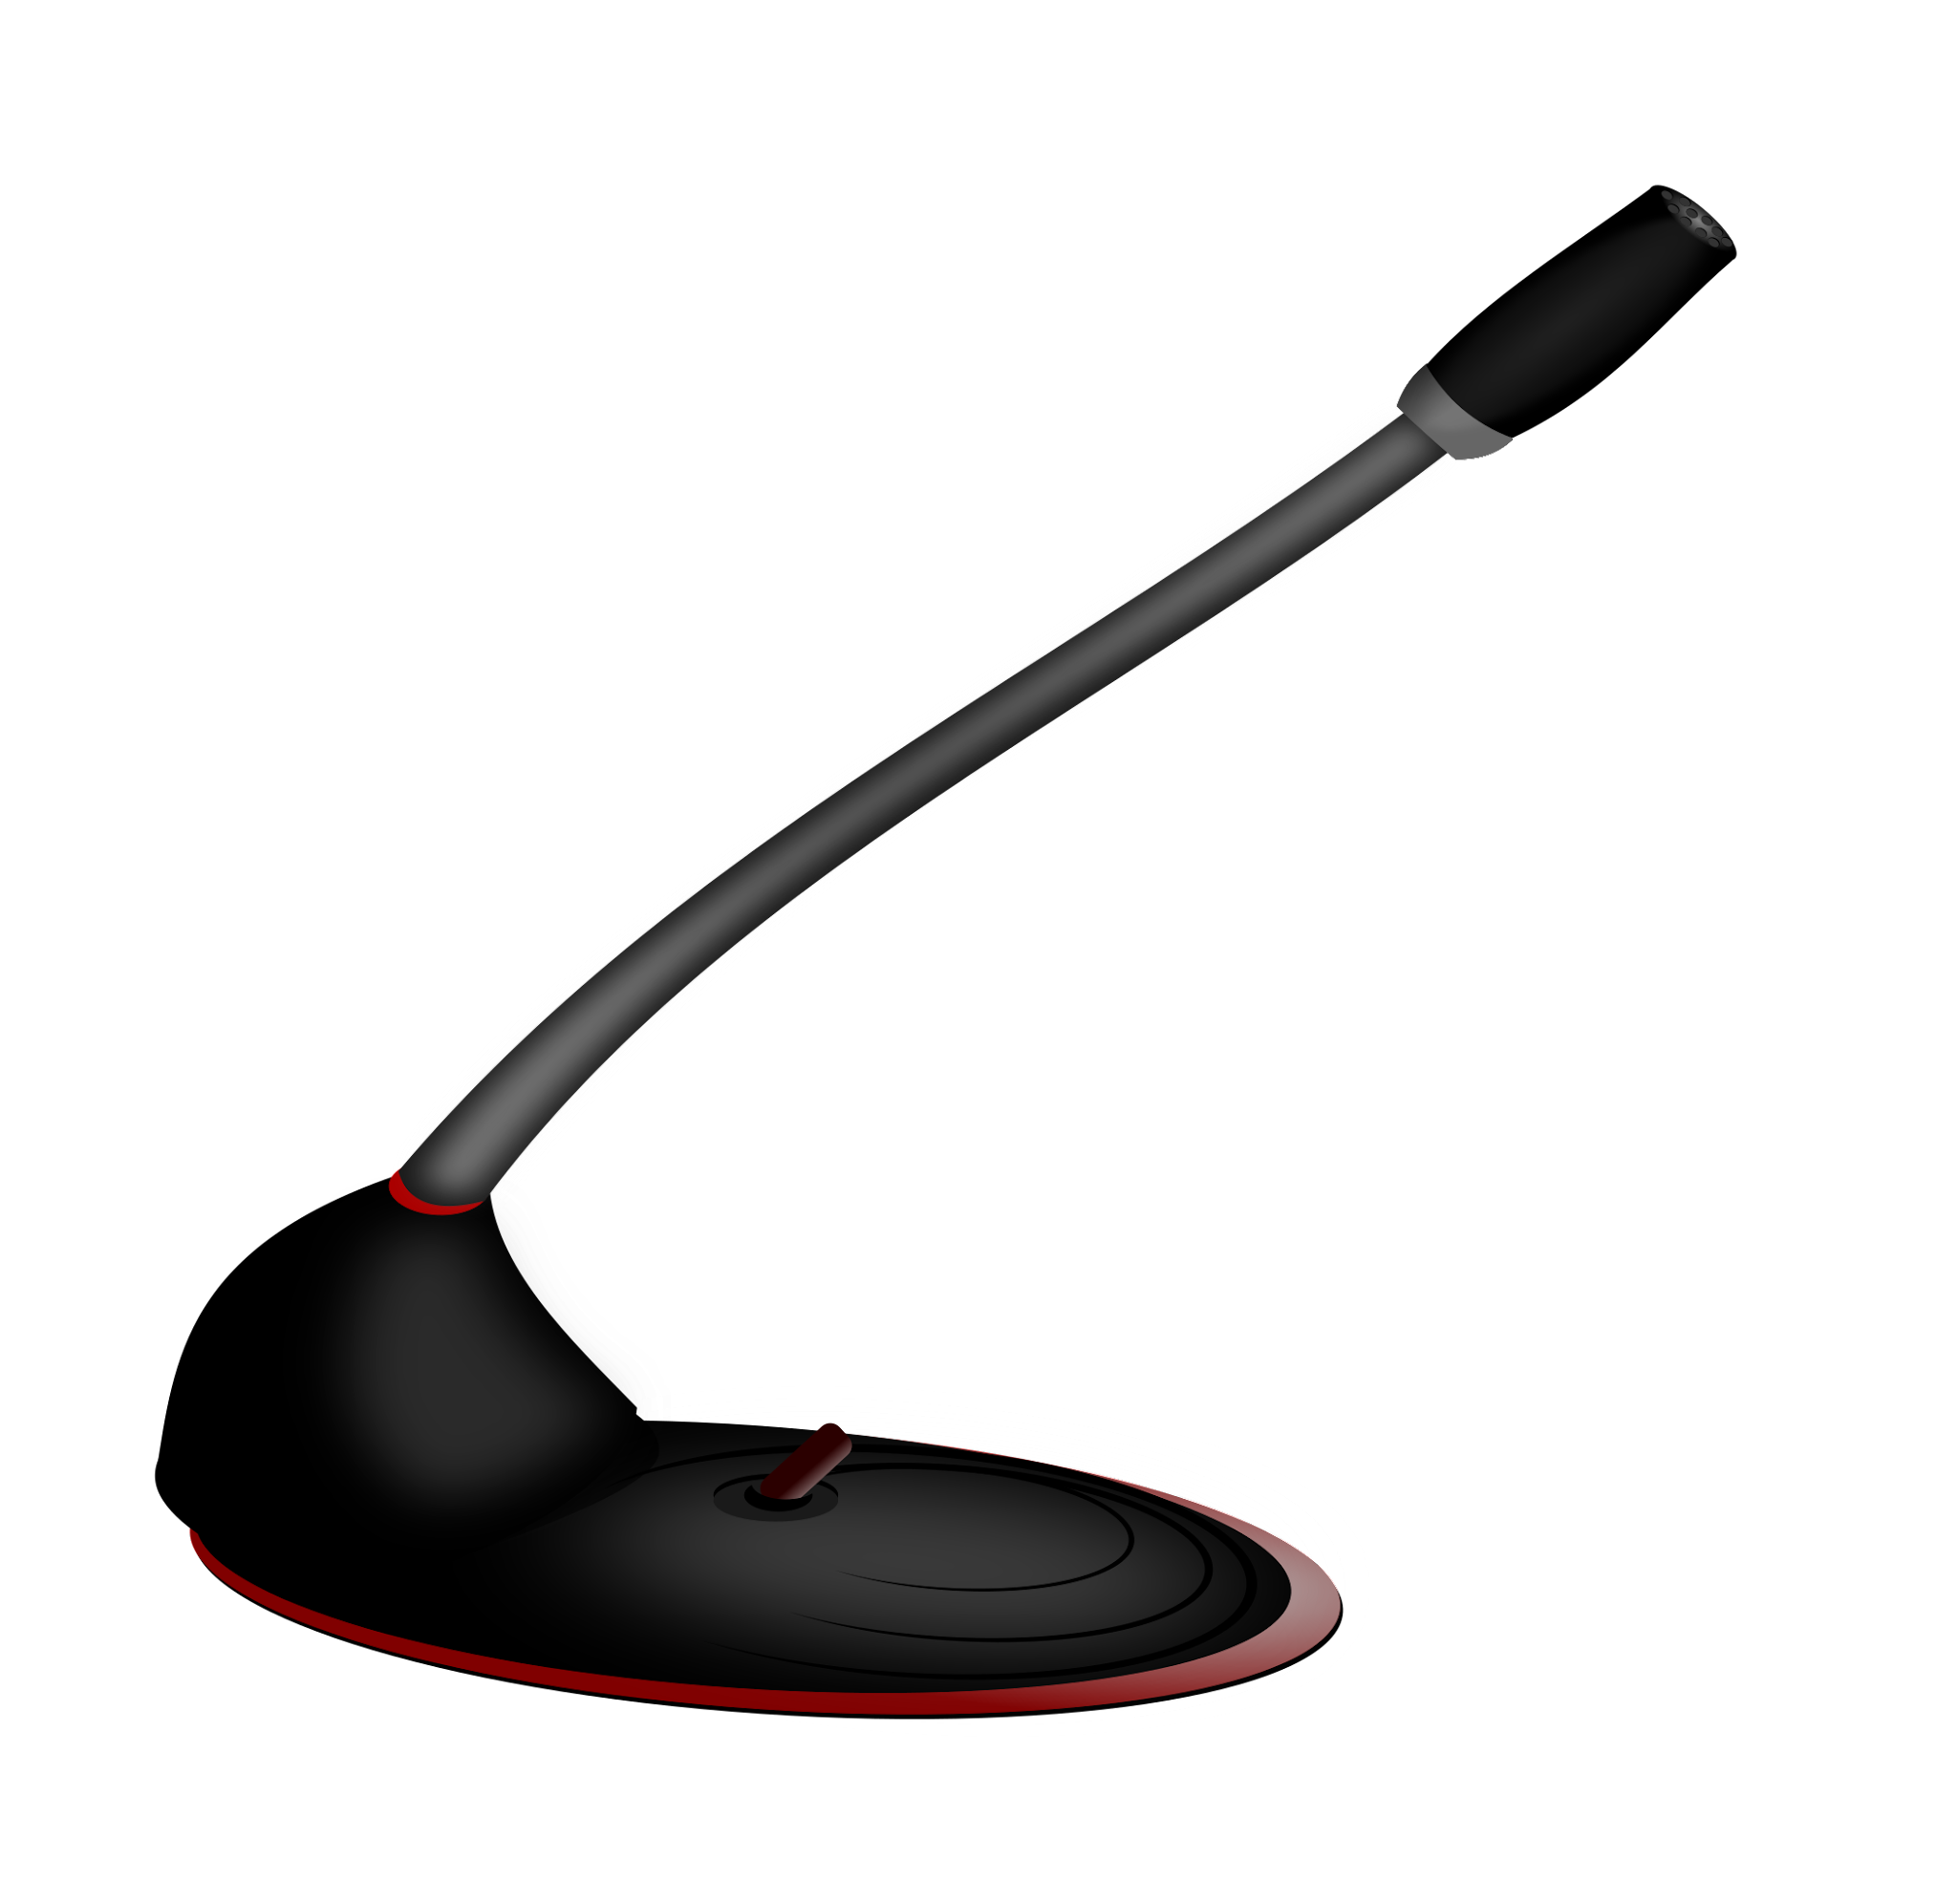
External Computer Hardware
C
S
A microphone is an input device that lets you record sounds like your voice. Some microphones are built into the device, some are wired and some are wireless.
8.1.2

Slide 41
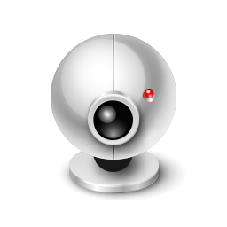
External Computer Hardware
C
S
A camera is an input device that lets you take pictures that can be stored on your computer.
Some cameras are built into the computing device and some are attached to it.
8.1.2

Slide 42
C
S
External Computer Hardware
Output Devices
8.1.2

Slide 43
External Computer Hardware
C
S
An outputs device allows you to retrieve (or get) information from the computer. Some output devices are wired and some are wireless (without wires).
8.1.2

Slide 44
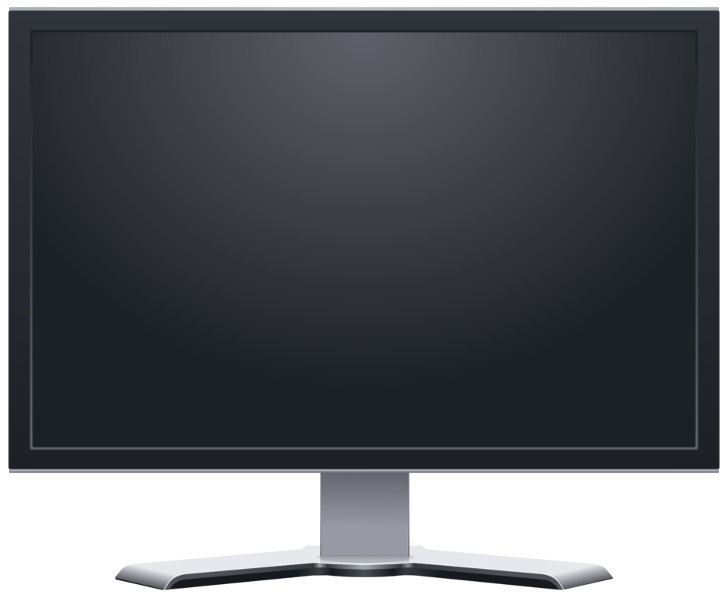
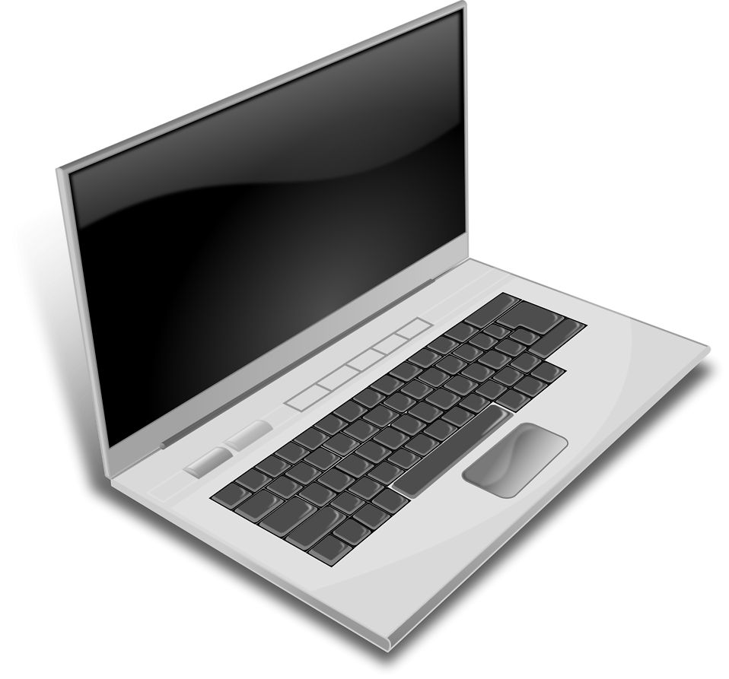
External Computer Hardware
C
S
An output device like a monitor allows you to see information on a monitor or screen.
8.1.2
screen or monitor

Slide 45
External Computer Hardware
C
S
An output device like speakers allows you to hear sound. Some speakers are built into the device and some are attached.
8.1.2

Slide 46
External Computer Hardware
C
S
An output device like headphones also allow you to hear sound. This device is placed over your ears. Some headphones are wired and some are wireless.
8.1.2

Slide 47
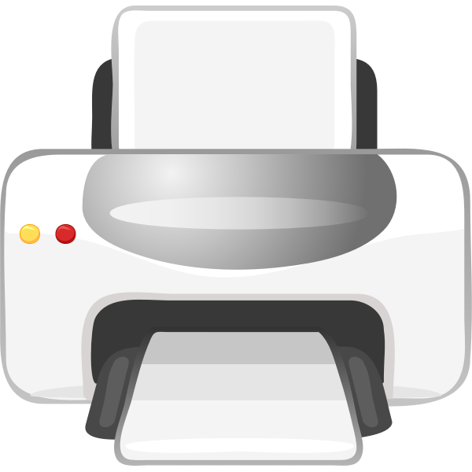
External Computer Hardware
C
S
An output device like a printer allows you to get a hardcopy or printout of your information. Some printers are wired to the computer and some are wireless.
Guide dogs serves humans in many ways. In addition to being a companion animal, they can alert people to the presence of danger.
8.1.2

Slide 48
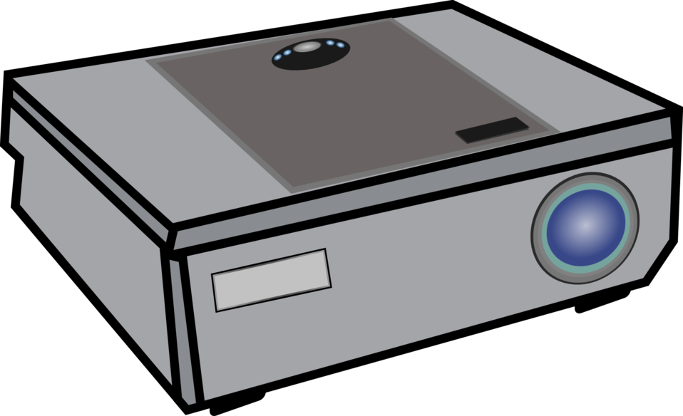
External Computer Hardware
C
S
An output device like a projector allows you to display images or video to a much larger screen.
8.1.2

Slide 49
C
S
Computer Software
8.1.2

Slide 50
What are software programs?
Computer Software Programs
C
S
software programs;
software;
software application; or
apps
8.1.2

Slide 51
Computer Software Programs
C
S
Software program or app, is a set of instructions that allow the computer to perform an operation or task.
8.1.2

Slide 52
Computer Software Programs
C
S
Software program are categorized or grouped according to the tasks they perform. The three main ones we use are:
System software
Operating Software
Applications Software
8.1.2

Slide 53
C
S
System Software
Control and coordinate the procedures and functions of computer hardware.
8.1.2

Slide 54
C
S
Operating Software
Converts user instructions into code that the computer can understand and vice versa.
8.1.2

Slide 55
C
S
Applications Software
Programs created to complete specific tasks.
8.1.2

Slide 56
C
S
Computer Software
Applications Software Programs
8.1.2

Slide 57
Applications Software Programs
C
S
There are many categories of of applications programs. The four main types of programs you use in school are:
Web Browser
Document Production
Presentation
Educational
8.1.2

Slide 58
C
S
Applications Software often used in school.
Web browsers
Chrome
Safari
Apps that facilitate easy surfing of the internet.
8.1.2
Internet Explorer

Slide 59
C
S
Applications Software often used in school.
Document Production
Apps like MS Word and Google Docs that enable document production like book reports and essays.
8.1.2

Slide 60
C
S
Applications Software often used in school.
Presentation
Apps like MS Powerpoint and Google Slides allow the visual presentation of information in the form of slides that can contain text, charts, tables, audio, video, and animation.
8.1.2

Slide 61
Applications Software often used in school.
C
S
Education Software
flocabulary.com
Educational software apps are designed for learning and practice!
ixl.com
8.1.2
typing.com

Slide 62
C
S
Apps that facilitate easy surfing of the internet like Internet Explorer and Chrome.
Web browsers
Apps like MS Word and Google Docs that enable document production like letters, essays, book reports, and research papers.
Applications Software
often used in school.
Document Production
Apps Like MS Powerpoint and Google Slides that allow visual presentations of information in the form of slides that incorporate text, charts, tables, audio, video, and animation.
Presentation
8.1.2
Apps like Typing.com and Flocabulary that are designed for learning and tutorials.
Education software

Slide 63
C
S
Troubleshooting
Sometimes things go wrong with a computing device. The key is not to worry! Find a trusted adult to help you! Here are some things you and a trusted adult can do.
8.1.2

Slide 64
C
S
Troubleshooting
8.1.2

Slide 65
C
S
8.1.2

Slide 66
C
S
8.1.2

Slide 67
C
S
8.1.2

Slide 68
C
S
8.1.2

Slide 69
C
S
8.1.2

Slide 70
C
S
8.1.2

Slide 71
C
S
8.1.2

Slide 72
Resources
C
S
Computer Hardware
Types of Software Programs
Different Types of Applications Software
I/O Devices
OpenAI. (2023-2024). ChatGPT (3.5) Retrieved from https://www.openai.com/
TechTerms.com
8.1.2

