Slide 1
Grade 6-8
Computer Science Education Primer
Katherine G. Herbert, Ph.D.
Director, Montclair Computer Science Education Hub
Sumi Hagiwara, Ph.D.
Director, Montclair Computer Science for Everyone Everywhere Program.

Slide 2
Introduction

Slide 3
Schedule - Tentative (we may run over on sections but we will be out by 3:00pm)
9:00am - 9:05am - Welcome
9:05am - 9:15am - NJDOE Required Data Collection
9:20am - 10:30am - Basics of Computer Science
10:20am - 10:30am - Break
10:30am - 11:15am - Computer Systems
11:15am - 12:00am - Networks and the Internet
11:45am - 12:30pm - Working Lunch - Pedagogy and CS Education
12:30pm - 1:15pm - Data and Analysis
1:15pm - 2:30pm - Algorithms and Programming (please take break on your own during programming)
2:30pm - 3:00pm - Impacts of Computing

Slide 4
Community of Learners
Styles we adopt in this session …
We are friendly and hopefully building friendship - please welcome people - especially singletons who you do not know to your table - and feel free to use first names.
We are Inclusive and try to design for UDL.
We are Positive - everyone has a voice, perspective and contribution to give.
We try to Laugh - this is a long day with a lot of content we may not have ever seen before so we are going to try to have fun.
We Accept there is no one authority or expert in the room - everyone has human moments and we support each other through them.
We are Safe - personal stories should stay here unless you have the express permission of the person.

Slide 5
Today will be …
Jammed - packed - while we will take short breaks please feel free to give yourself breaks as we go along.
Fun
Address Some of Your Questions
Inspire New Questions
Frustrate You - In a Good Way
Be a “Springboard” for you to Explore the Standards

Slide 6
Today will not be …
Complete and exhaustive and you will have a perfect understanding of everything computing by the end of these lessons
You will not have a complete understanding of CS or the Standards but you will be in a better position to begin your journey.

Slide 7
Data Collection
Please Please Please fill out your Pre-Survey Data If you don’t … we will find you!!!
Places to get the Pre-Survey Data:
Best: Your District Content Management Systems like Genesis, LinkIt!, or other places where you grade and get student information.
Better: New Jersey School District Performance Reports
https://rc.doe.state.nj.us/
Okay and Acceptable: National Center for Education Statistics IPEDS
https://nces.ed.gov/ipeds

Slide 8
Theme for 6-8 Computer Science Education
When we look at CS for 6-8, it is continuing on building on the 3-5 CS Education. K-2 it is about identifying things that we see in everyday life and trying to put the formal words (terminology) to the things we see. Grades 3-5 looks at trying to understand the whys of CS, while K-2 is about the whats. Grades 6-8 try to take those why and explain them more, building on problem solving skills and connecting computing to larger concepts in society
It is about trying to observe the patterns we are encountering and apply them to other areas - a lot of abstraction.
When considering the standards for 6-8, a lot of the standard is identifying things and finding patterns:
Vocabulary
How do we use things? Why are they used in that way?
What problems do we encounter?
How can we fix these problems?
What am I feeling, and how can I work through those feelings to find solutions?
With 6-8, keep it short, simple, as kinesthetic as possible (make them move and use sensory oriented techniques), help them to identify their emotions and work through them, and try to have fun.
Try to avoid keeping them solely on the computer for programming exercises.

Slide 9
Computer Science
an Overview for Teachers

Slide 10
Computer Science Definition
What is Computer Science?
Computer Science is the study of the generation, storage, transportation, and manipulation of data.
In the classification of sciences, computer science is a FORMAL SCIENCE - a science like how mathematics and physics are defined as a science.
Other types of sciences besides Formal Sciences: Natural Science, Social Science, Applied Science and Interdisciplinary Sciences.
Computational Thinking is part of the mindset for Computer Science and helps us with problem solving.
Computer Science for Everyone, Everywhere (CSEE)

Slide 11
Data
So if data is so central to computing, what is data?
Data is “something” that holds meaning for the human-user that the computer will do an action on. Note - there is no truth value on this other than the importance to the user. it is often the codes used to represent those somethings to a user.
Data can be interpreted into Information. Information is the meaning the user imposes on the data.
Information can be analyzed for Knowledge. Knowledge is the observable patterns within the information that we can measure with a level of confidence.
Knowledge that we can apply reliably is Wisdom (we don’t often talk about that ;-) )

Slide 12
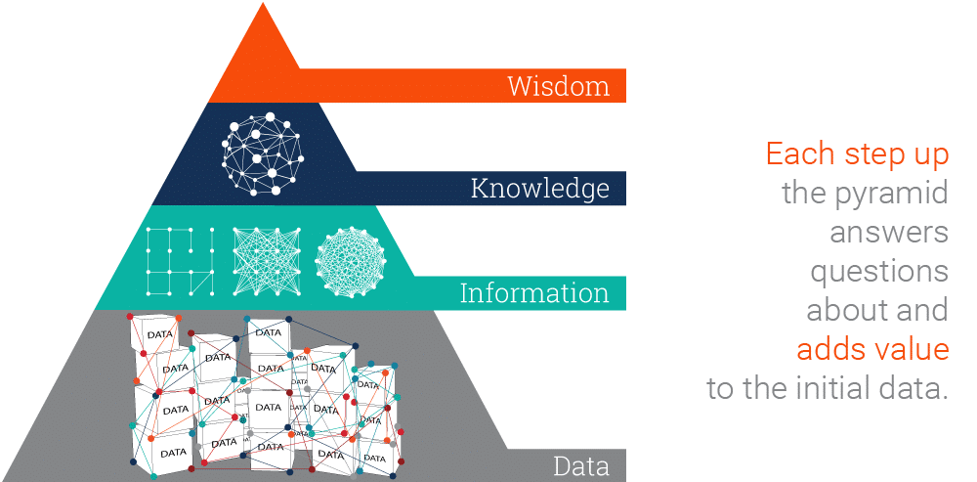
Data
Image source: https://www.ontotext.com/knowledgehub/fundamentals/dikw-pyramid/

Slide 18
Computer Science and the Standards –
What are we trying to accomplish ..
New Jersey has nearly 16,000 tech business establishments. The tech sector accounts for an estimated $56 billion of the state's economy, or 9.6% of total economic output. It is the ninth highest dollar value contribution among the 50 states and the District of Columbia. (I like to call us the Silicon Shore …)
New Jersey is generating 17,000 jobs in tech a month, while only 17% of NJ High Schoolers are considered proficient in CS.
New Jersey Universities only generate about 3,000 graduates a year - no where near the growth the state needs.
Computer Science is the fastest growing science field that can give students access to lucrative career paths and lifetime skills. However, computer science is more than just a one-course experience. It needs to be integrated into children’s learning
Citations: https://njbmagazine.com/njb-news-now/strong-decade-of-growth-for-nj-technology-industry/

Slide 19
Why Grades 6-8 Students
We often get feedback of why students so young?
Grades 6-8 are one of the most critical times in a Computer Scientist’s life.
A student’s experience with computing in grades 6-8 often define their relationship with computing moving forward in their academic career.
There is a huge misconception about computing - Computer Science isn’t doing things on the computer - even professional computer scientists don’t spend as much time on the computer as people think.
Computer Science is the intersection of a lot of disciplines - Math, Engineering, Physics, Logic and Philosophy - and applied to almost every other domain … Understanding it and developing skills over time will help students to have a better understanding.
Grades 6-8 students are developing critical executive functioning skills. Incorporating computing into their leaning helps for students to see computing as a part of their future.
Grades 6-8 also see the continued emergence of various biases among students - We have to be very aware of the the social emotional learning components. We also need to use active techniques to support diversity, equity, inclusion and belonging within the field.

Slide 20
Computer Systems

Slide 21
NJ SLS CS Standard - In a Nutshell
By the end of Grade 8
• The study of human-computer interaction can improve the design of devices and extend the abilities of humans.
• Software and hardware determine a computing system’s capability to store and process information. The design or selection of a computing system involves multiple considerations and potential trade-offs.
• Troubleshooting a problem is more effective when knowledge of the specific device along with a systematic process is used to identify the source of a problem.

Slide 22
Computer Systems Standard
Core Idea | Performance Expectations
The study of human–computer interaction can improve the design of devices and extend the abilities of humans. | 8.1.8.CS.1: Recommend improvements to computing devices in order to improve the ways users interact with the devices.
Software and hardware determine a computing system’s capability to store and process information. The design or selection of a computing system involves multiple considerations and potential trade-offs. | 8.1.8.CS.2: Design a system that combines hardware and software components to process data. • 8.1.8.CS.3: Justify design decisions and explain potential system trade-offs.
Troubleshooting a problem is more effective when knowledge of the specific device along with a systematic process is used to identify the source of a problem. | 8.1.8.CS.4: Systematically apply troubleshooting strategies to identify and resolve hardware and software problems in computing systems.

Slide 23
What do we dread about teaching this unit?

Slide 24
Lesson ideas we want to share

Slide 25
Definitions/Vocabulary
Human Computer Interaction: is a multidisciplinary field of study focusing on the design of computer technology and, in particular, the interaction between humans (the users) and computers.

Slide 26
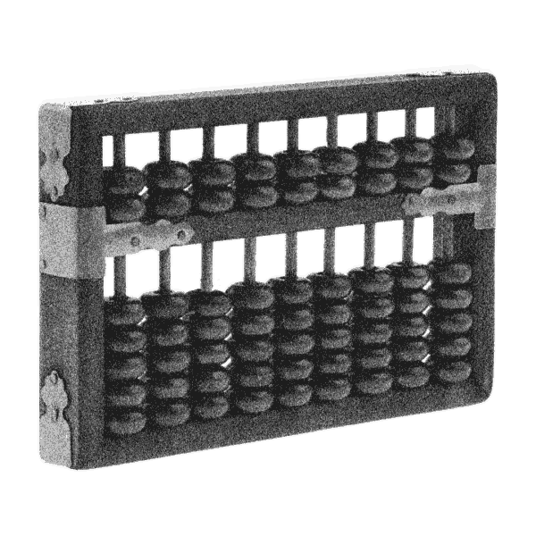
The First Computer
Computer Science for Everyone, Everywhere (CSEE)
Notes:
The first computer is generally considered to be the abacus. It was a manual computer that allowed for rapid calculations.

Slide 27
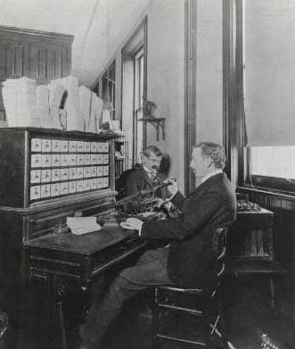
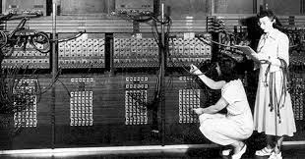
Hollerith Machine ENIAC
Notes:
Next came mechanical computers - computers that used simple machines to do the computations (Hollerith’s tabulating machine).
With the turn of the 20th century - data is exploding and everyone wants to do computations quicker - especially the military.

Slide 28
Electricity and computers…
https://palmetto.com/learning-center/blog/understanding-solar-power-electricity-terms-volts-amps-watts
https://www.thegeekpub.com/243163/what-is-resistance-ohms-electricity-basics/
Computer Science for Everyone, Everywhere (CSEE)
Notes:
Electricity offered a way to work very fast - theoretically at a speed close to light.
However, there are problems - namely electricity and reliability.

Slide 29
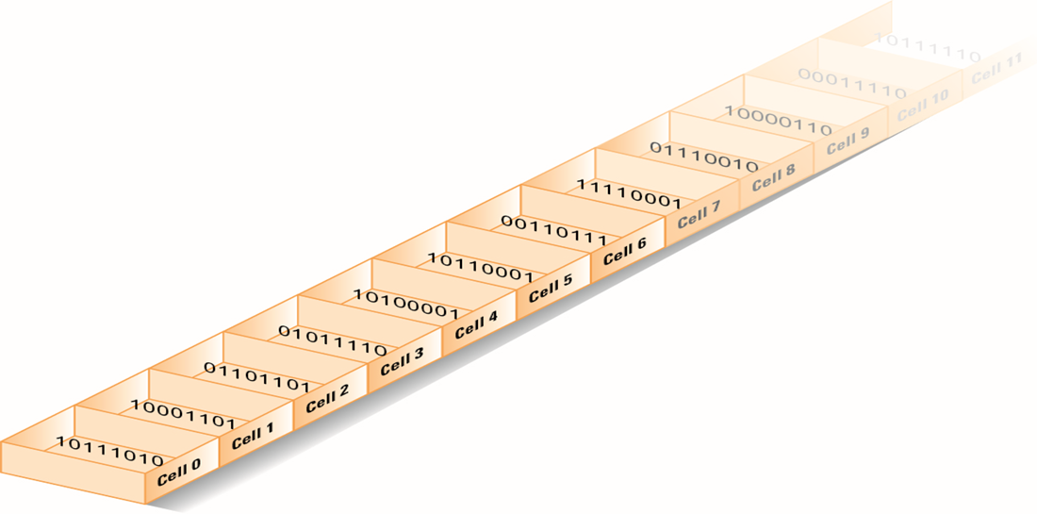
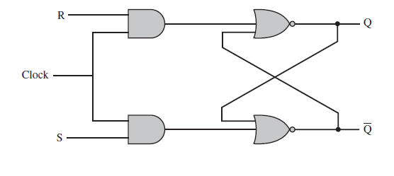
Computer memory - bits
Notes:
If we assign presence of voltage (on) the concept of “1” and absence of
voltage (power off) the concept of zero, we then had a math system to help us design ways to process the electricity with 100% reliability - Binary math!
To this day, everything on the modern computer at its most very basic level uses binary math. The circuits of the computer do approximately 100 math options, 20 of which are used frequently.

Slide 30
Counting by binary
Notes:
A Decimal Computer was just not practical. However, we could still work with the concept of power on and power off!
Math also had a ton of work on number systems - that is a number system with bases other than 10. And the cool thing was there are clear rules on how to convert numbers from one system to another.

Slide 31
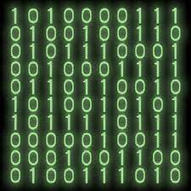
Data and Binary
Notes:
All data must be able to be mapped onto the binary number system. This type of data is called discrete data.
We can do a lot of representation with this - most text can be represented this way. Pictures used binary values to represent the presence of certain colors in a picture element or pixel. We can record sound waves and the play rapid pictures with sound over them to make movies.
Some things cannot be represented by the computer. For example - a computer cannot represent a circle completely - only an approximation of it.

Slide 32
Computer Systems
How do they talk to each other?
How does the computer know what to do?

Slide 33
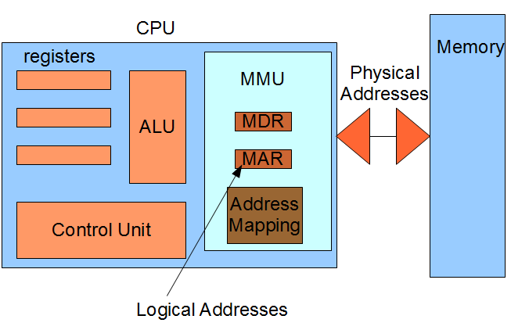
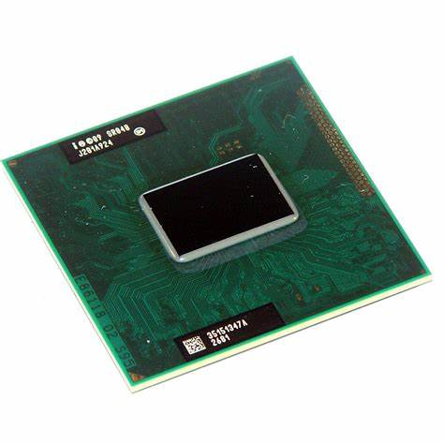
The Central Processing Unit: The Brains of the Computer
Computer Science for Everyone, Everywhere (CSEE)
Notes:
The ALU is responsible for carrying out the arithmetic and logical operations of the CPU. It consists of an arithmetic logic unit (which performs arithmetic and logical operations) and a set of registers (which store data and instructions).
The control unit is responsible for fetching, decoding, and executing instructions. It also controls the flow of data between the various components of the CPU.
The registers are used to store data and instructions. There are four types of registers: general-purpose, floating-point, control, and status. General-purpose registers can be used for any purpose. floating point registers are used for storing floating-point numbers. Control registers or unit contain control signals that tell the various components of the CPU what to do. Status registers contain information about the current state of the CPU.

Slide 34
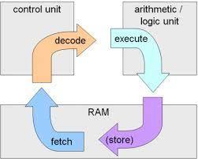
Machine Cycle
Computer Science for Everyone, Everywhere (CSEE)

Slide 35
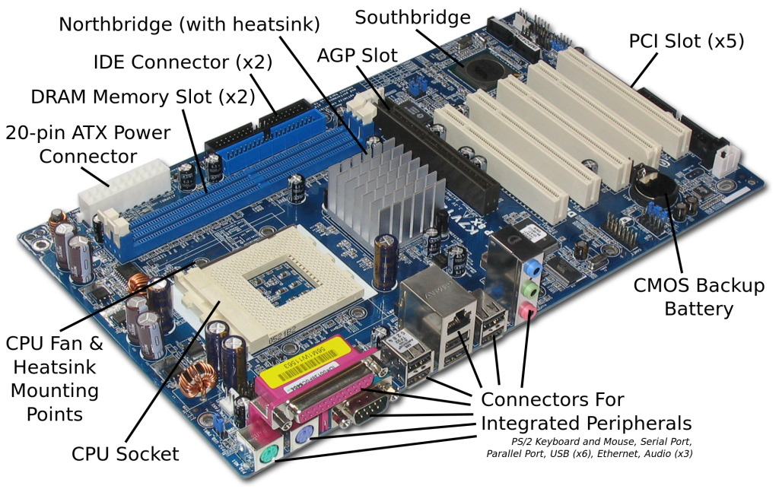
Motherboard and integrating with additional hardware
Computer Science for Everyone, Everywhere (CSEE)

Slide 36
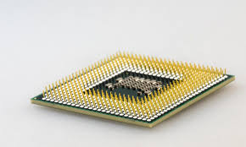
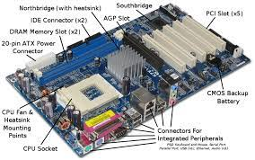
Hardware and Software Together - General Computer
The CPU does the “math” to create the actions”
The hard drive holds our programs. When we want to use the program, it is loaded into memory and run on the CPU.
The Motherboard holds the CPU and connects it to other devices like memory, hard drive USB - peripherals.
Computer Science for Everyone, Everywhere (CSEE)

Slide 37
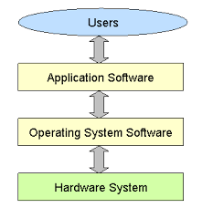
Hardware and Software Together
The program that does the thing I want to do.
The Program that manages all
of the Computer’s resources
Computer Science for Everyone, Everywhere (CSEE)
Notes:
Software is a set of programs that are used to help the computer complete a task.
Computers use to have their programs “hard coded” into them - that is if you wanted to change the program, you had to change the physical hardware.
Now, software lets a mass produce general purpose computers and then use software to do different things with them.
Software interfaces for the human user so that the user gets an experience that they expect, but the actions or directions the user wants to perform are translated by software into the 1’s and 0’s the computer needs to run a task.
All software reduces its actions down to about 20 mathematical actions on the Arithmetic Logic Unit.
Programming is a component of creating software.

Slide 38
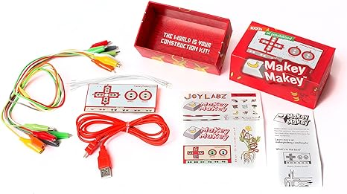
Connections for a Computer System
Computer Science for Everyone, Everywhere (CSEE)

Slide 39
Connections for a Computer System
https://makeymakey.com/pages/plug-and-play-makey-makey-apps
Or Google “makey makey plug and play”
8.1.5 Computer Systems Standard Core Ideas
Computing devices may be connected to other devices to form a system as a way to extend their capabilities.
Software and hardware work together as a system to accomplish tasks (e.g., sending, receiving, processing, and storing units of information).
Computer Science for Everyone, Everywhere (CSEE)

Slide 40
Troubleshooting
First - don’t panic. Seriously. Every teacher who taught in covid and most students are not experts in troubleshooting basic problems on the computer. You got this.
Make a checklist for yourself and run through it:
Check all of your wires - did something fall off or out of place?
Check your internet connection - it's often not you!
If software is not running properly - close it - this works for a traditional computer and your phone.
If it is still malfunctioning, turn off the computer - wait a good 20 seconds, and turn it back on.
Computer Science for Everyone, Everywhere (CSEE)

Slide 41
Troubleshooting - When do I need help?
Sometimes the problem can’t be fixed this way. Here are some clues:
If the computer is slowing down: This usually means the computer is having storage issues:
Close some applications!
Reboot
If this isn’t working, check to see if your hard drive is too full - you probably need at least 4 Gigabytes of Storage.
Does your computer have enough memory? - if no, get more
What is your bus speed? - if too slow, you are buying a new computer.
If I get a odd thing on my monitor
If possible, use an HDMI or USB cord to connect to another monitor - like your smart tv. See if it works fine that way.
If I get a black or blue screen - there may be a serious problem. Try to make sure your back up the computer - then try to run a diagnostic. If it persists, you may need to do more research or get help.
Computer Science for Everyone, Everywhere (CSEE)

Slide 42
Brainstorming
• 8.1.8.CS.1: Recommend improvements to computing devices in order to improve the ways users interact with the devices.
Every kid has an opinion on their phone or chromebook. Make an exercise of that - or a gaming system, their TVs, Amazon Alexa or any system.
• 8.1.8.CS.2: Design a system that combines hardware and software components to process data.
• 8.1.8.CS.3: Justify design decisions and explain potential system trade-offs.
Have students create their “Dream Device”. Have them describe both how the user would interact with the device and what the look and feel of the hardware is.
• 8.1.8.CS.4: Systematically apply troubleshooting strategies to identify and resolve hardware and software problems in computing systems.
https://docs.google.com/drawings/d/1RD0z7raBvgHbSlJ3xY6vmflj5prsB3a7_uq1W_CLPCE/edit?usp=sharing

Slide 43
Lesson 2 - Make your Own Computer
Teacher Guide:
https://drive.google.com/file/d/1jFhZ71fsOFAS1EDAeHDdURcg4_FVl3o2/view
This lesson has students “make” their own computer with art supplies.
Resources for Instruction:
https://www.helloruby.com/play/2
Video to explain lesson:
https://www.youtube.com/watch?v=Pih_5TlpngY

Slide 44
Computer Systems Standard
Core Idea | Performance Expectations | Lesson Ideas
The study of human–computer interaction can improve the design of devices and extend the abilities of humans. | 8.1.8.CS.1: Recommend improvements to computing devices in order to improve the ways users interact with the devices. | https://cs4hs.buffalostate.edu/sites/cs4hs.buffalostate.edu/files/uploads/Resources/ECS_unit1.pdf
Software and hardware determine a computing system’s capability to store and process information. The design or selection of a computing system involves multiple considerations and potential trade-offs. | • 8.1.8.CS.2: Design a system that combines hardware and software components to process data. • 8.1.8.CS.3: Justify design decisions and explain potential system trade-offs. | https://drive.google.com/file/d/1NfwhFo_uNX1R_fElOgETauJBfWVvH-fD/view?usp=drive_link
Troubleshooting a problem is more effective when knowledge of the specific device along with a systematic process is used to identify the source of a problem. | 8.1.8.CS.4: Systematically apply troubleshooting strategies to identify and resolve hardware and software problems in computing systems. | https://drive.google.com/file/d/1NfwhFo_uNX1R_fElOgETauJBfWVvH-fD/view?usp=drive_link

Slide 45
Further Resources
Lesson: Human Computer
https://www.educationworld.com/a_tech/tech/tech195.shtml
https://www.azed.gov/sites/default/files/2019/09/Kindergarten%20CS%20Lessons.pdf?id=5d72d0e91dcb251298c0faa2
https://www.sfusd.edu/learning/curriculum/elementary-school/computer-science/k-2-computer-science-curriculum

Slide 46
Break

Slide 47
Networks and the Internet

Slide 48
Networks - why learn them
There are two major issues at play with network and why students need to learn them:
Students need to be able to understand how to connect their devices to the network and the basic concepts of how data travels over the network.
Students need to learn how to protect both their data and their devices from any on-line security issues.

Slide 49
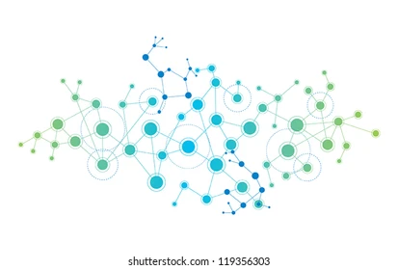
What is a network?
A connection between two or more computers so that they can share:
Data
Communication
Printing
Files
Other resources
A Network is Modeled as:
Line represents a connection
A Circle (vertex, node) represents a “thing” we are connecting - a computer, a website, etc.

Slide 50
NJ SLS CS Standard - In a Nutshell
By the end of Grade 8:
• Protocols, packets and addressing are the key components for reliable delivery of information across networks.
• The information sent and received across networks can be protected from unauthorized access and modification in a variety of ways.
• The evolution of malware leads to understanding the key security measures and best practices needed to proactively address the threat to digital data.

Slide 51
Teenagers and the Economics of Hacking
In 2017, families with members under the age of 20 lost $8.7 million in hacking schemes.
In 2021, families in this same demographic lost $101 million, in 2022 $210 million ($10 Billion National)
The United States is the primary target for most international hacking.
New Jersey is in the top 10 states for being targeted in hacking or malicious attacks.
*Source: FBI Internet Crimes Complaint Center https://www.ic3.gov/Media/PDF/AnnualReport/2021_IC3Report.pdf
/https://www.ic3.gov/Media/PDF/AnnualReport/2022_IC3Report.pdf

Slide 52
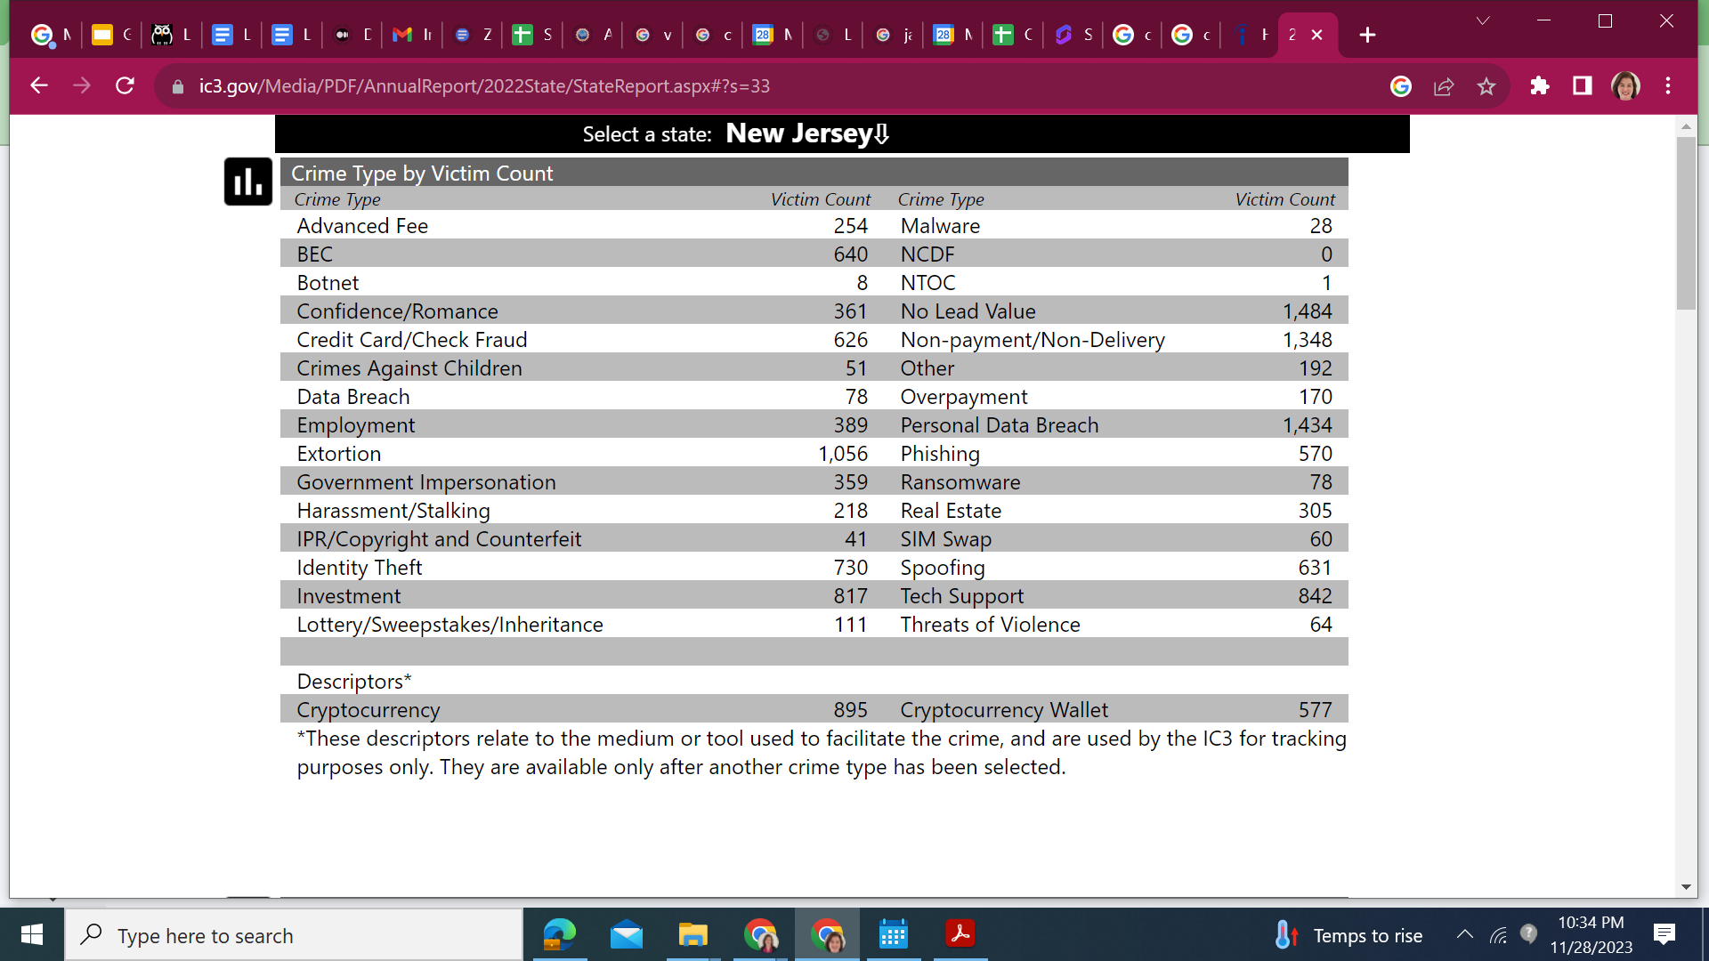
FBI 2022 Data - New Jersey

Slide 53
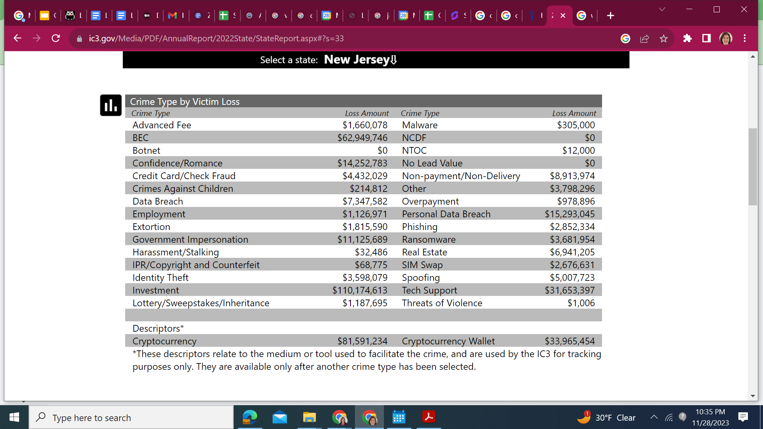

Slide 54
NJSLS - CS Standards
Core Idea | Performance Expectations
Protocols, packets, and addressing are the key components for reliable delivery of information across networks. | • 8.1.8.NI.1: Model how information is broken down into smaller pieces, transmitted as addressed packets through multiple devices over networks and the Internet, and reassembled at the destination. • 8.1.8.NI.2: Model the role of protocols in transmitting data across networks and the Internet and how they enable secure and errorless communication.
The information sent and received across networks can be protected from unauthorized access and modification in a variety of ways. The evolution of malware leads to understanding the key security measures and best practices needed to proactively address the threat to digital data. | • 8.1.8.NI.3: Explain how network security depends on a combination of hardware, software, and practices that control access to data and systems. • 8.1.8.NI.4: Explain how new security measures have been created in response to key malware events.

Slide 55
What do we dread about teaching this unit?

Slide 56
Lesson ideas we want to share

Slide 57
Definitions/Vocabulary
Protocol: a set of rules or procedures for transmitting data between electronic devices, such as computers.
Packet: a basic unit of data that's grouped together and transferred over a computer network, typically a packet-switched network, such as the internet. Each packet or chunk of data forms part of a complete message and carries pertinent address information that helps identify the sending computer and intended recipient of the message. A network packet has three parts: the packet header, payload and trailer.
IP Address: is a numerical label such as 192.0.2.1 that is assigned to a device connected to a computer network that uses the Internet Protocol for communication
Malware: short for malicious software, refers to any intrusive software developed by cybercriminals (often called hackers) to steal data and damage or destroy computers and computer systems. Examples of common malware include viruses, worms, Trojan viruses, spyware, adware, and ransomware.

Slide 58
Perspective - Networks and the Internet

Slide 59
Activity (Lesson): Send to my friend Niraj in California
Problem - I want to sent the dictionary to my friend Niraj in California. I do not have to include the hard bound cover.
Constraints: You are only allowed to send the physical dictionary that I am showing you in plain, letter envelopes. You have an unlimited number of envelopes to do this, but you must use the letter size envelope.
How do you send the dictionary?
Computer Science for Everyone, Everywhere (CSEE)

Slide 60
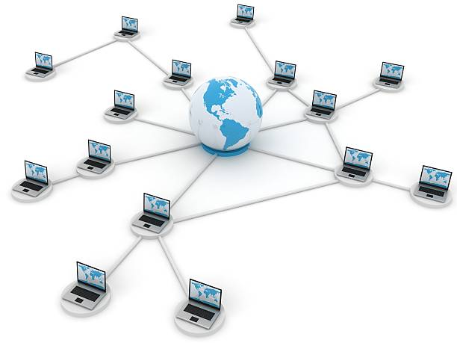
Data Communications
Data Communication or Networks is the study of the transport of data between two computing devices.
Essentially, how can we get computers to talk to each other and communicate?
Computer Science for Everyone, Everywhere (CSEE)

Slide 61
Networks - How are the Computers Connected
Your personal computer/tablet/phone connect to a network in one of two ways - either through a wired connection or a wireless connection.
Wired Connection: A wired connection is just that - a connection with wires! The first connections were like the old style phone lines - copper wire that was wrapped and insulated and then bound together.
Essentially for all media, they have to transports some form of the ones and the zeros. Copper wire could do this but we would lose data in the process - this is called signal degradation.
Fiber Optic cable came along and had better properties for sending a signal. Instead of using electricity, we use light pulses that follow a very thin glass wire that has some flexibility in it. We are now truly moving closer to the speed of light.
Wireless uses the properties of radio waves to send a signal. However, your need to be in “line of sight” of a router, tower, satellite. Signal has a lot of problems going through cinderblock, the hills of NJ, and is susceptible to outages when there is solar flare activity.
Computer Science for Everyone, Everywhere (CSEE)

Slide 62
Networks
A network is a connection between two or more computers that either share resources or what to communicate with each other.
Networks are described by a few features:
Topology - How is the network physically laid out?
Scope
Personal Area Network (short-range - earbud with your phone and smart watch)
Local Area Network (building/campus)
Metropolitan Area Network (community)
Wide Area Network (greater distances)
How is it connected: wired (bus) or wireless
Computer Science for Everyone, Everywhere (CSEE)

Slide 63
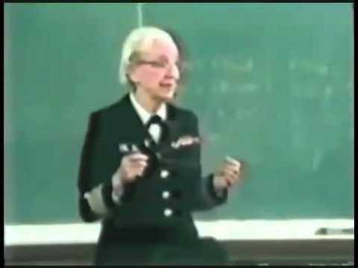
Networks - Speeds
Network speeds are managed in bits per second - we measure how many ones and zeros we can send in a second
When we talked about data last week, we talked about how we record data in Bytes.
Network speeds are measured in how many 1s and 0s I can send, not how many Bytes i send.
Most US homes have about 50 Megabits per second, or Mbps.
The average zoom/Google Hangout call is about 4 Mbps
Grace Hopper and the Nanosecond:
Computer Science for Everyone, Everywhere (CSEE)

Slide 64
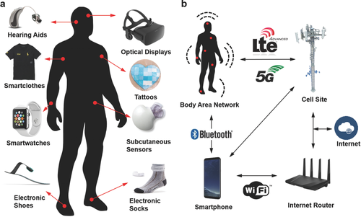
Example of Wearable
Wearable are taking the world by storm. Students will need to be able to navigate this world to understand their comfort levels and how to socialize and cope with this world.
Image Source: https://onlinelibrary.wiley.com/doi/full/10.1002/adma.201706910?_utm_campaign=mention57529&_utm_medium=inline&_utm_content=lnk241316896300&_utm_source=xakep

Slide 65
Brainstorming
• 8.1.2.NI.1: Model and describe how individuals use computers to connect to other individuals, places, information, and ideas through a network.
Issues:
How are we connecting?
• 8.1.2.NI.2: Describe how the Internet enables individuals to connect with others worldwide.
Issues:
Social connections
8.1.2.NI.3: Create a password that secures access to a device. Explain why it is important to create unique passwords that are not shared with others.
Issues:
• 8.1.2.NI.4: Explain why access to devices need to be secured.
Issues:

Slide 66
Lesson 1 - Understanding Connections - Wireless and Wired - Motivation for Teachers - Beacons of Gondor
https://www.youtube.com/watch?v=i6LGJ7evrAg

Slide 67
Debrief - Why are the Beacons of Gondor a Network?
Communicate very specific things - protocols
How fast was it? - quicker than horses
We needed the line of sight - message would have failed otherwise
Each station someone was ready - repeaters, network extenders
Security - no bugs or viruses because everyone can see

Slide 68
Lesson 1 - Building a Network Like the Beacons of Gondor
Supplies: Flashlights, String, scissors, index cards and paperclips
Part 1A - Wireless Networks
At your table - give everyone a flashlight.
Pair Up - Try to answer Yes/No questions with just the flashlight.
Next - try to create a chain of people like the Beacons of Gondor - how can you?
You want to send a message using your flashlights - How? Come up with a Scheme to do so

Slide 69
Beacons of Gondor - Evil Denathor Edition
Now while the Beacons are lit, the evil character Denathor does see that the beacons are lit and proceeds to do some things that are not so nice.
Look at the flashlight - how easy is it for people to intercept the message?
How can we keep the message private?

Slide 70
Lesson 1B - Wired Network
Let’s redo this - but now with String.
You have string on the table.
Pretend that each person at the table is a computer. Create a connection between at least two computers using your “Wire” which is the string.
How do you think the computers communicate?

Slide 71
Lesson 1B
Pick one person as your message sender, pick one person as your message receiver.
Sender: Write a sentence that is 5 words long - write each word - and only each word - on a index card. Do not tell your receiver what the message is. Shuffle the cards and “send” the cards over your wire to your receiver.
Receiver: Rebuild the message without any help or directions. Check with the sender.

Slide 72
Lesson 1B - Wired Network
Let’s redo this - but now with more connections
You have string on the table.
Pretend that each person at the table is a computer. Create a connection between every computer using your “Wire” which is the string.
How do you think the computers communicate? What problems do you think happen on this network?

Slide 73
Lesson 1B - Wired Network
Let’s redo this - but now with more connections
You have string on the table.
Pretend that each person at the table is a computer. Create a connection between every computer using your “Wire” which is the string.
How do you think the computers communicate? What problems do you think happen on this network?

Slide 74
Lesson 1B - Wired Network
Let’s redo this - but now with your own twist
Create your own layout for the network. It can be random (we call that ad hoc) or have a system to it. One rule - all computers must be reachable by every other computer.
How do you think the computers communicate? What problems do you think happen on this network?

Slide 75
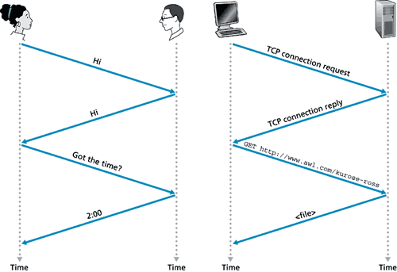
Protocols
Protocols are the system of rules by which communication happens.
Humans have protocols in their communication.
Computers use protocols to communicate with each other.

Slide 76
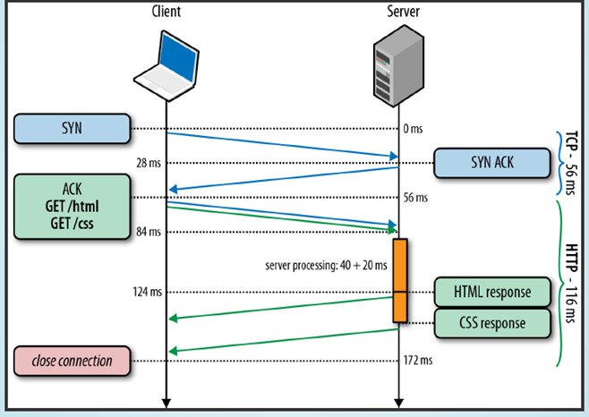
HTTP Protocol

Slide 77
Lesson 1 Debrief - Question: What were the differences between Wired and Wireless?
Wired Network Observation | My Home or School Network | Wireless Network Observation | My Cell Phone | Computer Concept it is Matching

Slide 78
Lesson 1 Debrief
What do you observe about sending the message?
How did you send it across the network?
Did you give any vocal directions about how to send the message?
Did you give any body language clues about how to send the message?
What do you observe about receiving the message?
Did the cards have any clues about what order the words should have been in?
Would a little more directions help you in putting the message together?
How much did you rely on your ELA skills to understand how to put the message together?
Which network was easier to interrupt?
Which network was it easier to see the messages other people were sending at other tables?

Slide 79
CyberSecurity

Slide 80
Hack My TikTok
{ "id": "7277986355668438314", "desc": "I hope they enjoy their new home \u2764\ufe0f #homereno #beforeandafter #construction We actually managed to completely renovate her house in 7 days \ud83d\ude33 Thanks @Emily Shaw and our construction team for making this happen!", "createTime": "1694538267", "scheduleTime": 0, "stats": { ** "diggCount": 2500000, "shareCount": 4346, "commentCount": 16800, "playCount": 16200000, "collectCount": "118252"** }, "nickname": "MrBeast", "authorId": "6614519312189947909", "authorSecId": "MS4wLjABAAAABKjQkOz_IIzXXzEAl_9LGsWhvK-gBnlczwRPXK8EmxAp6K3X0qiaP5_OEqmm0XwG", "avatarThumb": "https://p16-sign.tiktokcdn-us.com/tos-useast5-avt-0068-tx/54435a1ec165931f60f2a3872de74aa5~c5_100x100.jpeg?x-expires=1695236400&x-signature=FOzc8n8d8F6HCsXLKWIblmT5vcc%3D", "downloadSetting": 0, "authorPrivate": false, "capcutAnchorsOriginal": [], "capcutAnchors": [] }

Slide 81
Cybersecurity
Prof. Bharath Samanthula
Department of Computer Science
October 26, 2022

Slide 82
Outline
Motivation
Cybersecurity Objectives NJSLS
Data Classification
Basic Security Concepts
Common Security Threats
Common Counter Measures
Training and Awareness
Conclusion
Computer Science Hub

Slide 83
Kids in Digital Era
According to NCES, more than 90% of kids use internet
Kids ages 8-18 spend 50% of their time online when awake
Two-thirds of parents in US say parenting has become harder due to technology
Crimes that happen in physical world (e.g., cheating or stealing) is now increasingly happening in the digital world
Hackers often target children as kids have minimal knowledge about the risks involved while using internet
Some common online issues kids face include:
Identity Theft
Cyber Bullying
Phishing
Computer Science Hub

Slide 84
Cybersecurity for Children
Cyber threats can come from anywhere and anytime
About one in four children in the US experience identity theft or exposure to sexually explicit material
Example: cyber criminals often advertise malicious links, such as free games or rewards, that actually install a virus or steal private data
Kids should be taught cybersecurity from a young age
Leading to improved security in the present
A new generation of safe and knowledgeable Tech users
Computer Science Hub

Slide 85
Cybersecurity for Children
Ask students the following questions:
What are possible dangers online?
What information they would like to protect online?
What steps they will probably take to protect their information?
How they would respond if they see something unacceptable/inappropriate online?
Teaching Cybersecurity needs to be part of any school’s curriculum – Not just to students interested in STEM
Computer Science Hub

Slide 86
What is Cybersecurity
Cyber relates to computers or a network of computers
Generally referred to Internet
Security relates to protecting an asset/resource, such as a building or person
In computer world, security refers to Cybersecurity
Cybersecurity deals with protecting computers, programs, networks, and data from unauthorized access
Unauthorized access??
Hacking: gaining access into a computer, network etc, without owner’s permission
Considered as illegal and carry heavy penalties
Computer Science Hub

Slide 87
Cybersecurity - NJ SLS CS
8.1 Computer Science by the End of Grade 5
Computer Science Hub

Slide 88
Cybersecurity - NJ SLS CS
8.1 Computer Science by the End of Grade 8
Computer Science Hub

Slide 89
Cybersecurity - NJ SLS CS
8.1 Computer Science by the End of Grade 12
Computer Science Hub

Slide 90
Data Classification
Data is a collection of information we (or computers) collect
To better utilize this data, we need to classify, store, process, interpret, and retrieve it
Digital Data is the new currency
Not all data are created equal: Data is classified according to sensitive levels
In general, data is categorized as private or public
Computer Science Hub

Slide 91
Private/public data
Private Data
Examples - Social Security Number, Passwords, Gender, Birth Date, Credit Card Numbers
Public Data
Examples - Website homepages, Press releases, Public opinions
Activity:
Create a list of data examples and ask students to categorize them as either public or private data. The answers may vary across students
Ask students would they be concerned in protecting their personal data, if so, what specific data they don’t want to share online
Computer Science Hub

Slide 92
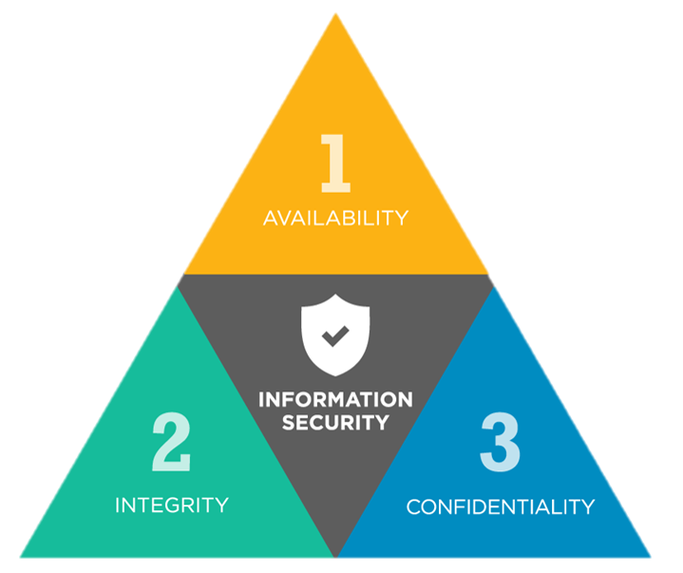
CIA Triad
Computer Science Hub

Slide 93
Confidentiality
Confidentiality - personal identifiable information (PII) that you don't want anyone to obtain without your permission
Who is allowed to see this data depends on the user
Personal Privacy - the ability of a person to determine for themselves when, how, and to what extent personal information about them is shared with or communicated to others
Examples:
Password protection
Data you post on social media
Student Grades
Medical records
Computer Science Hub

Slide 94
Integrity
Data at rest or in transit should not be changed by unauthorized people
Examples:
Data at rest – data (e.g., a student’s homework) stored on your computer should not be changed without your permission
Data in transmission - Suppose you are transferring $100 to your friend and someone changed the amount to $1000
Computer Science Hub

Slide 95
Availability
Making sure a computer resource or data is available for use when desired
Users with access to specific information must be able to consume it when they need to, and getting to the data should not take an inordinate amount of time.
Example: What happens if you cannot access your school or bank account?
Computer Science Hub

Slide 96
Identity Theft
A Child’s identity is very attractive to hackers
Identity Theft - the deliberate use of someone else's identity to gain a financial advantage or obtain credit and other benefits in the other person's name and perhaps to the other person's disadvantage or loss
Example: Stolen credit card details can be used to open new bank accounts, purchase new loans, applying for employment, etc.
Computer Science Hub

Slide 97
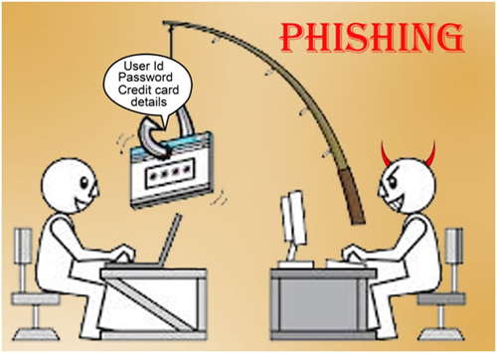
Phishing
Phishing is when attackers send malicious emails designed to trick people into falling for a scam.
In general, the intention is to get users to reveal their private information
Tips:
Explain the potential negative impact
Discuss important pieces in a message/email to check if it is fake
Create a fake email or message, distribute it to students and ask whether they will accept or deny the message
Computer Science Hub

Slide 98
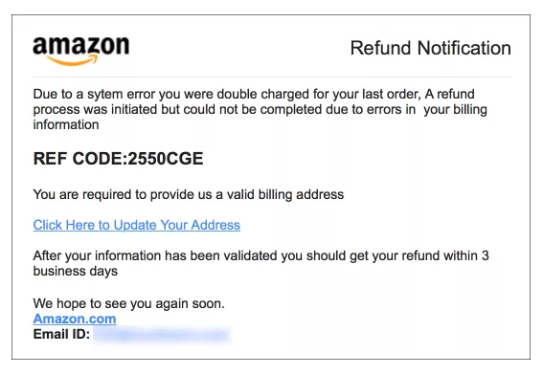
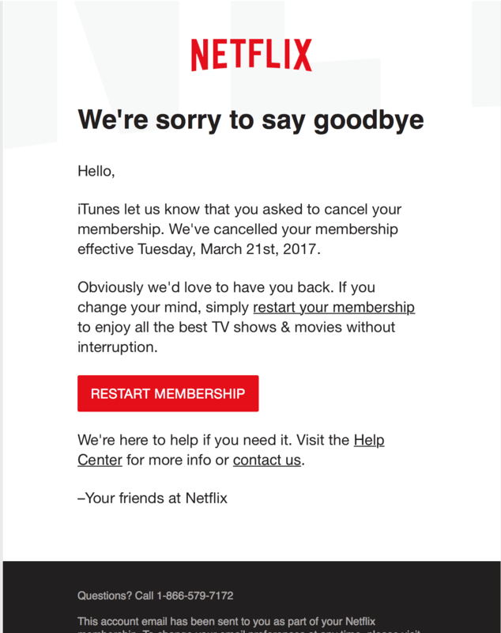
Phishing - Examples
Computer Science Hub

Slide 99
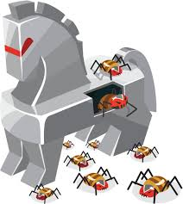
Malware
Malware, short for malicious software, is a kind of intrusive software that is designed to invade, damage and disrupt computers
Common types of malware include virus, worms and trojan horses
Viruses are a kind of malware that need a user-run program to work
Worms are a lot like viruses and are able to move through the internet and copy themselves onto computers without help from a host program
Trojan Horse is a program downloaded and installed on a computer that appears harmless, but is, in fact, malicious
Tips:
Take a real-world malware, explain its type, impact and damage
Example: a malicious Android app purports to provide a real-time coronavirus outbreak tracker but instead attempts to trick the user into providing administrative access to install "CovidLock" ransomware on their device
Computer Science Hub

Slide 100
Cyberbullying
Cyberbullying is bullying or harassment that happens online or using modern technology
It can happen in an email, a text message, an online game, or comments on a social networking site
It might involve rumours or images posted on someone’s profile or passed around for others to see, or creating a group or page to make a person feel left out
It can be helpful to collect evidence – text messages and screen shots of social media posts – to show what’s been going on.
For bullying to stop, it needs to be identified and reporting it is key. It can also help to show the bully that their behaviour is unacceptable.
Computer Science Hub

Slide 101
Authentication
Authentication - the process of checking that a user is who she says she is
In real-world, we do this by checking valid ID documents, such as passports or DLs
Methods
Something the user knows (e.g., passwords)
Something the user is (e.g., biometric)
Something user has (e.g., badge, swipecard)
Password-based authentication: simple, reusable and easy to manage
Very important to select good passwords
At least of 8 characters
Combination of upper case, lower case, digits and special characters
Activity:
Create 5-10 sample passwords and ask kids to circle strong passwords among them
Suppose Bob wants to pick a new password. Give a list and ask kids to help Bob in picking a strong password
https://www.dinopass.com/
Computer Science Hub

Slide 102
Encryption
Encryption is a process where digital data is “translated” using a method that makes the original information unreadable
Decryption is a way to change encrypted information back into original data
Encryption and decryption together facilitate users to privately exchange data
The use of encryption for data in transit and at rest are standard these days
Encryption plays a vital role for exchanging private information on the Internet
Tips
Explain the need and advantages of encryption
Take a popular website or messaging app and explain how secure communication is achieved via encryption
Computer Science Hub

Slide 103
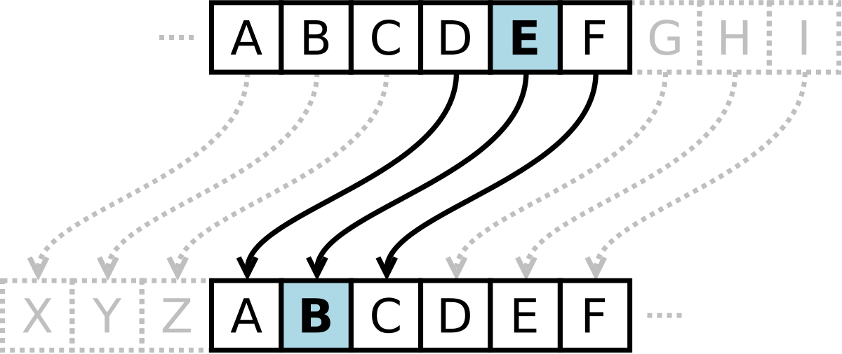
Encryption - Activity
Caesar Cipher – one of the simplest encryption method
It is a type of substitution method in which each letter in the plaintext is replaced by a letter some fixed number of positions further down the alphabet. For example, with a shift of 3, A would be replaced by D, B would become E, and so on.
Create sample text sentences and ask kids to encrypt them using Caesar Cipher.
You can use some fun challenges here: https://www.activityvillage.co.uk/3-caesar-cipher-challenges
https://www.giftofcuriosity.com/secret-codes-for-kids/
Computer Science Hub

Slide 104
Security Awareness for Kids
Don’t talk to strangers - Don't communicate with strangers online and never agree to meet in person. Tell a parent, teacher, or an adult you trust if a stranger contacts you in a chat room, through email, or via text messaging
Keep software up-to-date
No impersonating: Tell your kids not to impersonate someone else. Let your kids know that it’s wrong to create sites, pages, or posts that seem to come from someone else, like a teacher, a classmate, or someone they made up.
No Cyberbullying: Most schools take bullying seriously and will take action against it. If you are being cyberbullied by other students, report it to your school.
Use strong and unique passwords (when possible opt for two-factor authentication)
Make sure websites, apps, tools that you use are secure
Encourage kids to think before they click
Source: CISA
Computer Science Hub

Slide 105
Hands-on Activity
Information Hiding
Sharing Secrets - it allows people to share personal certain kinds of information accurately without having to give up any privacy at all.
https://classic.csunplugged.org/documents/activities/information-hiding/unplugged-16-information_hiding_0.pdf
Age group: Middle Elementary and up
Task: This activity illustrates a situation where information is shared, and yet none of it is revealed: a group of children (at least 3) will calculate their average age without anyone having to reveal to anyone else what their age is.
What is needed: Each group of children will need a small pad of paper and a pen
Computer Science Hub

Slide 106
Conclusion
Cybersecurity is everyone’s job
Even the best security technologies cannot guarantee 100%
Protection
Educate kids about Cybersecurity and encourage them to follow safer online habits
“Just like with learning how to drive, teens need to take care
when they learn to use the Internet”, says Michael Kaiser,
executive director of the National Cyber Security Alliance
Aspire them to be future Cyber Defenders - Plenty of jobs and the demand for information security experts will continue to grow
Computer Science Hub

Slide 107
Resources
Cybersecurity for Teachers
https://niccs.cisa.gov/education-training/cybersecurity-teachers
Cybersecurity for Kids https://www.cisa.gov/sites/default/files/publications/stc-tipcard-cyber%20for%20kids.pdf
Keeping Children Safe Online
https://www.cisa.gov/tips/st05-002
https://www.cisecurity.org/insights/blog/6-educational-cybersecurity-resources-for-kids
https://www.cisa.gov/cybergames
Computer Science Hub

Slide 108
October – National Cybersecurity Awareness Month
https://www.youtube.com/watch?v=_c6vOVsoGPw&ab_channel=NationalSecurityAgency

Slide 109
Questions?
Computer Science Hub

Slide 110
Contact
Bharath Samanthula, PhD
samanthulab@montclair.edu
Computer Science Hub

Slide 111
NJSLS - CS Standards
Core Idea | Performance Expectations | Lesson
Protocols, packets, and addressing are the key components for reliable delivery of information across networks. | • 8.1.8.NI.1: Model how information is broken down into smaller pieces, transmitted as addressed packets through multiple devices over networks and the Internet, and reassembled at the destination. • 8.1.8.NI.2: Model the role of protocols in transmitting data across networks and the Internet and how they enable secure and errorless communication. | Lesson 1
The information sent and received across networks can be protected from unauthorized access and modification in a variety of ways. The evolution of malware leads to understanding the key security measures and best practices needed to proactively address the threat to digital data. | • 8.1.8.NI.3: Explain how network security depends on a combination of hardware, software, and practices that control access to data and systems. • 8.1.8.NI.4: Explain how new security measures have been created in response to key malware events. | https://classic.csunplugged.org/documents/activities/information-hiding/unplugged-16-information_hiding_0.pdf https://www.uscyberpatriot.org/Pages/Special%20Initiatives/Elementary-School-Initiative.aspx https://www.cyber.nj.gov/

Slide 112
Further Resources
https://beinternetawesome.withgoogle.com/en_us/
https://www.commonsense.org/education/articles/23-great-lesson-plans-for-internet-safety
https://kids.britannica.com/kids/article/Internet/353293

Slide 113
Pedagogy

Slide 114
Approaches to Teaching CS
Storytelling
Inter-/Trans-disciplinary
Universal Design for Learning

Slide 115
Approaches to Teaching CS
Storytelling
“coding is also reflective of the imaginative and narrative elements of fiction writing workshops.” (Burke & Kafai, 2010)
Demonstration of Language, Literacy, Equity, and Bilingual/Multilingual Students
https://nyuscholars.nyu.edu/files/80078129/Fall_2020_PiLa_CS_Telenovela_Classroom_Case_Study.pdf

Slide 116
Approaches to Teaching CS
Inter-/Trans-disciplinary

Slide 117
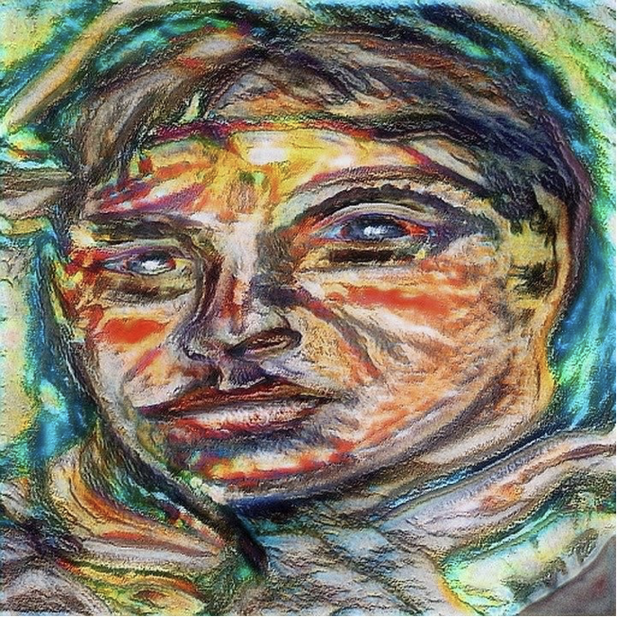
Abstraction and Art:
What is depicted in these Picasso paintings?

Slide 118
What is Scratch? - 3 minutes
Notes:
ASK: What types of projects did you see in the video?
animations, games, stories, presentations, etc.

Slide 119
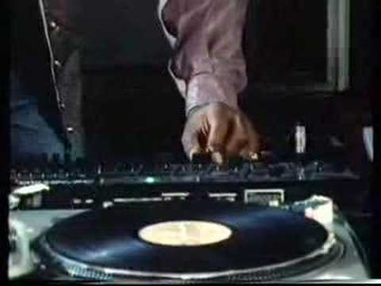
Impact of Computing
How do we impact computing technology positively/negatively?

Slide 120
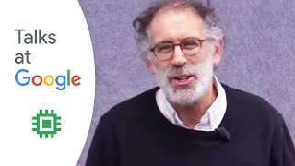
Scratch, Language, Math, and More
Notes:
Time: 19:10 - 20:50

Slide 121
Universal Design
for Learning (UDL)
Resources:
cast.org
https://udlguidelines.cast.org/
Computer Science for Everyone, Everywhere (CSEE)
Notes:
Move to the last slide

Slide 122
Foundations of UDL: Architecture
The Guggenheim Museum, NYC
Computer Science for Everyone, Everywhere (CSEE)

Slide 123
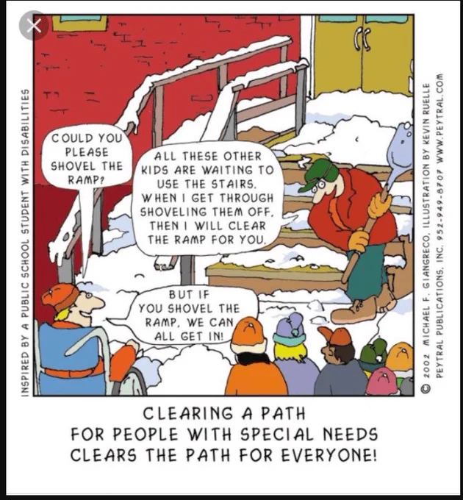
Computer Science for Everyone, Everywhere (CSEE)

Slide 124
UDL is…
“UDL is a framework that guides the shift from designing learning environments and lessons with potential barriers to designing barrier-free, instructionally rich learning environments and lessons” (Nelson, 2014, p. 2) --Scientifically valid framework
UDL provides a blueprint for creating instructional goals, methods, materials, and assessments that work for everyone--not a single, one-size-fits-all solution but rather flexible approaches that can be customized and adjusted for individual needs.
UDL involves helping all students succeed.
Computer Science for Everyone, Everywhere (CSEE)

Slide 125
What are the barriers?
Learning barriers are those elements of a lesson or the environment that prevent a learner from reaching the goal.
“barriers to learning are not, in fact, inherent in the capacities of learners, but instead arise in learners' interactions with inflexible educational goals, materials, methods, and assessments.”
(Dr. David Rose. Teaching Every Student in the Digital Age, p. vi)
A building barrier might be stairs;
a change made to the building might be _______________.
Computer Science for Everyone, Everywhere (CSEE)
Notes:
Move to the last slide

Slide 126
Learning barriers might be…
Removing barriers
Alphabet posters are hung on the narrowest wall because they visually look best there
Alphabet posters are hung on a spot where learners can see them easily (resource)
Learners are not motivated in math class. The goals are disconnected from their interests and experience.
The goal is rewritten to highlight an authentic application of the mathematical content to the real world.
Learners know that each day they need to come having read a chapter of the textbook and ready to take notes on that information.
Provide the reading materials in various formats (audio, digital, print) along with comprehension supports
Computer Science for Everyone, Everywhere (CSEE)

Slide 127
Data and Analysis

Slide 128
Exercise
Given a baggy of legos
Do something with them … in 5 minutes

Slide 129
Debrief
What did you do?

Slide 130
NJ SLS CS Standard - In a Nutshell
By the end of Grade 8
• People use digital devices and tools to automate the collection, use, and transformation of data.
• The manner in which data is collected and transformed is influenced by the type of digital device(s) available and the intended use of the data.
• Data is represented in many formats. Software tools translate the low-level representation of bits into a form understandable by individuals. Data is organized and accessible based on the application used to store it.
• The purpose of cleaning data is to remove errors and make it easier for computers to process.
• Computer models can be used to simulate events, examine theories and inferences, or make predictions.

Slide 131
What does that mean to us?
In many ways the Data Standard is the hardest of the standards. While it is with the best of intentions we want to help students learn the skills they need to analyze data properly, these skills can often be misinterpreted for other motives.
The important points in the Data Standard continuing with data concepts both from the 6-8 standard but also the math standard.
The important thing to remember with the data standard is that we are:
1 - Trying to help students understand the nature of data
2 - Begin to use some simple analysis and visualization tools
3 - Challenge students in why they are accepting the tool’s output as fact.

Slide 132
Grade 6-8 Data Sciences Expectation
Core Idea | Performance Expectations
People use digital devices and tools to automate the collection, use, and transformation of data. The manner in which data is collected and transformed is influenced by the type of digital device(s) available and the intended use of the data. | 8.1.8.DA.1: Organize and transform data collected using computational tools to make it usable for a specific purpose.
Data is represented in many formats. Software tools translate the low-level representation of bits into a form understandable by individuals. Data is organized and accessible based on the application used to store it. | • 8.1.8.DA.2: Explain the difference between how the computer stores data as bits and how the data is displayed. • 8.1.8.DA.3: Identify the appropriate tool to access data based on its file format.
The purpose of cleaning data is to remove errors and make it easier for computers to process. | • 8.1.8.DA.4: Transform data to remove errors and improve the accuracy of the data for analysis.
Computer models can be used to simulate events, examine theories and inferences, or make predictions. | • 8.1.8.DA.5: Test, analyze, and refine computational models. • 8.1.8.DA.6: Analyze climate change computational models and propose refinements.

Slide 133
What do we dread about teaching this unit?

Slide 134
Lesson ideas we want to share

Slide 135
Definitions/Vocabulary
Organize and Transform Data: Transforming data means to convert the data into a format a tool can us. Sometimes this might also mean organizing it in a new way.
Data Cleaning: Data cleaning is the process of reviewing the data for quality issues and the modifying the data to make sure it properly represents the data we want to capture. Be very careful in this process- we need to review data for organizational errors, not change data to fit what we expect.
Simulation: programs that run various mathematical scenarios to determine the potential scope or impact that a particular scenario could have.
Refinements: Improvements that impact either the quality of the output or how fast the tools runs.

Slide 136
Grade 6-8 Data Sciences Expectation - Reworded a bit
Core Idea | Performance Expectations
8.1.8.DA.1: Organize and transform data collected using computational tools to make it usable for a specific purpose. | Data can come in many formats. Tools to analyze data usually take data in a very specific format. We should use a process or a program to change data from one format to another (google docs to pdf for example)
• 8.1.8.DA.2: Explain the difference between how the computer stores data as bits and how the data is displayed. • 8.1.8.DA.3: Identify the appropriate tool to access data based on its file format. | This is reasonable. How do we access: Plain text? Images? Video?
• 8.1.8.DA.4: Transform data to remove errors and improve the accuracy of the data for analysis. | Be careful with this. More - look at a data set - answer why you trust that data set to be reliable?
• 8.1.8.DA.5: Test, analyze, and refine computational models. • 8.1.8.DA.6: Analyze climate change computational models and propose refinements. | Look at one simple model - see if we can recommend a change.

Slide 137
Perspective
Data Sciences, Data and Analysis

Slide 138
Data and Binary
All data must be able to be mapped onto the binary number system. This type of data is called discrete data.
We can do a lot of representation with this - most text can be represented this way. Pictures used binary values to represent the presence of certain colors in a picture element or pixel. We can record sound waves and the play rapid pictures with sound over them to make movies.
Some things cannot be represented by the computer. For example - a computer cannot represent a circle completely - only an approximation of it.
Computer Science for Everyone, Everywhere (CSEE)

Slide 139
Data and Binary
Computer Science for Everyone, Everywhere (CSEE)

Slide 140
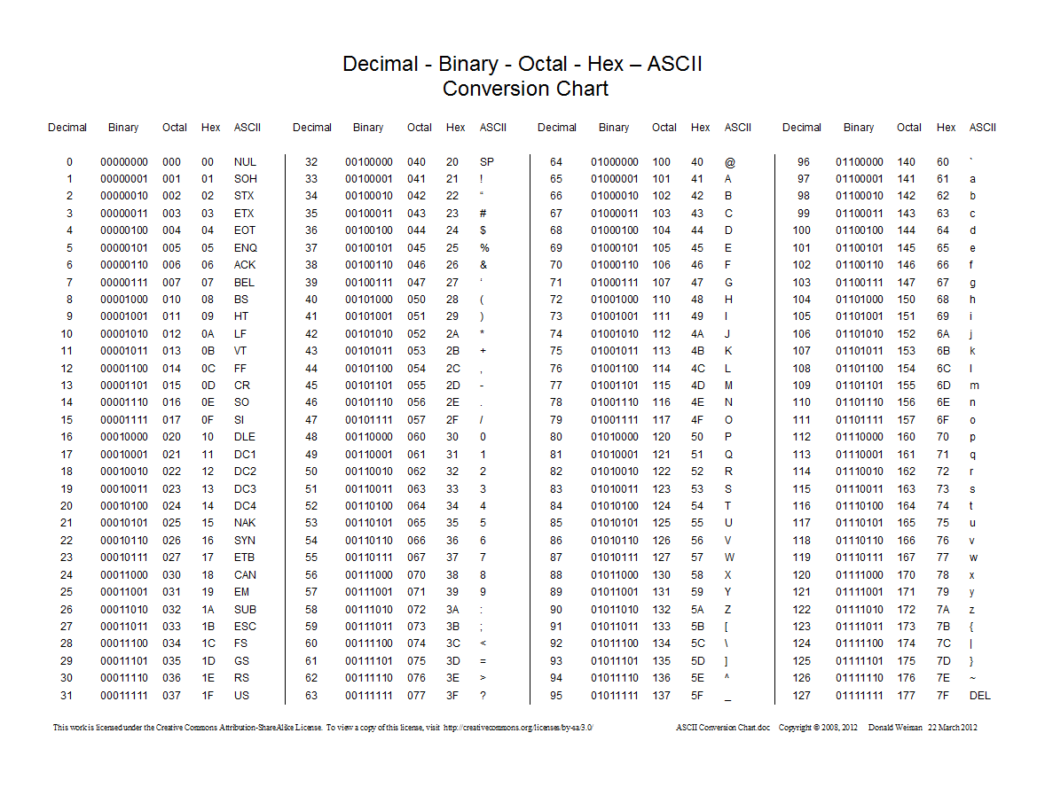
Data and Binary
Computer Science for Everyone, Everywhere (CSEE)

Slide 141
Bits, Bytes and Data Storage
Binary Digit: Bit - this is our ones and zeros.
Byte: 8 bits equal 1 byte. I can store 256 different values with 1 Byte. With 2 Bytes working together, I can store 65,536 values. One byte lets me represent all English characters (ASCII). Two bytes lets me represent all other alphabets except languages like Mandarin. Even those, the major characters can be represented (Unicode).
In working with powers of two, every time you add a bit, you are doubling the amount of data that you can store or work with.
Computer Science for Everyone, Everywhere (CSEE)

Slide 142
Computer Science for Everyone, Everywhere (CSEE)

Slide 143
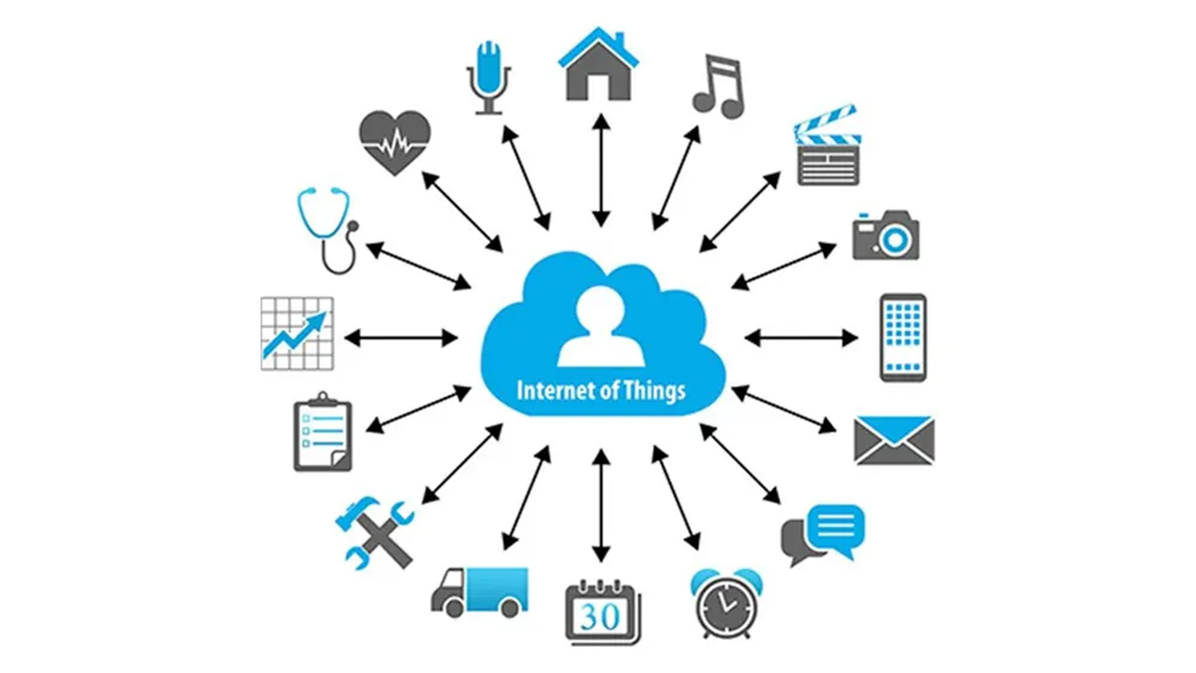
How is data collected
Computer Science for Everyone, Everywhere (CSEE)

Slide 144
US 2020 Election visualization on NPR
Look at this visualization: https://www.npr.org/sections/live-updates-2020-election-results
Note: This is not a statement about who won the election, just how the information is visualized.
What visualization are you most used to?
What visualization do you feel is most representative of the data?

Slide 145
Data Dashboards
Covid -19 Dashboards:
NY Times: https://www.nytimes.com/interactive/2021/us/covid-cases.html
University of Washington: https://covid19.healthdata.org/global?view=cumulative-deaths&tab=trend

Slide 146
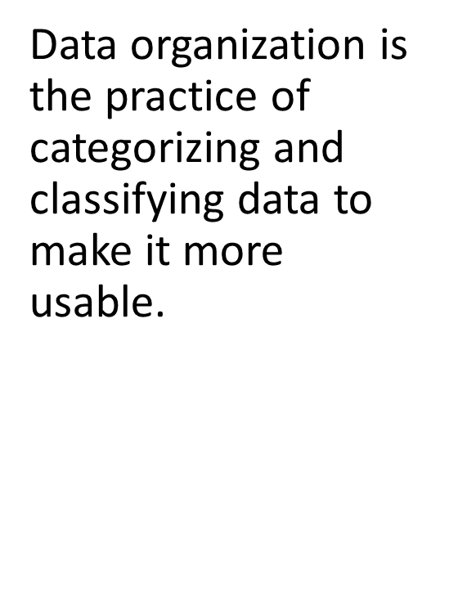
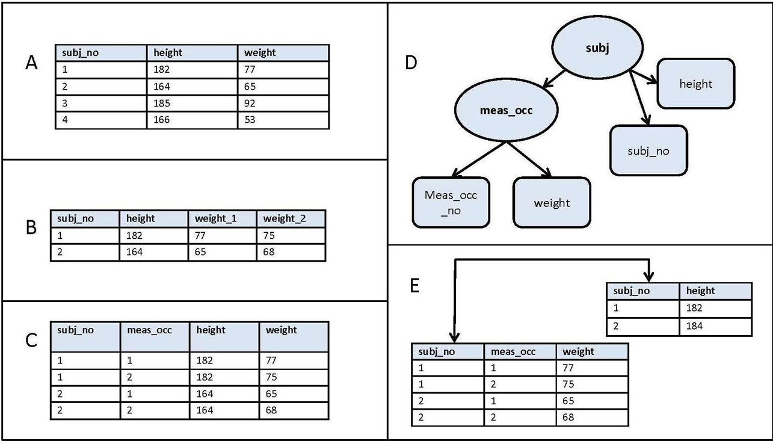
How is data organized?
Computer Science for Everyone, Everywhere (CSEE)

Slide 147
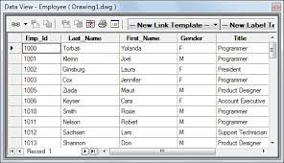
How is data organized? - Tables
Computer Science for Everyone, Everywhere (CSEE)

Slide 148
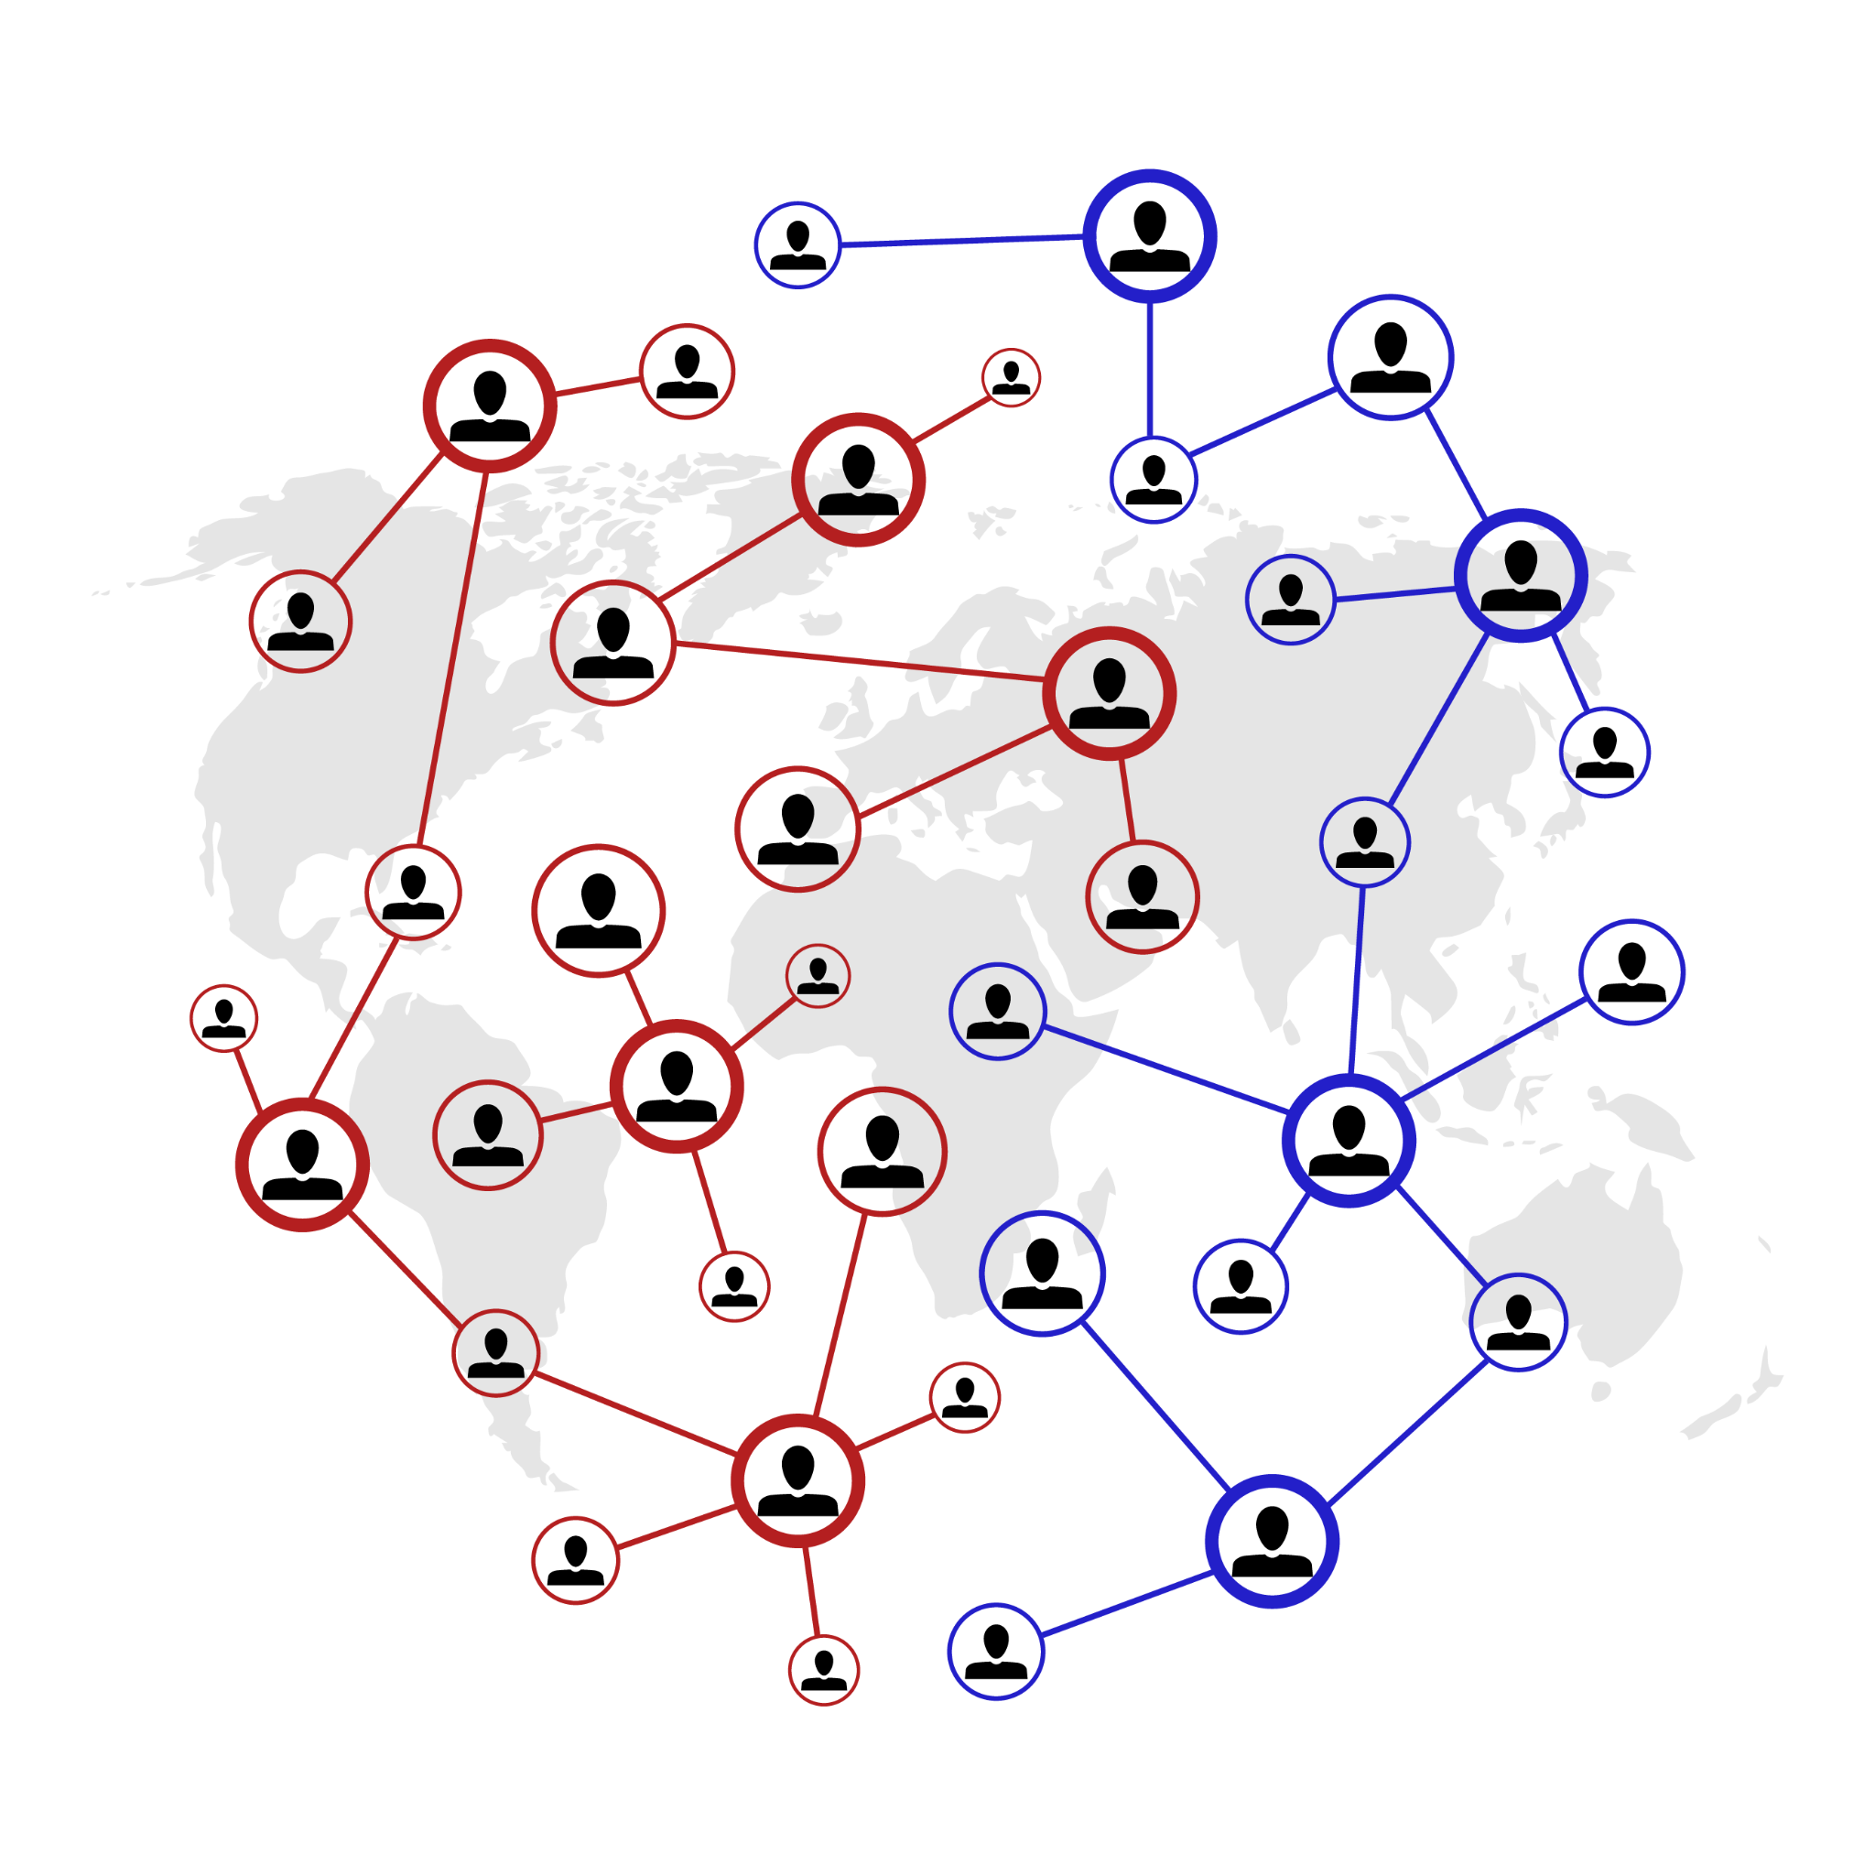
How is data organized? - Graphs or Network
Computer Science for Everyone, Everywhere (CSEE)

Slide 149
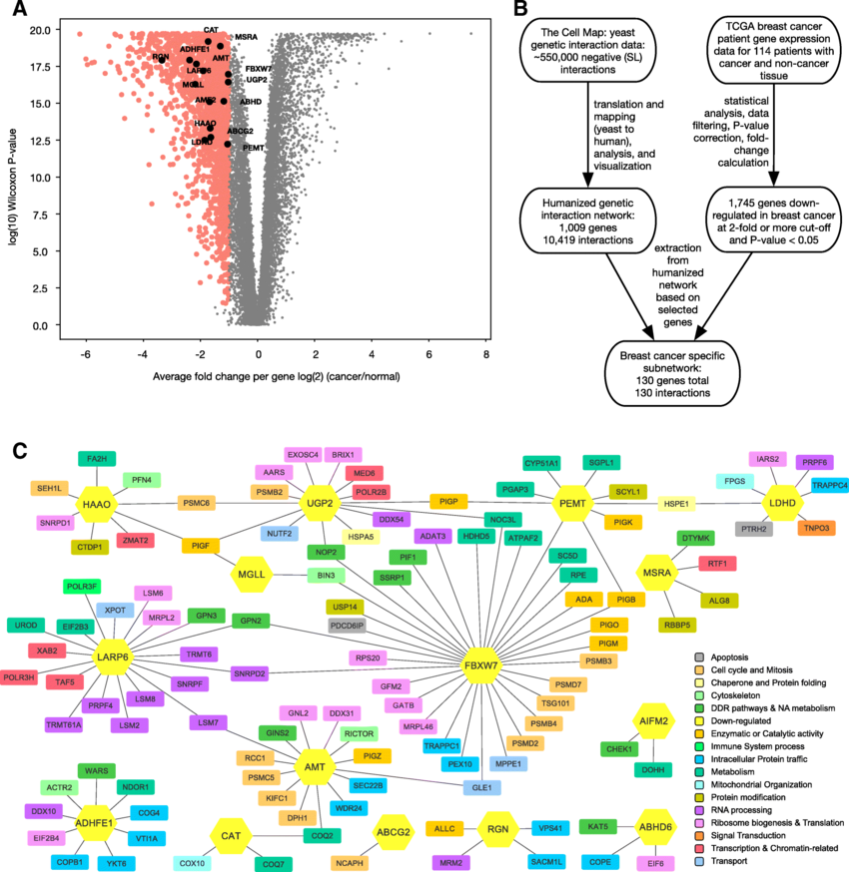
How is data organized?
- Graphs or Network
Computer Science for Everyone, Everywhere (CSEE)

Slide 150
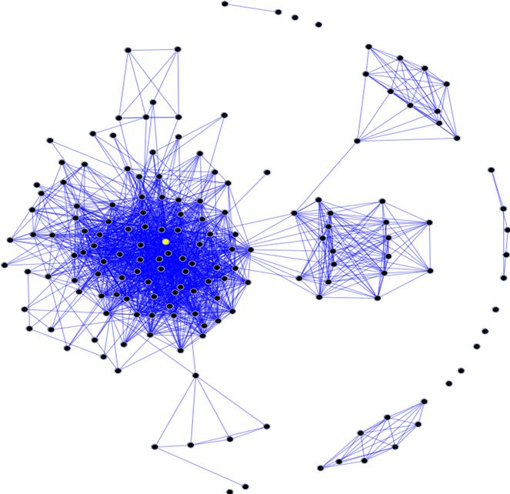
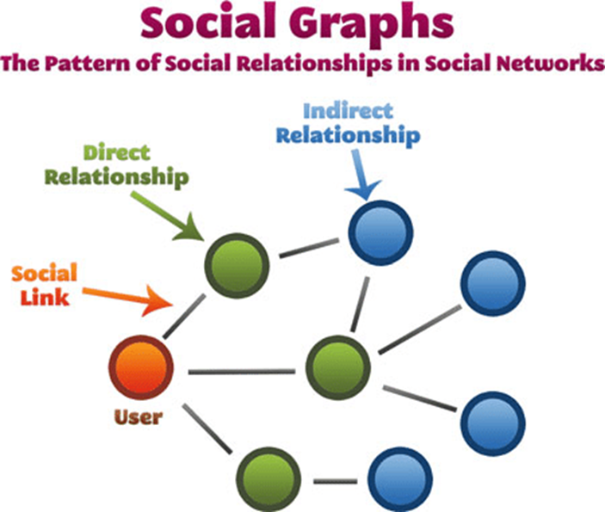
How is data collected
•Often, besides the actual information the data represents, how data interact with each other is also important. Social Media is an example of this concept.
Computer Science for Everyone, Everywhere (CSEE)

Slide 151
Lesson 1: File Formats
As a part of the standard, we have to help students understand file formats. In general we have the following formats:
Proprietary: MS Office, Comma Seperated Values (CSV) PDF, Kindle Book, etc…
Text: ASCII, Unicode
Image: JPEG, PNG
Video: MP4
Sound: MP3, WAV

Slide 152
Lesson 1 - File Formats
We can use a plain text editor to see what type a file is when we don’t know what it is.
There are websites on-line that will analyze the content.
Use a tool like Notepad to look at the file header.

Slide 153
Lesson 2: Comma Seperated Values and Data: IMDB
There are many publicly available data sets.
Sources for data:
https://www.kaggle.com/datasets
https://data.gov/
https://careers.uw.edu/blog/2021/10/05/21-places-to-find-free-datasets-for-data-science-projects-shared-article-from-dataquest/
https://www.ncdc.noaa.gov/cdo-web/datasets
At Kaggle, you can get the Internet Movie Database (IMDB) and teach students about data formats.

Slide 154
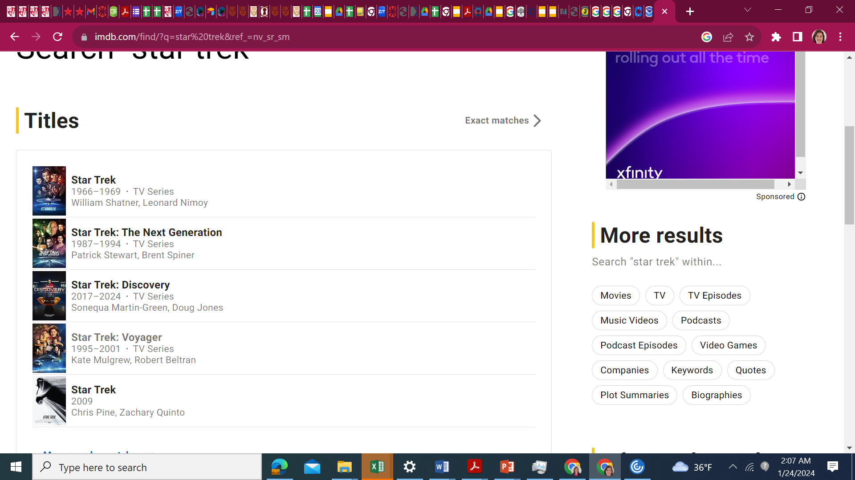
Lesson 2:CSV and IMDB

Slide 155
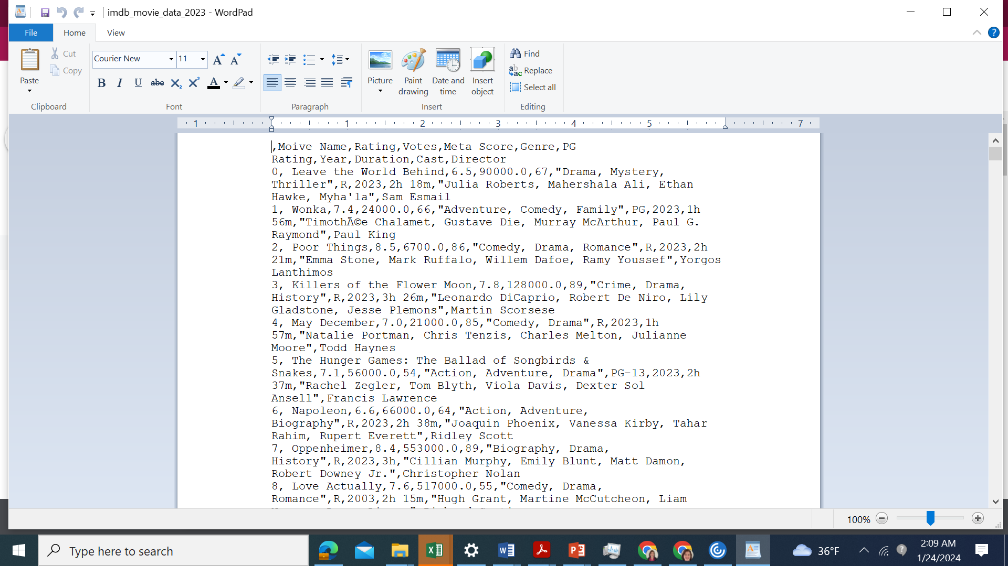
Lesson 2: CSV and IMDB

Slide 156
Lesson 2: CSV
Have children create a spreadsheet - maybe of observations about the weather or something else having to do with climate.
Use the tools in Google Sheets (Download as) to change the format from a spreadsheet to a comma separated value file.
Also, try using a spreadsheet software to view a CSV file.

Slide 157
Lesson 3 - Climate Change Simulation
https://scied.ucar.edu/activity/very-simple-climate-model-activity

Slide 158
Kids Data Resources
https://www.epa.gov/climate-change/climate-change-resources-educators-and-students
Satellite data over time: https://education.nationalgeographic.org/resource/satellite-imagery-and-change-over-time/
https://www.nesdis.noaa.gov/
https://www.noaa.gov/education/resource-collections/data/classroom-ready
https://climatekids.nasa.gov/kids-guide-to-climate-change/

Slide 159
Kids as Data Visualizers
Let children imagine what is possible - how would it be meaningful to them to understand the information.
Redesigning Google Classroom
What do they wish they had?

Slide 160
Grade 6-8 Data Sciences Expectation
Core Idea | Performance Expectations
People use digital devices and tools to automate the collection, use, and transformation of data. The manner in which data is collected and transformed is influenced by the type of digital device(s) available and the intended use of the data. | 8.1.8.DA.1: Organize and transform data collected using computational tools to make it usable for a specific purpose. | CSV and IMDB Lesson CSV and Google Spreadsheets
Data is represented in many formats. Software tools translate the low-level representation of bits into a form understandable by individuals. Data is organized and accessible based on the application used to store it. | • 8.1.8.DA.2: Explain the difference between how the computer stores data as bits and how the data is displayed. • 8.1.8.DA.3: Identify the appropriate tool to access data based on its file format. | Understanding file formats
The purpose of cleaning data is to remove errors and make it easier for computers to process. | • 8.1.8.DA.4: Transform data to remove errors and improve the accuracy of the data for analysis. | Google spreadsheets and CSV
Computer models can be used to simulate events, examine theories and inferences, or make predictions. | • 8.1.8.DA.5: Test, analyze, and refine computational models. • 8.1.8.DA.6: Analyze climate change computational models and propose refinements. | https://scied.ucar.edu/activity/very-simple-climate-model-activity

Slide 161
Further Resources
NASA’s Kid’s Climate Change site: https://climatekids.nasa.gov/kids-guide-to-climate-change/
NOAA’s Kids’ Climate Change site: https://oceanservice.noaa.gov/kids/
Octonaut Science: https://oceanexplorer.noaa.gov/octonauts/

Slide 162
Algorithms and
Computer Programming

Slide 163
Exercise
What do you do the same every single day?
Why do you do it the same way?
What goal do you reach or how do you complete a task with it?

Slide 164
Algorithms and Programming
What is an Algorithm?
Informally: An Algorithm is a step by step process by which we complete a task.
Formal definition: An algorithm is an ordered set of unambiguous, executable steps that defines a terminating process
What is Programming?
Programming is a representation of an algorithm into a form that the computer can understand.
How are they related?
Computer scientists develop algorithms and test them through math to solve problems. Then we use programming languages to develop software based on those algorithms.

Slide 165
NJ SLS CS Standard - In a Nutshell
By the end of Grade 8
• Individuals design algorithms that are reusable in many situations.
• Algorithms that are readable are easier to follow, test, and debug.
• Programmers create variables to store data values of different types and perform appropriate operations on their values.
• Control structures are selected and combined in programs to solve more complex problems. • Programs use procedures to organize code and hide implementation details. Procedures can be repurposed in new programs. Defining parameters for procedures can generalize behavior and increase reusability.
• Individuals design and test solutions to identify problems taking into consideration the diverse needs of the users and the community.

Slide 166
What does that mean to us?
The standard asks that we get students to the point where they understand the purpose of a loop - not necessarily program it well, but understand its purpose and do a simple loop.
Core ideas in this standard are:
How do we represent our ideas for a program?
How do we work with data?
How do we do a simple program?

Slide 167
Algorithms and Programming
Core Idea | Performance Expectations
Individuals design algorithms that are reusable in many situations. Algorithms that are readable are easier to follow, test, and debug. | 8.1.8.AP.1: Design and illustrate algorithms that solve complex problems using flowcharts and/or pseudocode.
Programmers create variables to store data values of different types and perform appropriate operations on their values. | 8.1.8.AP.2: Create clearly named variables that represent different data types and perform operations on their values.
Control structures are selected and combined in programs to solve more complex problems. | 8.1.8.AP.3: Design and iteratively develop programs that combine control structures, including nested loops and compound conditionals.

Slide 168
Algorithms and Programming - Part 2
Core Idea | Performance Expectations
Programs use procedures to organize code and hide implementation details. Procedures can be repurposed in new programs. Defining parameters for procedures can generalize behavior and increase reusability. | • 8.1.8.AP.4: Decompose problems and sub-problems into parts to facilitate the design, implementation, and review of programs. • 8.1.8.AP.5: Create procedures with parameters to organize code and make it easier to reuse.
Individuals design and test solutions to identify problems taking into consideration the diverse needs of the users and the community. | • 8.1.8.AP.6: Refine a solution that meets users’ needs by incorporating feedback from team members and users. • 8.1.8.AP.7: Design programs, incorporating existing code, media, and libraries, and give attribution. • 8.1.8.AP.8: Systematically test and refine programs using a range of test cases and users. • 8.1.8.AP.9: Document programs in order to make them easier to follow, test, and debug.

Slide 169
What do we dread about teaching this unit?

Slide 170
Lesson ideas we want to share

Slide 171
Definitions/Vocabulary
Iterative: To repeat

Slide 172
Perspective
Algorithms and Programming

Slide 173
The Anatomy of an Algorithm
An algorithms definition is deceptively simple: A step-by-step process by which we complete a task. There are many important elements to this definition!
Formal definition: An algorithm is an ordered set of unambiguous, executable steps that defines a terminating process
What is important:
It is ordered
It is step-by-step and its very clear steps
It is possible for the computer to do those steps
There is a clear way the algorithm ends
There is a result at the end of the algorithm
Montclair Computer Science Education Hub

Slide 174
Algorithms: It has order!
The key design factor for algorithms is that it has order.
Why is order important?
Often a step is dependent upon a previous step. We need to follow the direction like a path or recipe.
Is everything ordered on a computer?
Not everything in computing requires order - in fact, for many things to work they have to unordered or even random. This is one of the reasons why we say clearly it must be ordered.
Montclair Computer Science Education Hub

Slide 175
Algorithms: It is step-by-step!
Related to ordered, there must be clear, precise steps that are followed in the algorithm. This is often the hardest part of algorithms because often the “math proof” lets you describe the concept every openly, but the programming implementation does not allow that.
We often start with a “high level” concept, then refine until we get to pseudo-code (notation that uses many common programming techniques). We usually work on about three versions of the algorithm, using problem solving techniques to get us to code.
Montclair Computer Science Education Hub

Slide 176
Algorithms: Three Versions
Working on algorithms is like writing a paper - and using a similar process for writing a paper helps.
Brainstorming
Begin with crafting a clear statement of what you want the algorithm to do. Include the following components: what is your input, what is your output, how does the algorithm end and describe in plain language how you want to go about getting to your end state/final output. Note - this should be in PLAIN LANGUAGE
Revision
You take your brainstorming and organize it. You begin to identify programming concepts that can implement your ideas.
Sometimes you need multiple revisions at this phase.
Your last revision should be in a good place where you know the code you need to use.
Translation: Translate the Revision into any programming language.
Montclair Computer Science Education Hub

Slide 177
Algorithms: Version Example - Brainstorming
Our problem is to create an adding program. It will add two numbers, return a result and then ask the user if they want to add something else.
Brainstorming:
I think about the program …
I am adding two numbers, so I will need to input two numbers and save those somewhere. Then I have to add them. Then I have to tell the user the result. Then I have to see if they want to do it again.
Considerations:
How am I getting the two numbers that I am adding? Are they typing it in or am I using a Graphical User Interface (windows, something they touch) to get the info?
Montclair Computer Science Education Hub

Slide 178
Algorithms: Version Example - Revision 1
Brainstorm:
I am adding two numbers, so I will need to input two numbers and save those somewhere. Then I have to add them. Then I have to tell the user the result.
Revision 1
Montclair Computer Science Education Hub

Slide 179
Algorithms: Version Example - Translation phase
Revision 1 - with more details
Get two numbers from user typing in number on the keyboard
Get first number through an input statement
Assign my result to variable number1
Get second number from an input statement
Assignment my result to variable number2
I save them in a container that holds data -> variables
This work was done in the above steps.
Add numbers and save in the result
Create a result variable to hold the value of the addition.
Add number and number 2 - save the addition value in variable result
Print out the result for the user
Use an output statement to the print out result
Pseudo-code (looks like code but independent of language)
number 1 = 0
number1 = input(““Please enter your first number to be added: “)
number 2 = 0
number2 = input(““Please enter your second number to be added: “)
result = 0
result = number1 + number2
print(“Your result is “ + result)
Montclair Computer Science Education Hub

Slide 180
Algorithms: Techniques for development
We use three basic techniques to develop our algorithms:
Top-down approach
Top-down is what we did in the previous example. We start with a High-level idea and we revise it, breaking it into smaller parts until we can visible see the coding elements needed to create the program.
Top-down approach uses a concept called step-wise refinement. This means you do multiple versions of your outline, breaking up each bullet point again and again until your bullet points can be easily translatable into code.
We often use the Divide and Conquer Technique in Top Down - breaking the problem into smaller, more manageable pieces.
Montclair Computer Science Education Hub

Slide 181
Algorithms: Techniques for development
Bottom Up Approach:
Design a problem that you want to address with an algorithm
Then look at problems similar to it.
Use the pieces from other programs to build out your solution.
Bottom up is an engineering technique where you have goal x and supplies y, how do you get to your goal?
Combination of the two approaches
The reality is we use both approaches often together to get a robust solution.
Trying to look at problems from different points of view often help us with understanding where problems are in our logic.
Montclair Computer Science Education Hub

Slide 182
Algorithms: A computer can complete the task
Computers work in binary: yes and no, one and zero, true and false.
The computer isn’t good with “loose instructions” or instructions that are indefinite.
It is impossible for the computer to do the following instruction:
When you are done enjoying the sunset, do this step.
Therefore the instruction must be able to end.
Montclair Computer Science Education Hub

Slide 183
Algorithms: It Ends
It must end. When try to design with infinity with caution.
For the most part, the only place that we work with the program being allowed to run infinitely are systems programs - the operating system, the computer security features, etc.
These programs work on the idea that they run infinitely until an “interrupt” event occurs. We assume a lot of interrupts will happen.
These programs are then ended either by an interrupt or the user turning off the devise.
Montclair Computer Science Education Hub

Slide 184
Algorithms: There is a result at the end
The purpose of the algorithm is to manipulate the data in some way - therefore by the time the algorithm ends - something should have happened with the data.
Examples:
Something was stored
Something was printed or reported to the user
A value changed
A value was visualized in a cool way
A set of values were analyzed
etc…
Montclair Computer Science Education Hub

Slide 185
Simple Lessons

Slide 186
Unplugged Activities
1. Pattern Recognition: Getting loopy
Activity: https://code.org/curriculum/course1/12/Teacher#Activity1
chrome-extension://efaidnbmnnnibpcajpcglclefindmkaj/https://code.org/curriculum/course1/12/Activity12-GettingLoopy.pdf
2. Unplugged: Cup stacking
Activity: chrome-extension://efaidnbmnnnibpcajpcglclefindmkaj/https://active-living.ucalgary.ca/sites/default/files/teams/1/Coding%20Cups%20-%20MIM.pdf
Video for teachers: https://youtu.be/7zXtn8CoJ-w
3
Computer Science Education Hub

Slide 187
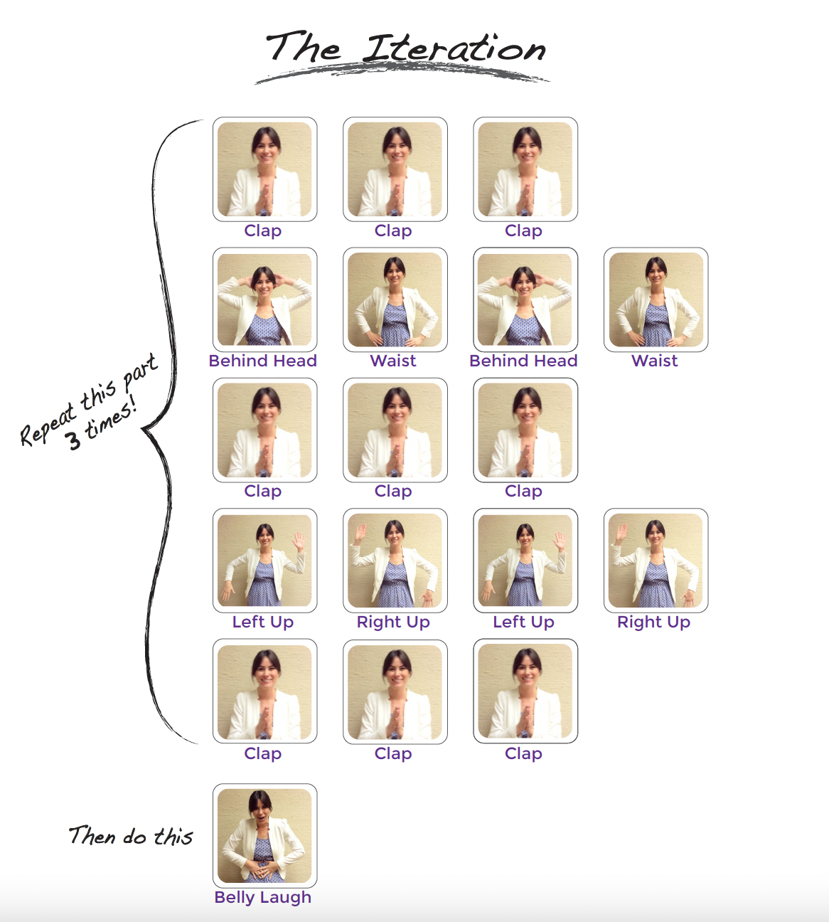
GETTING LOOPY
Resource: code.org
Vocabulary:
Loop - Say it with me: Loop
The action of doing something over and over again
Interdisciplinary:
ISTE Standards (formerly NETS)
CSTA K-12 Computer Science Standards
NGSS Science and Engineering Practices
NJ SLS Math, Language Arts

Slide 188
GETTING LOOPY:
VOLUNTEER TO
CREATE YOUR LOOP and ITERATION
Variation:
Go Noodle
https://app.gonoodle.com/activities/meow-moo-moo?sp=search&sn=search&st=video%20versions&sid=471

Slide 189
CUP STACK
Our language (code)
= Pick up stack
= Set bottom cup down
= Move ½ cup width forward
= Move ½ cup width backward
= Flip cup over
Computer Science for Everyone, Everywhere (CSEE)

Slide 190
CUP STACK
position of cup = 0 1 2
Computer Science for Everyone, Everywhere (CSEE)

Slide 191
Programming in Scratch or MIT App Inventor
https://scratch.mit.edu/
https://appinventor.mit.edu/

Slide 192
Programming in Scratch
All of your Algorithms and Programming objectives can be addressed by Scratch.
Note - the Algorithms and Programming (and also the Data Standard) should be divided up over multiple years.
Grade 3/6: Get them started with Scratch - learn to design and visualize, create pseudocode
Grade 4/7: Introduce variable and if statements
Grade 5/8: Integrate more control structures

Slide 193
Resources for Scratch
Scratch Lessons by Year at Code for Fun: https://www.codeforfun.com/LessonPlans/
Videos to help learn the basics for Scratch: https://www.youtube.com/thetechtrain

Slide 194
Vocabulary: Algorithms and Programming
Syntax: Meaning variable: Capitalized, variables store a number. set: Sets a VARIABLE equal to a number. input: Input a number to be stored in a VARIABLE. calculate: Performs mathematical operations. +, -, *, /, = : Add, subtract, multiply, divide, equals. <, <= : Less than, less than or equal to. >, >= : Greater than, greater than or equal to. | display: Prints information to the screen. if: If a condition is true, run its block of code. Otherwise, skip the block of code. else if: See if. Follows if statement and checks if a different condition is true. start loop: Begins a repeating block of code. repeat x times: Repeats a loop x times. end loop: Stops repeating a block of code.
Montclair Computer Science Education Hub

Slide 195
Further Resources
https://code.org/student/middle-high
https://www.create-learn.us/blog/coding-competitions-for-kids-teens/

Slide 196
Impacts of Computing

Slide 197
NJ SLS CS Standard for Impacts of Computing - In a Nutshell
By the end of Grade 8
• Advancements in computing technology can change individuals’ behaviors.
• Society is faced with tradeoffs due to the increasing globalization and automation that computing brings.

Slide 198
What does that mean to us?
Kids today are experiencing the world in an extremely different way than even the generation 10 years ago.
They are constantly in contact with others
Life is facilitated by technology - they barely know what commercials, cliffhangers and must see TV is!
Those who have trouble accessing technology are experiencing larger access gaps with regards to education, jobs and wealth.

Slide 199
Impacts of Computing
Core Idea | Performance Expectations
Advancements in computing technology can change individuals’ behaviors. Society is faced with trade-offs due to the increasing globalization and automation that computing brings. | • 8.1.8.IC.1: Compare the trade-offs associated with computing technologies that affect individual’s everyday activities and career options. • 8.1.8.IC.2: Describe issues of bias and accessibility in the design of existing technologies.

Slide 200
Perspective - Computers and Society

Slide 201
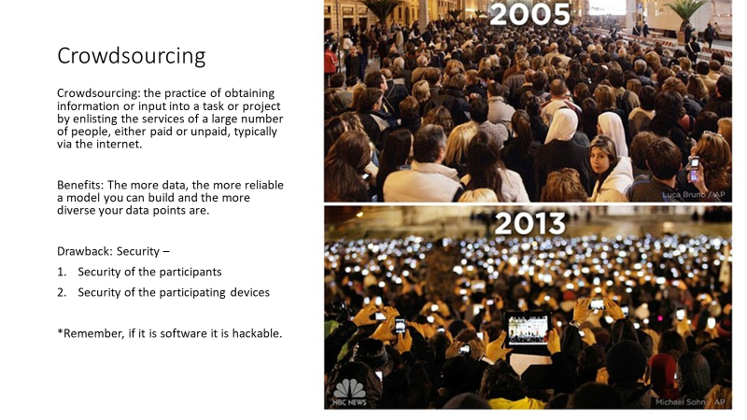

Slide 202
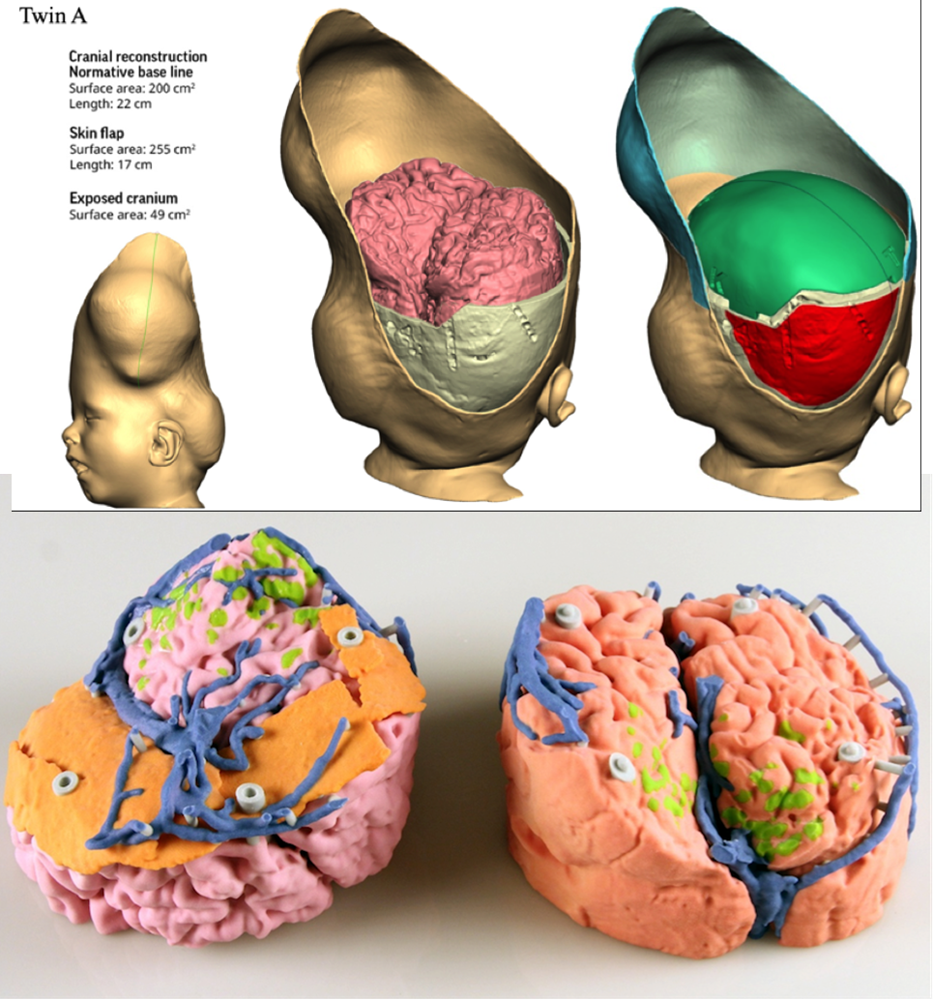
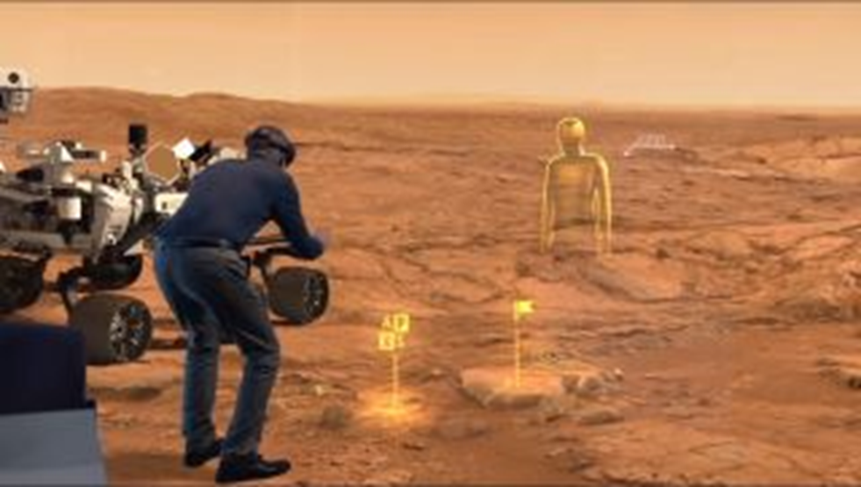
How is data visualized?
Computer Science for Everyone, Everywhere (CSEE)

Slide 203
AI and Life Changing Tools
ChatGPT - write a paper on computer science education …
ChatGPT - if you have a hypothetical patient with these symptoms, what illness do you think they have
ChatGPT - translate this sentence from English to Spanish: Can I help you?
ChatGPT - Generate a knitting pattern for me …
More at: Epic ChatGPT Fails: https://www.buzzfeed.com/andyneuenschwander/chatgpt-ai-fails-funny

Slide 204
Lesson 1: Computing Art Crawl!!!
Have students do an art project based on one trade-off that they observe with technology. Many have just gotten their phones - ask them about the tradeoffs they observe since getting phones.

Slide 205
Lesson 2: Bias in Algorithms
Computers represent the people who program them - therefore there are biases in them.
Exercise - look at various images created by AIs - What patterns do you see?
For example - ask an AI generator to generate a picture of a person in a certain career field - what genders and races do you observe?
https://www.bloomberg.com/graphics/2023-generative-ai-bias/

Slide 206
Conclusions
This was a boot camp experience! You will need time to decompress.
Try to integrate one idea from a lesson you learned today in your teaching - then email us at k12csed@montclair.edu and tell us how it went - better yet - take pics and video and send them to us or tag us on social media.
Thank you so much to everyone for coming today and supporting this project.
Please fill out our Post-PD survey: https://forms.gle/AJEiBHf1wcMPmyfA8
Also, and this is optional, if you could fill out this reflection, we would appreciate it:
https://forms.gle/ZcENGE9BqXUJSwqd6

