Slide 1
AP
The New Jersey Student Learning Standards
Computer Science & Design Thinking
8.1.2
Algorithms & Programming
8.1.2

Slide 2
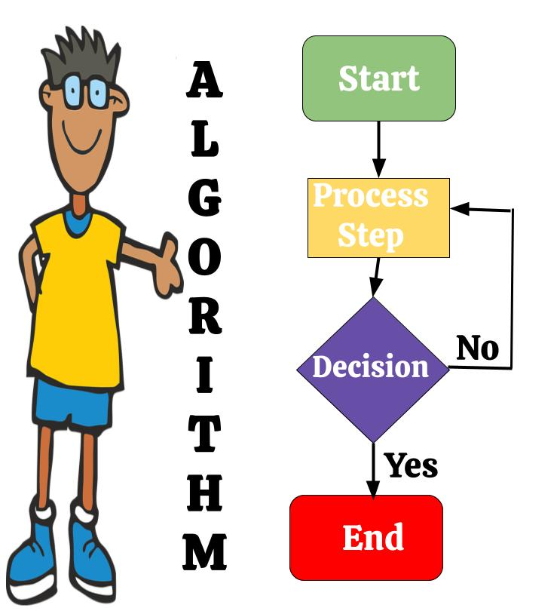
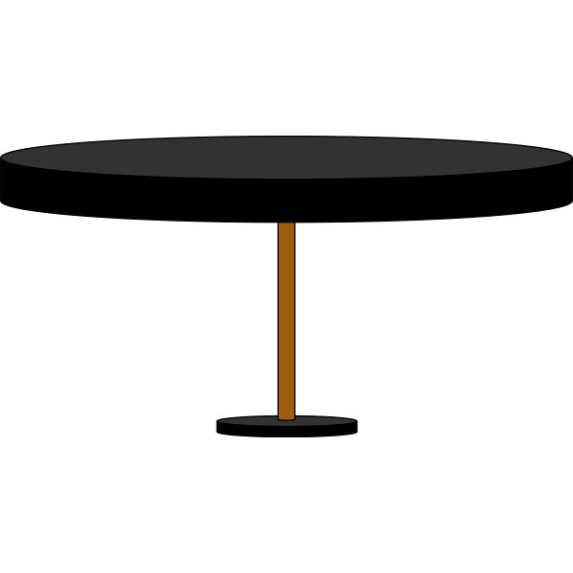
New Jersey Student Learning Standards
AP
Technology:
8.1.2.AP.1: Model daily processes by creating and following algorithms to complete tasks.
8.1.2.AP.2: Model the way programs store and manipulate data by using numbers or other symbols to represent information.
8.1.2.AP.3: Create programs with sequences and simple loops to accomplish tasks.
8.1.2.AP.4: Break down a task into a sequence of steps.
8.1.2.AP.5: Describe a program’s sequence of events, goals, and expected outcomes.
8.1.2.AP.6: Debug errors in an algorithm or program that includes sequences and simple loops.
8.1.2

Slide 3
I
AP
Core Concept 8.1.2 Algorithms & Programming
People develop and follow directions as part of daily life. A sequence of steps designed to accomplish a specific task is called an algorithm. Computer programmers create algorithms for programs, or code by providing instructions to computing devices. Algorithms and programming control all computing systems, empowering people to communicate with the world in new ways and solve all type of problems.
8.1.2

Slide 4
AP
Topics Covered
Communication Between Humans
Algorithms
Debugging
Programming
Computer Programming
Works Cited
8.1.2

Slide 5
AP
Communication
Between Humans
8.1.2

Slide 6
AP
Communication Between Humans
People create ways to communicate with each other without speaking.
We have codes with
pictures and symbols
to share secret messages!
↪↻↾←⍇╅┆┗☨♽⛕⛤☡✆⛦⛚⛓⛮
8.1.2

Slide 7
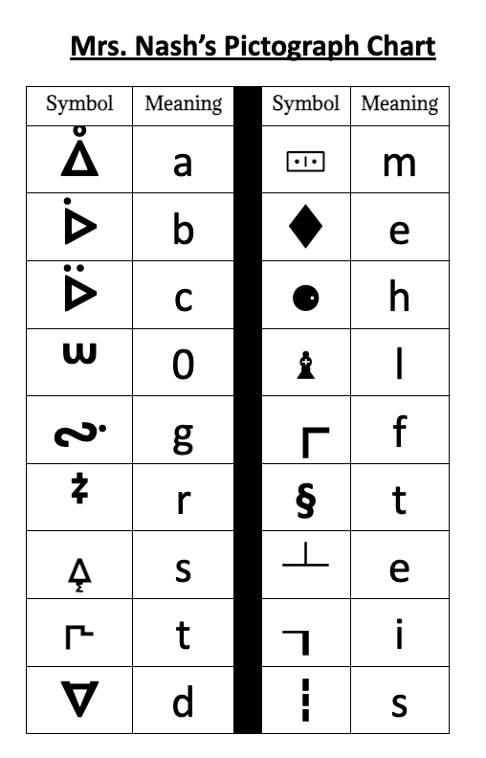
Writing Algorithms
AP
Pictographs
Pictographs represent letters or words. It is a graphical representation of data using symbols, icons, or pictures.
8.1.2
Notes:
Have students come up with a third option. For example a triangle for Yes and a circle for No.

Slide 8
Writing Algorithms
AP
Use the pictograph chart to decode the following message!
ᐂ♝ᔞᐜᙇ┒𐅬⚈🀹𐅐
8.1.2
Notes:
Have students come up with a third option. For example a triangle for Yes and a circle for No.

Slide 9
AP
Communication Between Humans
Braille is a reading and writing system for blind and vision impaired people, made up of raised dots that can be 'read' by touch.
8.1.2
Notes:
Try to get and show an actual passage in braille so students can see and touch it.

Slide 10
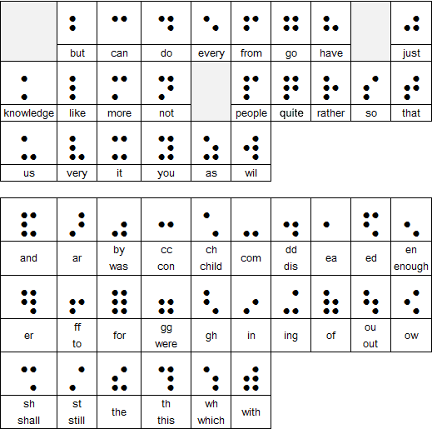
AP
Communication Between Humans
Braille Chart
8.1.2

Slide 11
AP
Communication Between Humans
Sign language is commonly used by people who are deaf. The gestures or symbols in sign language are organized in a linguistic way. Each individual gesture is called a sign.
8.1.2

Slide 12
AP
Communication Between Humans
Sign language Each sign has three distinct parts:
the handshape,
the position of the hands, and
the movement of the hands.
American Sign Language (ASL) is used most in our country. Other countries have their own sign language.
8.1.2

Slide 13
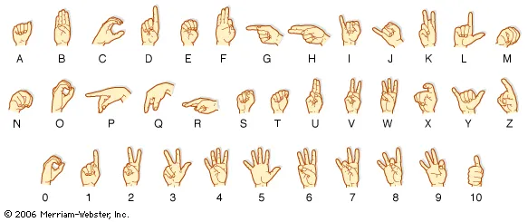
AP
Communication Between Humans
American Sign Language Symbols
8.1.2
Notes:
Have students sign the word “Hello”.

Slide 14
AP
Communication Between Humans
We create our own code to send and receive secret messages.
8.1.2

Slide 15
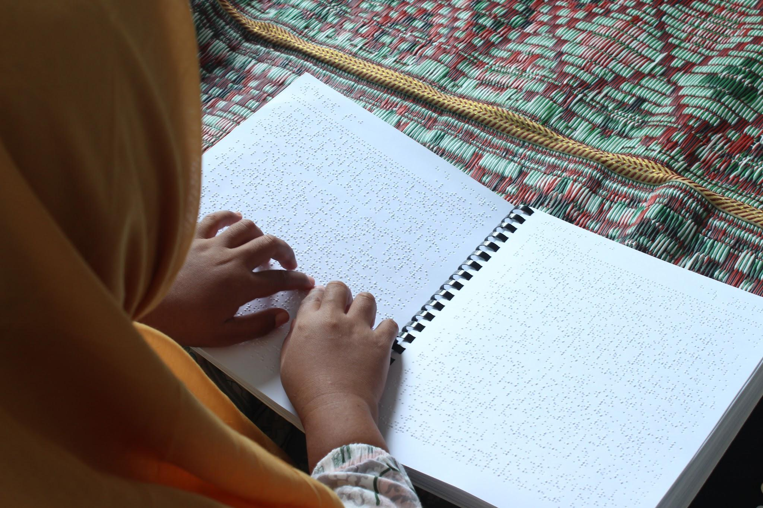
AP
Communication Between Humans
We have braille to communicate with the visually impaired.
8.1.2

Slide 16
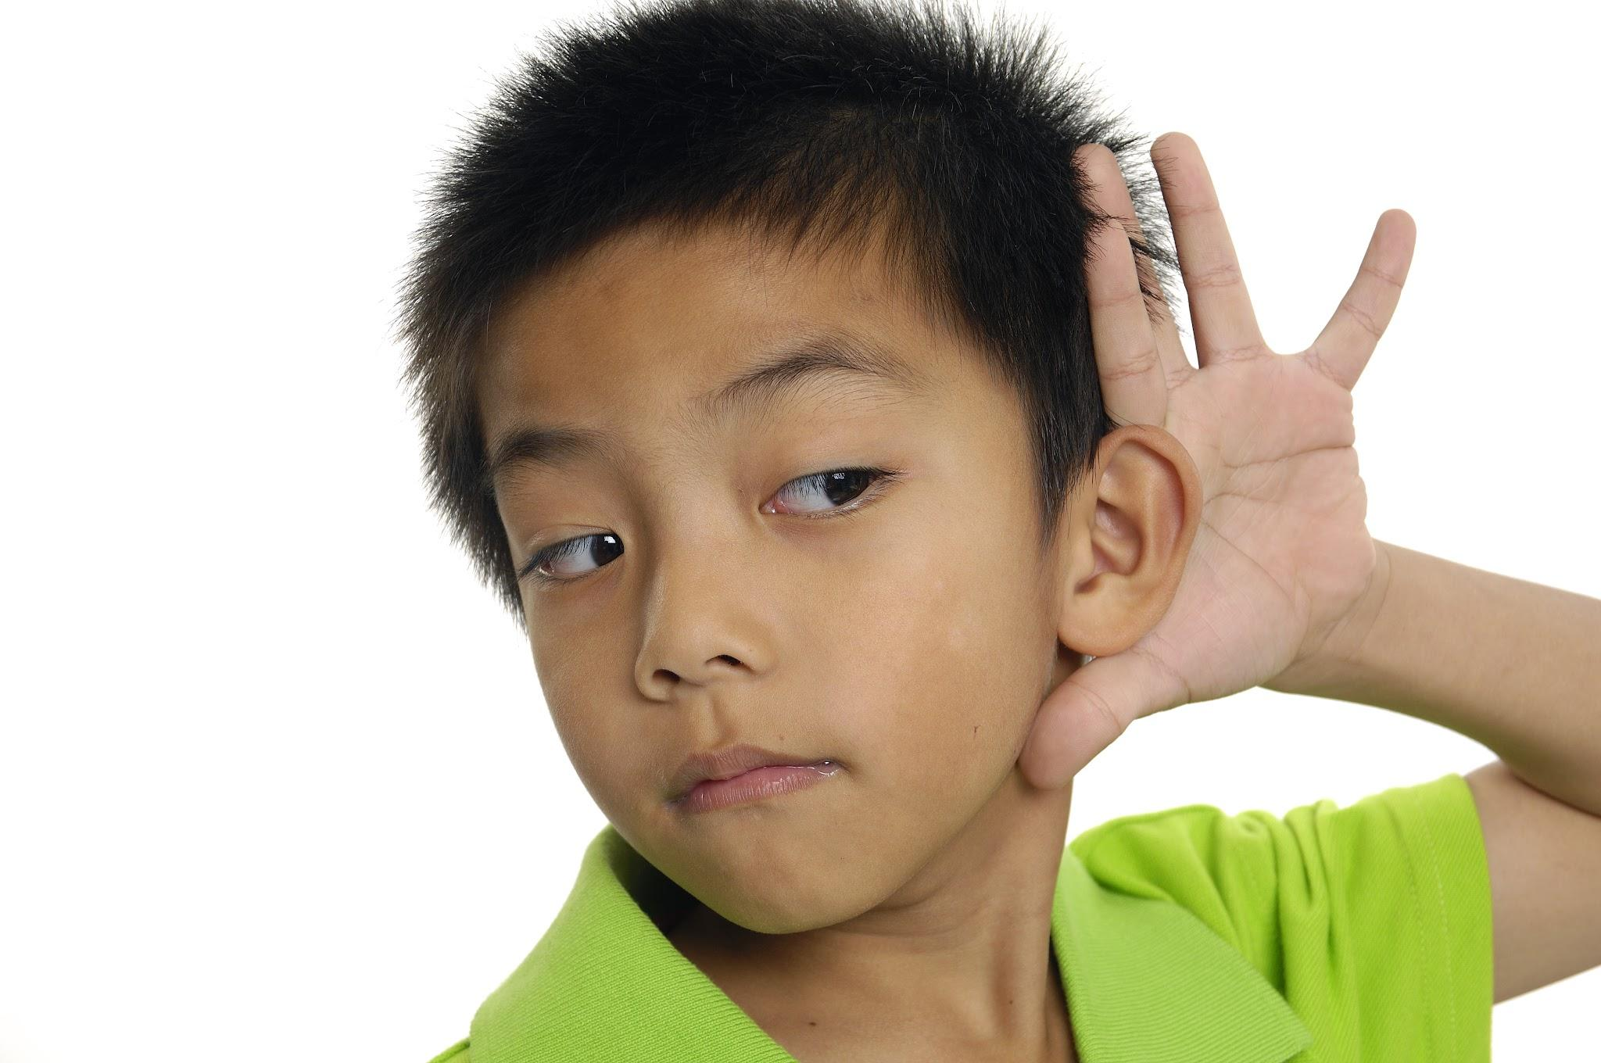
Communication Between Humans
AP
We have sign language to communicate with the deaf!
8.1.2
Notes:
Have students come up with a third option. For example a triangle for Yes and a circle for No.

Slide 17
AP
Algorithms
8.1.2

Slide 18
What Is An Algorithm?
AP
List three tasks or things you do everyday?
8.1.2
Notes:
Note to teacher: After a few minutes have students share their list. Write ideas on the smartboard.

Slide 19
What Is An Algorithm?
AP
Examples of Daily Tasks
getting ready for school
brushing teeth
tying sneaker strings
travelling to or from school
school day
structure of a class
participating in clean-up time
8.1.2
Notes:
Note to teacher: After a few minutes have students share their list. Write ideas on the smartboard.

Slide 20
What Is An Algorithm?
AP
Take one item from your list and write the steps you use to complete that task.
8.1.2
Notes:
From the completed list discuss how we usually complete task the same way every time. Have students write the steps for one of their tasks. Have several students share with class.

Slide 21
What Is An Algorithm?
AP
Congratulations! You have just created your first algorithm!
8.1.2
Notes:
From the completed list discuss how we usually complete task the same way every time. Have students write the steps for one of their tasks. Have several students share with class.

Slide 22
What Is An Algorithm?
AP
Sooooo!
What is an algorithm?
8.1.2
Notes:
From the completed list discuss how we usually complete task the same way every time. Have students write the steps for one of their tasks. Have several students share with class.

Slide 23
What Is An Algorithm?
AP
Imagine you have a recipe book. In this book, you have instructions on how to make your favorite sandwich. The book has step by step directions of how to put the sandwich together using words like first, second, third, next, and last.
8.1.2
Notes:
From the completed list discuss how we usually complete task the same way every time. Have students write the steps for one of their tasks. Have several students share with class.

Slide 24
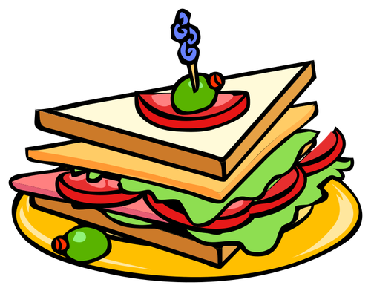
What Is An Algorithm?
AP
After following instructions in the recipe book, your sandwich comes out perfectly!
8.1.2
Notes:
From the completed list discuss how we usually complete task the same way every time. Have students write the steps for one of their tasks. Have several students share with class.

Slide 25
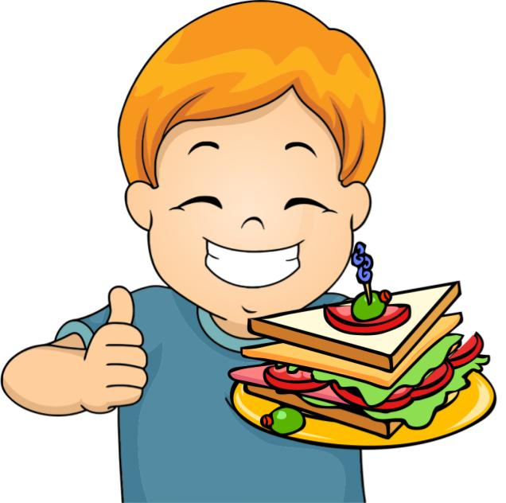
What Is An Algorithm?
AP
In fact, the instructions are so good, that anyone who follows the recipe can make the same, exact sandwich!
8.1.2
Notes:
From the completed list discuss how we usually complete task the same way every time. Have students write the steps for one of their tasks. Have several students share with class.

Slide 26
What Is An Algorithm?
AP
A computer algorithm is like a set of
instructions that tell
the computer what to
do!
8.1.2
Notes:
From the completed list discuss how we usually complete task the same way every time. Have students write the steps for one of their tasks. Have several students share with class.

Slide 27
What Is An Algorithm?
AP
So, just like your recipe book tells you how to make a sandwich, a computer algorithm is a
list of step by step
instructions that are
followed in order to
complete a task (run a program).
8.1.2
Notes:
From the completed list discuss how we usually complete task the same way every time. Have students write the steps for one of their tasks. Have several students share with class.

Slide 28
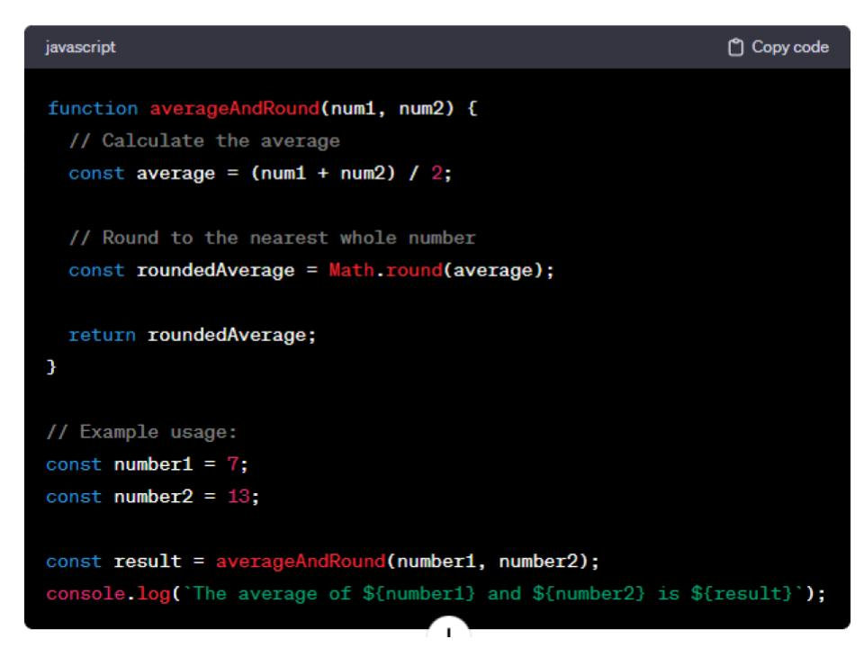
What Is An Algorithm?
AP
It's like giving the computer a recipe to follow to do something cool!
8.1.2
Notes:
From the completed list discuss how we usually complete task the same way every time. Have students write the steps for one of their tasks. Have several students share with class.

Slide 29
What Is An Algorithm?
AP
Remember! In order for your algorithm to work you must use provide, clear, precise and efficient steps!
STEP …
STEP 4
8.1.2
STEP 3
STEP 2
STEP 1
Notes:
From the completed list discuss how we usually complete task the same way every time. Have students write the steps for one of their tasks. Have several students share with class.

Slide 30
AP
Writing Algorithms
Representing Yes or No
Yes | No
1 | 2
8.1.2
Notes:
Have students come up with a third option. For example a triangle for Yes and a circle for No.

Slide 31
Writing Algorithms
AP
Directional Arrows
left
right
up
down
Clockwise turn
Counter clockwise turn
8.1.2
Notes:
Have students come up with a third option. For example a triangle for Yes and a circle for No.

Slide 32
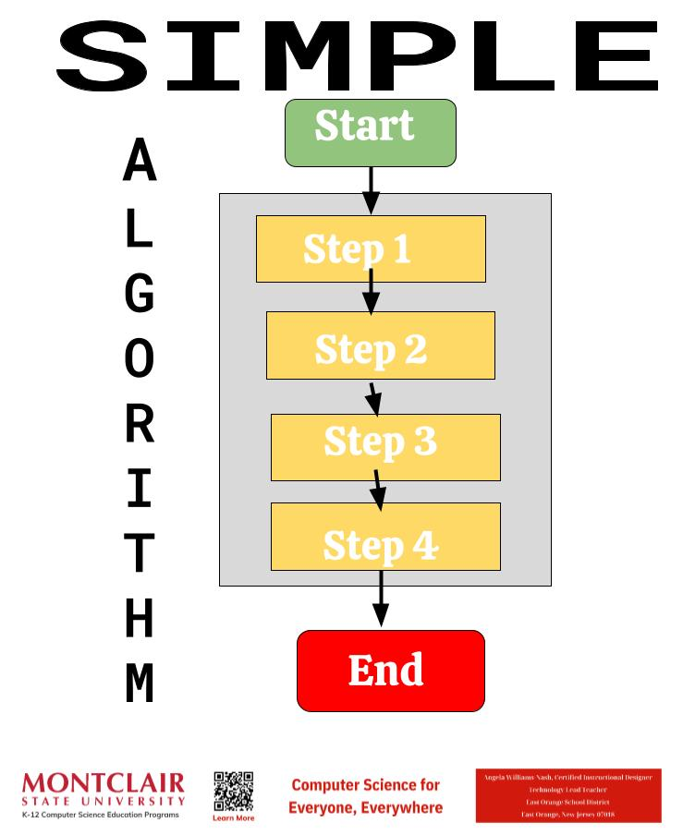
Writing Algorithms
AP
Simple Algorithm
8.1.2
Notes:
From the completed list discuss how we usually complete task the same way every time. Have students write the steps for one of their tasks. Have several students share with class.

Slide 33
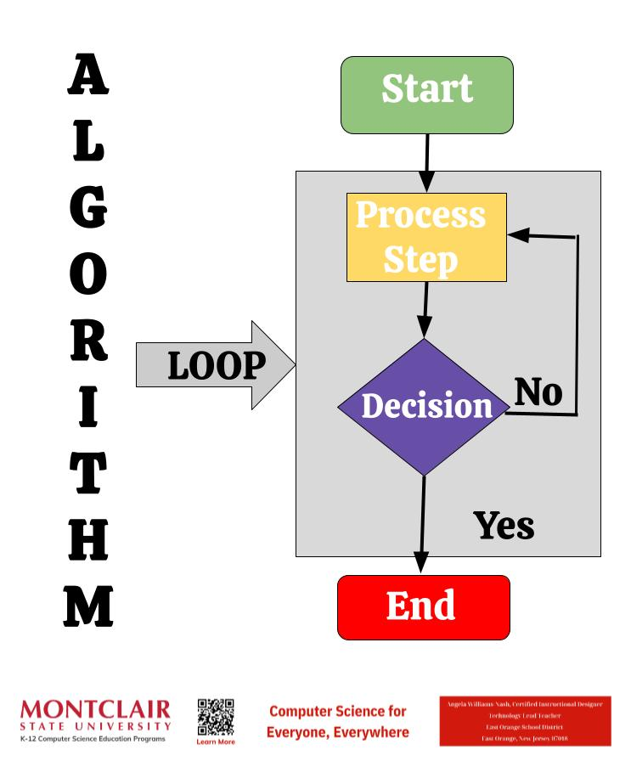
Writing Algorithms
AP
Algorithm With A Loop
Allow you to repeat sets of instructions without having to write them out multiple times.
8.1.2

Slide 34
Writing Algorithms
AP
Pseudocode
Humans use pseudocode (a notation resembling a simplified programming language, used in program design), to create and assess an algorithm before coding.
8.1.2
Notes:
From the completed list discuss how we usually complete task the same way every time. Have students write the steps for one of their tasks. Have several students share with class.

Slide 35
Writing Algorithms
AP
Decomposition
Sometimes, an a problem is too big. In this case, we decompose or break down a problem or task into smaller, more manageable parts.
8.1.2
Notes:
From the completed list discuss how we usually complete task the same way every time. Have students write the steps for one of their tasks. Have several students share with class.

Slide 36
Writing Algorithms
AP
Writing An Algorithm
Use the box below to write an algorithm, using arrows and turns that will make your human robot move from one spot to another in the class.
8.1.2
Notes:
Have students come up with a third option. For example a triangle for Yes and a circle for No.

Slide 37
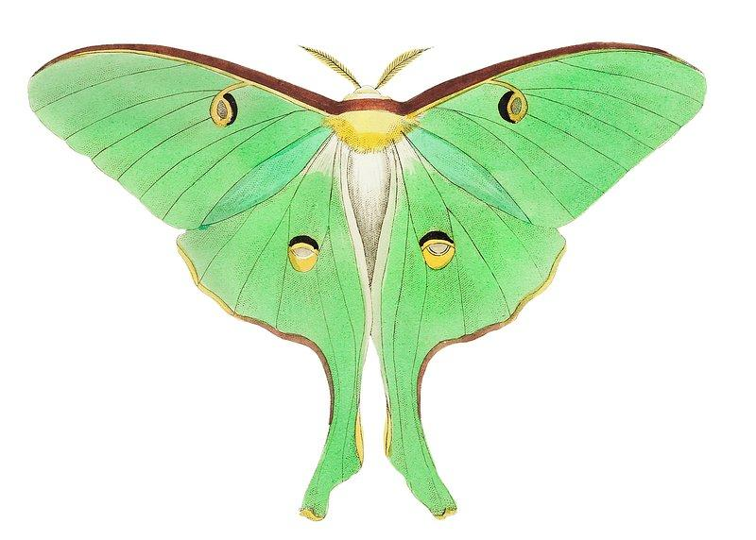
AP
Debugging
8.1.2

Slide 38
Debugging
AP
Debugging is the process of finding and fixing errors. A bug is present anytime your program does not function as expected.
8.1.2
Notes:
Have students come up with a third option. For example a triangle for Yes and a circle for No.

Slide 39
AP
Programming
8.1.2

Slide 40
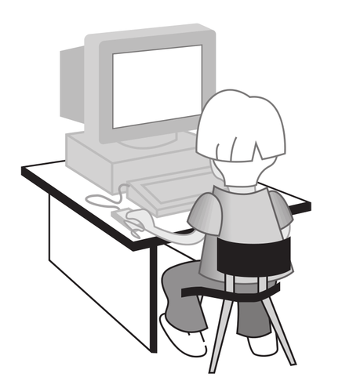
Programming
AP
Let’s look at the way people communicate with computers!
8.1.2
Notes:
Have students come up with a third option. For example a triangle for Yes and a circle for No.

Slide 41
Programming
AP
Programs store and manipulate data by using numbers or other symbols to represent information. Let’s go through a few examples.
8.1.2
Notes:
From the completed list discuss how we usually complete task the same way every time. Have students write the steps for one of their tasks. Have several students share with class.

Slide 42
Programming
AP
Human-Computer Communication
Binary code is one type of coding that uses only 0 and 1 to represent letters, numbers, and symbols. It is called binary code because it’s made of only two symbols. The “bi” in binary means two!
8.1.2
Notes:
Have students come up with a third option. For example a triangle for Yes and a circle for No.

Slide 43
Programming
AP
Human-Computer Communication
The hardware of computers has only two electrical states, on or off. These can be represented by
0 or zero (off), or
1 or one (on).
8.1.2
Notes:
Have students come up with a third option. For example a triangle for Yes and a circle for No.

Slide 44
Programming
AP
Human-Computer Communication
Letters, numbers, and symbols are translated to eight-character binary numbers (0 and 1) as you work with them through the software on your computer.
8.1.2
Notes:
Have students come up with a third option. For example a triangle for Yes and a circle for No.

Slide 45
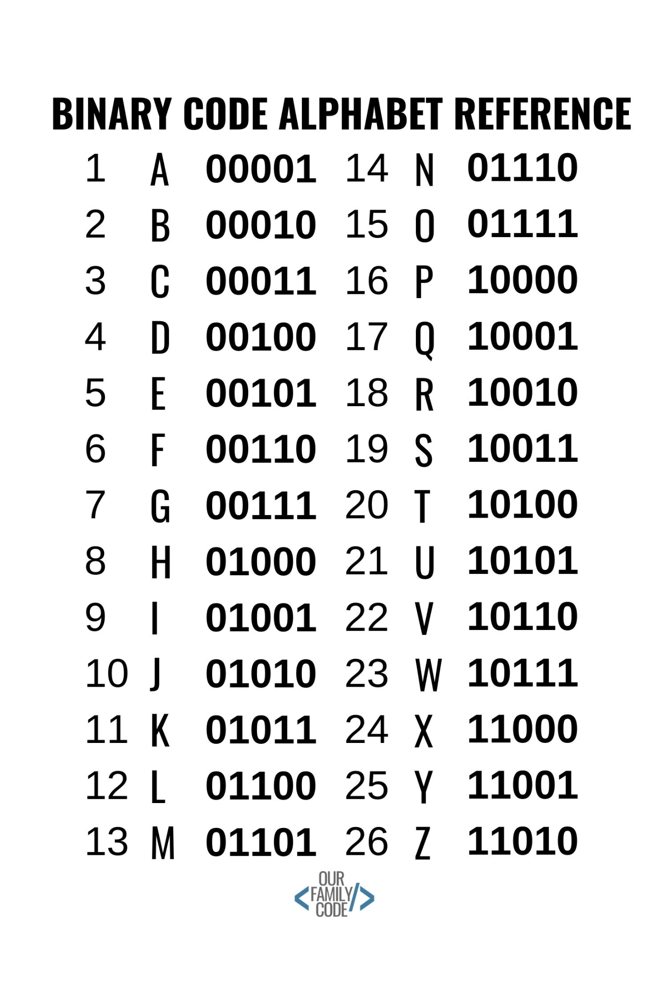
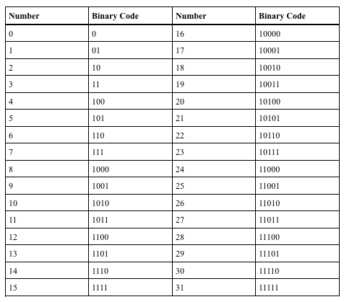
Programming
AP
Human-Computer Communication
8.1.2
Notes:
Have students come up with a third option. For example a triangle for Yes and a circle for No.

Slide 46
Programming
AP
Exercise
Use the chart to write your first name in binary code:
8.1.2
Notes:
Have students come up with a third option. For example a triangle for Yes and a circle for No.

Slide 47
AP
Computer Programming
8.1.2

Slide 48
Computer Programming
AP
What is Computer Programming?
Imagine you have a big box of colorful building blocks. Each block is like a little instruction for the computer to follow. When you put these blocks together in a certain order, they tell the computer what to do, just like when you follow the steps to build a tower with your blocks.
8.1.2
Notes:
Have students come up with a third option. For example a triangle for Yes and a circle for No.

Slide 49
Computer Programming
AP
What is Computer Programming?
Now, these blocks are special because they're made for the computer. They tell it how to do things like play a game, draw a picture, or even talk to other computers far away. When you press a button on the computer or a tablet, it follows the instructions from these blocks to do what you want, like open a game or show a video.
8.1.2
Notes:
Have students come up with a third option. For example a triangle for Yes and a circle for No.

Slide 50
Computer Programming
AP
What is Computer Programming?
So, computer programs are like sets of instructions that tell the computer what to do, just like you use instructions to build something with your building blocks!
// Function to collect numbers from the user
function collectNumbers() {
let numbers = [];
for (let i = 1; i <= 4; i++) {
let input = prompt("Enter number " + i + ":");
let number = parseFloat(input);
if (!isNaN(number)) {
numbers.push(number);
} else {
alert("Invalid input. Please enter a valid number.");
return null;
}
}
return numbers;
}
// Function to calculate sum of numbers
function calculateSum(numbers) {
let sum = 0;
for (let number of numbers) {
sum += number;
}
return sum;
}
// Function to calculate average of numbers
function calculateAverage(numbers) {
let sum = calculateSum(numbers);
return sum / numbers.length;
}
// Main function
function main() {
let numbers = collectNumbers();
if (numbers !== null) {
let sum = calculateSum(numbers);
let average = calculateAverage(numbers);
alert("Sum: " + sum + "\nAverage: " + average);
}
}
// Call the main function
main();
8.1.2
Notes:
Have students come up with a third option. For example a triangle for Yes and a circle for No.

Slide 51
AP
Works Cited
OpenAI. 2024. ChatGPT (2023) Algorithms & Programming. Retrieved from https://www.openai.com/
What is Braille?
What is Sign Language?
What is ASCII?
What is Binary Code?
8.1.2

