Slide 1


NI
The New Jersey Student Learning Standards
Computer Science & Design Thinking
8.1.2 Networks
& The Internet
8.1.2

Slide 2

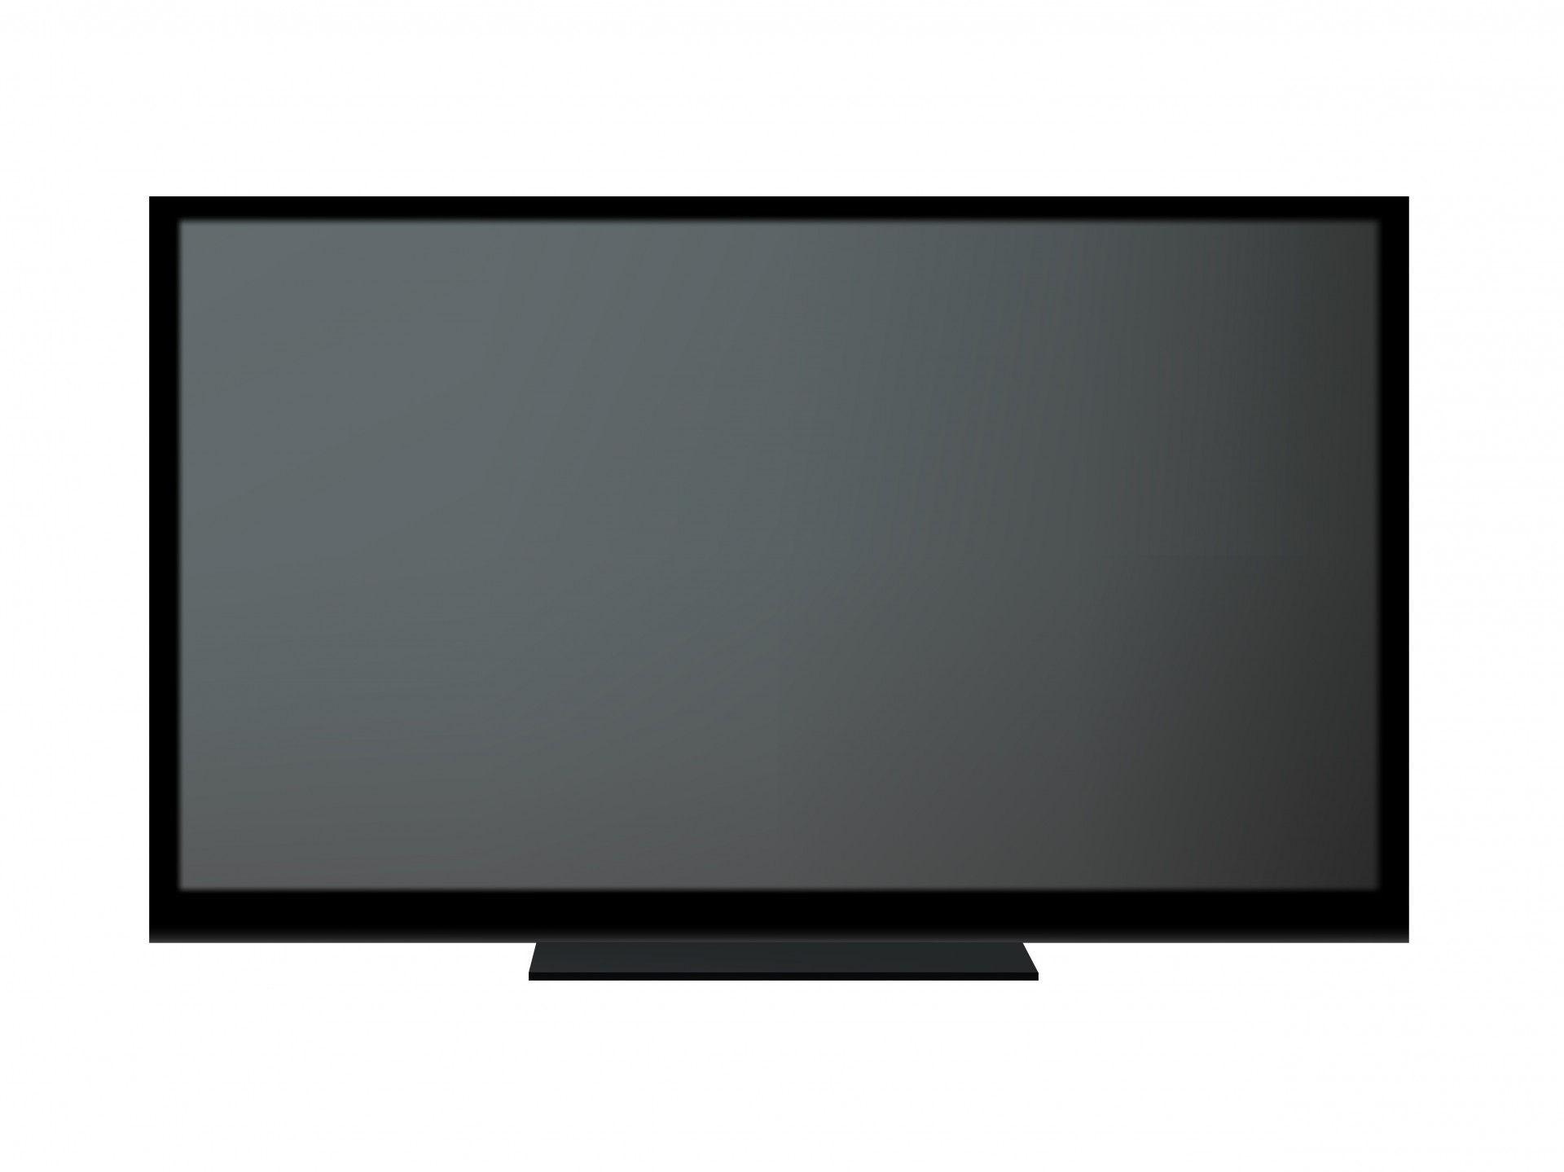
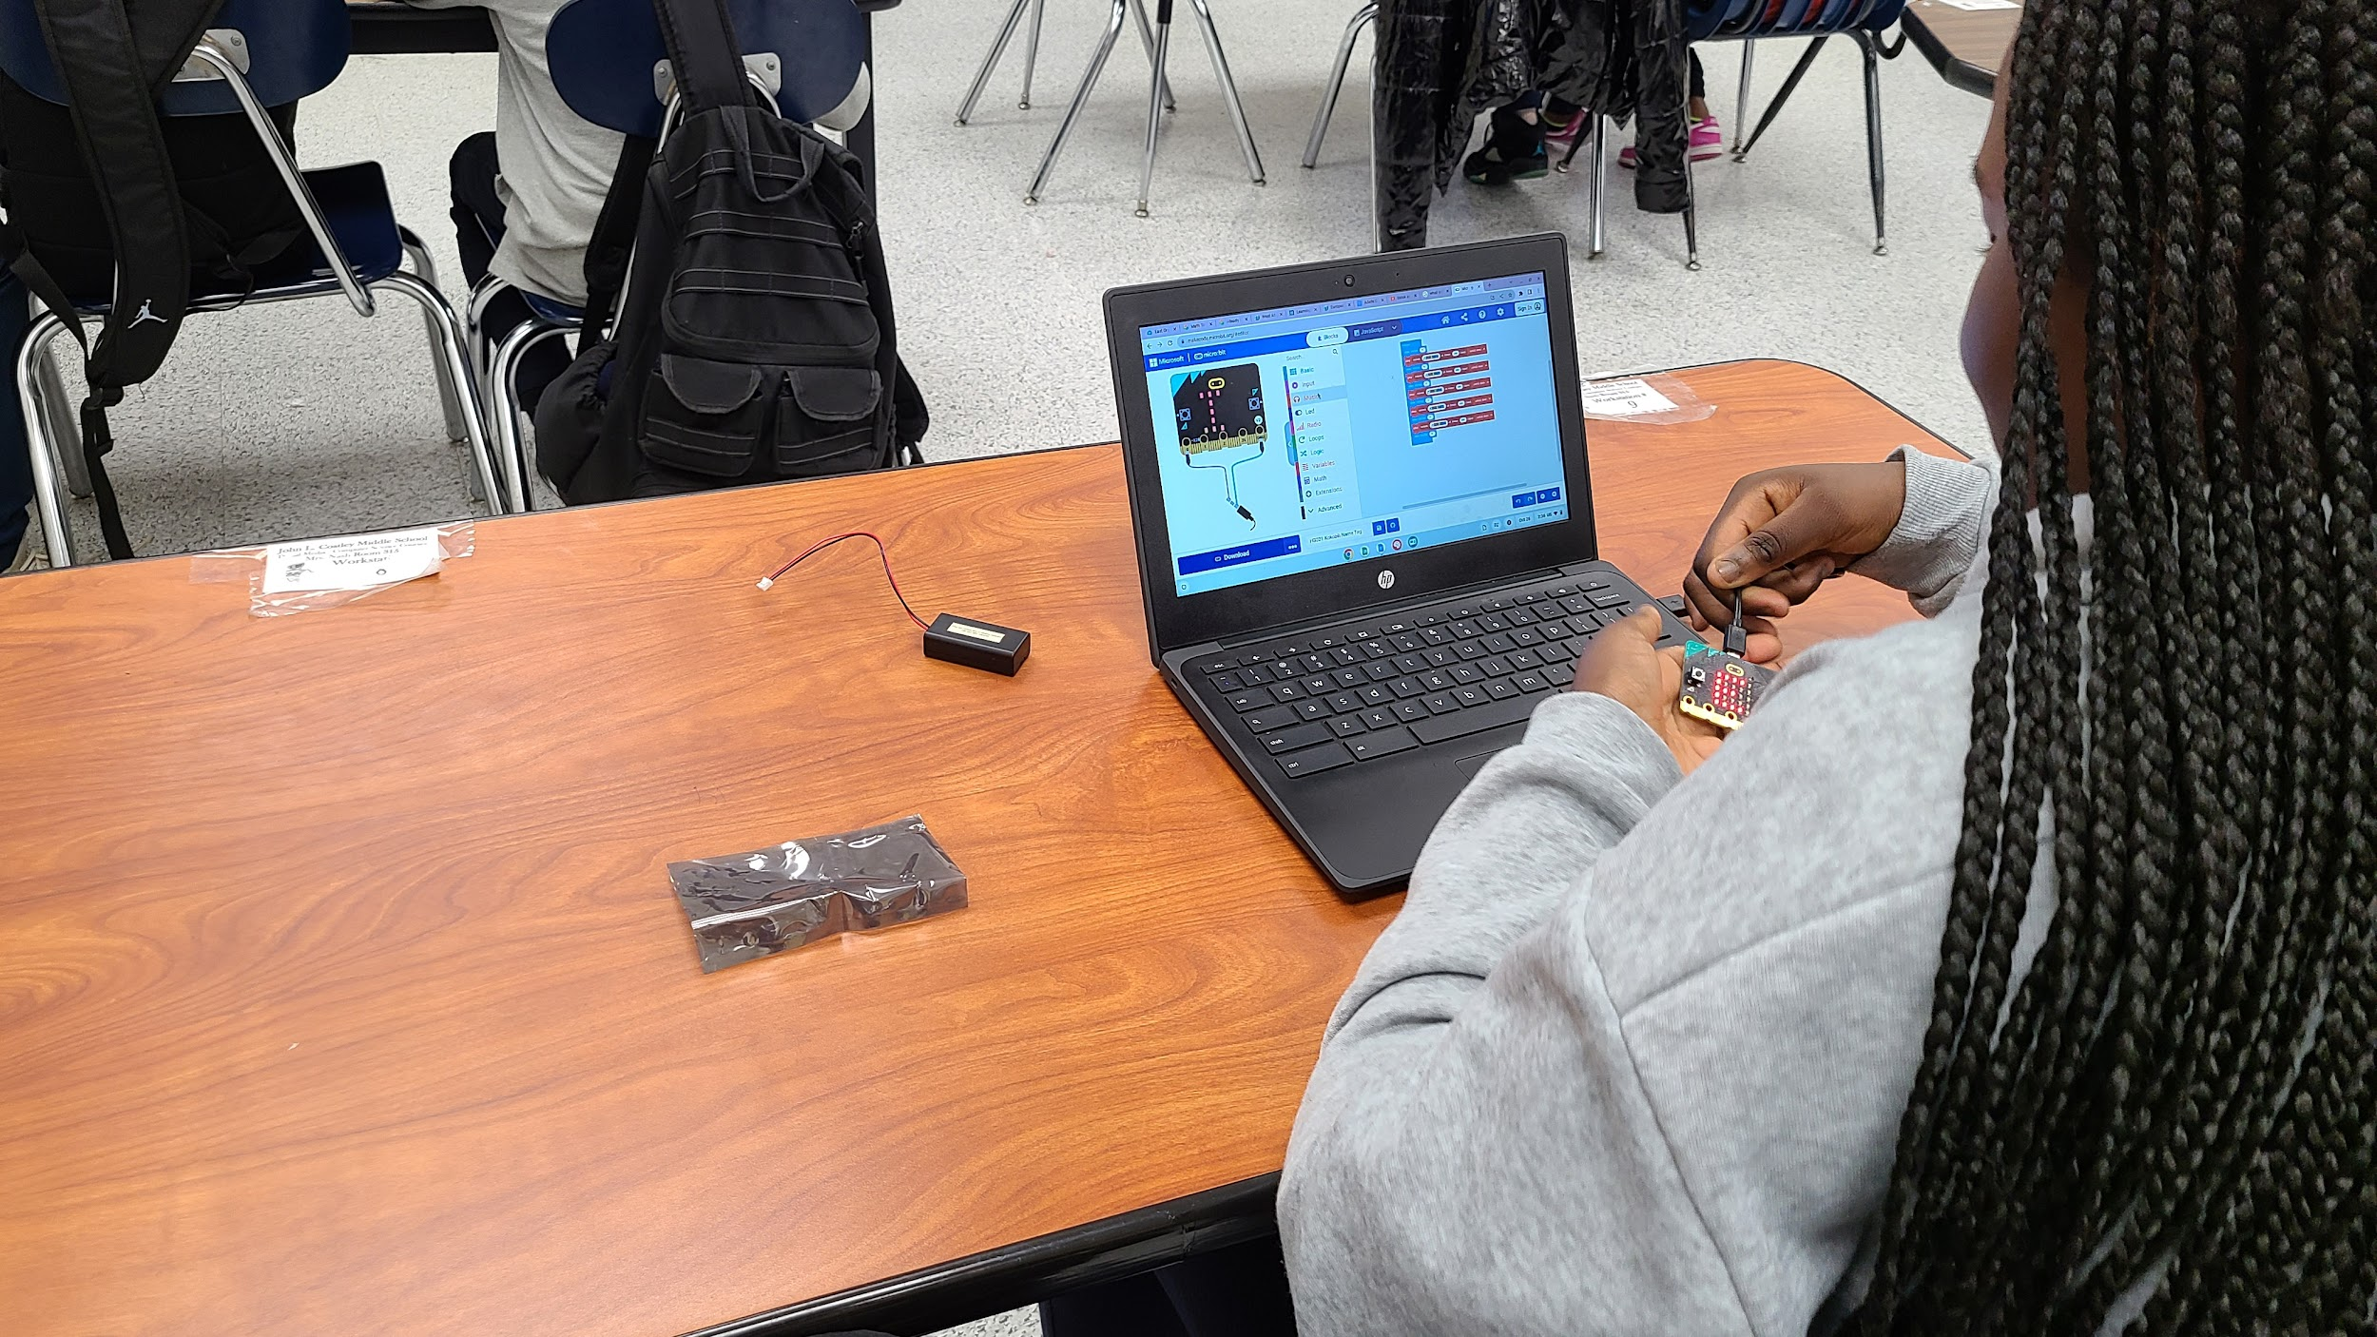




New Jersey Student Learning Standards
NI
Technology:
8.1.2.NI.1: Model and describe how individuals use computers to connect to other individuals, places, information, and ideas through a network.
8.1.2.NI.2: Describe how the Internet enables individuals to connect with others worldwide.
8.1.2.NI.3: Create a password that secures access to a device. Explain why it is important to create unique passwords that are not shared with others.
8.1.2.NI.4: Explain why access to devices need to be secured.
8.1.2

Slide 3
I
NI
Core Concept 8.1.2 Networks & The Internet
Computing devices typically do not operate in isolation. Networks connect computing devices to share information and resources and are an increasingly integral part of computing. Networks and communication systems provide greater connectivity in the computing world.
8.1.2

Slide 4
NI
Topics Covered
Background Vocabulary
Computer Network
The Internet
Types of Networks
Network Protocols
Accessing the Internet
8.1.2

Slide 5
NI
Background Vocabulary
8.1.2

Slide 6
Background Vocabulary
NI
Before discussing networks, we will define the following key vocabulary words:
Data
Hardware
Software
8.1.2

Slide 7
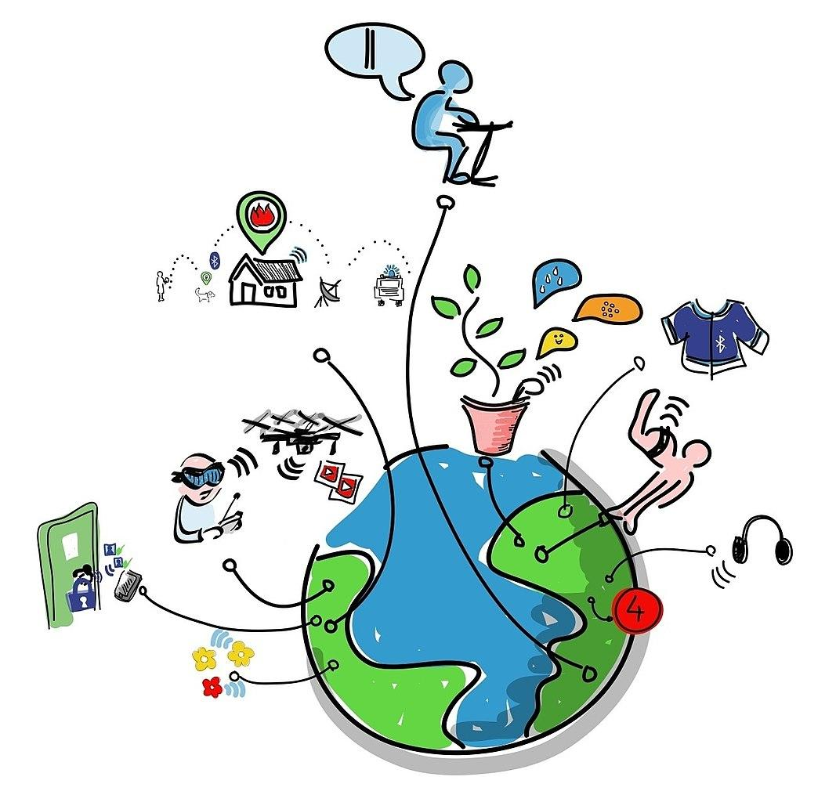
Background Vocabulary -> Data
NI
Data is the information you send and receive over the Internet.
8.1.2

Slide 8
Background Vocabulary -> Data
NI
Question:
What types of data do you send or receive over the internet?
8.1.2

Slide 9
Background Vocabulary -> Data
NI
Answer:
Data includes pictures, drawings, images, sounds, and text like notes, letters, essays and book reports.
8.1.2

Slide 10
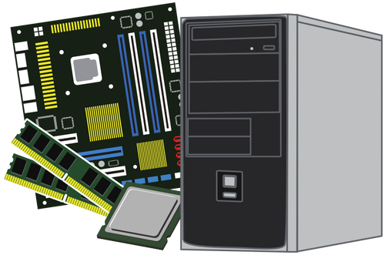
Background Vocabulary -> Hardware
NI
Hardware is all of the physical equipment (inside and outside) that makes up a computer system. If you can touch it, its hardware!
8.1.2

Slide 11
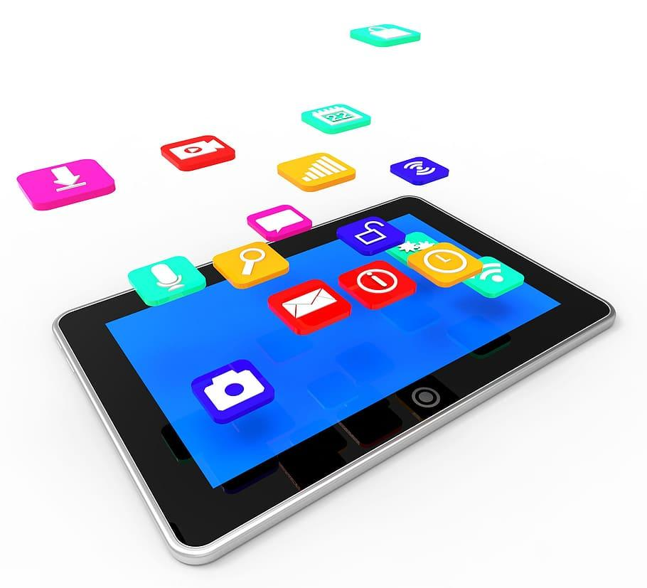
Background Vocabulary -> Software
NI
Software are the programs that manage the computer and complete tasks for users like you.
8.1.2

Slide 12
Background Vocabulary
NI
You need both hardware and software in order to have a operable computer system!
8.1.2

Slide 13
NI
Computer Network
8.1.2

Slide 14
NI
What is a Computer Network
Imagine you have a bunch of friends. You all like to talk to each other and share your toys. Your friends live in different houses and in different towns.
8.1.2

Slide 15
NI
What is a Computer Network
Think of the houses that your friends live in as computers. Think about the roads you travel to get to their houses as connections.
8.1.2

Slide 16
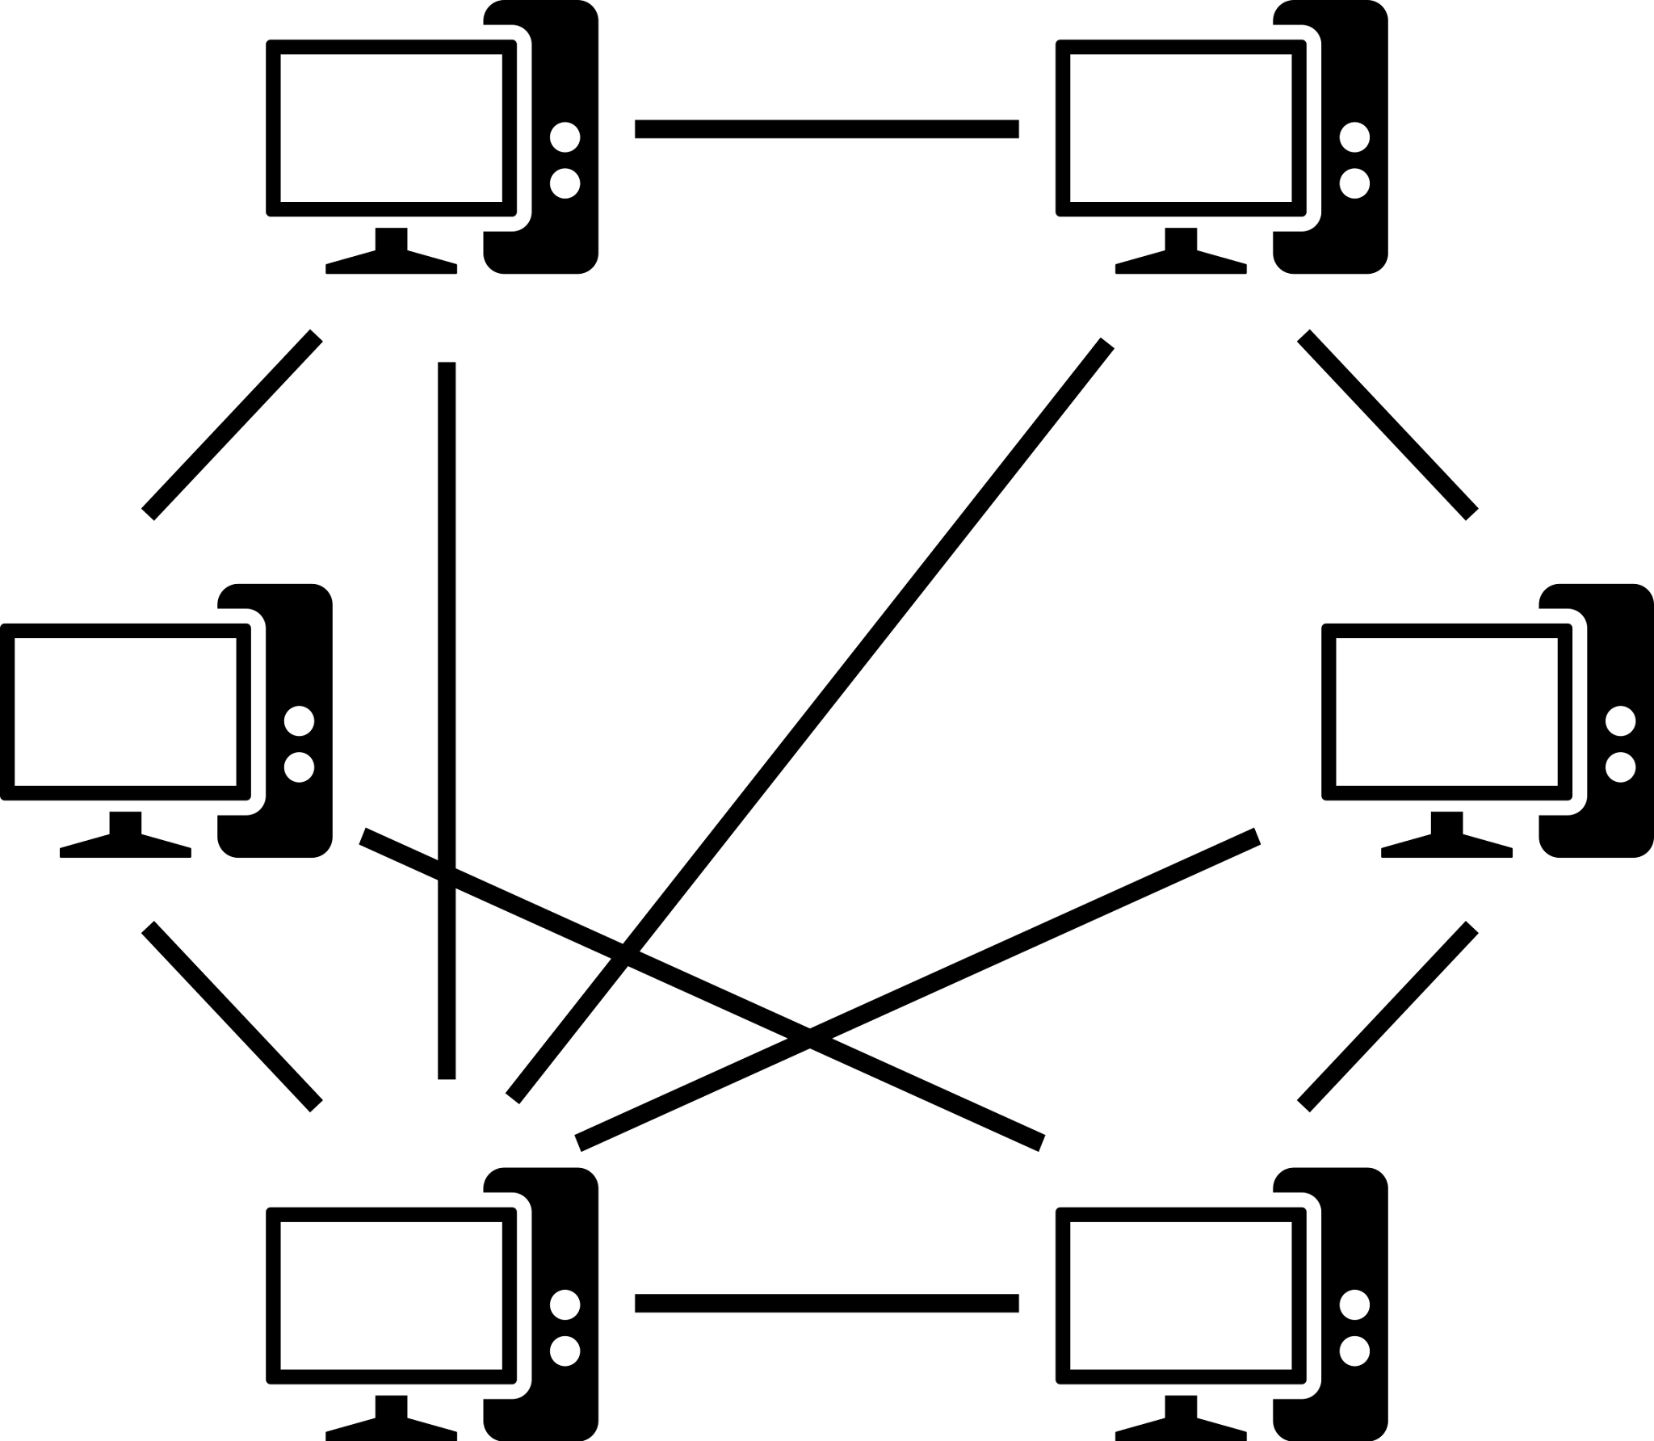
NI
What is a Computer Network
A computer network is like a big map that shows all the roads (connections) between the houses (computers).
8.1.2

Slide 17
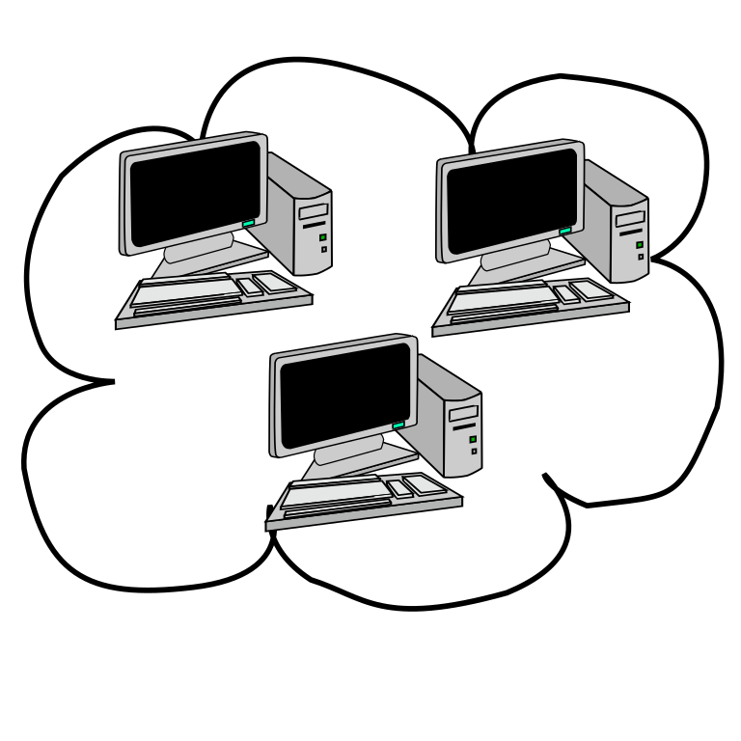
NI
What is a Computer Network
When your friends want to share or play a game, they use these roads (connections) to send messages back and forth between their houses (computers).
8.1.2

Slide 18
NI
What is a Computer Network
Computers pass information to each other through network connections.
8.1.2

Slide 19
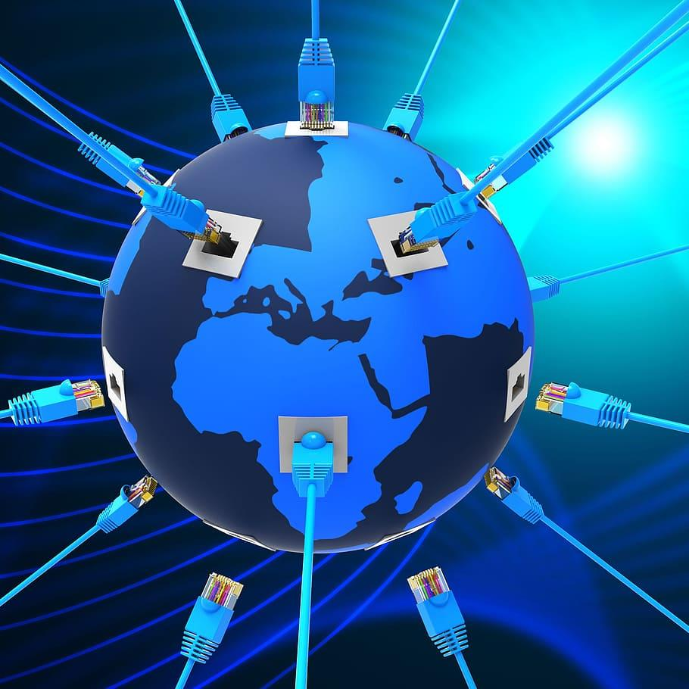

NI
What is a Computer Network
The more roads (connections) there are and the faster they are, the quicker your friends can share and play together! That's what computer networks do—they help computers talk and share stuff with each other, no matter where they are!
8.1.2

Slide 20
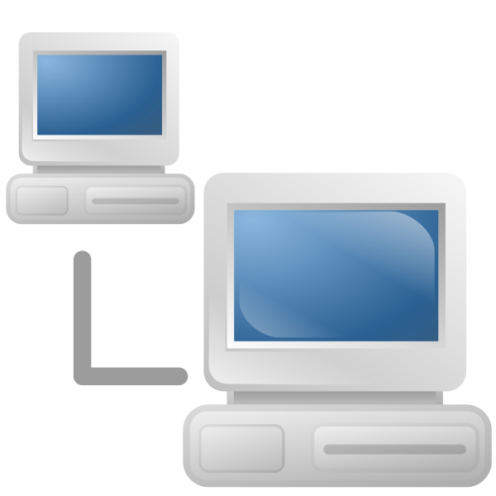
NI
What is a Computer Network
A computer network has lots of devices that are connected via wires or wireless to communicate with one another to share information and resources.
8.1.2

Slide 21
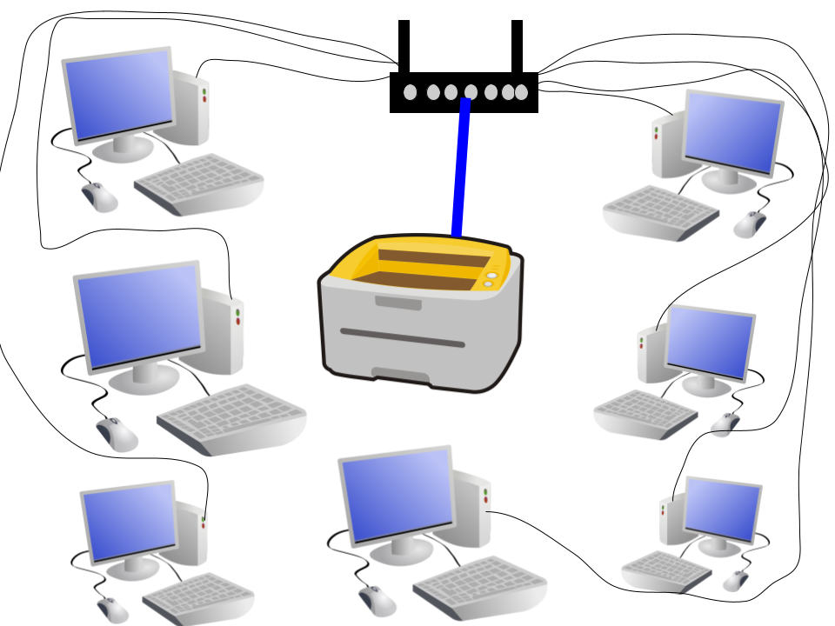
NI
What is a Computer Network
Traditional computer networks have desktop computers connect to printers.
8.1.2

Slide 22
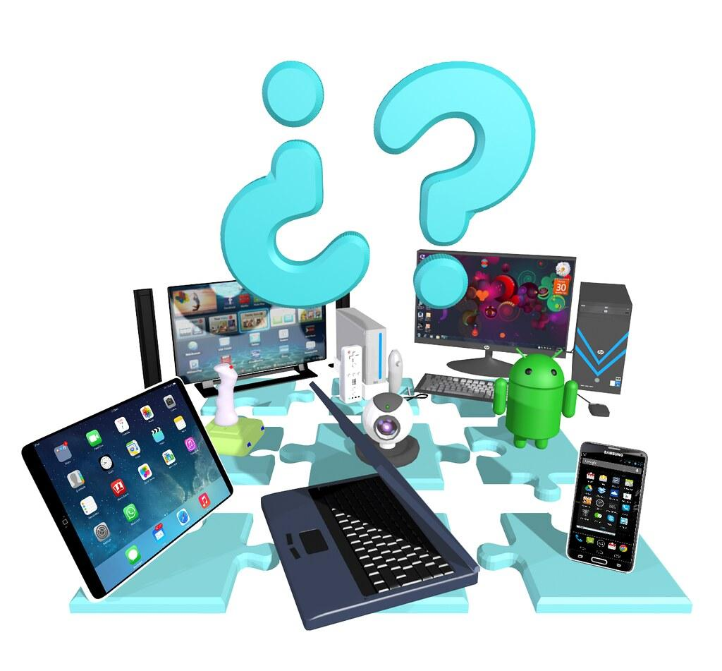
NI
What is a Computer Network
Modern computer networks include a lot of different devices like laptops, tablets, smart phones, smart TVs and other electronics.
8.1.2

Slide 23
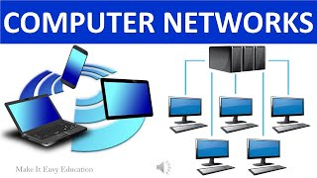
NI
What is a Computer Network
8.1.2

Slide 24
NI
What is a Computer Network
Remember, computer networks are used to connect individuals to other individuals, places, information, and ideas.
8.1.2

Slide 25
NI
The Internet
8.1.2

Slide 26
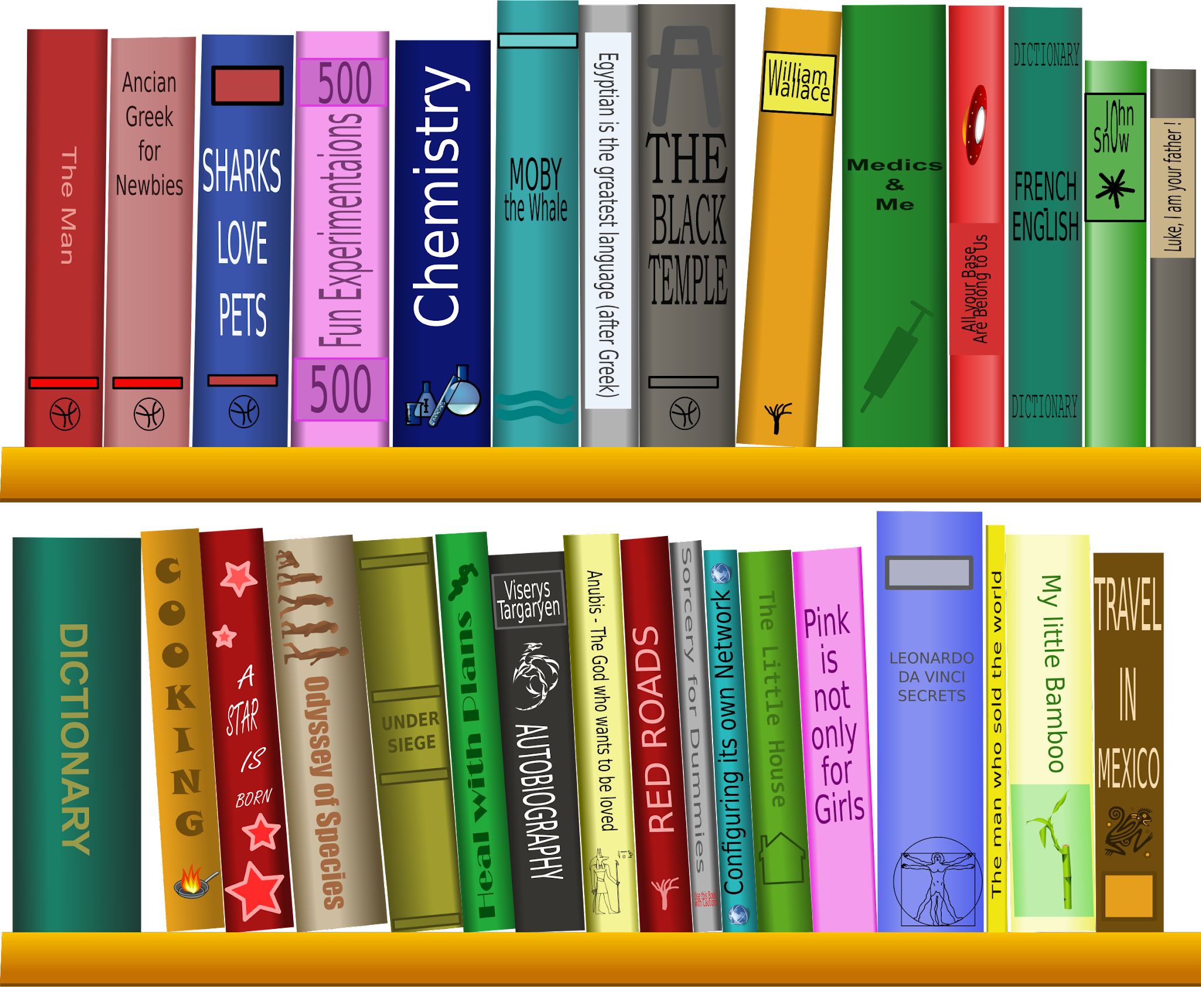
What is the Internet?
NI
The Internet is also called the world wide web. Imagine the Internet as a super, duper, humongous library that has every book, movie, video game, picture and other stuff in it ever made.
8.1.2

Slide 27
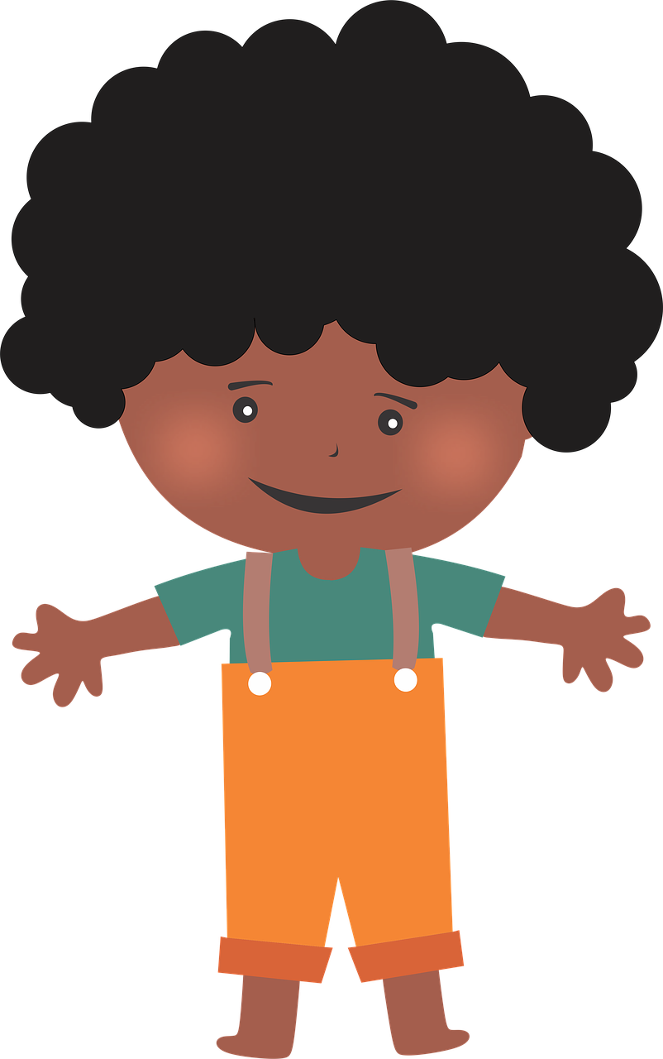
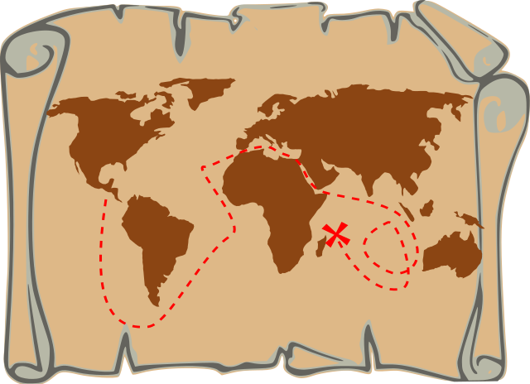
What is the Internet?
NI
Picture yourself with a magical map that can take you to any book in the library just by touching it.
8.1.2

Slide 28
What is the Internet?
NI
So, when you want to watch a funny video of cats or learn about dinosaurs, you can use this magical map (the Internet) to find what you're looking for, just like flipping through books in a library. You can even talk to your friends who are far away by sending messages through this magical map.
8.1.2

Slide 29
What is the Internet?
NI
The Internet is like a magical map that helps you find and visit all the cool stuff on the Internet.
8.1.2

Slide 30
NI
Types of Networks
8.1.2

Slide 31
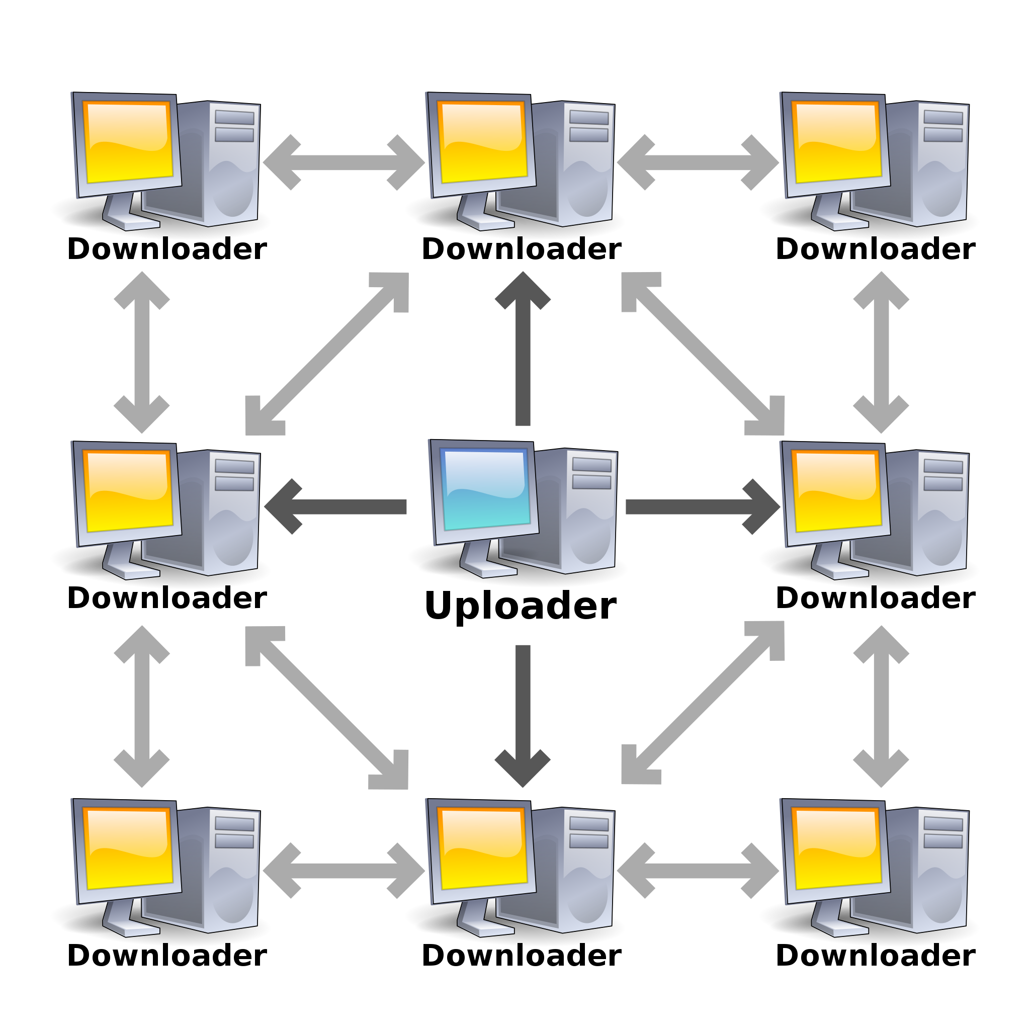
Types of Networks
NI
Computer networks come in different sizes. Some are very small like the one in a classroom that connects all computers to one printer. And some are very large. The Internet is the largest computer network in the world!
8.1.2

Slide 32
NI
Network Protocols
8.1.2

Slide 33

NI
What is a Network Protocol?
A protocol is a standard set of rules that allow electronic devices to communicate with each other.
8.1.2

Slide 34
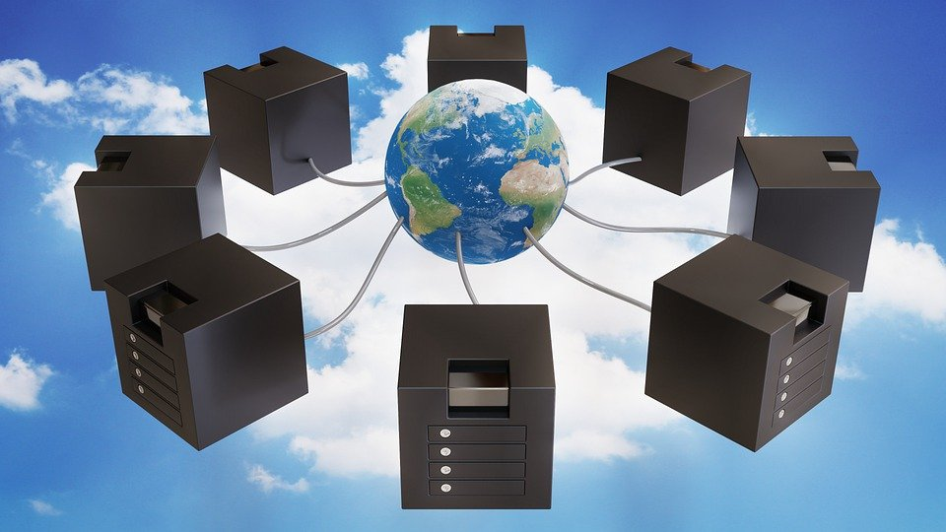
NI
What is a Network Protocol?
There are different types of protocols for the different types of jobs or tasks needed to make the Internet work.
8.1.2

Slide 35
NI
Accessing the Internet
8.1.2

Slide 36
NI
The Login Process
The computer logon process is like having a secret code. Imagine you have a magical treehouse that only you and your friends can enter. But to get inside, you need a secret code. That secret code is like your password.
8.1.2

Slide 37
NI
The Login Process
So, when you get to the treehouse you state your name (username) and then you give your secret code (password).
8.1.2

Slide 38
NI
The Login Process
The treehouse keeper checks to make sure the your information is on the members only list. If it is, the keeper lets you in. But if it's the wrong the door will be shut tight and you will not be allowed to go in.
8.1.2

Slide 39
NI
The Login Process
Before you can use your desktop, laptop, tablet or similar devices, you must first give your name (username) and secret code (password). This is called the login process. Remember, your device just want to make sure you are really you!
8.1.2

Slide 40
NI
The Login Process
The username and password make up your account information. The username usually stays the same. Your password should be changed sometimes. Just remember to keep your password in a safe place and keep it private. Never share personal information.
8.1.2

Slide 41
Protecting Your Password
NI
In order to keep your password secure you need to do two things:
Change it every few months.
Create a strong password.
8.1.2

Slide 42
Protecting Your Password
NI
Weak passwords are simple and easy to guess, often consisting of common words, phrases, or patterns.
8.1.2

Slide 43
Protecting Your Password
NI
Strong passwords make it difficult for others to guess and gain access to your device and your personal, private information. Strong passwords typically contain:
6 or more characters:
contain upper and lower case letters,
numbers, and
special characters.
8.1.2

Slide 44
Protecting Your Password
NI
Let’s look at some passwords and discuss whether they are strong or weak.
abcdefg | 123456
password | abc123
mytoys | hello
Rvt54vBz | cat$D0g$z
hst8$3wl | la75k$RT
8.1.2

Slide 45
Protecting Your Password
NI
Now, I want you to practice creating a password.
8.1.2

Slide 46

NI
Protecting Your Password
Here are some reasons why you need a strong password:
1. Stop Unauthorized Access.
2. Protect Sensitive Information.
3. Mitigation of Security Risks.
4. Compliance Requirements.
5. Maintaining Trust and Reputation.
6. Preventing Account Takeover.
8.1.2

Slide 47
Protecting Your Password
NI
Remember, strong passwords are needed to maintain the security and integrity of your devices, accounts, and personal information.
8.1.2

Slide 48
NI
Works Cited
TechTerms.com
Algorithms
Introduction to Computer Networks
RBC Cyber Security - Powerful Passwords
OpenAI. (2023-2024). ChatGPT (3.5)
8.1.2

