Slide 1
Montclair CITI- New User Export Instructions
Contact: Hila Berger, Research Compliance Officer,
Ext. 7781, bergerh@montclair.edu

Slide 2
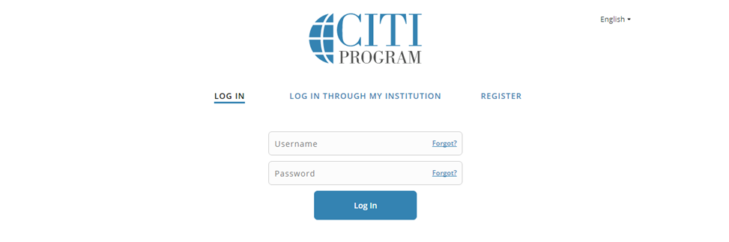
Instructions
Login: http://www.citiprogram.org/default.asp
Click on Create an Account (If you are not a new user you may log in with your existing account and affiliate with MSU)

Slide 3
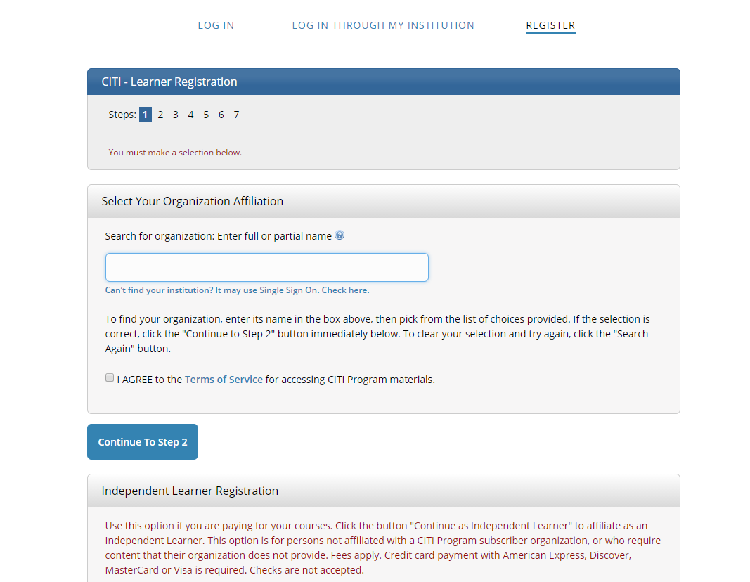
Step 1
Complete Institutional Affiliation
Select Montclair State University as the participating institution and ignore all other headings.
Hit Continue to Step 2.

Slide 4
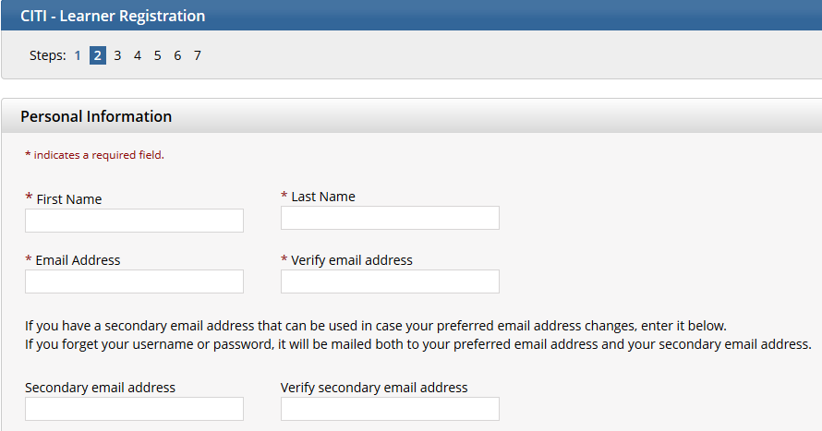
Step 2
Next page: Enter your personal information- Set up username & password
Step 2 requires that you enter your first and last name along with your email address.
Please enter your name here as you would like it to appear on your completion report received at the end of the course. Ensure you use an email address that you can access so you can complete the registration process by verifying the email.
Hit Continue to Step 3

Slide 5
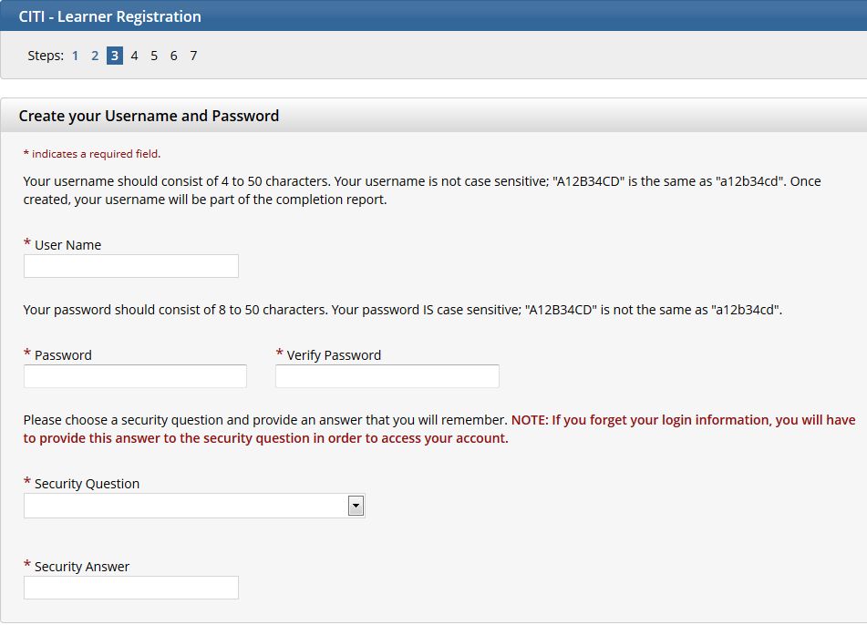
Step 3
Choose a username and password for your account. Please follow the on screen instructions for the expected parameters of each field. Passwords are case sensitive.
During this step you will also select and answer a security question. This question will be used to assist in the recovery of your account if you have forgotten your username or password. Please select a question that is applicable to you and you can comfortably answer for the tech support team.
Hit Continue to Step 4.

Slide 6
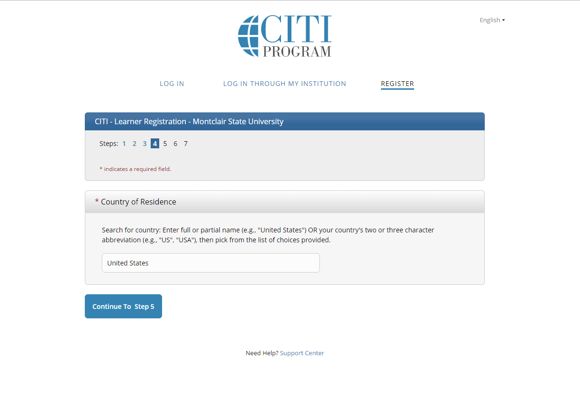
Step 4
Step 4 collects country of residence. Select country and hit Continue to Step 5.

Slide 7
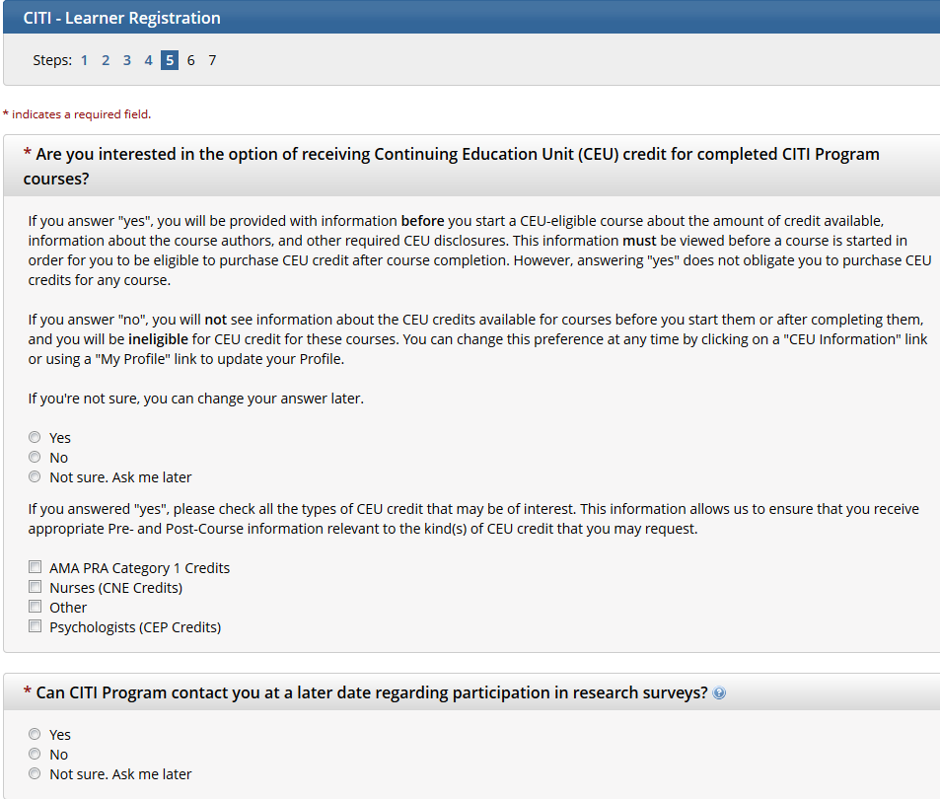
Steps 5 & 6
Professionals seeking credit for CITI Program courses can make their selection for Continuing Education credits during Step 5.
Select NO
Hit Continue to Step 6
Step 6 is institutional specific. Enter all required fields including Institutional Email Address, NetID, Department and Role in Research and then Continue to Step 7.

Slide 8
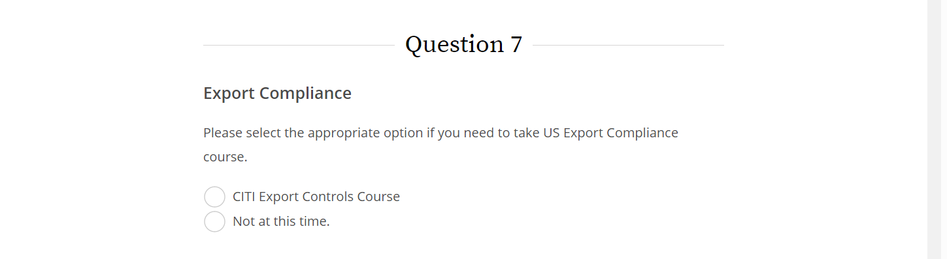
Step 7
The questions in Step 7 enroll you in CITI Program courses.
Only Question 7, Export Compliance is required. Select CITI Export Controls Course.

Slide 9
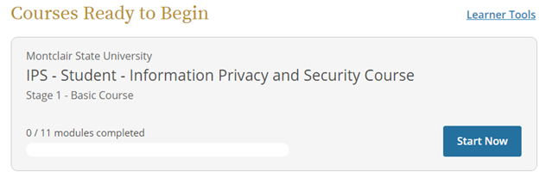
Step 8
Click Finalize Registration.
This will take you to the Main Menu. Enter into the assigned Export Compliance course by clicking the course name.
You must complete the Integrity Assurance Statement for the course before beginning any modules.
Export Compliance

Slide 10
For Existing CITI Users

Slide 11
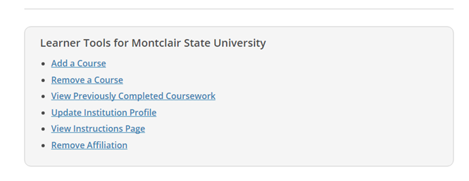
Add the Export Course
Click “Add a Course” under Learner Tools for Montclair State University
Scroll down to Question 7 and select the Export course

Slide 12
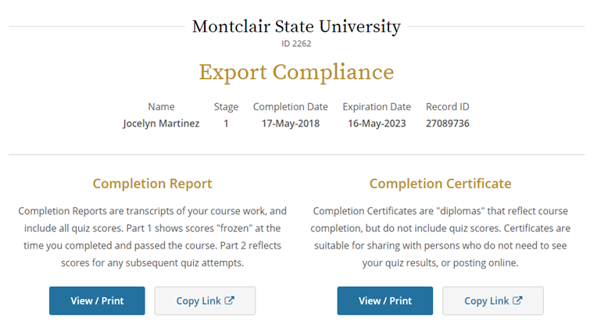
Printing a Completion Report
When all modules are completed with an overall score of >80%, CITI will issue you a “completion report.”
At that point, your name and certification expiration date will be entered in a database accessible to the Compliance office.

Slide 13
Other Tips
You do not need to complete all required modules at one time. CITI will remember where you left off the next time you log in.
You do not need to complete modules labeled as optional.
After reading the curriculum for each module, you have to click on Take Quiz.
You can refer to the grade book anytime to see how much you have scored thus far.
You need a quiz score of 80 for all modules.
You can re-take any single module that you got a low score in.

Slide 14
Questions or Problems?
Contact:
Hila Berger
Ext. 7781

