Slide 1
Day One

Slide 2
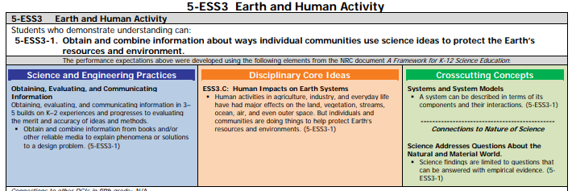

Slide 3
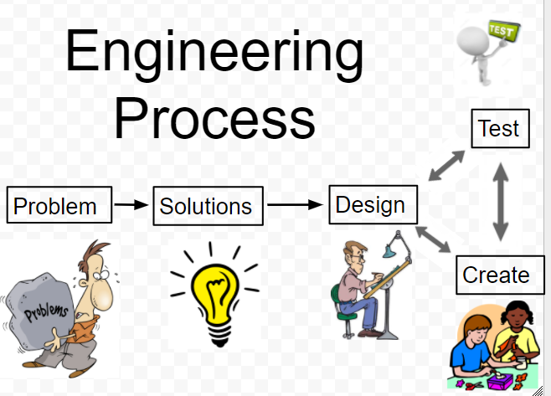

Slide 4
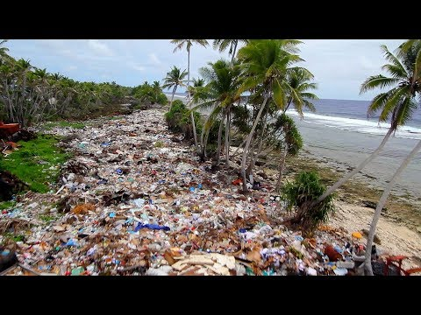
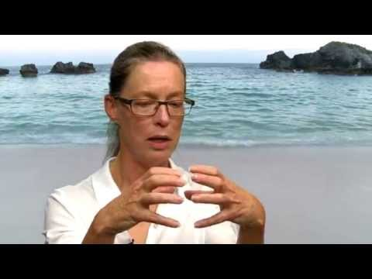
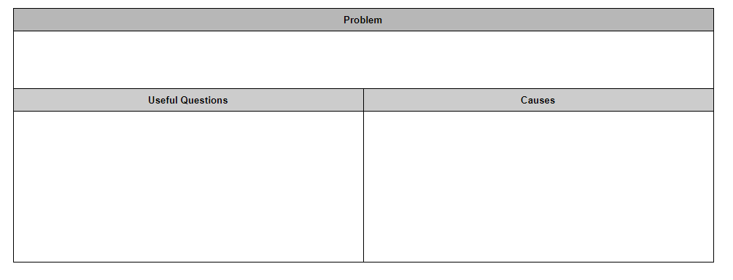
Plastic Bots
Notes:
You also show part of A plastic Ocean(first 25 minutes) or Plastic Paradise to help identify the problem. A plastic ocean is a little too rough for fifth grade to show the entire documentary but the first 25 minutes are appropriate.

Slide 5
Over 1.8 Trillion pieces of plastic are currently polluting the world’s oceans

Slide 6
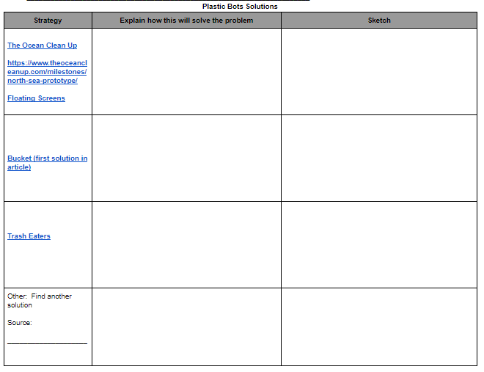
Notes:
Click on the link for resources that will help the students learn about the current solutions that exist. Students can also search for additional resources or other solutions.

Slide 8
Day Three- Day Five
Notes:
Between all the designs, testing and Ollie Driving school I think this may take anywhere between 2 to 3 days. You can certainly make this happen quicker but try your best to allow the students to test and redesign!

Slide 10
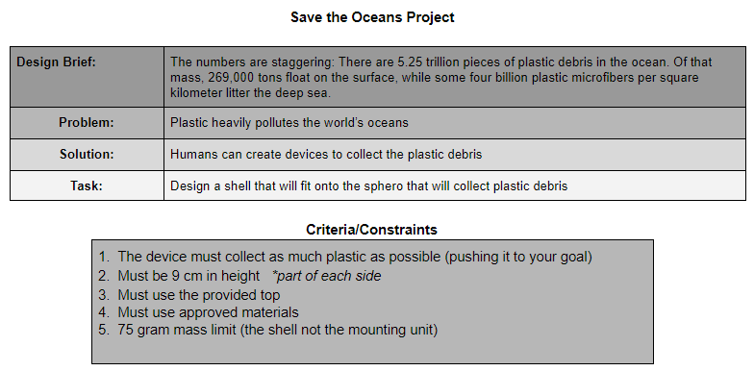

Slide 11
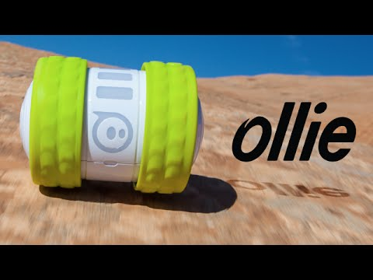
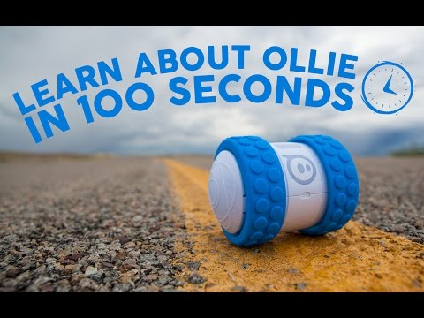
Ollie Driving School
Notes:
You will need to spend some time teaching the students how to operate the ollies. IPADS should be able to connect. Just be careful to make sure they connect to their team’s Ollie. You may lose a day to driving lessons but you could have this as part of a rotation as one member on each team learns to drive the ollie while the others work on design and or solution research.

Slide 12
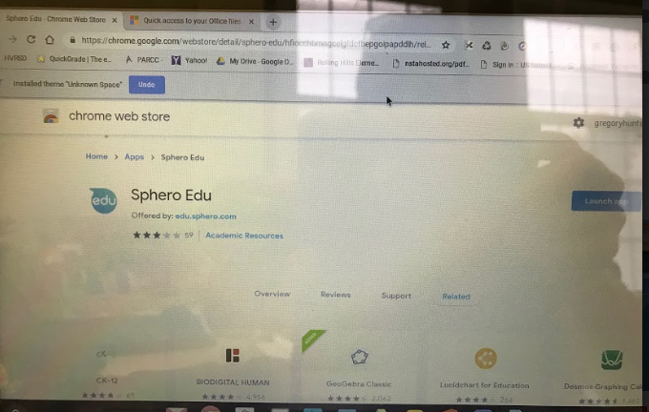
Search: Sphero Education Google
Add Extension

Slide 13
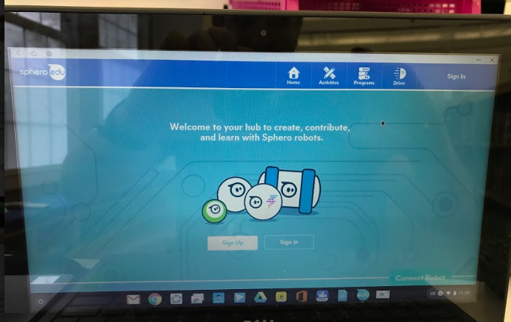

Slide 14
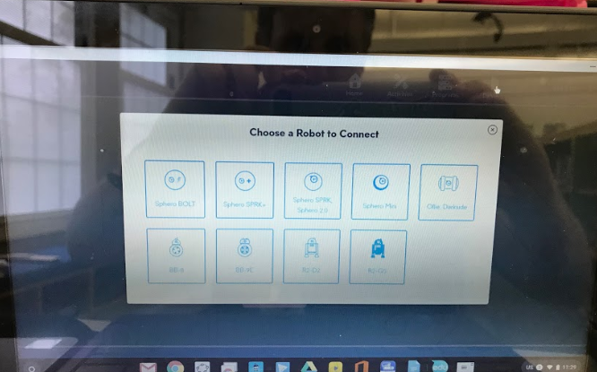

Slide 15
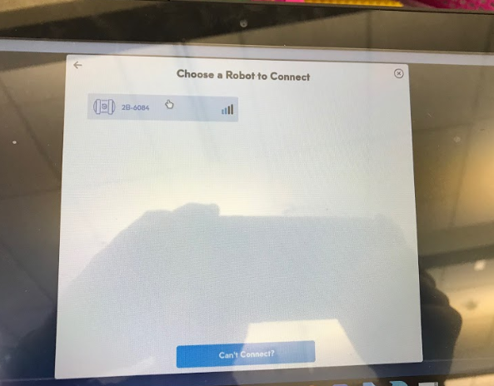
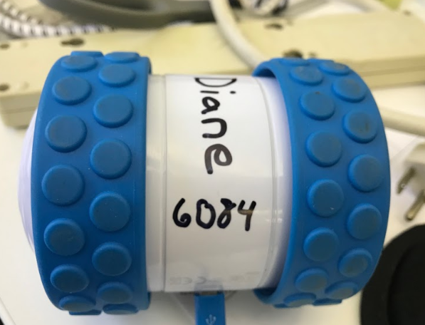

Slide 16
Daily Goals
Continue documenting and testing design #1 *you need to be able to really maneuver your bot
PRACTICE, PRACTICE, PRACTICE driving you bot
YOU WILL TEST IN THE GYM TODAY!

Slide 17
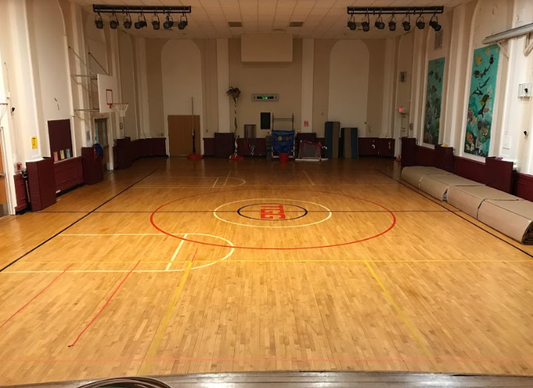

Slide 19
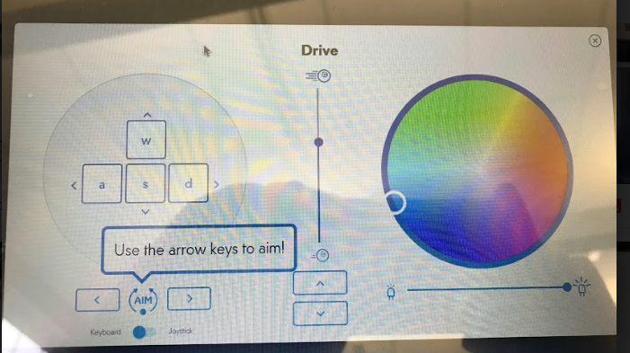

Slide 20
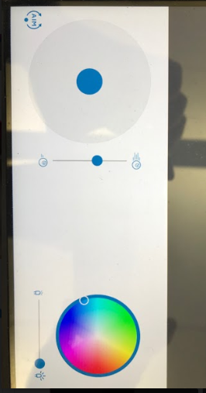

Slide 21
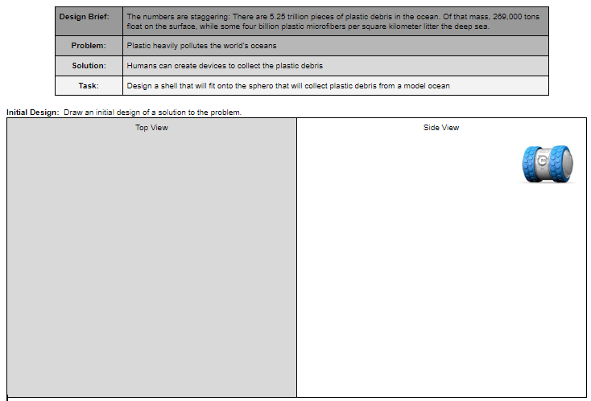

Slide 22
Daily Goals
Continue documenting and testing design #1 (you need to be able to really maneuver your bot
PRACTICE, PRACTICE, PRACTICE driving you bot
We will start design two tomorrow

Slide 23
Driving School

Slide 24
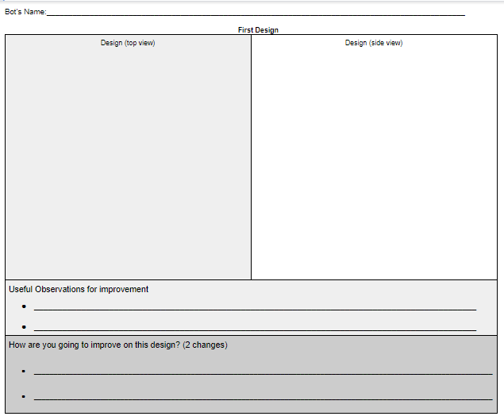

Slide 25
Daily Goals
Document Design #2
Build and Test

Slide 26
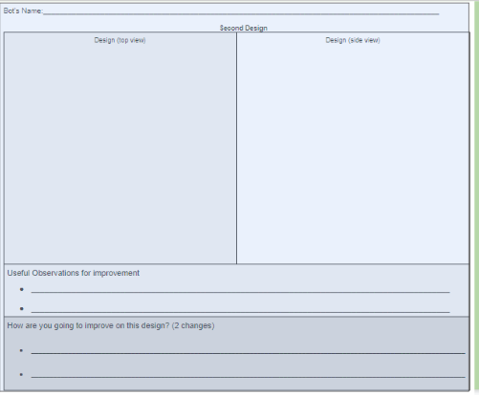
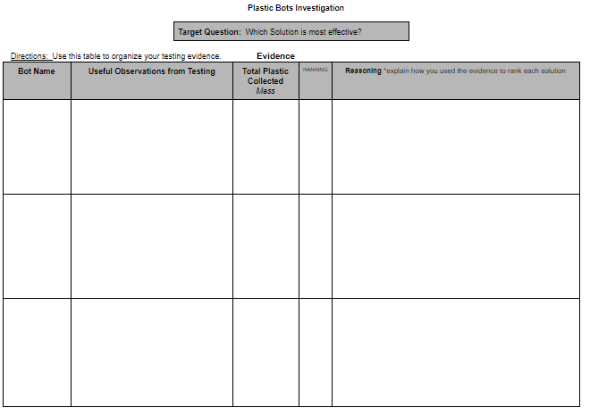
Daily Goals
Continue Documenting, Designing, Building and Testing

Slide 27
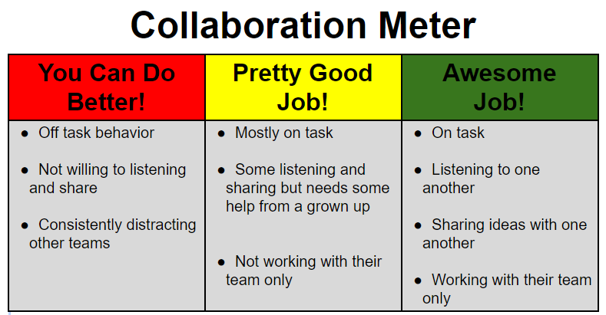

Slide 29
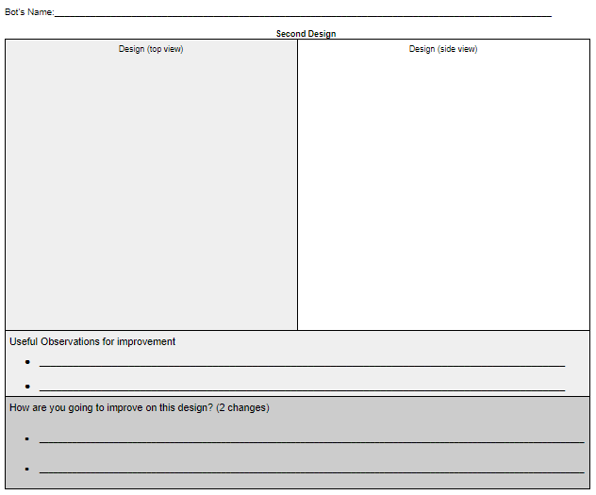

Slide 30
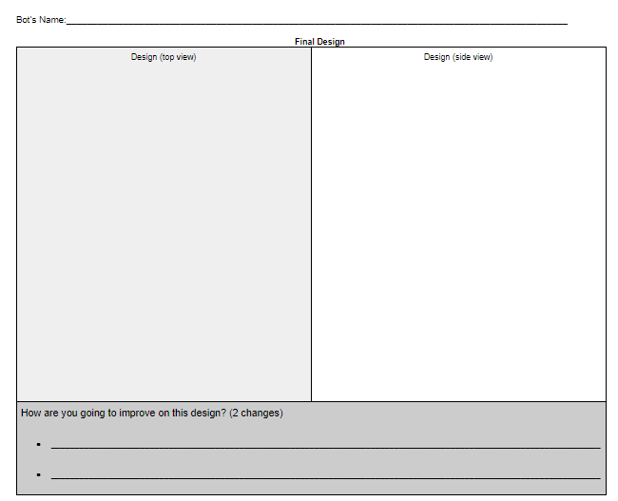

Slide 31
Notes:
At this point the students should have been through the entire process.

Slide 32
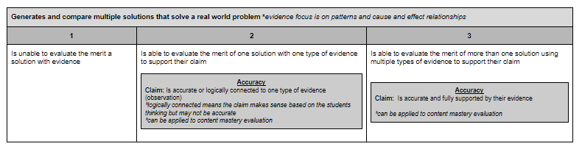

Slide 34
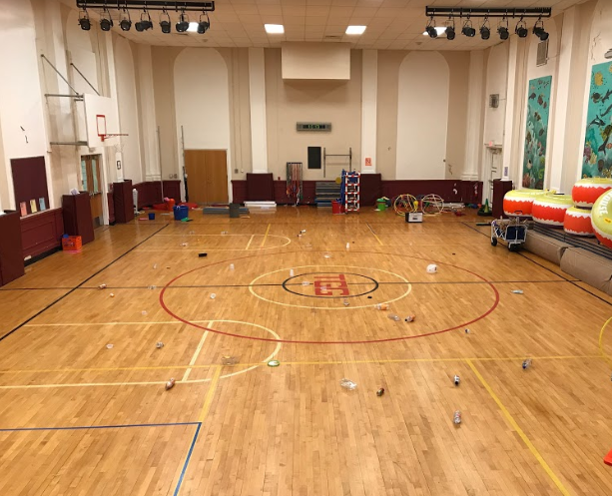

Slide 35
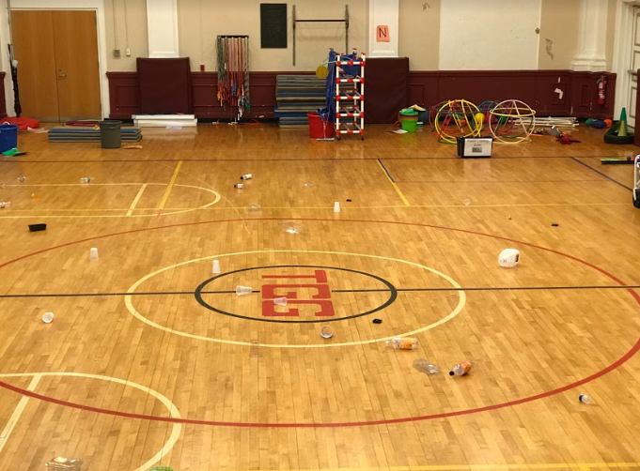

Slide 36
Plastic Bot Testing
Pilot: Person in charge of driving your bot
Runner: Person in charge of getting your bot if it gets stuck and returning your bot to the starting line
Plastic Data Recorder: Person in charge of adding up all the plastic that has been collected by your bot
*you may rotate roles but make sure you do not lose any time!

Slide 37
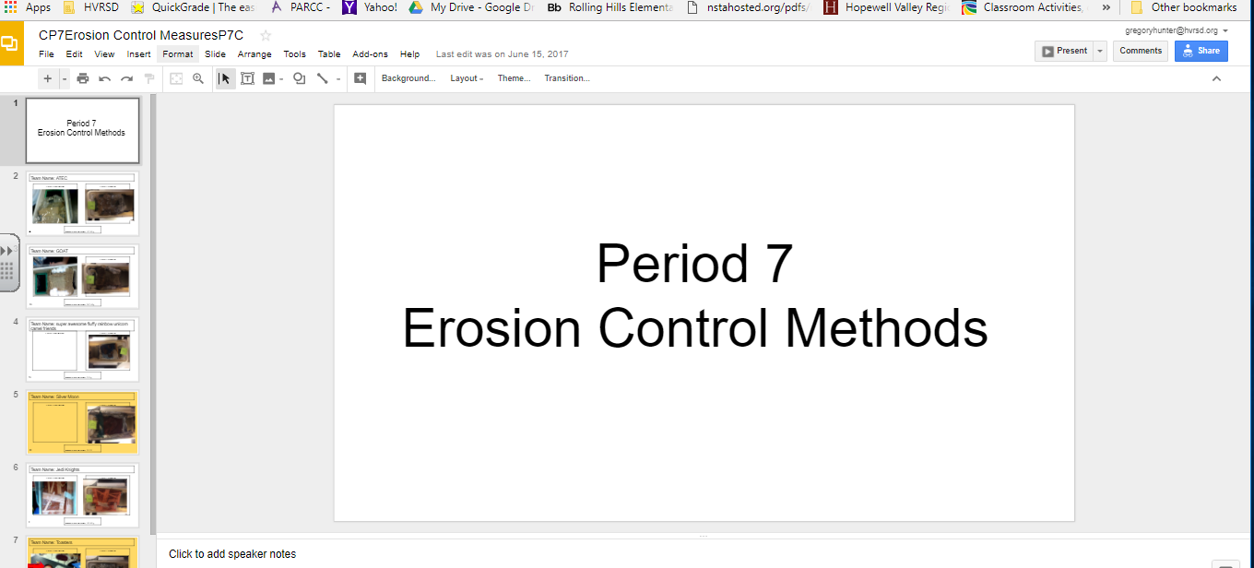
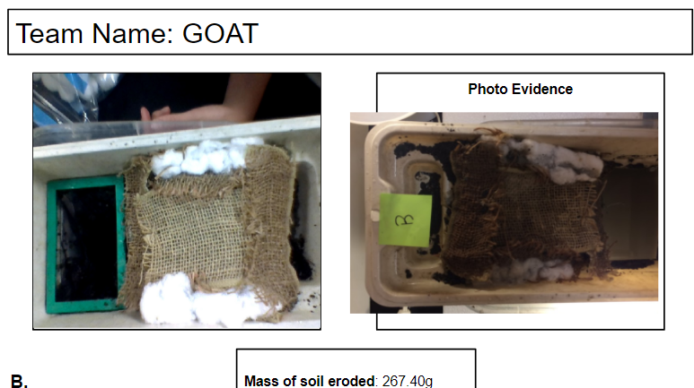
Example of using a google slideshow.
Google slide show that I shared with all the students. I actually shared a folder and dropped photos in the folder for them to access.
This is an example of one team’s slide. I made a template of what I wanted and the students pasted photos and recorded evidence
Notes:
This takes a bit of work to organize but makes it possible for the students to use evidence to evaluate the merit of other design solutions (which is a biggie for the new standards!)

