Slide 1
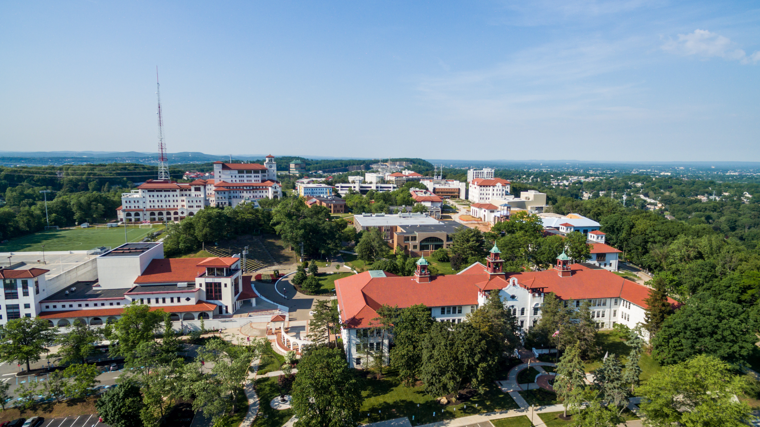

Project IMPACT: An Effective Family Preservation Program for Parents with Intellectual Disabilities
Wendy Zeitlin, PhD; Trupti Rao, PsyD & Astraea Augsberger, PhD

Slide 2

Agenda
Setting the stage
Project IMPACT
What we did
What we found
What does this mean?
Where do we go next?
COLLEGE OF HUMANITIES AND SOCIAL SCIENCES

Slide 3
Child Welfare and Intellectual Disability in the US
Parents with intellectual disabilities are over-represented in US child welfare systems (DeZelar & Lightfoot, 2108; Powell & Albert, 2020)
Families with parents with intellectual disabilities experience more family disruption (McConnell et al., 2020; White, 2015)
Child welfare systems struggle to meet the service needs of families with intellectual disabilities because:
  No data? No problem!
  Lack of training and specialized knowledge
  Few programs
  Inadequate funding (Aunos & Pacheco, 2020; Collings, 2017; LaLiberte, 2013; Powell et al., 2017)
COLLEGE OF HUMANITIES AND SOCIAL SCIENCES
Notes:
Bullet 1 – refer to child welfare systems because each state has at least one system, and while there is some commonality amongst these systems, they are independent of one another
Bullet 2 – higher rates of foster care place, TPR, and/or permanent guardianship
Bullet 3 – we don’t look to see whether parents have a disability, and in many states, there are good reasons not to, as state laws often support family separation based on parental disability
As for funding – federal funds are only available when interventions are adequately documented as being evidence-based, following stringent guideline to demonstrate evidence. What we are doing here is the first step.

Slide 4

More on the US Landscape: Existing In-Home Services
Project IMPACT – Westchester County, NY
Through the Looking Glass – San Francisco Bay Area, California
Positive Parenting Program – The ARC of Massachusetts (uses elements of Step-by-Step Parenting)
Parents with Special Needs – YAI in New York City
COLLEGE OF HUMANITIES AND SOCIAL SCIENCES
Notes:
Of existing programs, Project IMPACT is the only one in the US with empirical evidence as to effectiveness in child welfare

Slide 5
Introducing Project IMPACT
Intensive, home-based program in Westchester County, NY for parents with intellectual disabilities and/or significant learning needs
Based on Step-by-Step Parenting, but tailored for child welfare-involved parents (Feldman et al., 1992; 1999; 2012)
Created in 2006 based on need for specialized parent training
Developed with funding support from the Westchester County Department of Social Services (DSS)
Eligible families have an IQ of 80 or less and are receiving DSS Preventive Services
COLLEGE OF HUMANITIES AND SOCIAL SCIENCES

Slide 6
Description of the Program
Staffing:
Clinicians: 2 Social Workers (1 Bilingual)
Expanding to 1 additional Bilingual Social Worker
Program Director: Psychologist
Supervisor: Psychologist
Intensity:
Clinicians work with 3 families at a time.
Each family is seen:
1-½ to 2 hours a day
3 days a week
for 4-6 months
COLLEGE OF HUMANITIES AND SOCIAL SCIENCES
Notes:
This is a VERY small program

Slide 7
Key Curriculum Domains
Curriculum ranges from basic childcare skills to more complex decision-making/problem-solving skills:
  Interaction Skills
  Promoting Development
  Basic Child Care
  Safety
  Health Safety
  Home Management/Budgeting
  Problem-Solving
  Advocacy
COLLEGE OF HUMANITIES AND SOCIAL SCIENCES

Slide 8
Building on prior research
2013 – Small study found improvements in parenting skills and quality of home environment (N=50)(Rao, 2013)
2021 (Study 1) – Participation in Project IMPACT led to improvements in parenting skills while controlling for covariates (# of children in family, children’s behavior, amount of time spent in program)(N=133) (Augsberger et al., 2021)
2021 (Study 2) – Participation in Project IMPACT was related to less family separation (N=133) (Zeitlin et al., 2021)
  Completers had lower rates of family separation
  More time spent in program was related to lower rates of family separation
COLLEGE OF HUMANITIES AND SOCIAL SCIENCES
Notes:
These studies were relatively small, but their largest weakness was no comparison group.

Slide 9
Our Research Question
Is Project IMPACT effective at reducing family separation compared to:
Non-specialized family preservation services
No family preservation services (TAU)
COLLEGE OF HUMANITIES AND SOCIAL SCIENCES
Notes:
FPS in the US is most similar to IMPACT in that they are intensive, home-based services that are implemented when families are seen as being at high risk for out-of-home placement; however, they are not always available, and families are only selected to participate in FPS if they are seen as being likely to be successful.

Slide 10
Our participants
Project IMPACT
Comparison
Program data retrieved from all clients who had at least one session between 2006 and 2017
Limited to clients where out-of-home placement information could be obtained
Children had to reside in family home
Open child welfare cases
Parents had to qualify for the program based on IQ/functioning
Administrative data: NCANDS Child Files from 2006 – 2019
Cases involved a parent with intellectual disability living in a non-rural county in NJ with children living at home
Some parents received family preservation services
COLLEGE OF HUMANITIES AND SOCIAL SCIENCES
Notes:
We chose NJ because of its proximity to NY, the similarity in TPR laws, and the information that was provided in NCANDS was more complete than in other states regarding ID and out-of-home placement

Slide 11
What we measured
Number of children in the household
Number of children with disabilities in the household
Number of additional services provided to the family
Race (Black, non-Hispanic compared to all other race/ethnicities)
Family history of:
  IPV
  Mental health treatment
  Child welfare involvement
  Out-of-home placement
Whether the family remained intact a year after terminating from services (Project IMPACT cases) or 21 months after initial report (NCANDS cases)
COLLEGE OF HUMANITIES AND SOCIAL SCIENCES

Slide 12
Treatment Effects Analysis
Combined Project IMPACT and NCANDS files based on question
01
Compared groups to test for equivalence (we didn’t expect this to be the case)
02
Used Mahalanobis distance matching with propensity scores to create new datasets with groups as similar as possible
03
Used new dataset for each question to compare the differences in families remaining intact while controlling for known predictors of out-of-home placement
04
COLLEGE OF HUMANITIES AND SOCIAL SCIENCES

Slide 13

COLLEGE OF HUMANITIES AND SOCIAL SCIENCES

Slide 14
Project IMPACT families initially had higher needs: Example
 | Pre-matched sample (n=307) |  |  |  | Post-matched sample (n=158)
 | Non-specialized family preservation (n=173) N (%) | Project IMPACT (n=134) N (%) | p | Effect size | Non-specialized family preservation (n=30) N (%) | Project IMPACT (n=128) N (%) | p | Effect size
# of additional services (M, SD) | 0.85 (0.68) | 0.86 (1.01) | 0.89 |  | 0.87 (0.78) | 0.87 (1.01) | 1.00
Age of youngest child (M, SD) | 4.83 (4.79) | 3.99 (4.29) | 0.11 |  | 4.47 (4.03) | 3.88 (4.28) | 0.50
Age of oldest child (M, SD) | 6.02 (5.46) | 8.56 (5.96) | <0.00 | d=0.45 | 6.57 (4.55) | 8.58 (5.98) | 0.09
# of children living at home (M, SD) | 1.44 (0.85) | 2.48 (1.54) | <0.00 | d=0.86 | 1.90 (1.33) | 2.48 (1.54) | 0.06
# of children with disabilities (M, SD) | 0.57 (0.76) | 1.04 (0.99) | <0.00 | d=0.54 | 0.63 (0.93) | 1.03 (0.98) | 0.04 | d=0.41
Race
Not Black, non-Hisp | 82 (51.90%) | 73 (54.48%) | 0.66 |  | 16 (55.17%) | 72 (56.25%) | 0.92
Black, non-Hisp | 76 (48.10%) | 61 (45.52%) |  |  | 13 (44.83%) | 56 (43.75%)
History of IPV: Yes | 23 (16.67%) | 50 (39.06%) | <0.00 | V=0.25 | 5 (16.67%) | 50 (39.06%) | 0.02 | V=0.18
History of mental health treatment: Yes | 20 (11.56%) | 77 (58.78%) | <0.00 | V=0.50 | 9 (30.00%) | 77 (60.16%) | <0.00 | V=0.24
History of CPS involvement: Yes | 55 (31.79%) | 122 (91.04%) | <0.00 | V=0.59 | 21 (70.00%) | 116 (90.62%) | <0.00 | V=0.24
History of foster care placement: Yes | 11 (6.36%) | 40 (29.85%) | <0.00 | V=0.31 | 7 (23.33%) | 39 (30.47%) | 0.44
Intact family: Yes | 129 (74.57%) | 115 (85.82%) | 0.02 | V=0.14 | 21 (70.00%) | 112 (87.50%) | 0.02 | V=0.19
COLLEGE OF HUMANITIES AND SOCIAL SCIENCES

Slide 15
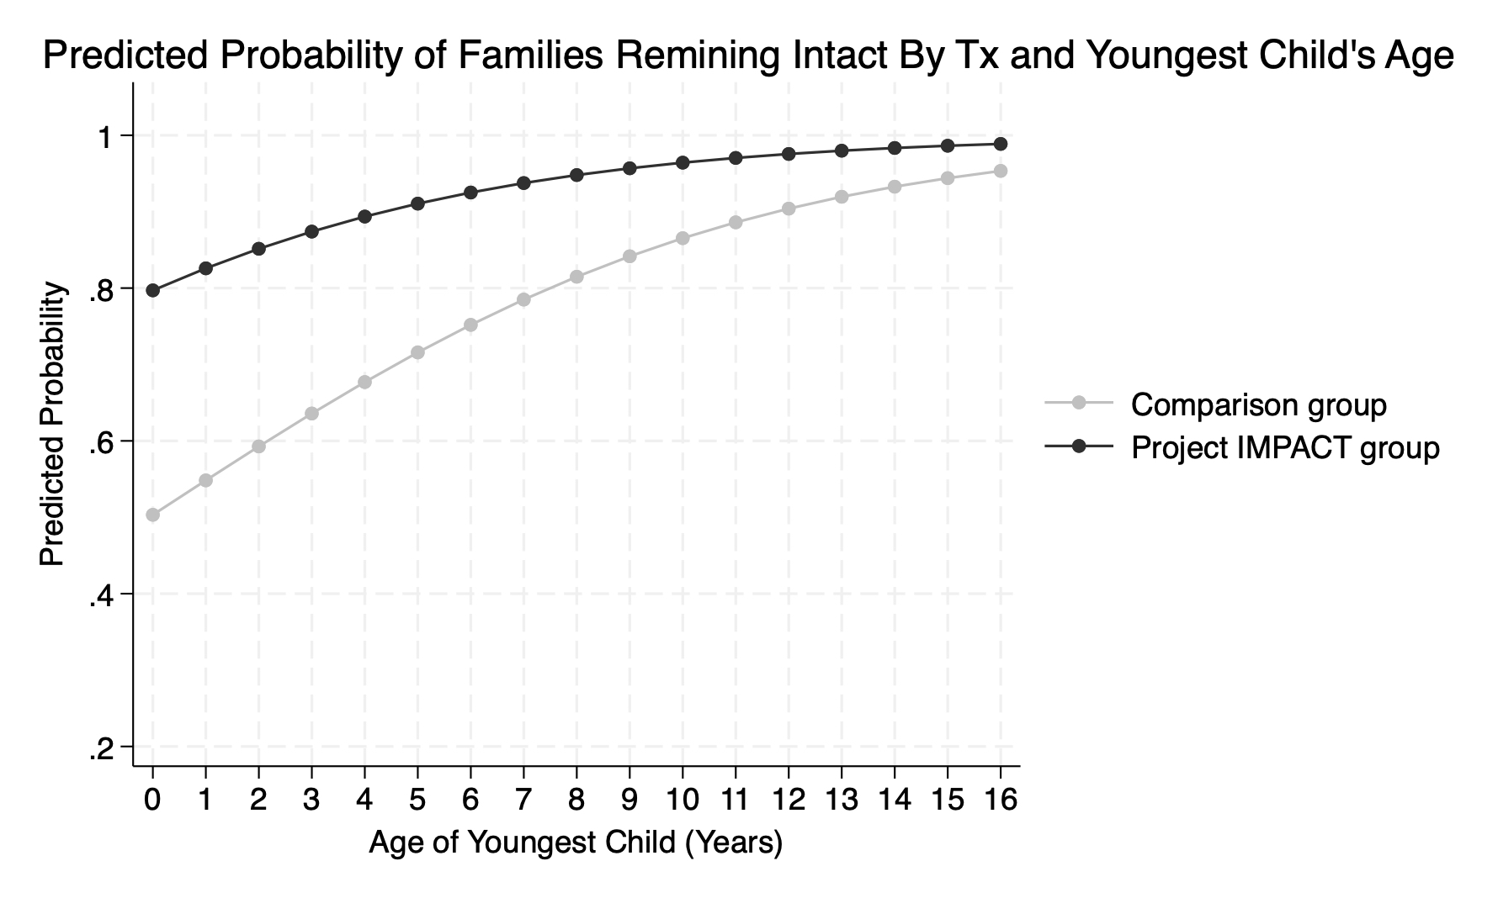
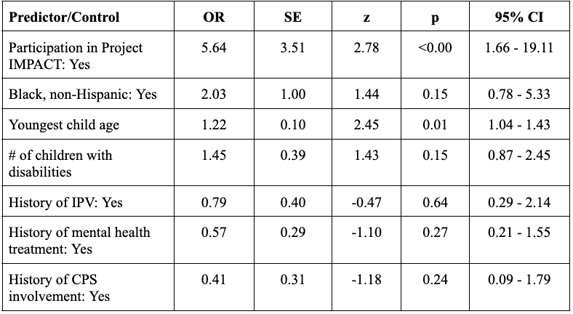
Project IMPACT compared to non-specialized family preservation
COLLEGE OF HUMANITIES AND SOCIAL SCIENCES
Notes:
Current manuscript in review

Slide 16
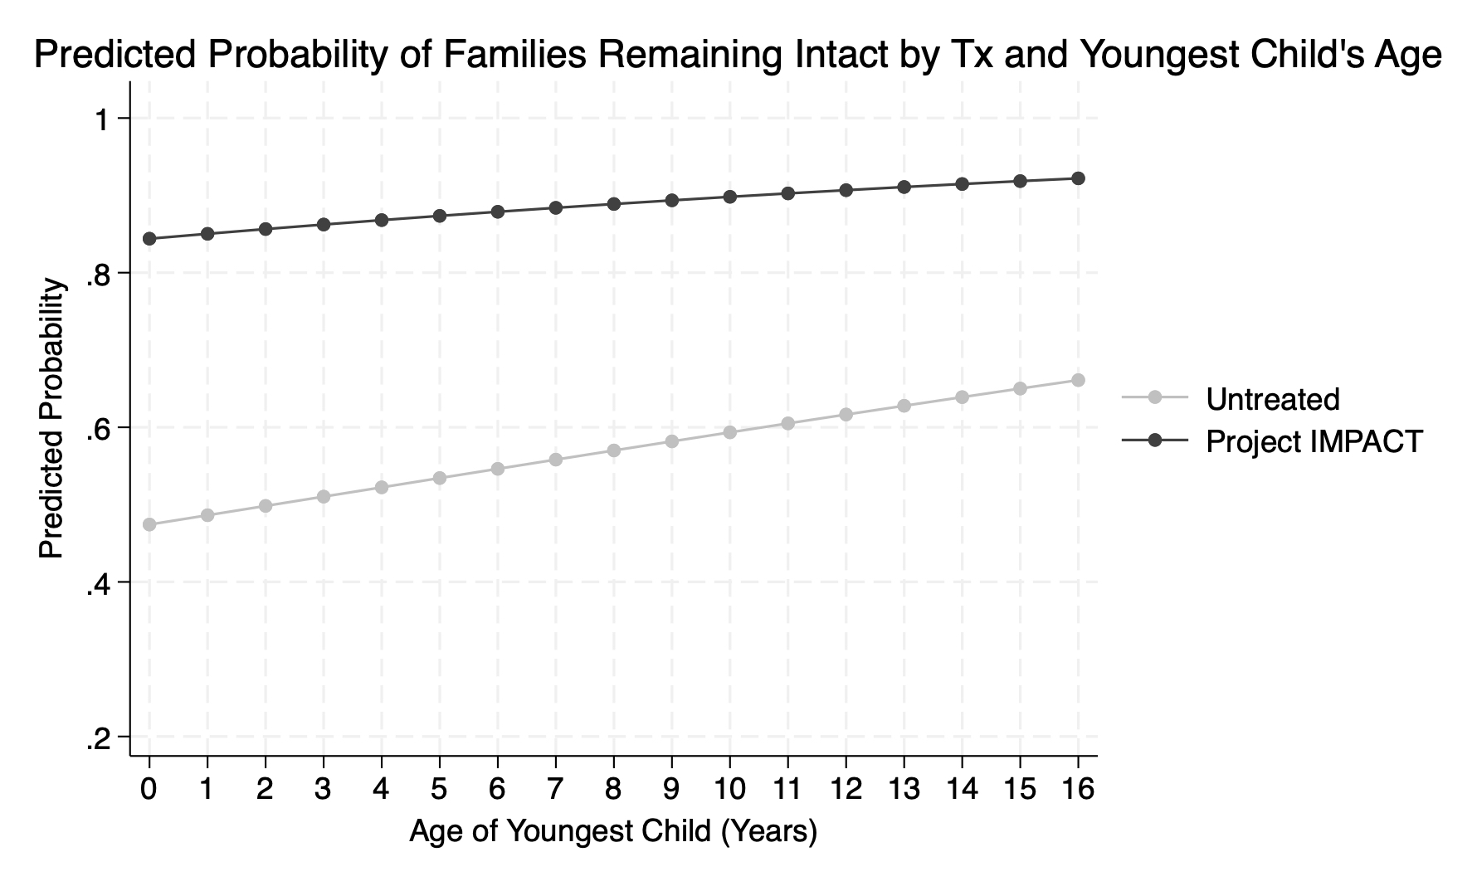
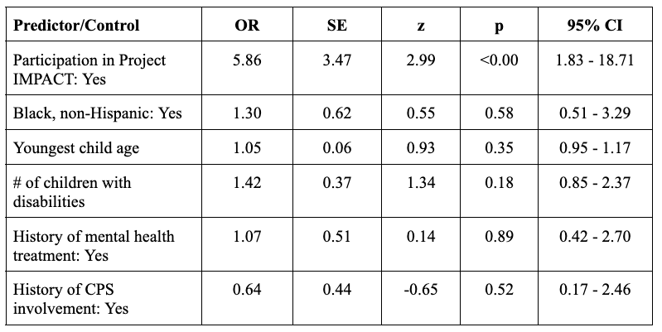
Project IMPACT compared to no family preservation
COLLEGE OF HUMANITIES AND SOCIAL SCIENCES
Notes:
Manuscript in preparation

Slide 17
Discussion
Project IMPACT is similar to other interventions developed for parents with intellectual disability
Parents can not only learn parenting skills, but they can keep their children home safely when they have previously had CW involvement
Treated families who completed IMPACT had better rates of preventing out-of-home placement than all families receiving FPS one-year post-termination
Replication interest has been a challenge: ”it’s too expensive!”
COLLEGE OF HUMANITIES AND SOCIAL SCIENCES
Notes:
Bullet 1 – in the home, breaks down larger tasks, considers each parents’ strengths, including how they learn best
Bullet 3 – 95.4% compared to 83% of NJ. Plus of parents with ID, only 70% of parents with ID who participated in NJ’s FPS program remained intact at the end of the tracking period.
Although a social return on investment study found that each $1 spent on IMPACT reduced future costs of over $4.00.

Slide 18

Largest Study Weaknesses
Comparing administrative data is not the same as clinical data
Do not know the intensity or duration of services for families not enrolled in Project IMPACT
COLLEGE OF HUMANITIES AND SOCIAL SCIENCES

Slide 19
Wendy Zeitlin
zeitlinw@Montclair.edu
Trupti Rao
trao@wihd.org
Questions?
NIH Award # R03HD110761
COLLEGE OF HUMANITIES AND SOCIAL SCIENCES
COLLEGE OR SCHOOL IDENTIFICATION
COLLEGE OF HUMANITIES AND SOCIAL SCIENCES

Slide 20
References
Augsberger, A., Zeitlin, W., Rao, T., Weisberg, D., & Toraif, N. (2021). Examining a child welfare parenting intervention for parents with intellectual disabilities. Research on Social Work Practice, 31(1), 65–74.
Aunos, M., & Pacheco, L. (2021). Able or unable: How do professionals determine the parenting capacity of mothers with intellectual disabilities. Journal of Public Child Welfare, 15(3), 357-383.
Collings, S., Grace, R., & Llewellyn, G. (2017). The role of formal support in the lives of children of mothers with intellectual disability. Journal of Applied Research in Intellectual Disabilities, 30(3), 492–500.
DeZelar, S., & Lightfoot, E. (2018). Use of parental disability as a removal reason for children in foster care in the US. Children and Youth Services Review, 86, 128–134.
Feldman, M. A., Case, L., & Sparks, B. (1992). Effectiveness of a Child-Care Training Program for Parents At-Risk for Child Neglect.
Feldman, M. A., Ducharme, J. M., & Case, L. (1999). Using self-instructional pictorial manuals to teach child-care skills to mothers with intellectual disabilities. Behavior Modification, 23(3), 480–497.
Feldman, M., McConnell, D., & Aunos, M. (2012). Parental cognitive impairment, mental health, and child outcomes in a child protection population. Journal of Mental Health Research in Intellectual Disabilities, 5(1), 66–90.
LaLiberte, T. L. (2013). Are we prepared? Child welfare work with parents with intellectual and/or developmental disabilities. Journal of Public Child Welfare, 7(5), 633–657.
McConnell, D., Aunos, M., Pacheco, L., & Feldman, M. (2020). Child maltreatment investigations in Canada: Main and moderating effects of primary caregiver cognitive impairment. Child Maltreatment, 1–11.
Powell, R., & Albert, S. (2020). Barriers and Facilitators to Compliance with the Americans with Disabilities Act by the Child Welfare System: Insights from Interviews with Disabled Parents, Child Welfare Workers, and Attorneys (SSRN Scholarly Paper ID 3679229). Social Science Research Network.
Powell, R. M., Parish, S. L., & Akobirshoev, I. (2017). The Health and Economic Well-Being of US Mothers with Intellectual Impairments. Journal of Applied Research in Intellectual Disabilities, 30(3), 456.
Rao, T. (2013). Implementation of an intensive, home-based program for parents with intellectual disabilities. Journal of Public Child Welfare, 7, 691–706.
White, B. R. (2015). Termination of parental rights of mentally disabled parents in New York: Suggestions for fixing an overbroad, outdated statute. Buffalo Public Interest Law Journal, 34, 1–42.
Zeitlin, W., Augsberger, A., Rao, T., Weisberg, D., & Toraif, N. (2021). Measuring parenting skills: Validating the Skills Assessment for Parents with Intellectual Disability. Journal of Evidence-Based Social Work, 18(2), 235–248.
COLLEGE OF HUMANITIES AND SOCIAL SCIENCES

