Slide 1
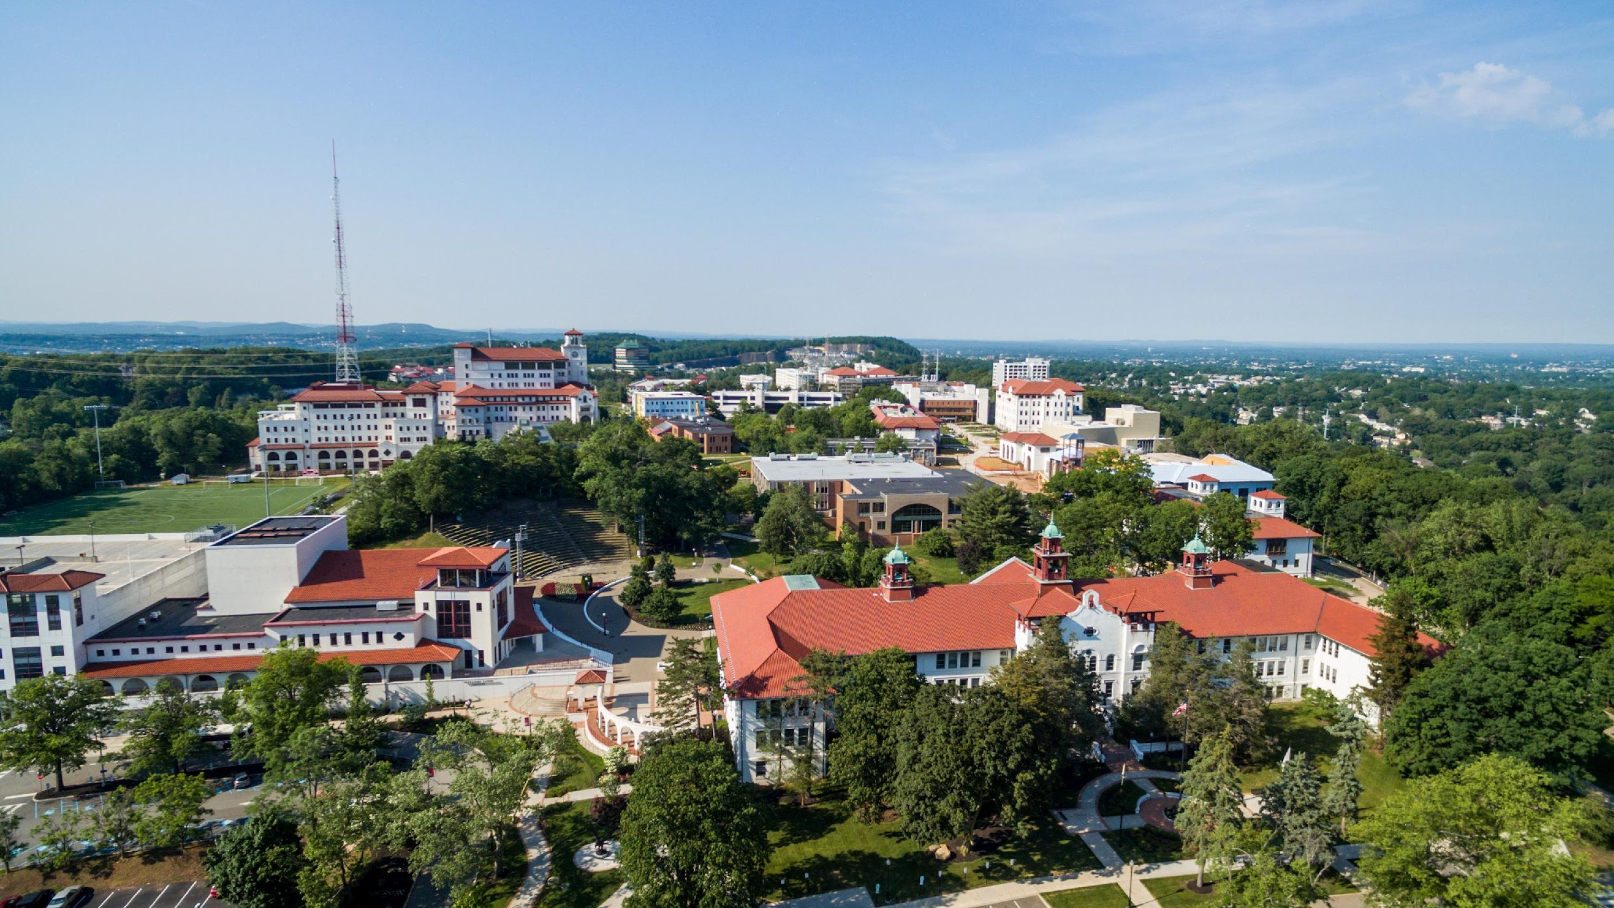
Tell Us What You Want: What Underserved Parents Need to Follow-up With NJ’s EHDI Program
Wendy Zeitlin, PhD; Maryrose McInerney, PhD; Janine Ang, BS; Susan Mason, PhD

Slide 2
What We Did and Why We Did It
Background and Purpose
Methods
EHDI programs seek to identify the 2-3 infants per 1,000 born yearly with hearing loss
Loss to follow-up (LTF) has been a persistent problem nationally
SDOH have been linked to LTF
A deeper understanding of how negative SDOH relates LTF may assist healthcare systems develop more effective interventions
Recruitment through DOH
Eligibility
26 in-depth interviews
Thematic analysis
COLLEGE OF HUMANITIES AND SOCIAL SCIENCES
Notes:
Bullet 1 - GOALS: screen all infants for hearing loss by 1 month of age, diagnose those with hearing loss by 3 months, and initiate treatment by 6 months (i.e. 1-3-6 Plan). Initial screenings are completed in hospitals at birth, but a substantial number of babies are referred for additional outpatient screening or diagnostic testing because they either don’t pass their hospital screening or there are conditions that put them at higher risk for early hearing loss
Bullet 2 – Follow-up has been a problem since the inception of these programs for babies that require follow-up with about 30% of babies being LTF nationally.
Bullet 3 – These include lack of private health insurance, lower levels of maternal education, poverty, and living in a single-parent household. While we can guess why these SDOH are barriers to follow-up we absolutely don’t know why and what we can do to remediate the problem. We know this because traditional approaches to improving follow-up have, by and large, not been terribly successful or sustainable.
Bullet 4 – Therefore, our overarching research question was “What do underserved parents need that could encourage follow-up in NJ’s EHDI program?”
Bullet 5 – Families who were enrolled in state-funded programs through DOH were recruited to participate. These included WIC and Head Start. All families possessed multiple characteristics consistent with LTF
Bullet 6 – having a child under the age of 6 who was referred for audiological care after hospital discharge; child did not have to have hearing loss, nor did they have to have followed up at all.
Bullet 8 – We used Braun & Clark’s method with 3 researchers.

Slide 3
What We Found and What It Means
Results
Implications
Practical needs
Parents need hearing health information
Parents need emotional support
Parents continue to have unmet needs
Social workers could have a unique role in helping parents make informed hearing healthcare decisions
Next steps: Try to address those needs through targeted intervention
COLLEGE OF HUMANITIES AND SOCIAL SCIENCES
Notes:
Found 3 themes; some of which is related to SDOH and the last, not as much.
Bullet 1 – Everyday problems that were barriers to follow-up, including difficulty finding a provider that accepted the family’s insurance, long wait times esp. for Medicaid providers, finding babyisitters, transportation problems, managing multiple medical appointments for medically complicated babies
Bullet 2 – information was needed before delivery and throughout the process. Parents needed more and clearer information about EHDI services and hearing loss. Many parents didn’t really know what to do next even though they may have been told shortly after the child’s birth (attributed to being flooded with information); parents also could not understand medical terminology and jargon used by medical personnel
Bullet 3 – Parents needed help in decision making often talking about not having previous experience with hearing loss. Parents wanted professional support in processing test results and allaying fears about their child’s development
Bullet 5 – Looking at parents needs on the left, we should note that social workers are trained to address those needs specifically
Bullet 6 - We are thinking about next steps and trying to apply what we have learned in this study and others to design an intervention to improve follow-up rates in NJ.

Slide 4
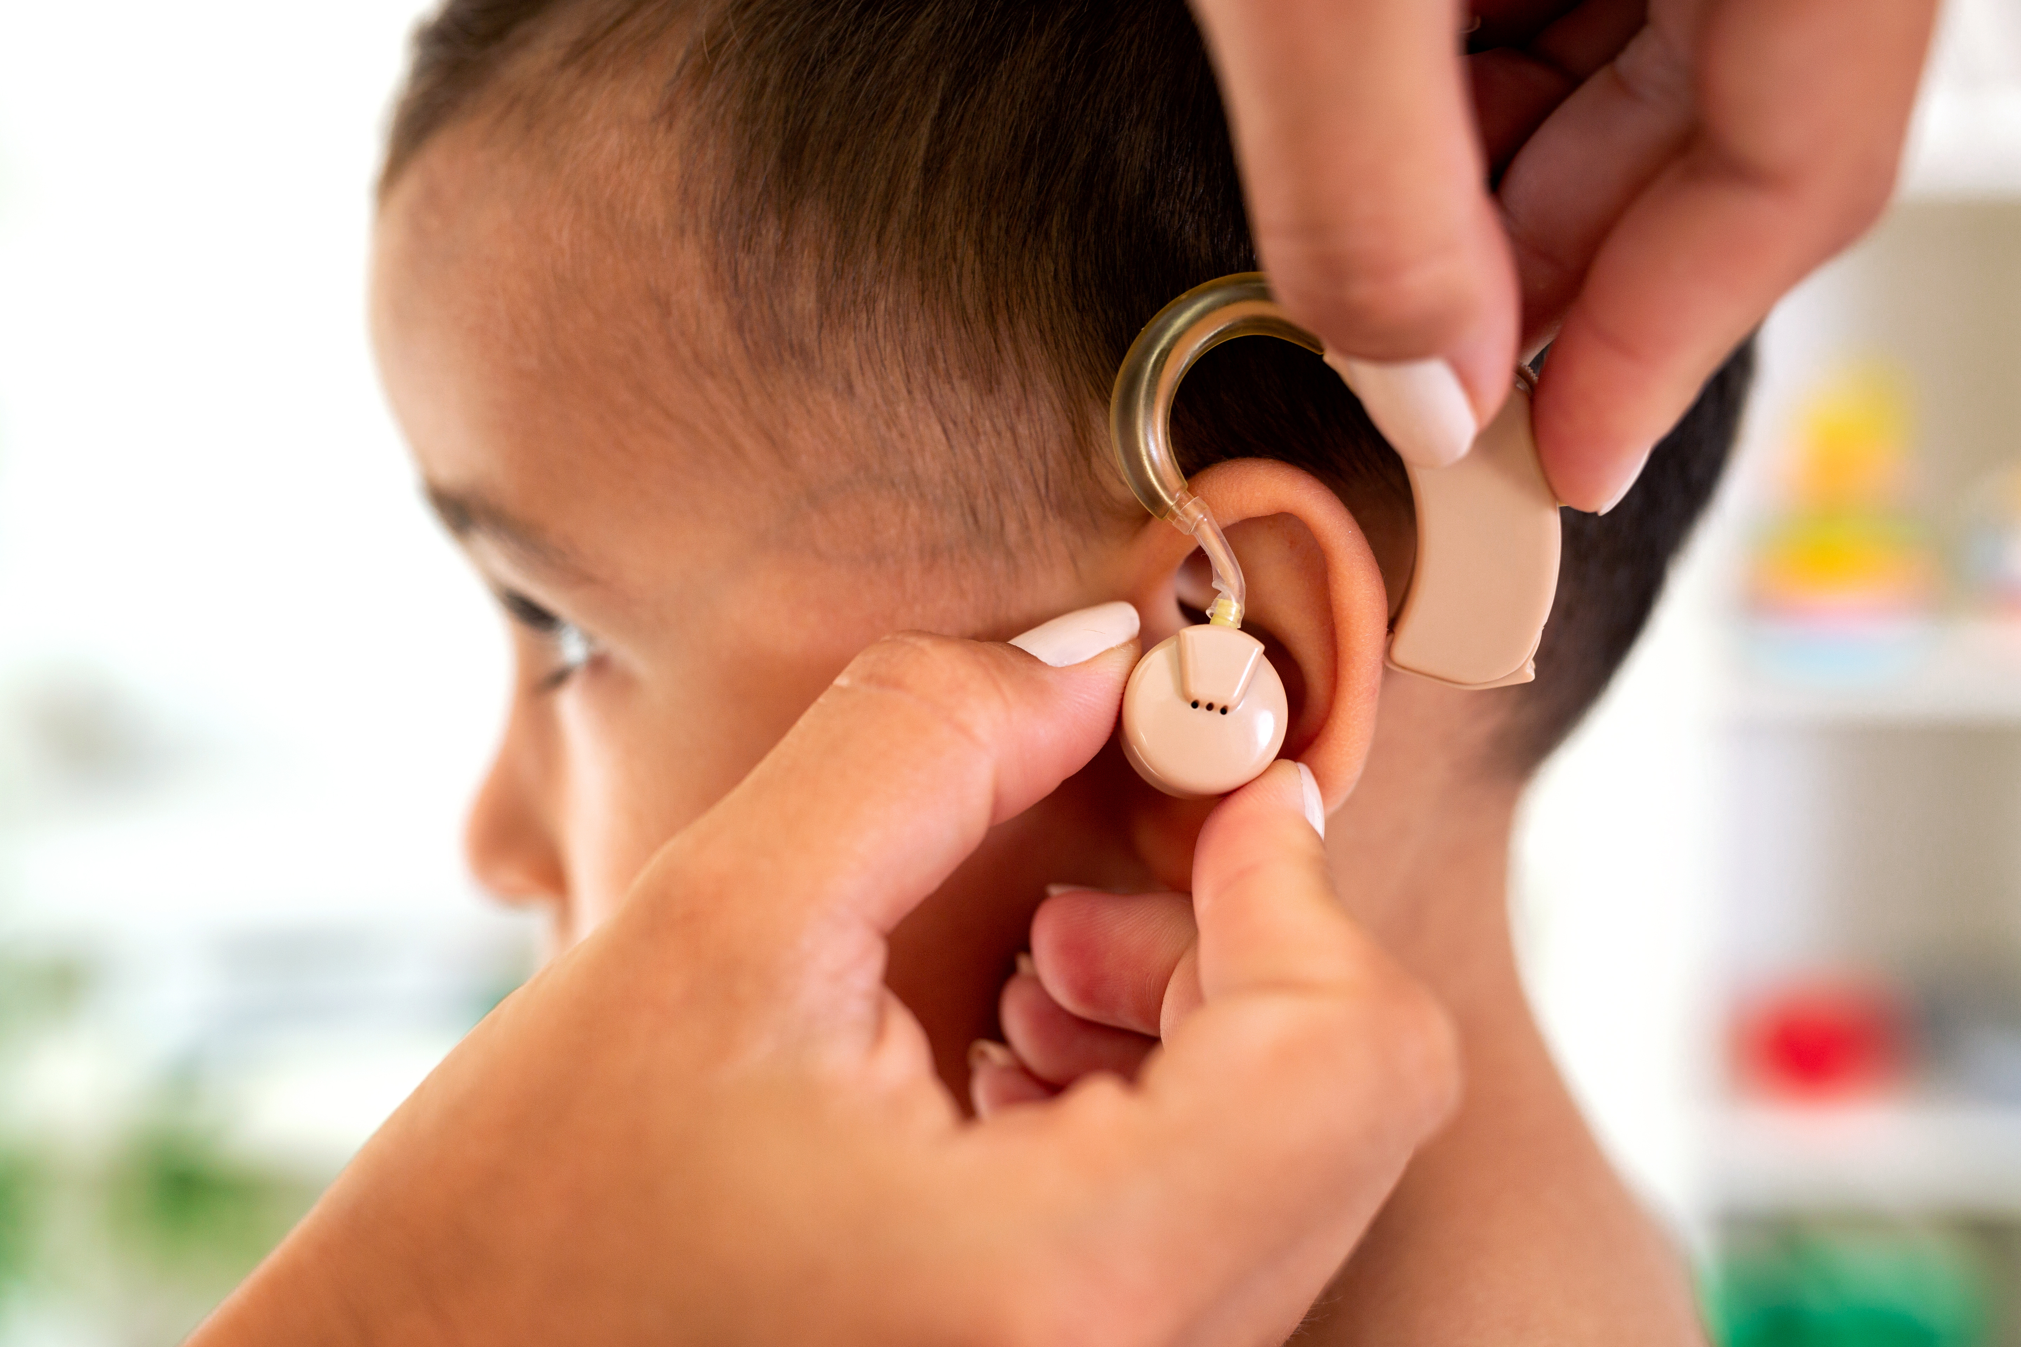
Wendy Zeitlin
zeitlinw@Montclair.edu
COLLEGE OF HUMANITIES AND SOCIAL SCIENCES
COLLEGE OR SCHOOL IDENTIFICATION
COLLEGE OF HUMANITIES AND SOCIAL SCIENCES

