Slide 1
PROGRAM MANAGEMENT OFFICE
Program Quality Management
Requirements Overview
March, 2014

Slide 2
Agenda
What is a Requirement?
What could go Wrong?
Getting it Right
Types of Requirements
OneMontclair Documents for Requirements
Questions & Answers

Slide 3
What Is a Requirement?
Notes:
Can Stop and do exercise: Individual or in Pairs

Slide 4
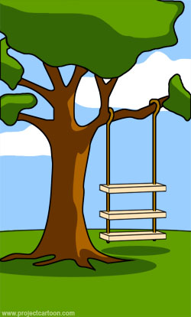



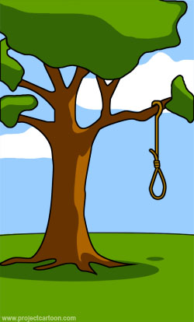




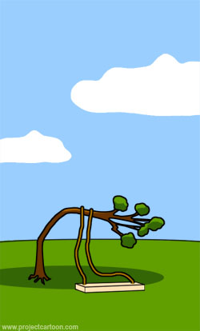
Swing Example
How Customer Explained It
How the Consultant
Described It
How the Project Leader
Understood It
How the Developers
Wrote It
What the Testers Received
to Test
How Operations Installed
It
How It Was Supported
How Patches Were Applied
How It Performed Under
Load
The Disaster Recovery Plan
Notes:
Walk thru examples

Slide 5
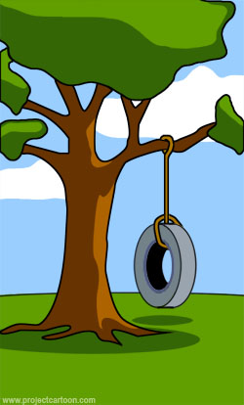
Swing Example
What the Customer ACTUALLY Needed

Slide 6
What is a Requirement?
So, what is a “Requirement” in industry-speak, then?
“A condition or capability needed by a stakeholder to solve a problem or achieve an objective.”
“A condition or capability that must be met or possessed by a solution or solution component to satisfy a contract, standard, specification, or other formally posed documents.”
From The Guide to the Business Analysis Body of Knowledge Version 2.0 Framework (BABOK) by the International Institute of Business Analysis (IIBA)
Notes:
Can we go back to the Tire Swing and identify some requirements, then?

Slide 7
What is a Requirement?
It is also an agreement between two parties which defines completion of work.
Service Provider and Customer
Engineer and Manager
Tester and Provider
When all the requirements are satisfactorily met, the work is done.

Slide 8
What Could Go Wrong?
Notes:
Can Stop and do exercise: Individual or in Pairs

Slide 9
What could go wrong?
I need to get my house painted …
Requirements are not specific or not documented
Requirements are not complete
You said to paint the room
I said to paint the room Blue, I don’t want White
I painted all 4 walls
What about the ceiling?

Slide 10
What could go wrong?
Mis-matched expectations
Unimportant details – not relevant to the job
I expected you to use a paint roller on the walls – it would have been much faster
I always use a paint brush
Use only horse-hair paintbrushes and use a new brush for each color.
Really? That is going to cost extra.

Slide 11
What could go wrong?
Un-measurable Requirements
Unattainable Requirements
The paint has to make the room look bright and airy.
Uh … OK
Sure, no problem
We will discuss that later
You have to paint around the furniture – don’t move anything.

Slide 12
What could go wrong?
Changing Requirements
Accepting Requirements from Anyone
That shade of blue is all wrong – I want a lighter shade.
OK, another two days and more money
Sure, no problem
My Mom said to paint the ceiling white but I want it to be pink.

Slide 13
Getting it Right
Notes:
Can Stop and do exercise: Individual or in Pairs

Slide 14
Getting it Right
Apply SMART techniques when writing effective requirements.
Each requirement should be:
S – Specific
M – Measureable
A – Attainable
R – Relevant
T – Testable

Slide 15
Getting it Right
Use a hierarchical Approach – review at each level of decomposition with relevant stakeholders – and trace the relationships
Business Requirements
Requirements Traceability Matrix (RTM)
Functional
Requirements
Business Rules &
Data Requirements
Decide early the types and format of requirements documentation required
Test Plans and Scripts

Slide 16
Getting it Right
Review and Discuss
Discussion sessions or Joint Application Design (JAD) sessions
The technical teams from both sides of the contract meet to review, revise, and agree on the requirements
Diagrams (work flows) help
The output is better understanding and agreement on both sides

Slide 17
Getting it Right
Involve all groups or teams that will be stakeholders for the project when reviewing the requirements
Customers (who “pay the bill”)
Users
Testers
Support staff
Approvers
Specify who can request changes to agreed requirements and ensure that an impact analysis is performed on any changes (budget, schedule, resources)

Slide 18
Types of Requirements
Notes:
Can Stop and do exercise: Individual or in Pairs

Slide 19
Types of Requirements
Requirement Type | Definition
Business Requirement | A business requirement is a goal of the organization requesting the system.
Functional Requirement | A functional requirement is a decomposed business requirement into greater detail. Each business requirement will have 1:n functional requirements.
Business Rules | A business rule is the logic upon which the data will be processed such as a formula, comparison with other data, edit checks or other rules. Each functional requirement will also have a 1:n relationship with the business rules.
Data Requirements | Where will the system get the data it needs? Will it be entered by the user or sent/retrieved by another system? How much data for each field? Where will the data go? Again, there can be 1 or more data requirements for each business rule.
Non-Functional Requirement | A non-functional requirement is a quality attribute that the system must have. These attributes are not system features (functional requirements), but they do influence how the functionality of the system is implemented. Non-functional requirements usually deal with some aspect of usability, performance, or security or are operational in nature.

Slide 20
OneMontclair Requirements Documents
The BRD is required for all projects – each project selects the requirements documents to be used.
OM-STD-001 – Project Document Requirements – Requirements Phase

Slide 21
OneMontclair Requirements Documents

Slide 22
OneMontclair Requirements Documents

Slide 23

Questions?
Concerns?
Suggestions?

